Slide 1
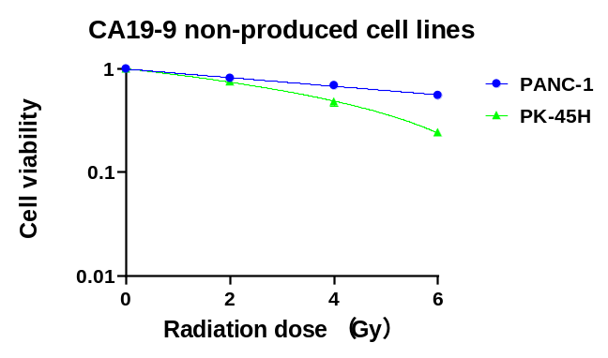
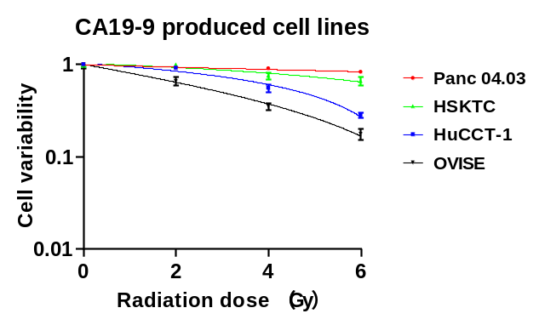
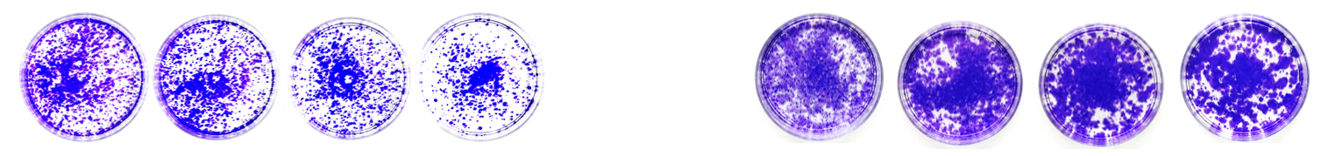
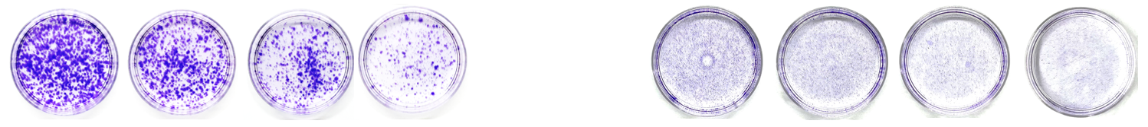
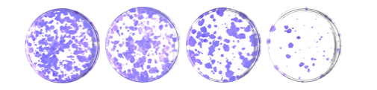
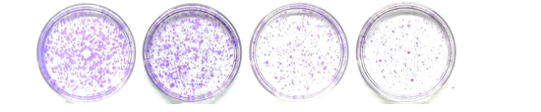
Supplementary Figure S4.
A B
PANC-1
Panc 04.03
0 2 4 6 (Gy)
0 2 4 6 (Gy)
PK-45H
HSKTC
0 2 4 6 (Gy)
0 2 4 6 (Gy)
HuCCT-1
0 2 4 6 (Gy)
OVISE
0 2 4 6 (Gy)
Supplementary Figure S4. Radioresistance profiles of CA19-9–producing and non–producing cancer cell lines following X-ray irradiation.
(A) Clonogenic survival of CA19-9–negative pancreatic cancer cell lines (PANC-1 and PK-45H) after X-ray irradiation at 0, 2, 4, and 6 Gy. Surviving fraction at 2 Gy (SF2): PANC-1 = 0.81, PK-45H = 0.75.
(B) Clonogenic survival of CA19-9–positive cancer cell lines including Panc 04.03 (pancreatic), HSKTC (Krukenberg tumor), HuCCT-1 (cholangiocarcinoma), and OVISE (ovarian) after X-ray exposure. SF2 values: Panc 04.03 = 0.92, HSKTC = 1.00, HuCCT-1 = 0.92, OVISE = 0.66.
Clonogenic assays were used to evaluate radiation-induced cytotoxicity. SF2 refers to the surviving fraction of cells after exposure to 2 Gy of X-ray irradiation, and is a commonly used index of cellular radioresistance. X-axis: radiation dose (Gy). Data are presented as mean ± SEM (n = 4 per group).
Notes:
薬物動態
T/N比
腫瘍径
BNCT照射ごの経過

