Slide 1
Fig.1H
TROP2
68kd
55kd
40kd
30kd
68kd
ACTIN
55kd
40kd
30kd

Slide 2
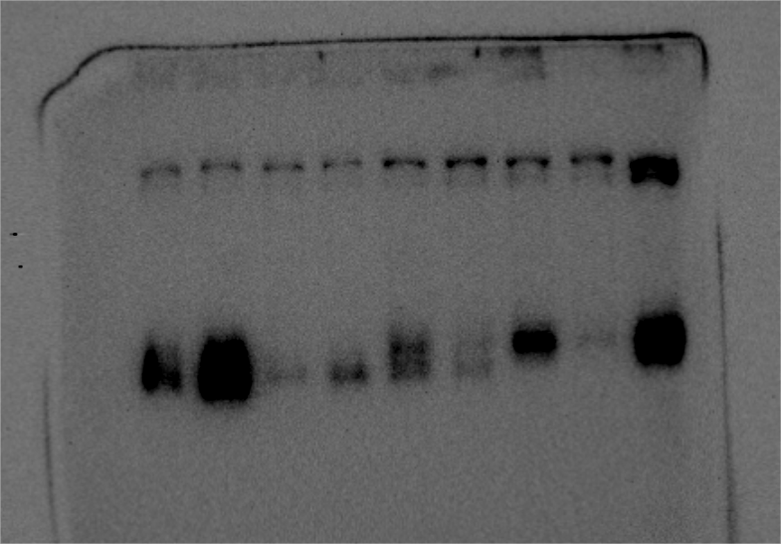
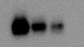
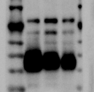
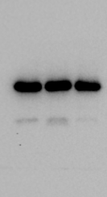
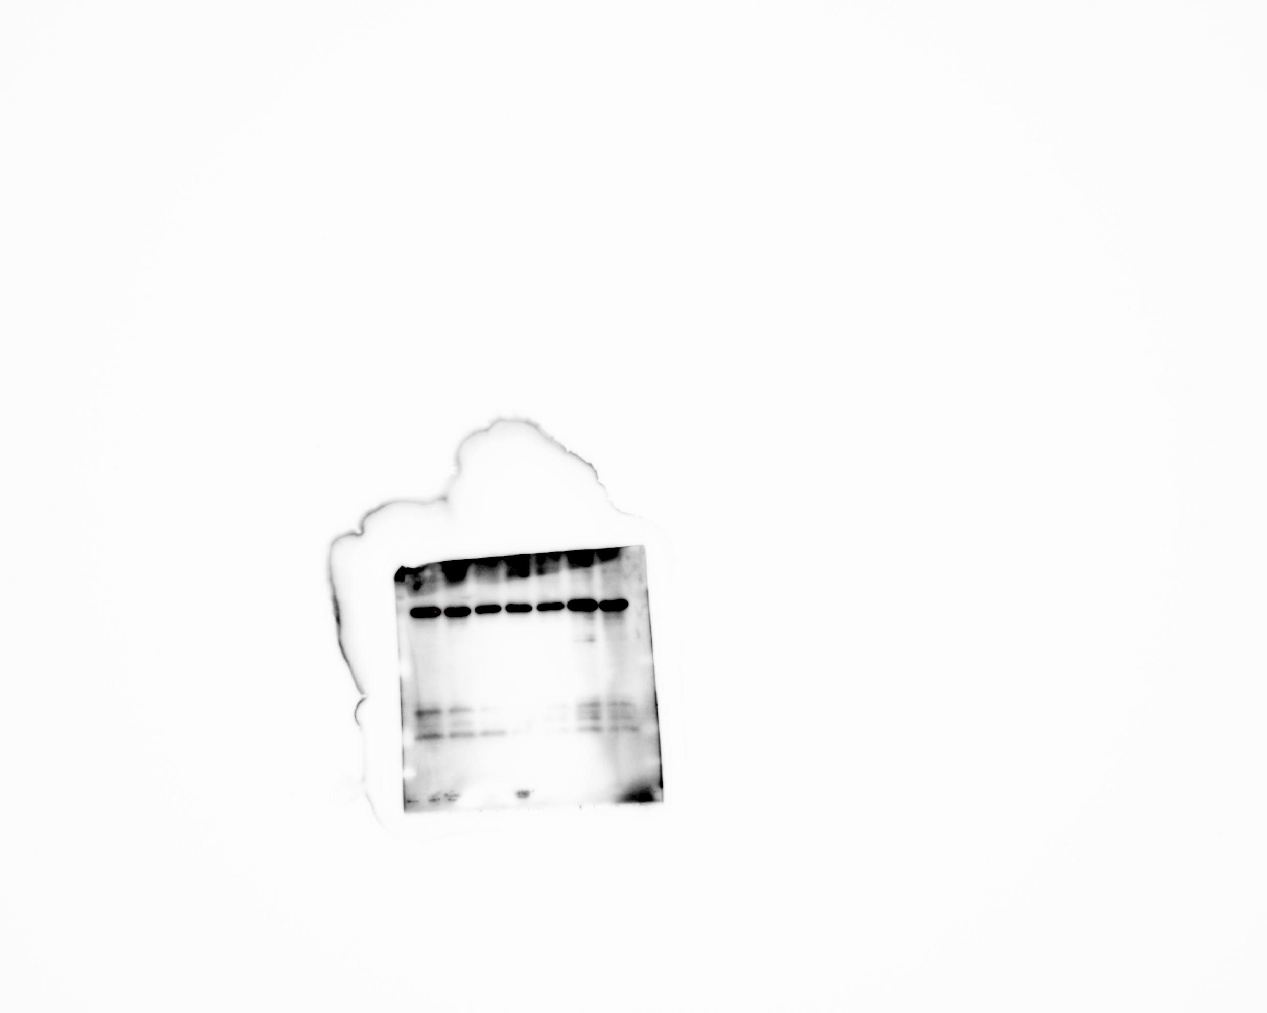
Fig 2B
H292
PC9
40kd
TROP2
40kd
40kd
30kd
40kd
GAPDH
30kd
40kd
30kd

Slide 3
Fig.3K
TROP2
55kd
40kd
GPX4
30kd
20kd
ACSL4
90kd
68kd
40kd
GAPDH
30kd
40kd
SLC7A11
30kd

Slide 4
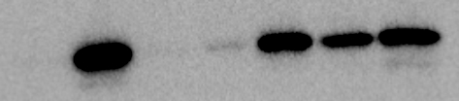

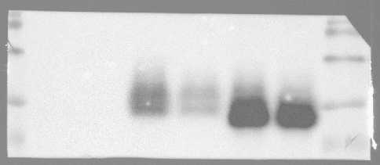
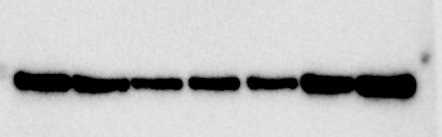
Fig 5B
HO1
30kd
TROP2
40kd
55kd
40kd
30kd
GAPDH
40kd
30kd
40kd
30kd

Slide 5
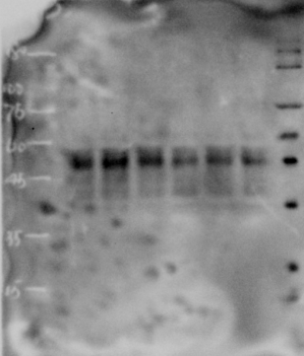
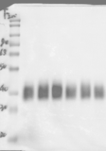
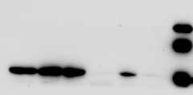
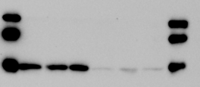
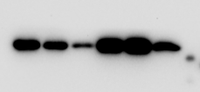
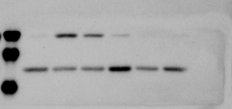

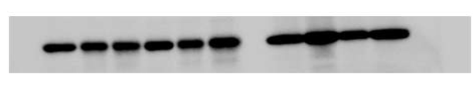
Fig 5L
PC9
H292
55kd
68kd
TROP2
40kd
55kd
40kd
30kd
30kd
40kd
40kd
SLC7A11
30kd
30kd
HO1
40kd
40kd
30kd
30kd
GAPDH
40kd

Slide 6
Fig.6E
Tubulin
68kd
YAP
55kd
68kd
55kd
30kd
H3
P-YAP
68kd
55kd
TROP2
55kd
40kd
HO1
40kd

Slide 7
Fig.6F
YAP
68kd
Tubulin
55kd
55kd
30kd
H3
P-YAP
68kd
55kd
TROP2
55kd
HO1
40kd
40kd
30kd

Slide 8
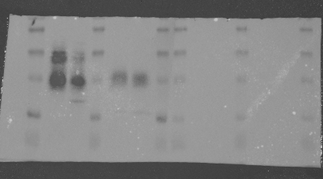
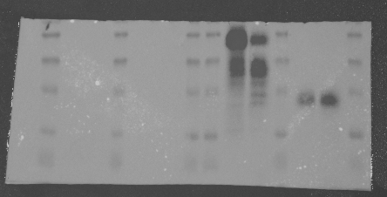
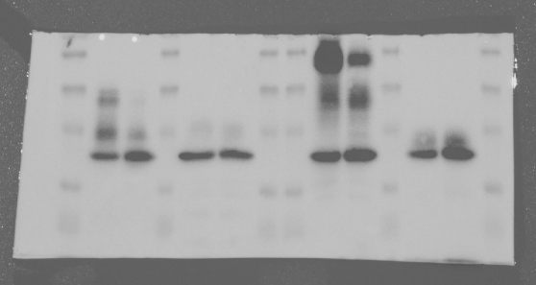
Fig S2B
PC9
H292
GAPDH
40kd
TROP2
40kd
GAPDH
40kd
30kd

Slide 9
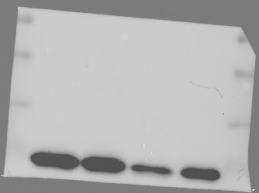
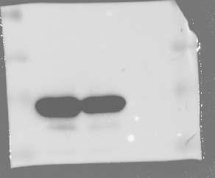
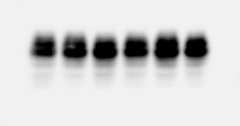

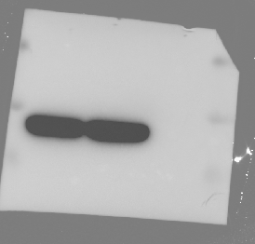
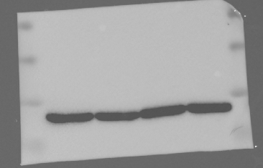
Fig S4B
HO1
40kd
55kd
40kd
30kd
TROP2
40kd
40kd
30kd
30kd
GAPDH
40kd
40kd
30kd
30kd

Slide 10

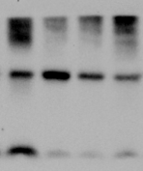

Fig S5B
68kd
YAP1
55kd
HO1
40kd
30kd
GAPDH

Slide 11
Fig.S7
40kd
40kd
TROP2
30kd
TROP2
30kd
P-LATS1
200kd
140kd
200kd
110kd
LATS1
140kd
110kd
200kd
140kd
LATS1
110kd
200kd
P-LATS1
140kd
110kd
GAPDH
40kd
GAPDH
40kd
30kd
30kd

