Slide 1
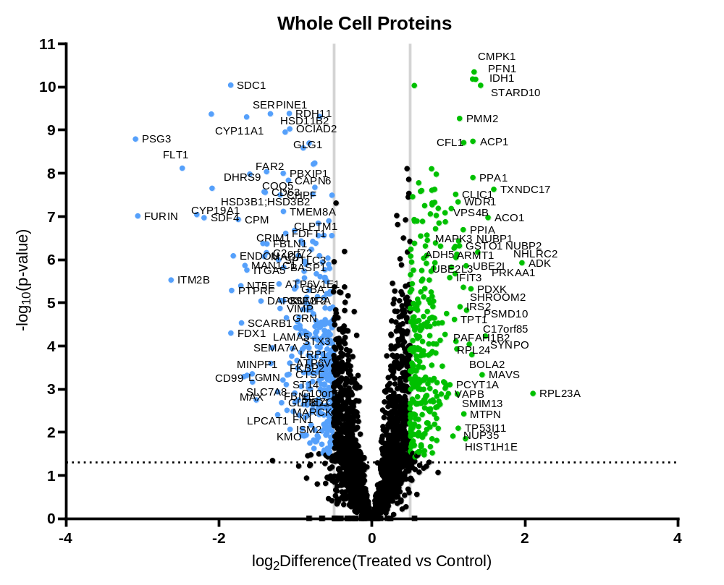
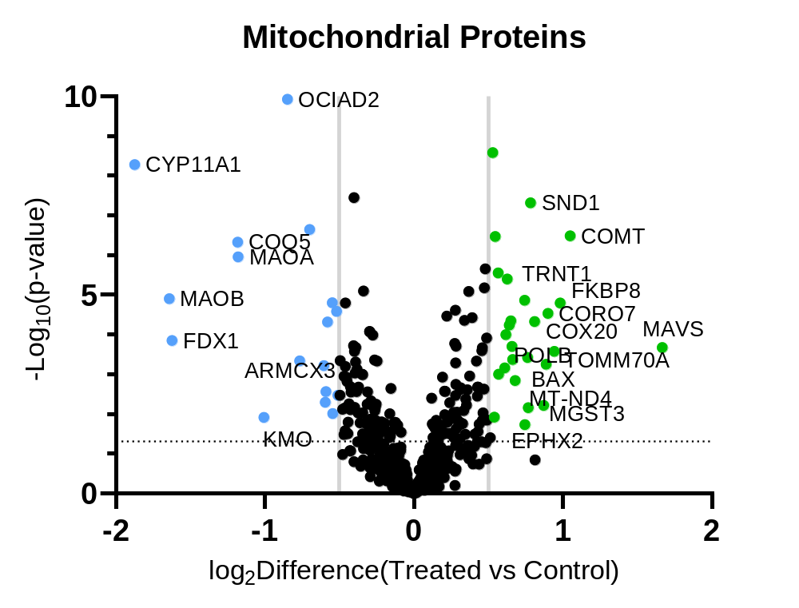
Figure 1
A
A
B
Notes:
Figure labels in figures

Slide 2
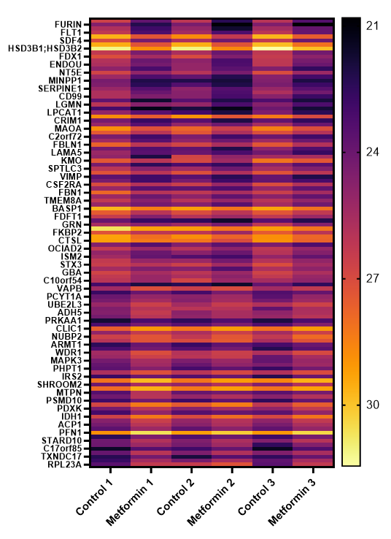
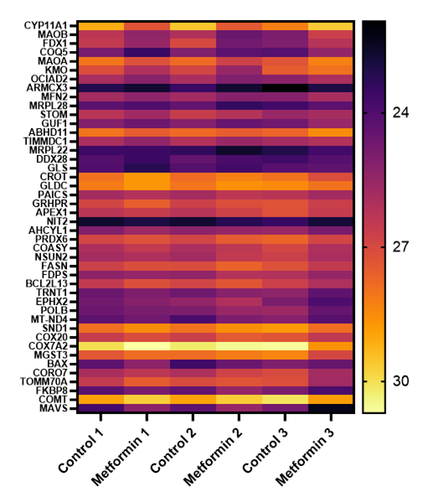
Figure 2
A
B

Slide 3
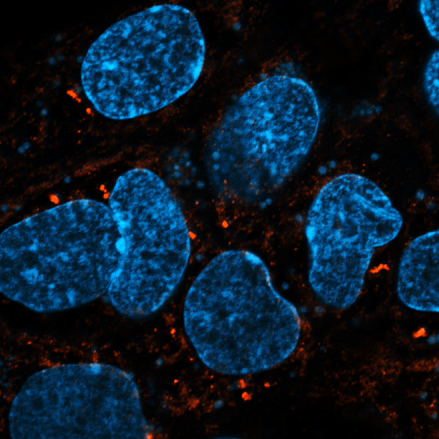
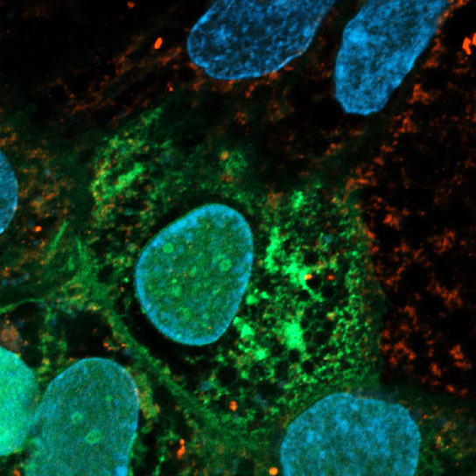
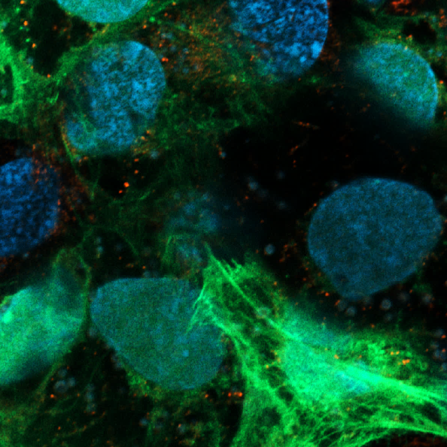
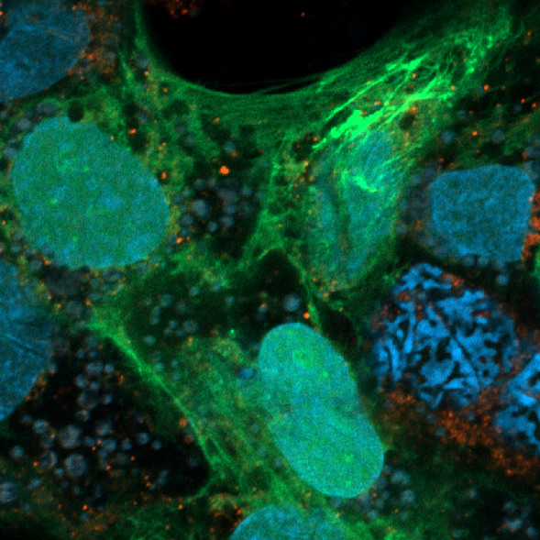
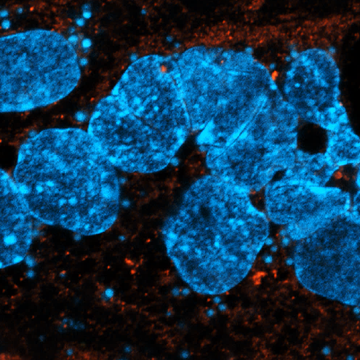
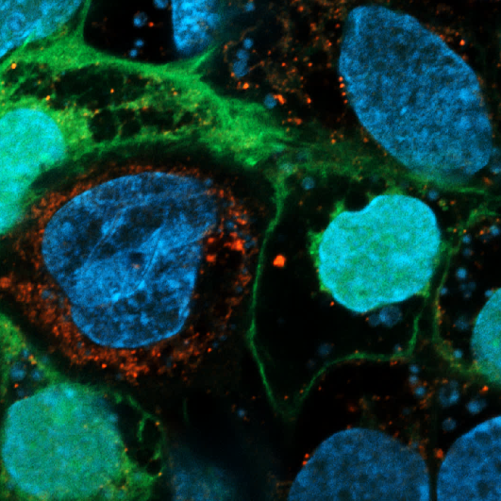
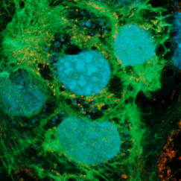
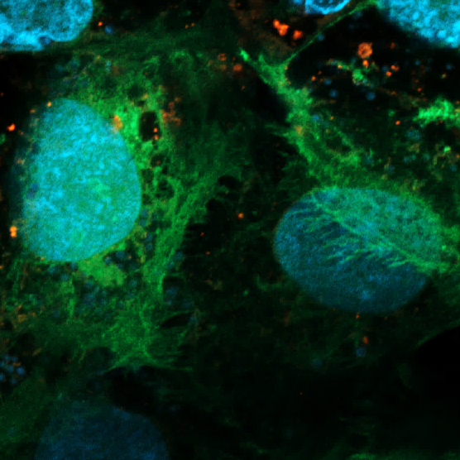
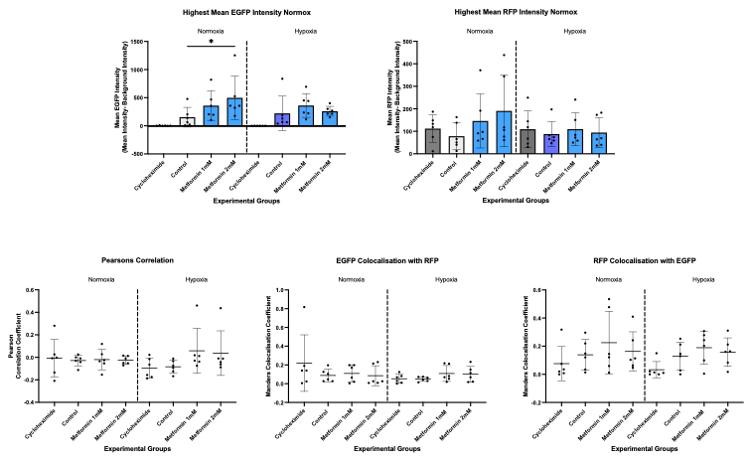
Figure 3
A
B
C
D
E
F
G
H
I
J
K
L
M

Slide 4
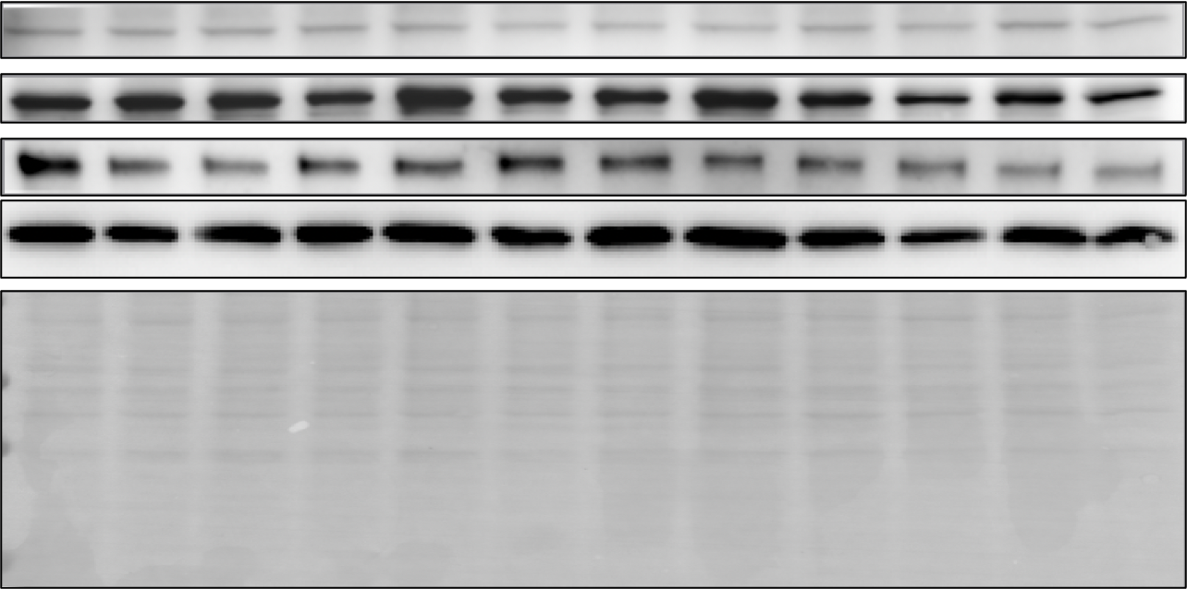
Figure 4
A
3 Hours |  |  |  | 6 Hours |  |  |  | 24 Hours
 |  | Metformin |  |  |  | Metformin |  |  |  | Metformin
N | H | 1 | 2 | N | H | 1 | 2 | N | H | 1 | 2
p-eIF2a (ser51) (38kDa)
ATF6 (85kDa)
ATF5 (31kDa)
SIRT1 (110kDa)
FOXO3 (90kDa)
Total Protein

Slide 5
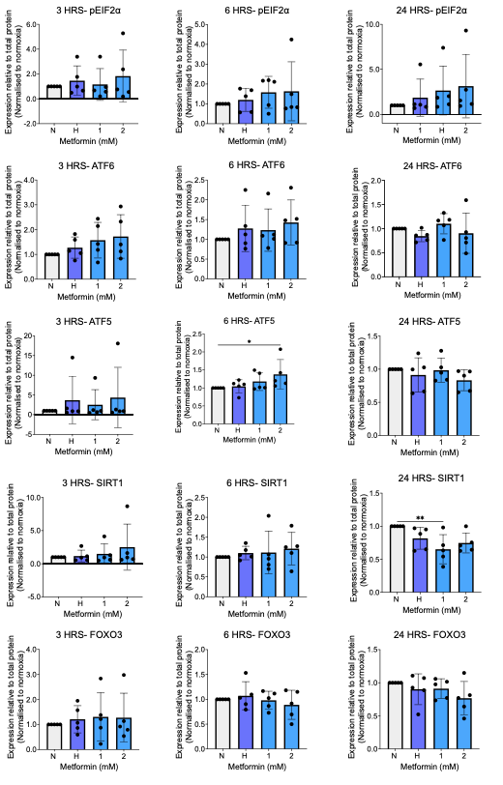
B

Slide 6
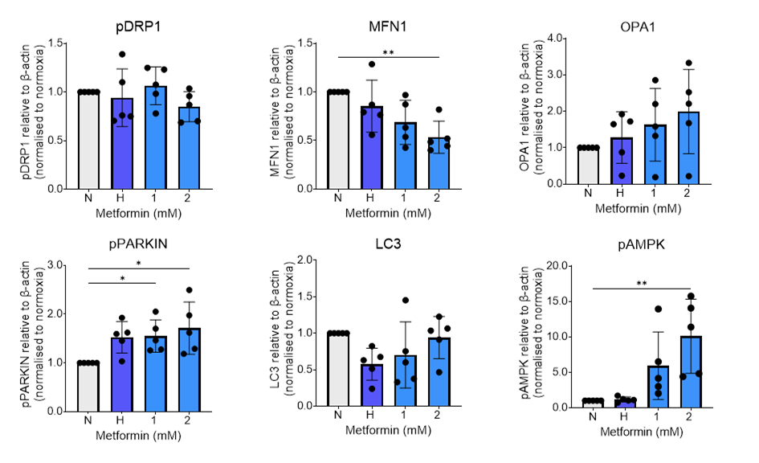
Figure 5
A
 |  | Metformin (mM)
N | H | 1 | 2
pAMPK (62 kDa)
pDRP1 (~82 kDa)
OPA1 (~70 kDa)
MFN1 (86 kDa)
pPARKIN (55 kDa)
LC3 (14 kDa)
β-Actin (42 kDa)
B
C
D
E
F
G

Slide 7
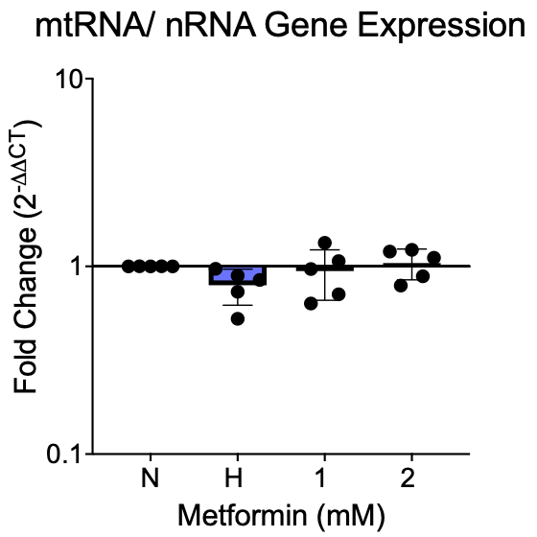
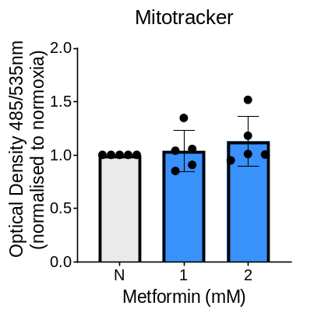
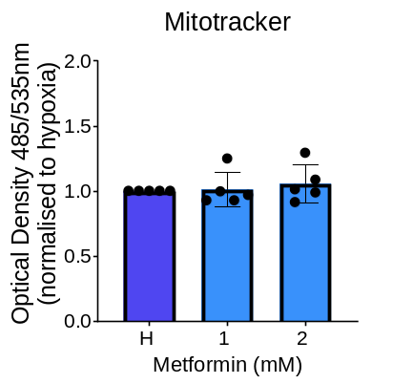
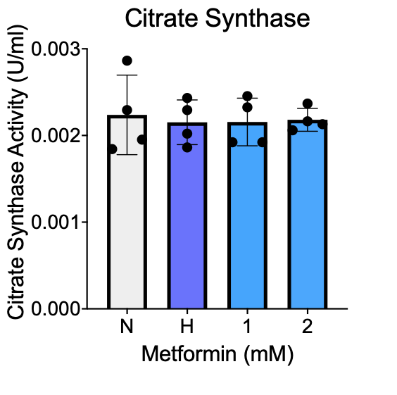
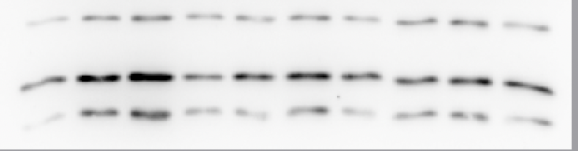

Figure 6
A
B
C
D
 | Metformin (mM)
N | 1 | 2
F
 | Metformin (mM)
H | 1 | 2
TFAM
Complex I
Complex II
Complex III
Complex IV
Complex V
β-Actin

Slide 8
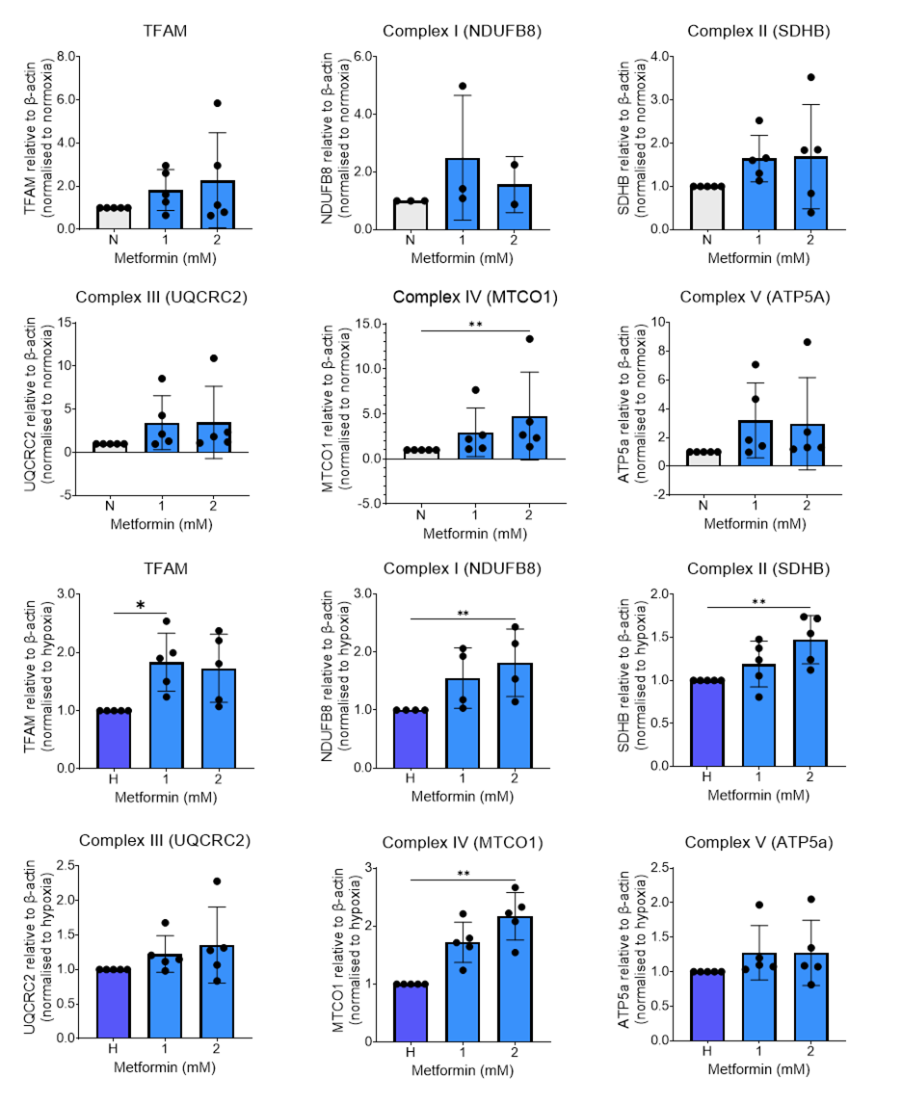
Figure 6
F
G
H
I
J
K
L
M
N
O
P
Q

Slide 9
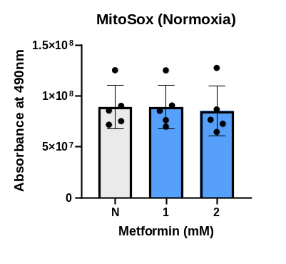
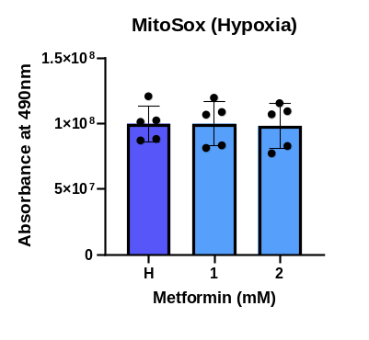
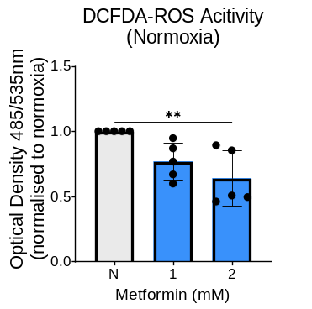
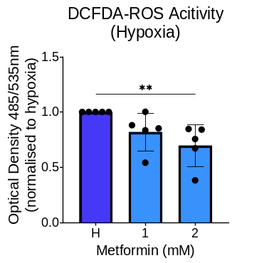
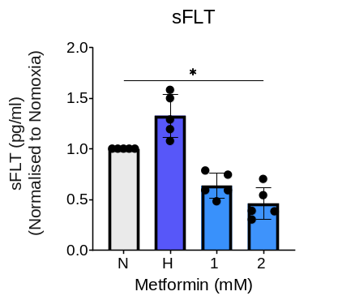
Figure 7
A
B
C
D
E

Slide 10
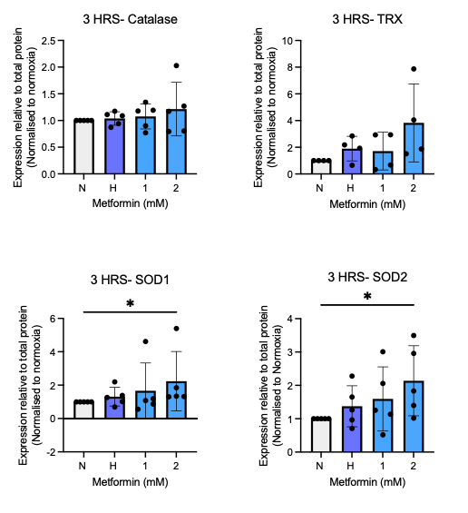
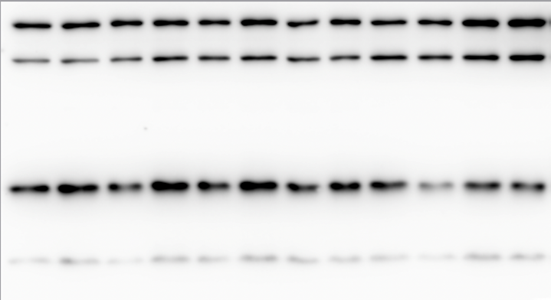
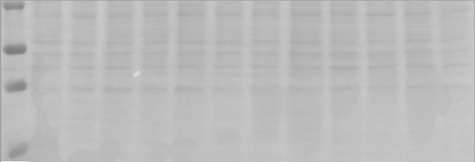
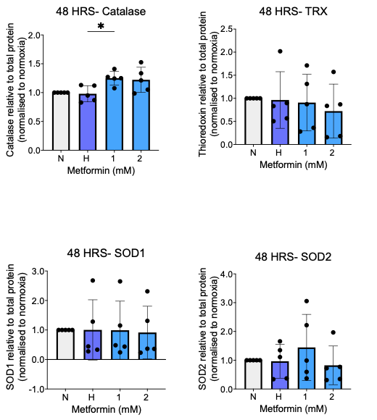
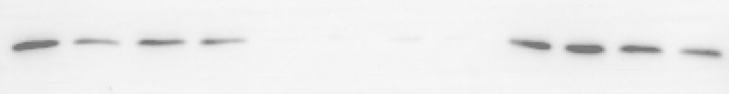
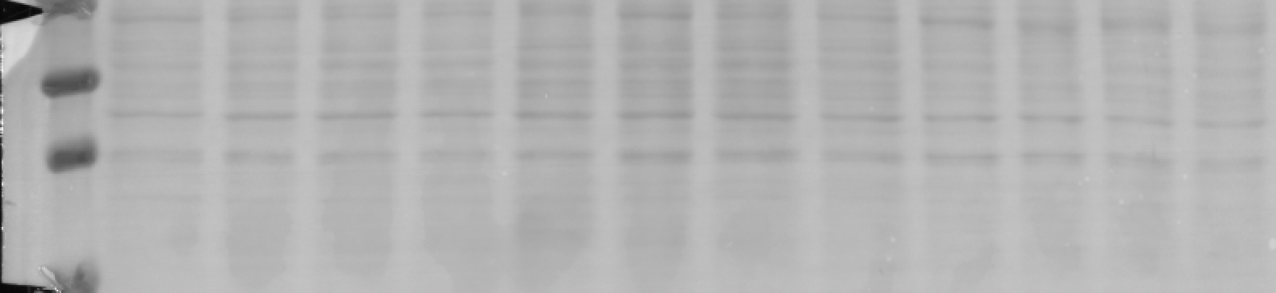
F
Figure 8
B
C
A
 |  | Metformin (mM)
N | H | 1 | 2
Catalase
Thioredoxin
SOD1
SOD2
Total Protein
D
E
G
H
F
 |  | Metformin (mM)
N | H | 1 | 2
Catalase
Thioredoxin
SOD1
SOD2
Total Protein
I
J

Slide 11
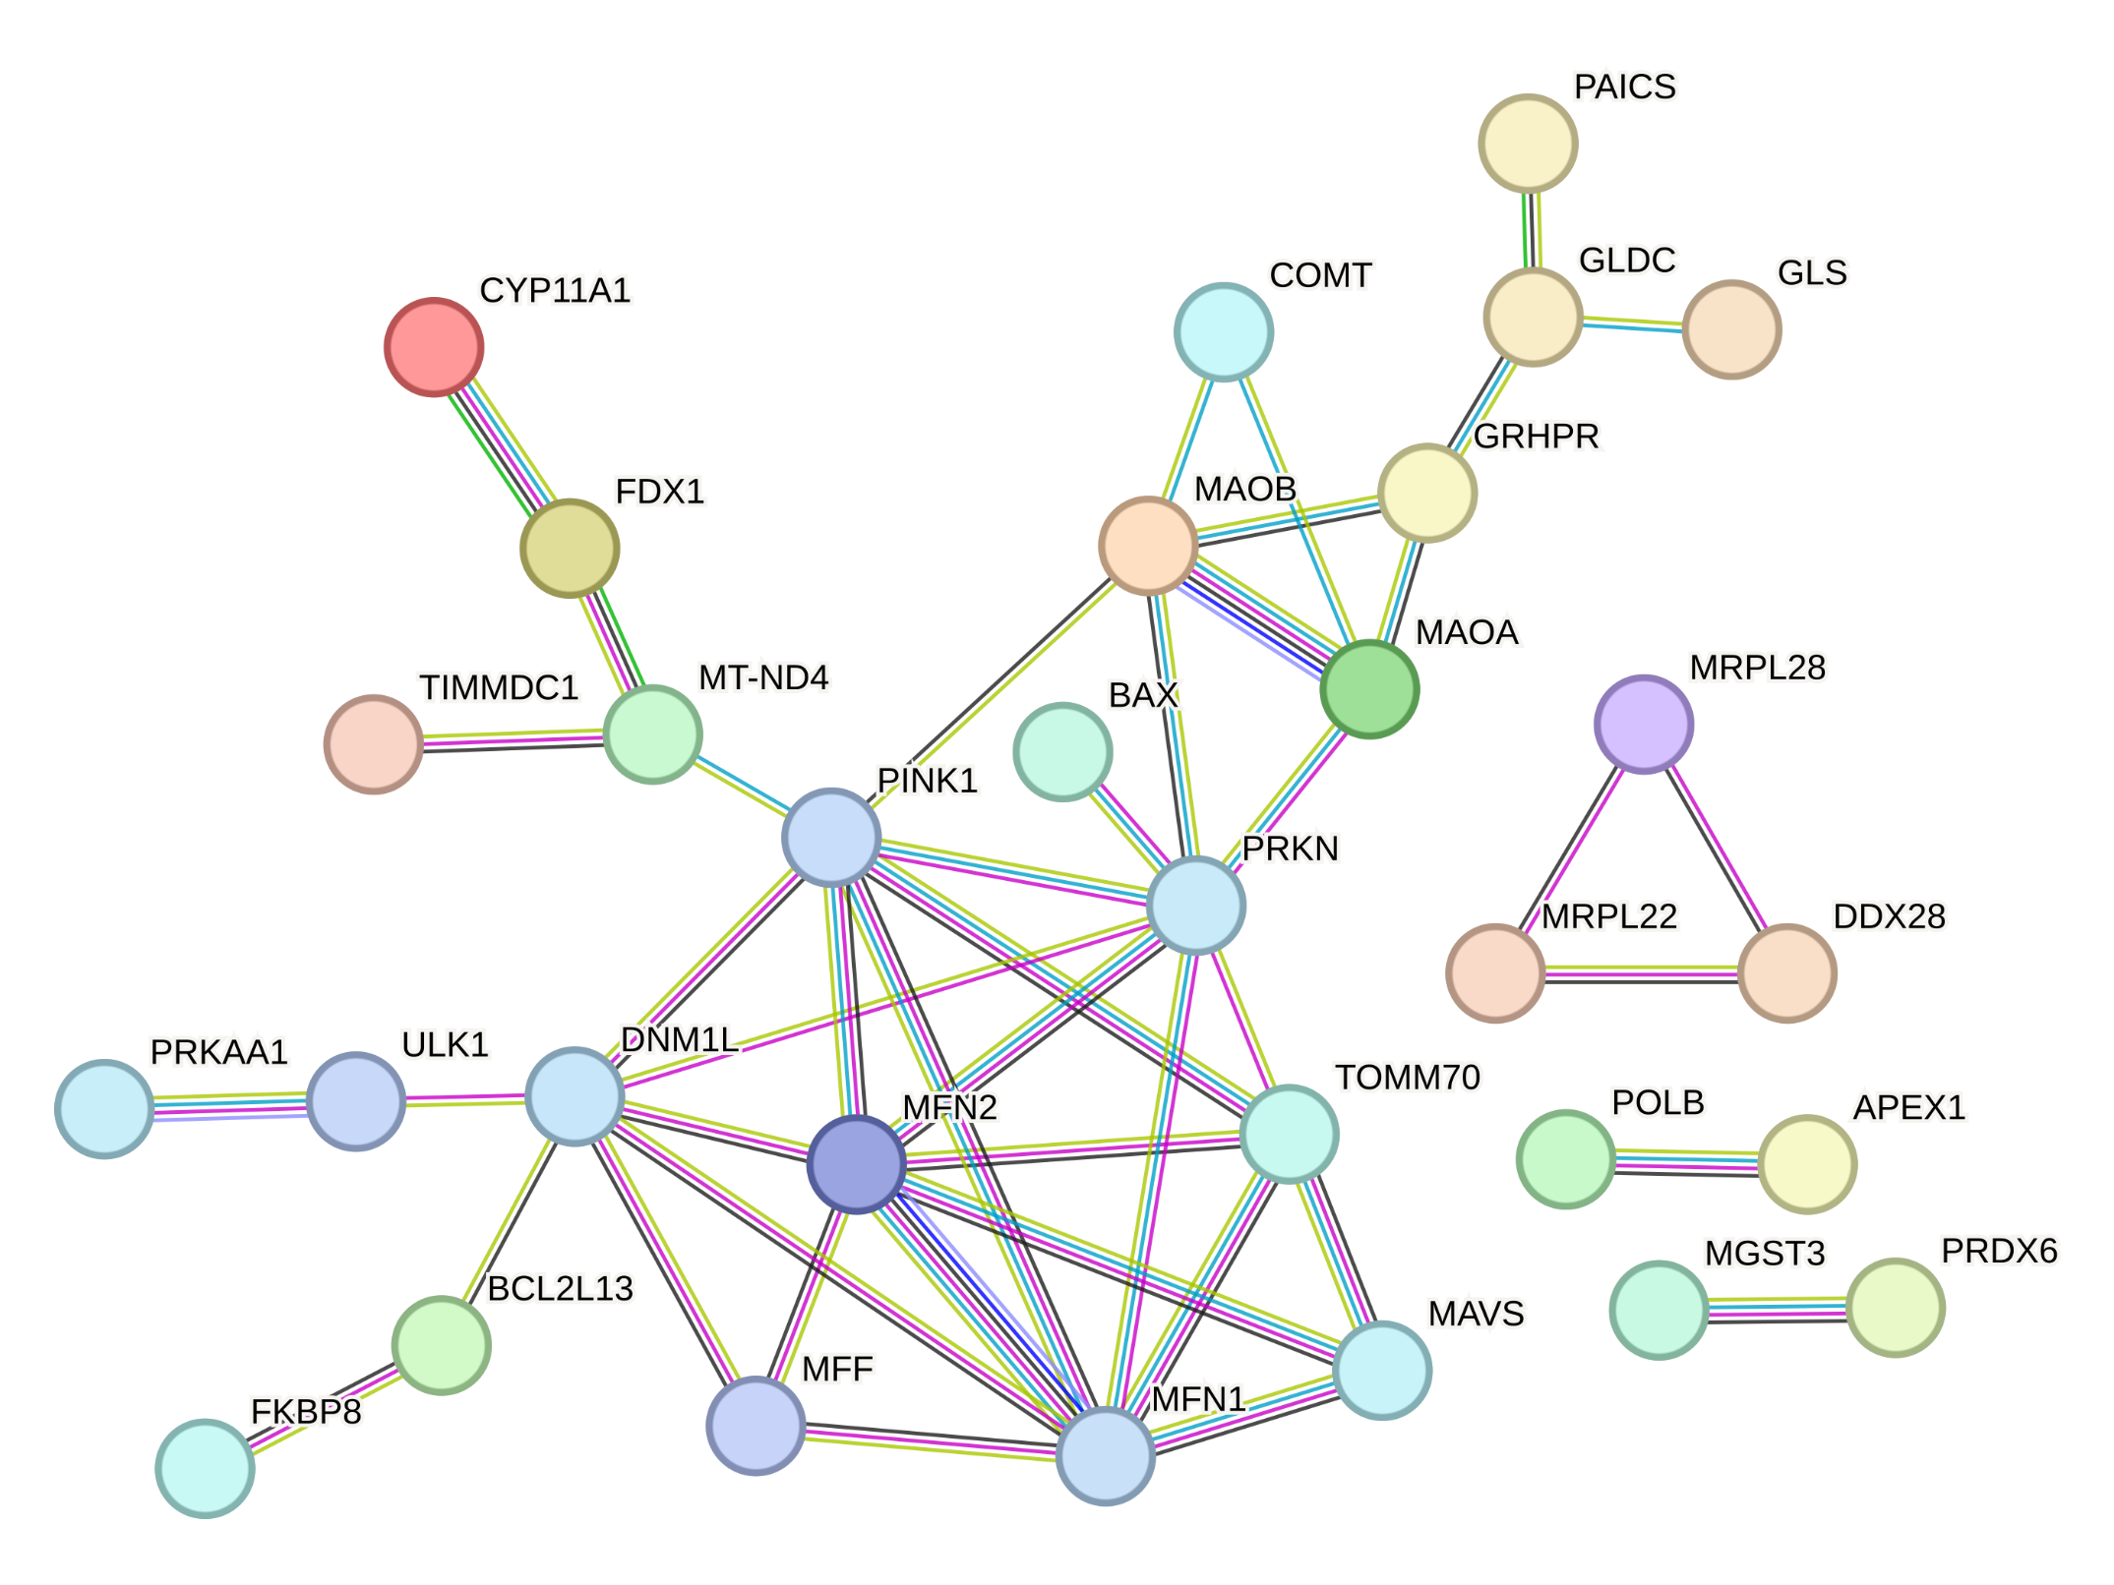
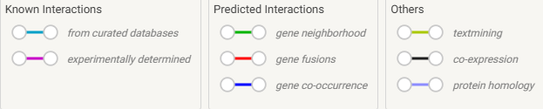
Supplementary Figure 1
Supplementary Figure 1. STRING association network linking the AMPK activation to mitochondrial quality control machinery. Differentially abundant, MitoCarta3.0-annotated proteins from treated vs control were submitted to STRING (v12.0; homo sapiens; minimum interaction confidence = 0.7) together with core AMPK-pathway components added as scaffold nodes (PRKAA1 (AMPK catalytic α-subunit), ULK1, PINK1, PRKN, DNM1L, MFN1, MFF; bold black outlines). Nodes denote proteins; edges denote functional associations, with edge colour indicating evidence class and thickness indicating confidence score. AMPK (PRKAA1) connects to ULK1, which associates with DNM1L and the mitophagy effectors PINK1/PRKN, positioning AMPK upstream of mitochondrial fission (DNM1L, MFF), fusion (MFN1/MFN2) and PINK1/PRKN-dependent mitophagy. Experimentally detected proteins from our dataset include (bold red outlines) the Complex I subunit MT-ND4 (associating with PINK1), the outer-membrane import receptor TOMM70, and the apoptosis/mitophagy regulator BAX (associating with PRKN). Peripheral clusters such as the monoamine/amino-acid metabolism (MAOA, MAOB, COMT, GLDC, GLS) and the mitoribosomal module (MRPL22, MRPL28, DDX28) represent additional differentially abundant proteins outside the AMPK sub-network.

Slide 12
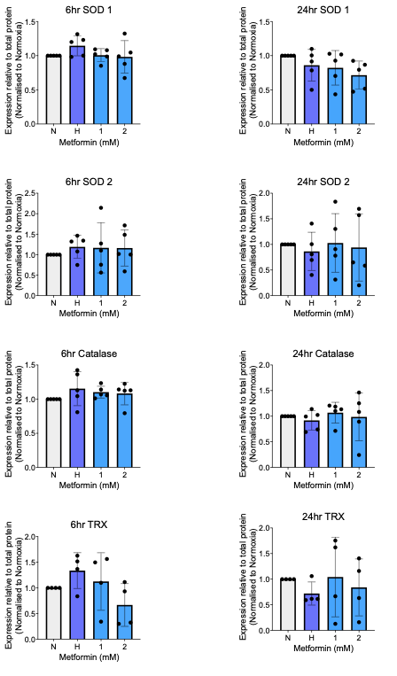
Supplementary Figure 2

Slide 13
Supplementary Figure 2. Metformin does not significantly alter antioxidant protein expression after 6 or 24hrs of treatment. SOD1, SOD2, catalase, and thioredoxin (TRX) protein expression was measured following 6 h and 24 h exposure with metformin treatment (1 or 2 mM) . No significant differences were detected between treatment groups. Data: Mean ± SD; N = 5 biological replicates/treatment; except TRX as bands were unable to be quantified (n=4); Friedman test.

