Slide 1
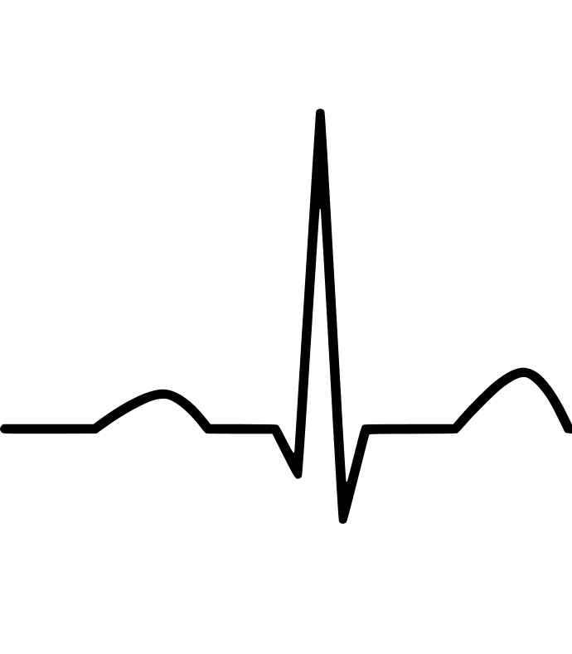
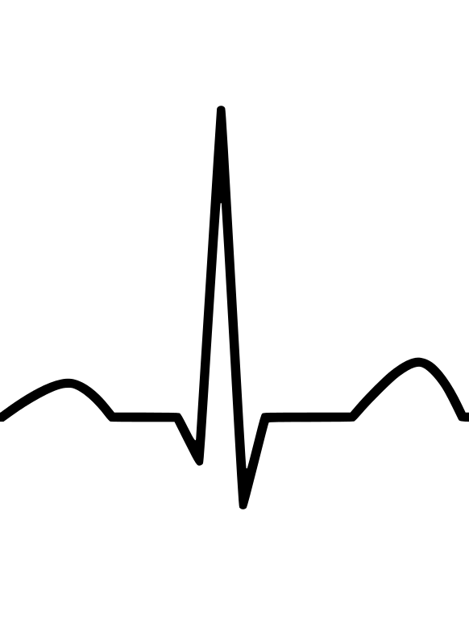
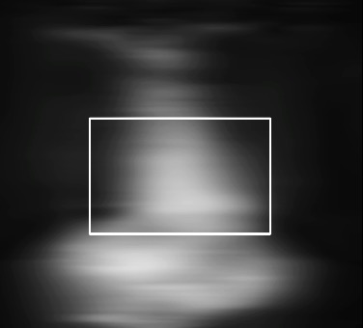



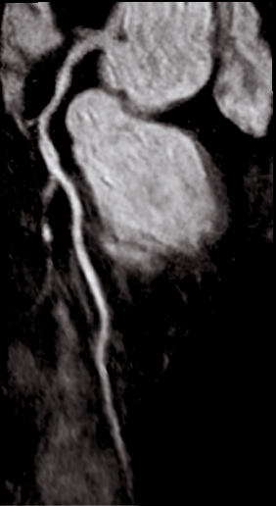
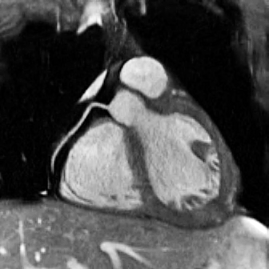
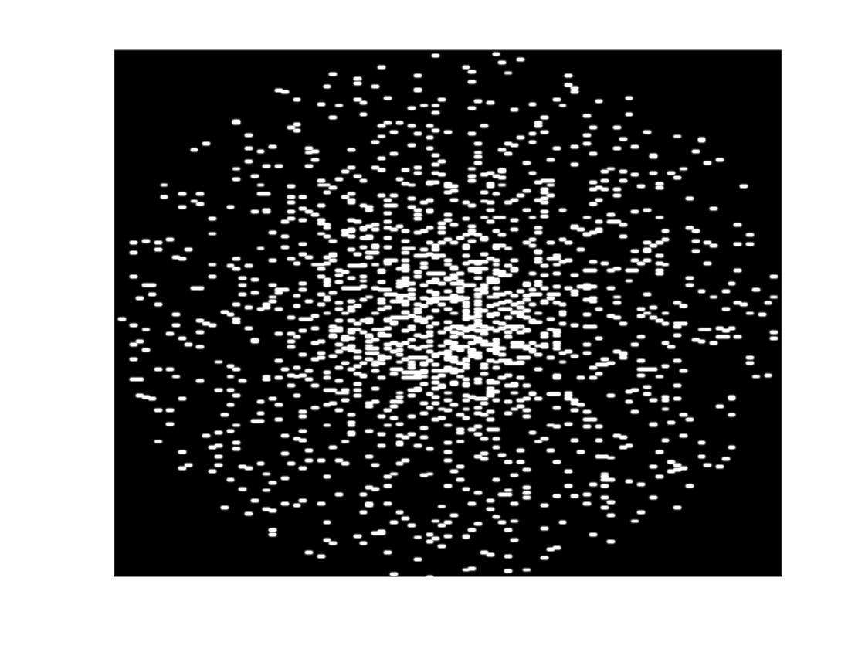
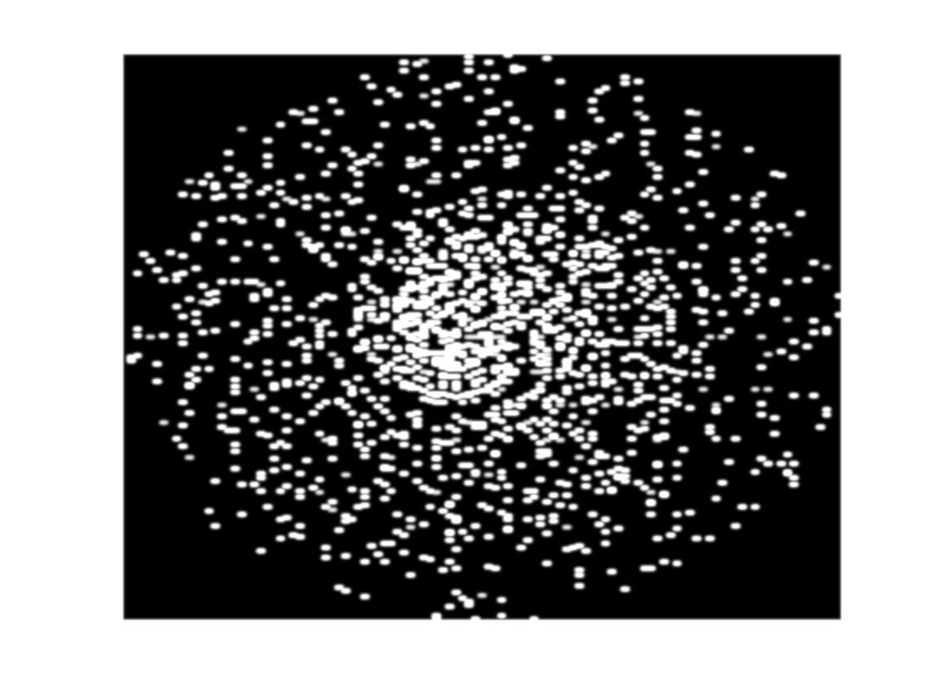
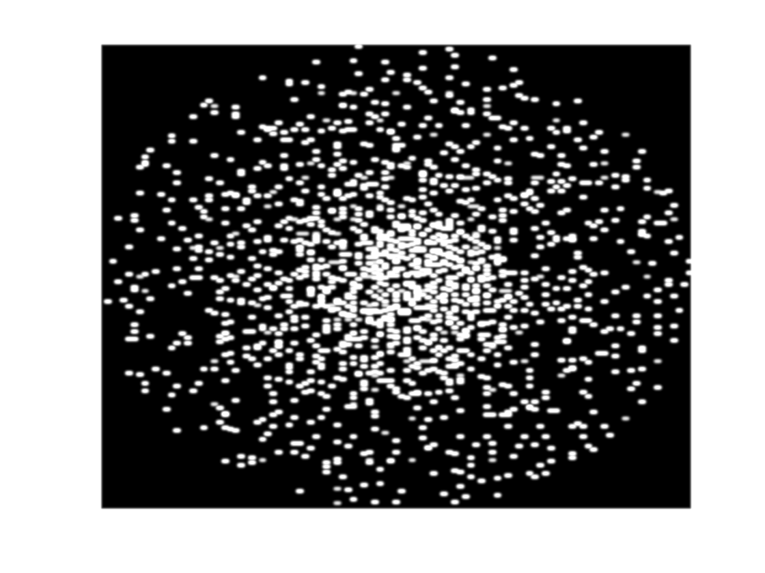
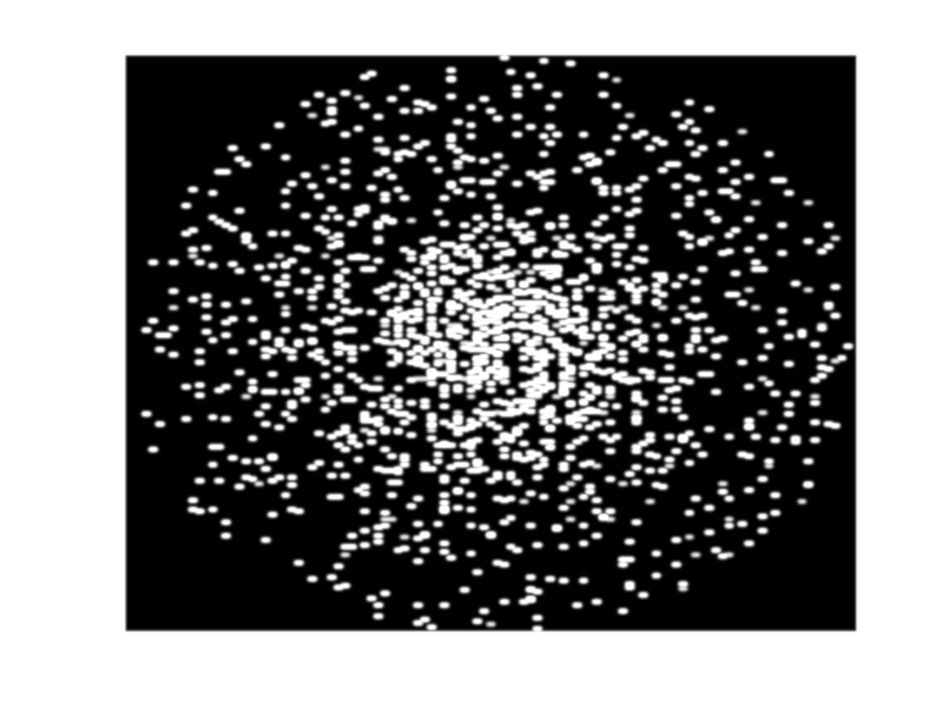
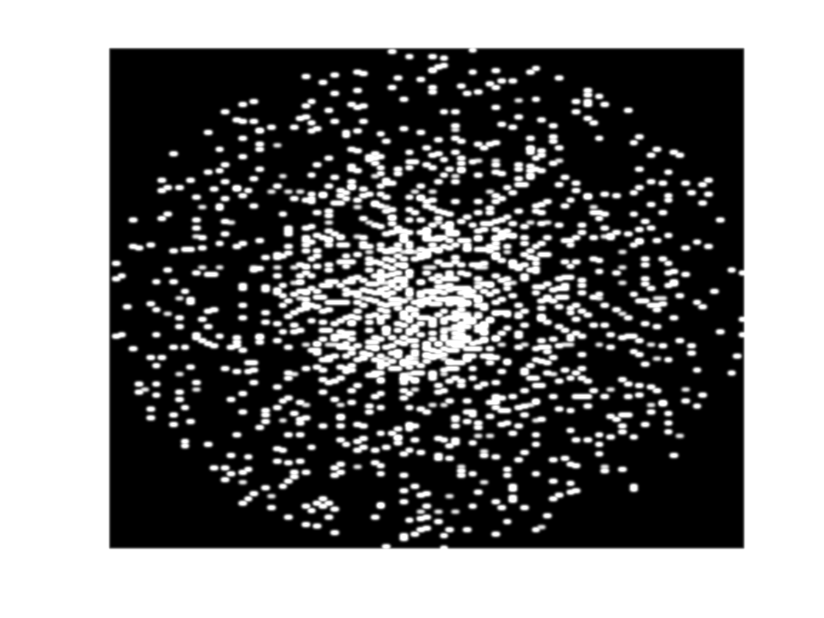
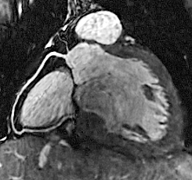

CENTRAL ILLUSTRATION
A
Trigger Delay
Acquisition Window
B
CMRA
CCTA
FAT SAT
3D
CMRA
FAT SAT
3D
CMRA
ECG
T2-Prep
iNAV
T2-Prep
iNAV
$$k_{z}$$
$$k_{z}$$
$$k_{y}$$
$$k_{x}$$
$$k_{y}$$
$$k_{x}$$
CMRA acquisition
Respiratory signal with intra-bin translation motion correction
Motion corrected, patch-based low-rank reconstruction
Bin 1
Respiratory Binning
Bin 5
Binned k-space
Binned images
LAD
LAD
3D Respiratory motion fields
Beat to beat 2D translation motion correction and 3D nonrigid motion estimation
Motion-corrected 3D CMRA
Notes:
Central Illustration

