Slide 1
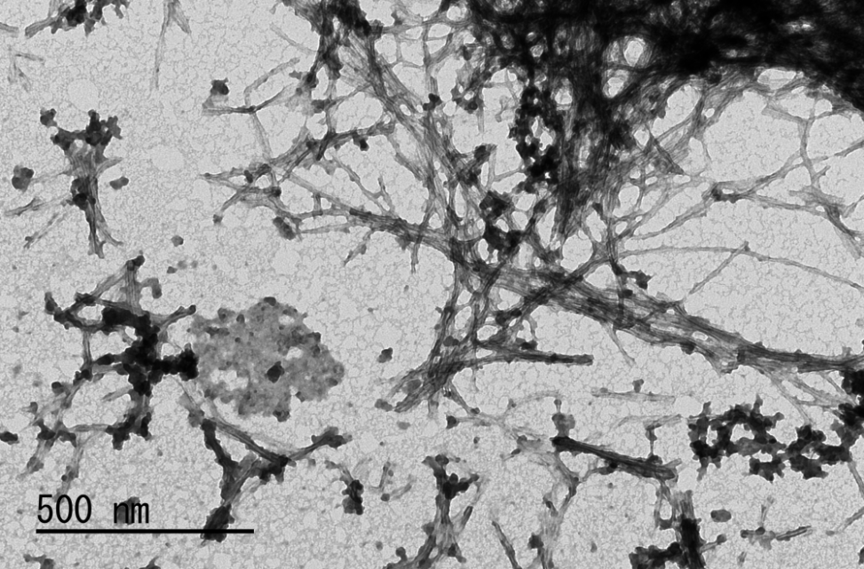
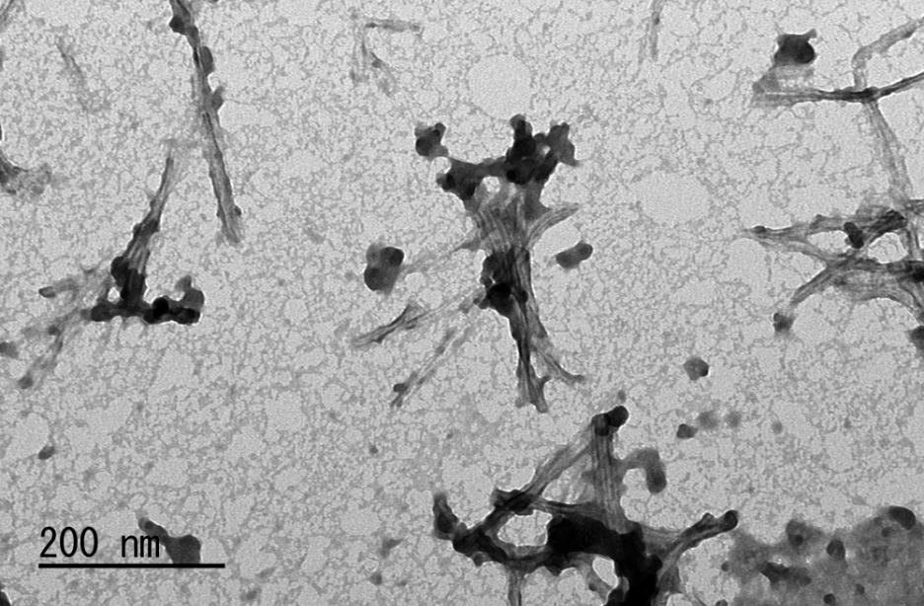
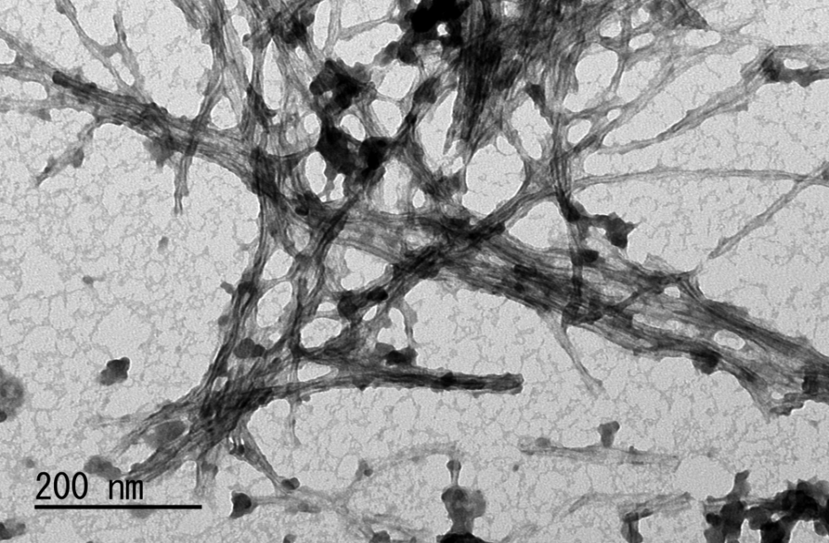
Supplemental Figure 1. Transmission electron microscopy of Aβ1-40 solution after incubation at 37 ˚C for two days. Aβ1-40 solution
represents a mixture of more the soluble oligomers, monomers and less the insoluble fibrils. Only parts of the
aggregation exhibits long and straight fibrils with some intertwining fibrils. Upper photos, X 100,000 magnification.
Lower photos, X 200,000 magnification.

Slide 2
WT
smAT₂
Overall Average Speed (m/s)
PBS, BCCAO (-)
PBS, BCCAO (-)
PBS, BCCAO (+)
PBS, BCCAO (+)
Aβ, BCCAO (-)
Aβ, BCCAO (-)
Aβ, BCCAO (+)
Aβ, BCCAO (+)
1
2
3
4
5
(days)
1
2
3
4
5
(days)
Supplemental Figure 2. Mean swimming speed of Morris Water Maze Test (MWMT). Three weeks after injection, MWMT was performed
for 5 days. Time courses of mean swimming speed in each group in WT and smAT₂ mice are show. n=12 in WT-PBS,
BCCAO (-); n=12 in WT-PBS, BCCAO (+); n=15 in WT-Aβ, BCCAO (-); n=14 in WT-Aβ, BCCAO (+); n=8 in smAT₂-
PBS, BCCAO (-); n=9 in smAT₂-PBS, BCCAO (+); n=14 in smAT₂-Aβ, BCCAO (-); n=14 in smAT₂-Aβ, BCCAO (+).

Slide 3
WT
collagen IV
p < 0.05
VEGF-A
p < 0.01
p < 0.01
p < 0.01
*
†
†
Relative mRNA Expression
(fold change)
†
BCCAO
–
+
–
+
BCCAO
–
+
–
+
PBS
Aβ
PBS
Aβ
smAT₂
collagen IV
VEGF-A
Relative mRNA Expression
(fold change)
BCCAO
–
+
–
+
BCCAO
–
+
–
+
PBS
Aβ
PBS
Aβ
Supplemental Figure 3. Effect of BCCAO with/without Aβ1-40 on cerebrovascular function markers. mRNA expression of collagen IV
and VEGF-A in the hippocampus 3 weeks after injection by real-time RT-PCR in WT and smAT₂ mice are shown.
*P<0.05, †P<0.01 vs. PBS, BCCAO (-). n=6 for each group in WT and smAT₂, respectively.

