Slide 1
Supplementary Table 1: Neuropathological and Demographic Characteristics of Autopsy Tissue Donors
Patient | Classification | Neuropathological and Demographic Characteristics
1 | nonMS | Female, 63, neuropathologically normal brain, esophageal cancer, sepsis
2 | nonMS | Neuropathologically normal brain, 50 year old male, sepsis
3 | MS | Male, 54, primary progressive MS, duration = 11 years, EDSS = 8.5, comorbidities = epilepsy, UTI/sepsis
4 | MS | Female, 77, secondary progressive MS, EDSS = 8.0; duration of disease = 28 years, comorbidities = trigeminal neuralgia and urinary tract infection

Slide 2
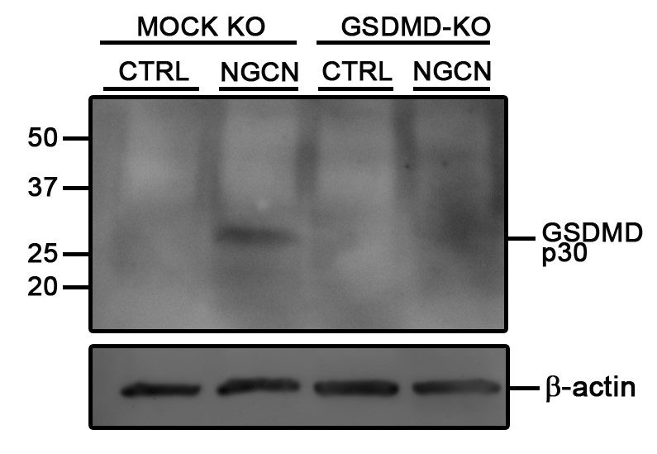
Supplemental Figure 1
A.

Slide 3
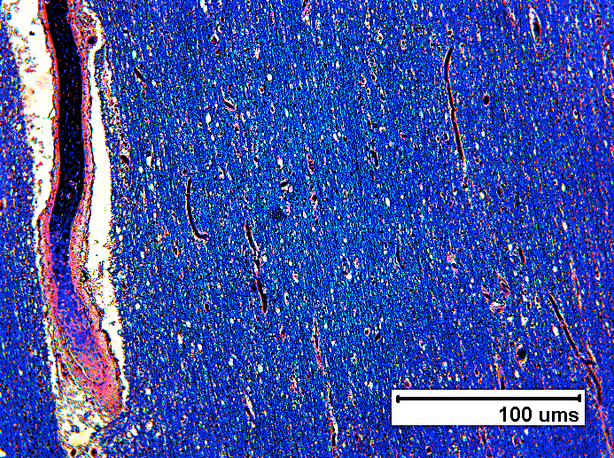
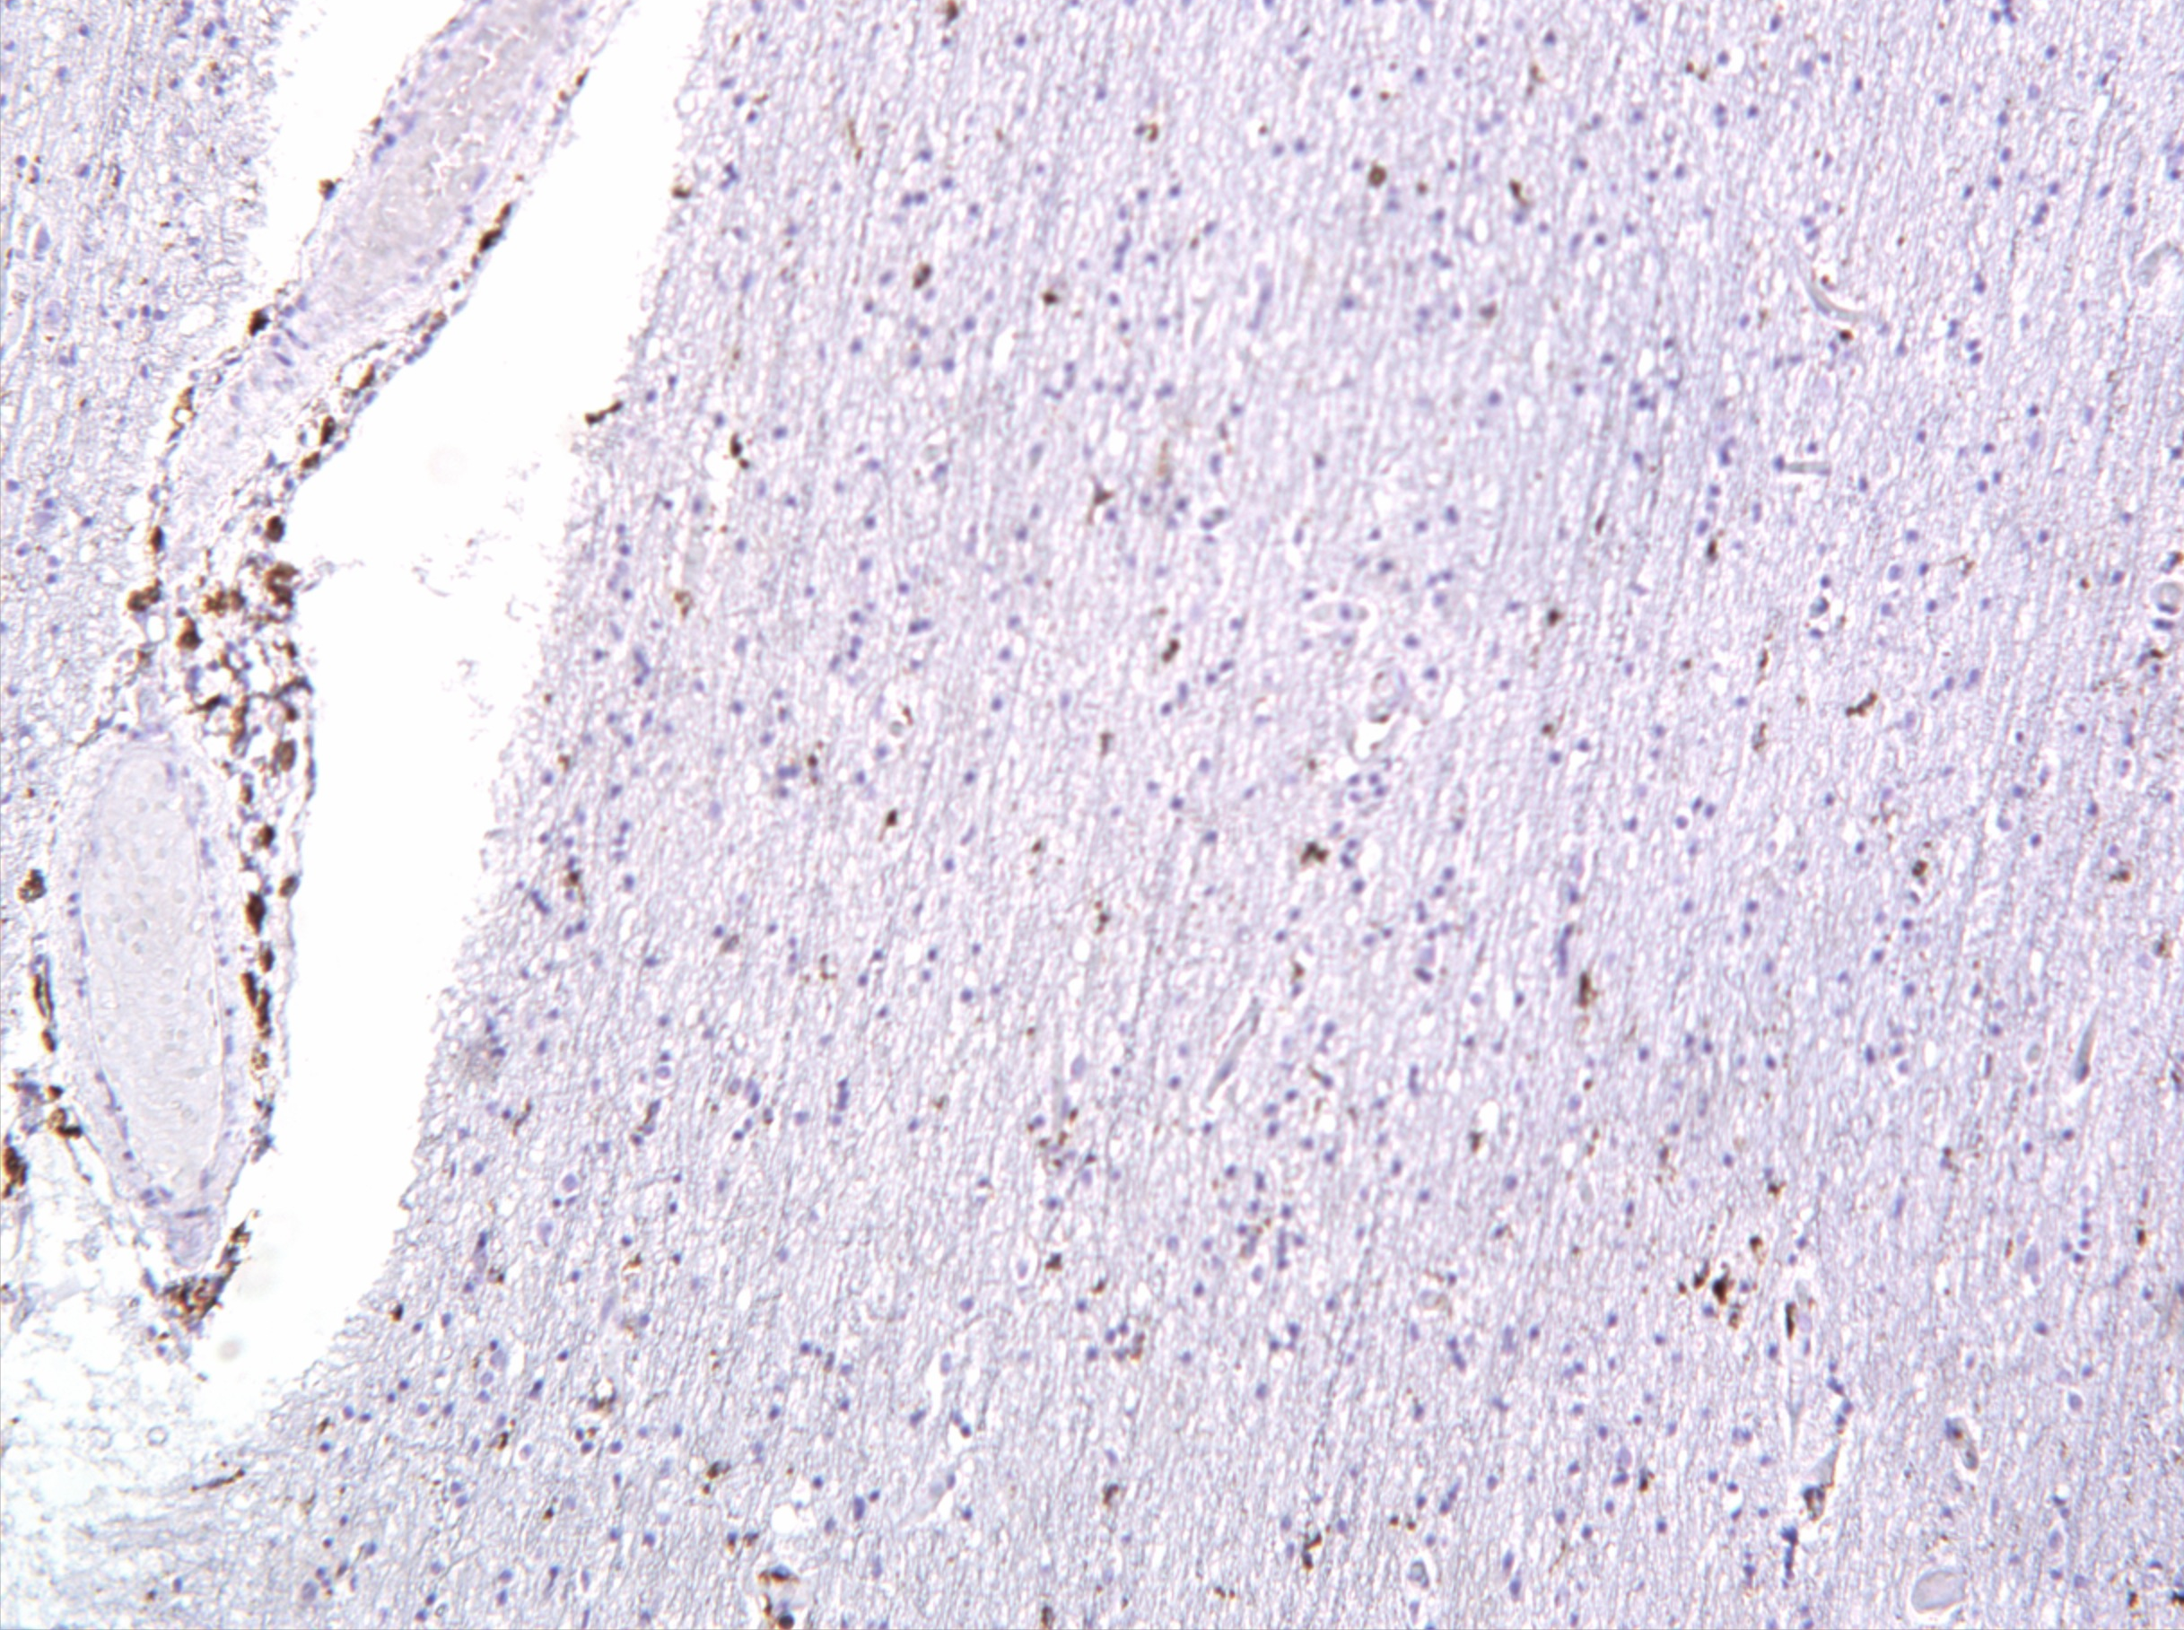
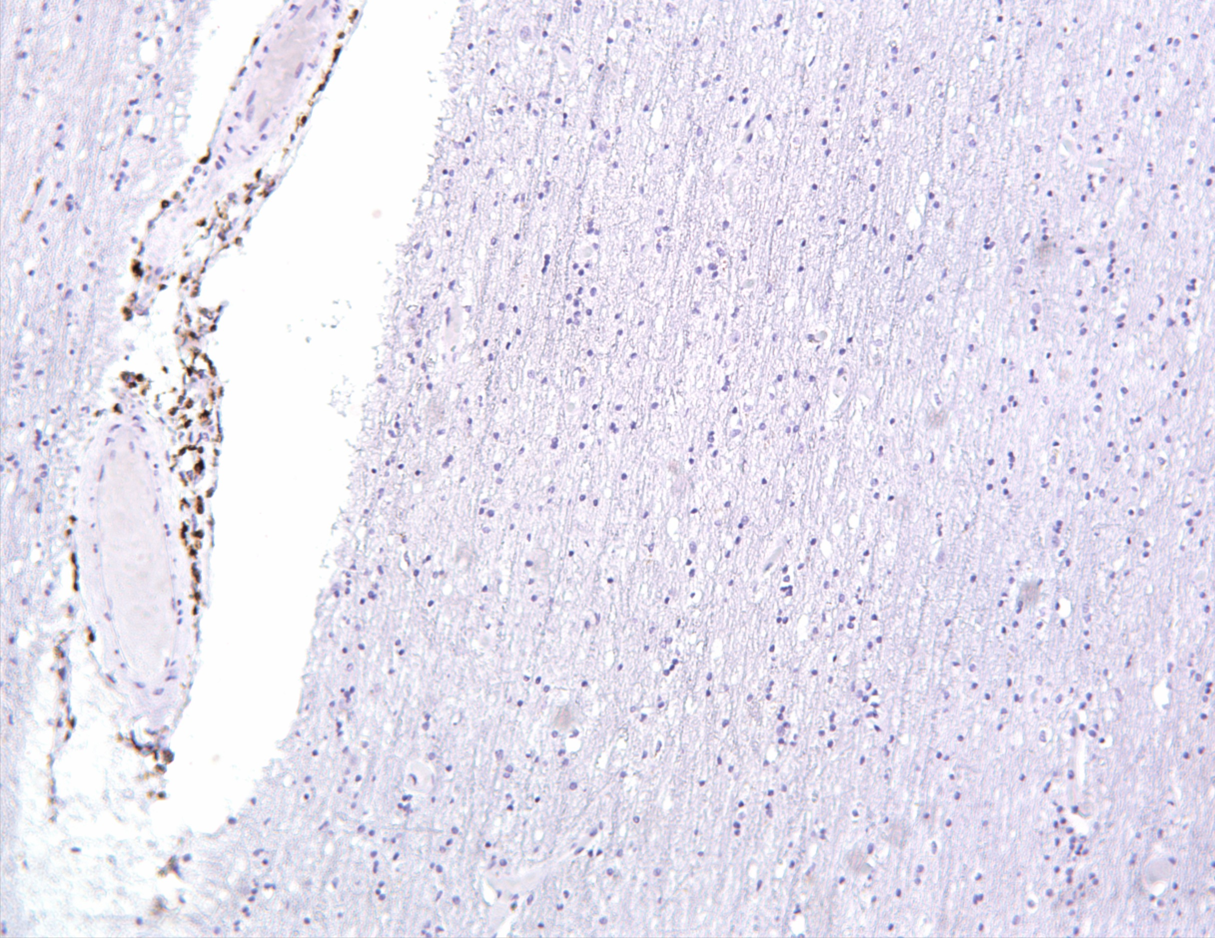
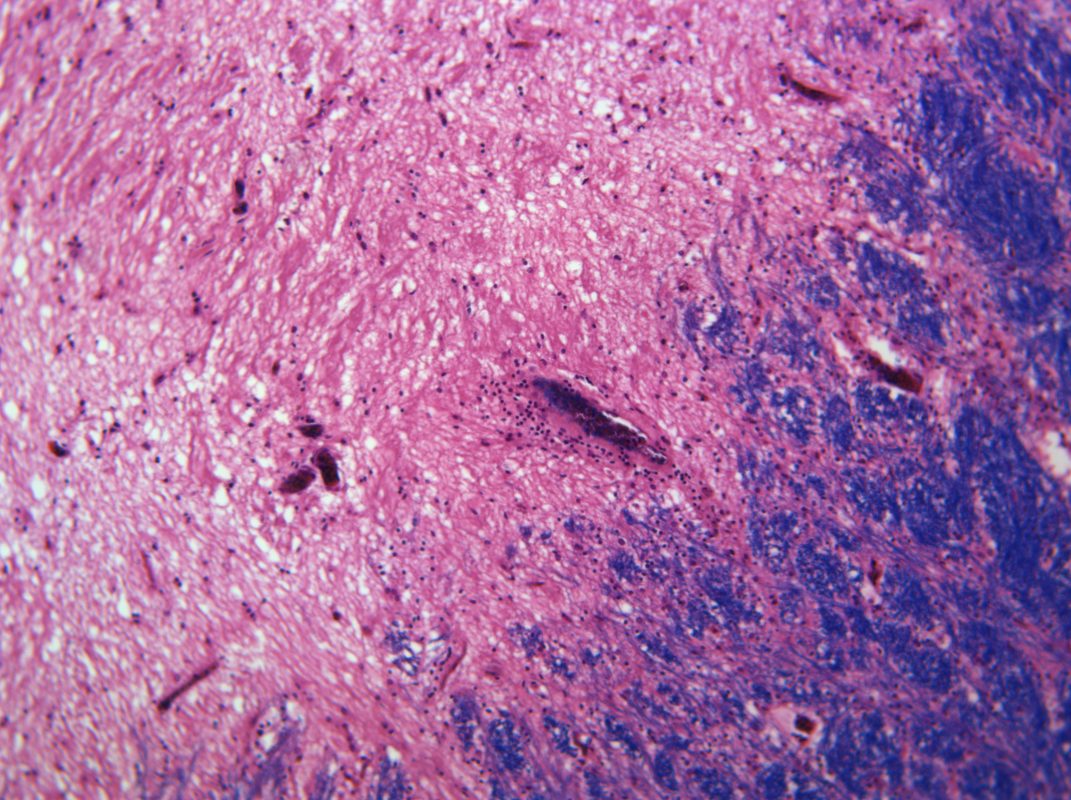
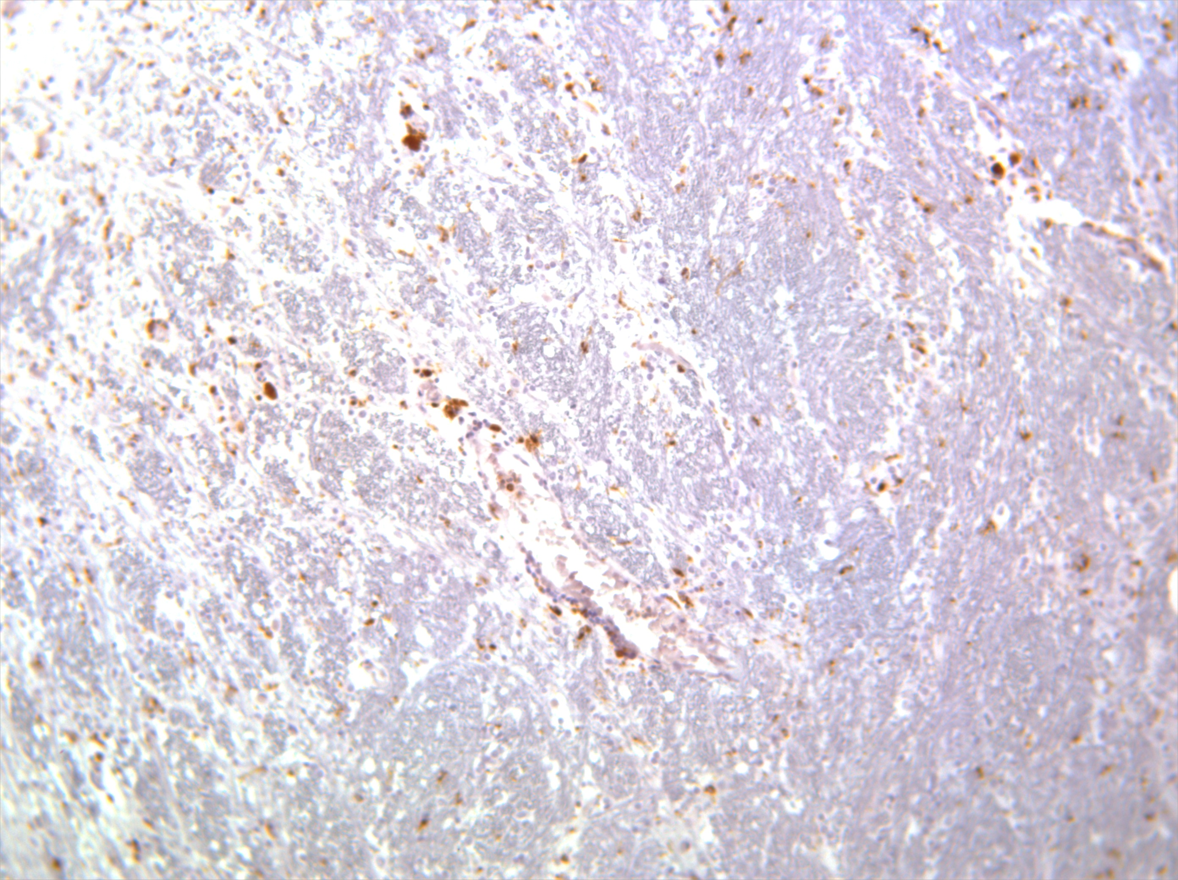
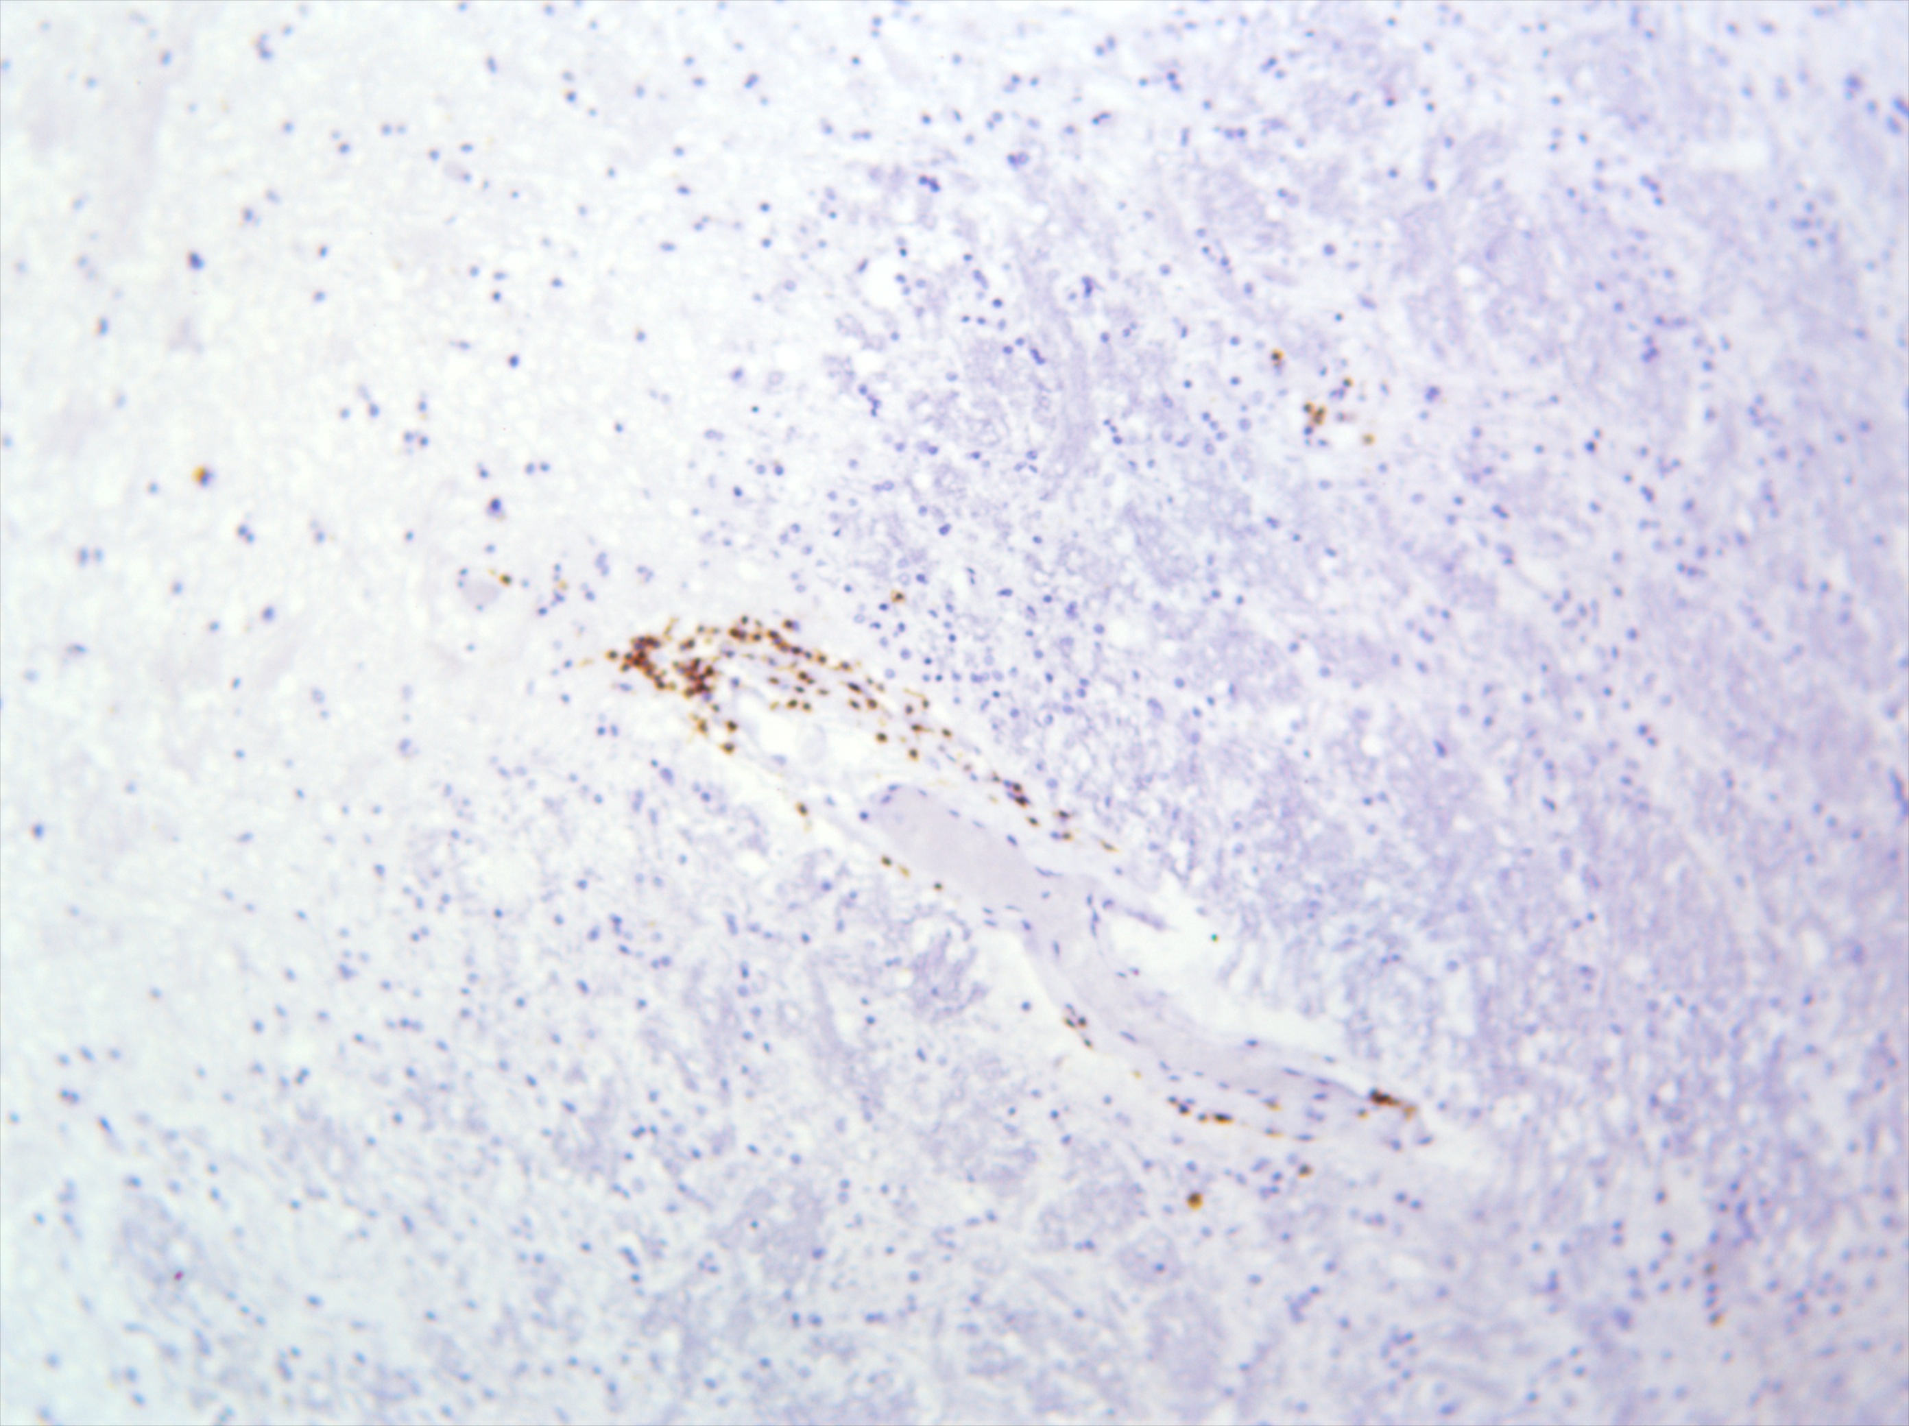
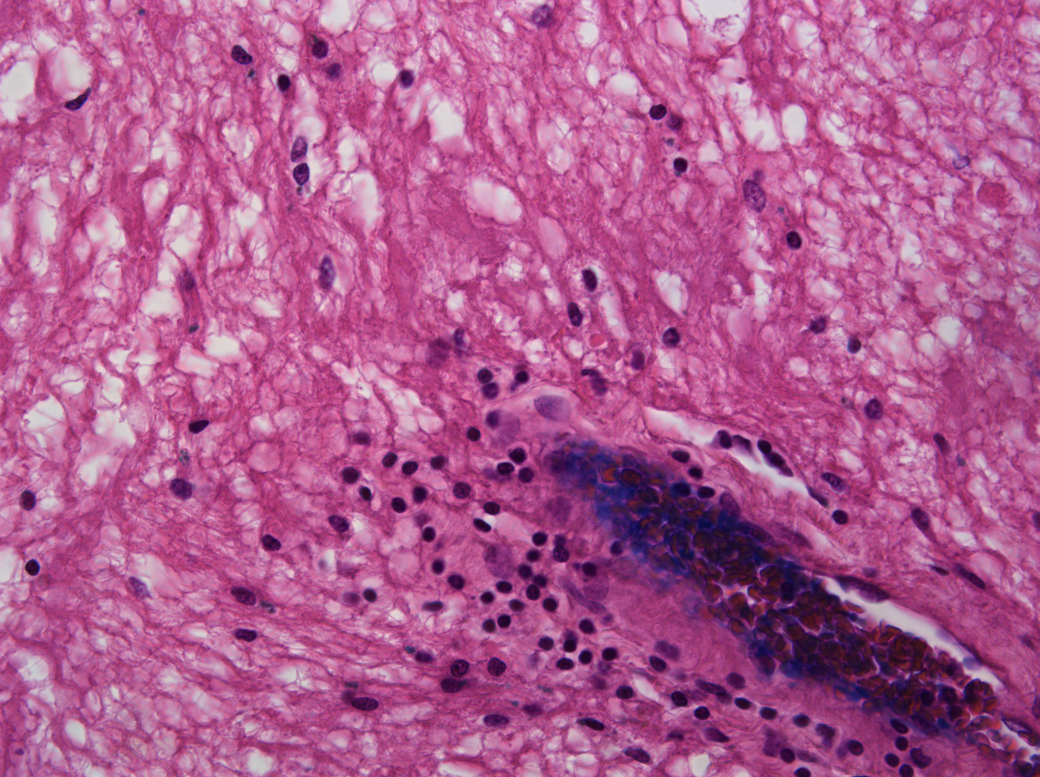
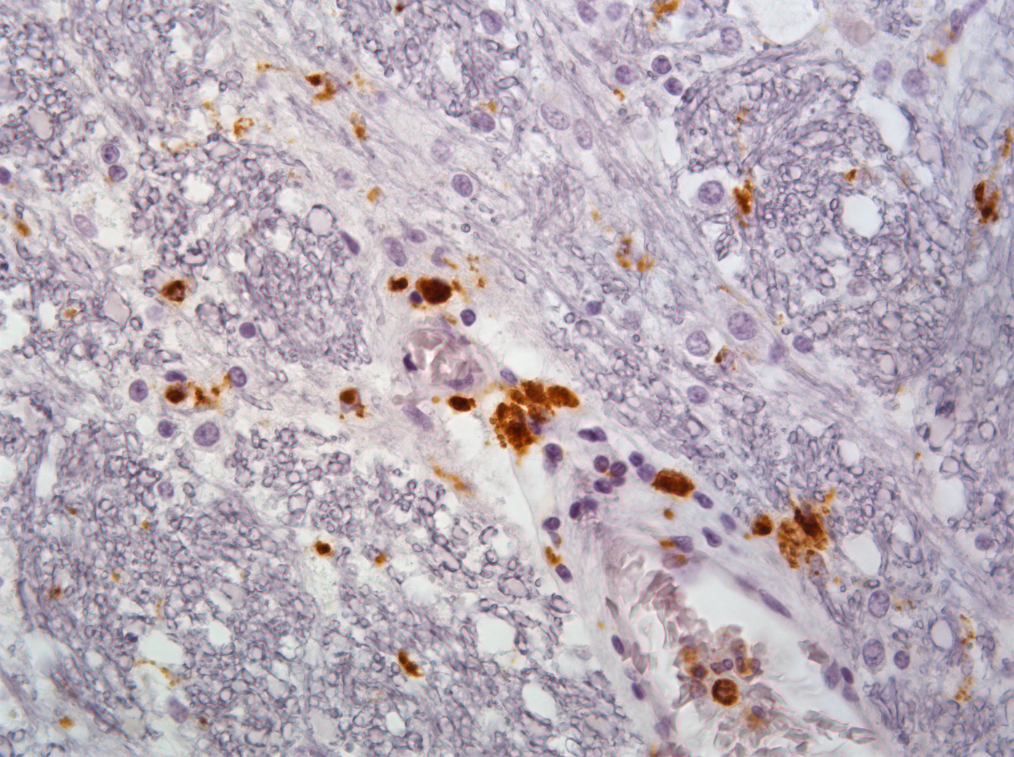
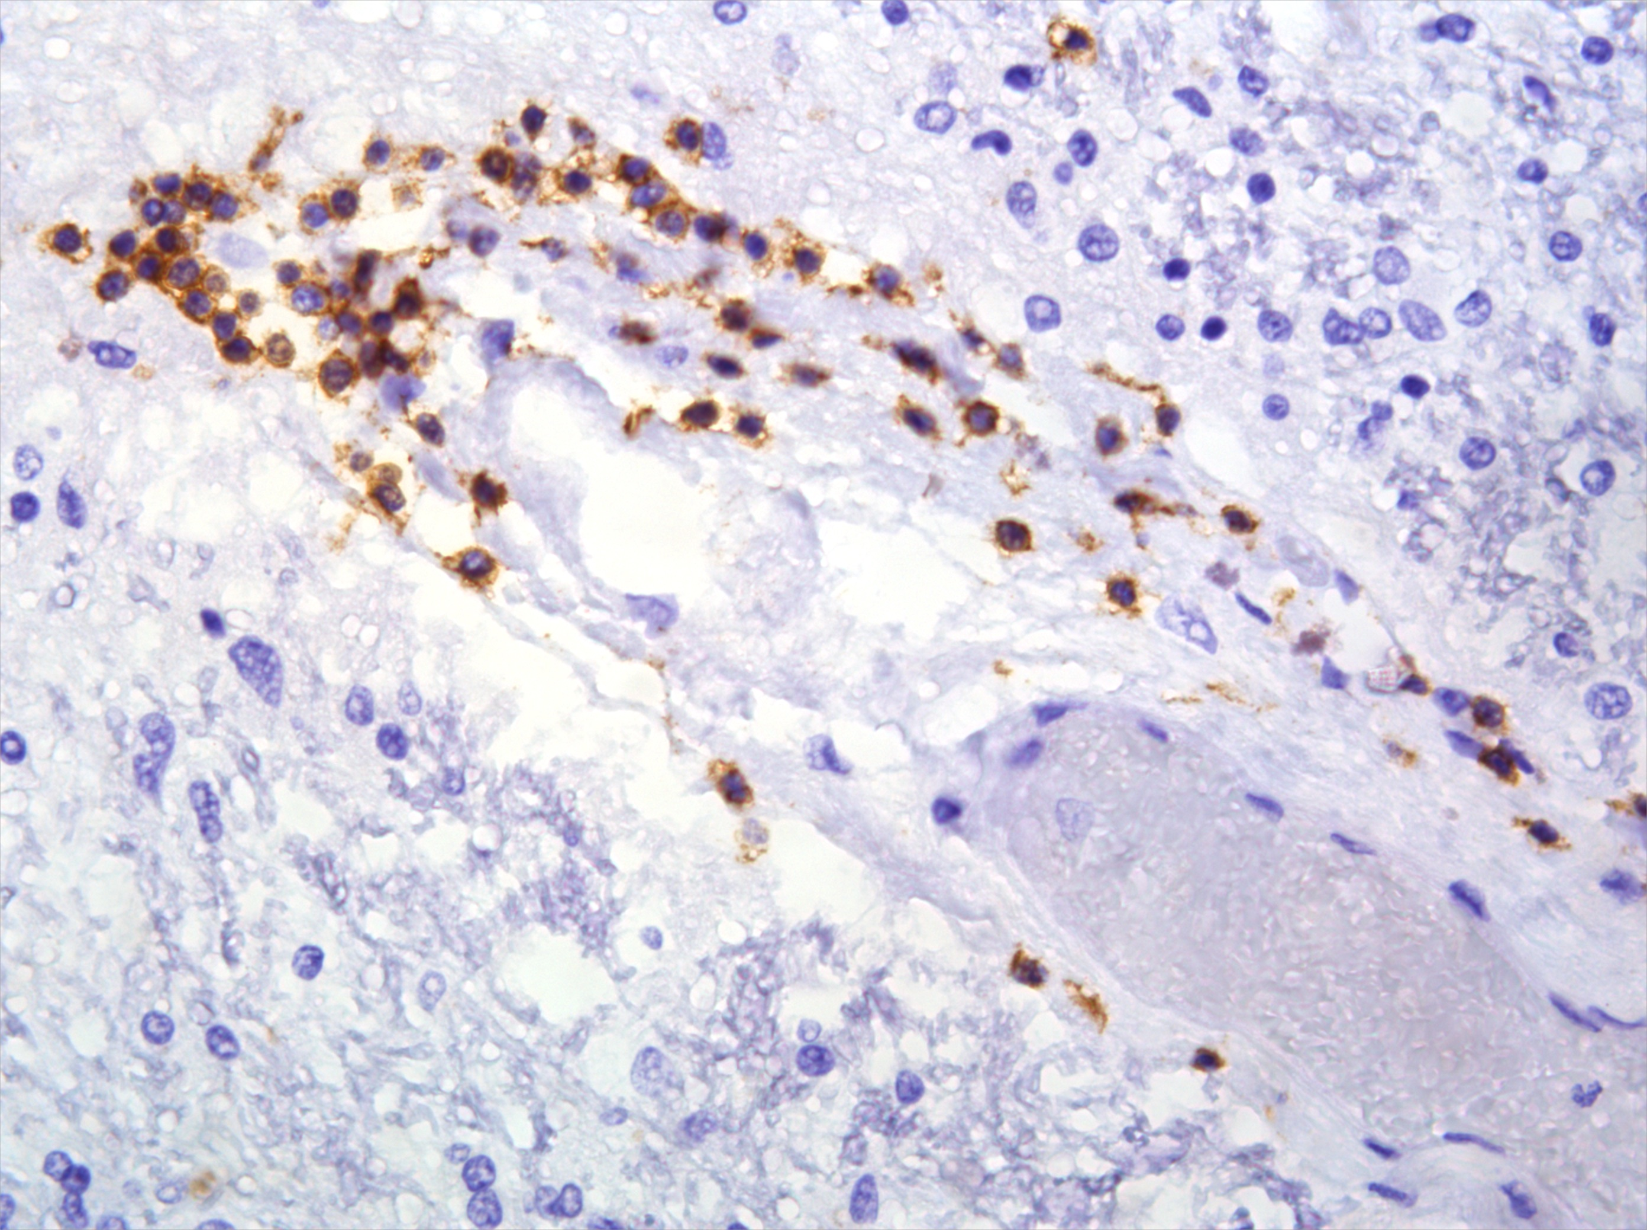
Supplemental Figure 2
A.
LFB/H&E
CD68/H&E
CD3/H&E
i.
ii.
iii.
i.
non-MS WM
iv.
v.
vi.
MS Lesion
vii.
viii.
ix.
B.
****
C.
****
D.
****
****
***

Slide 4
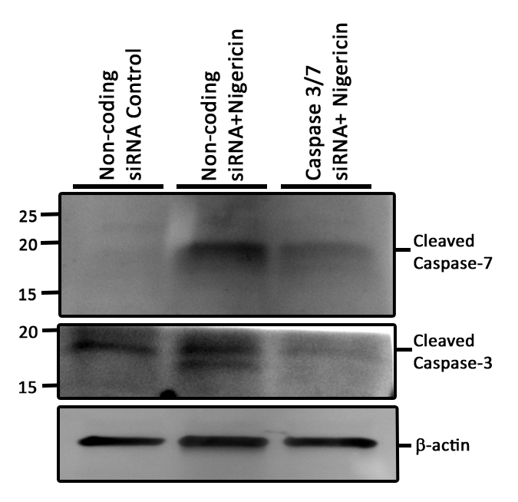
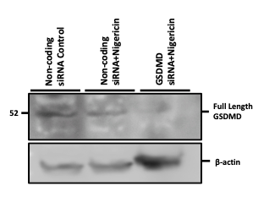
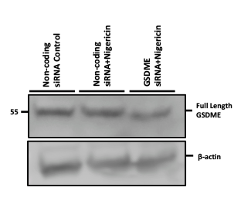
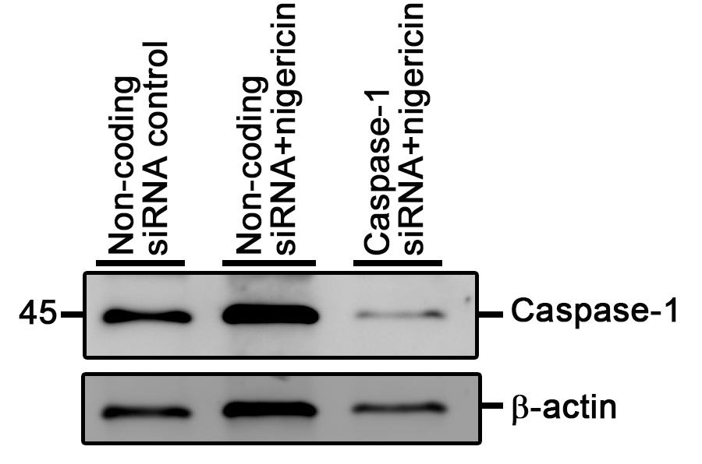
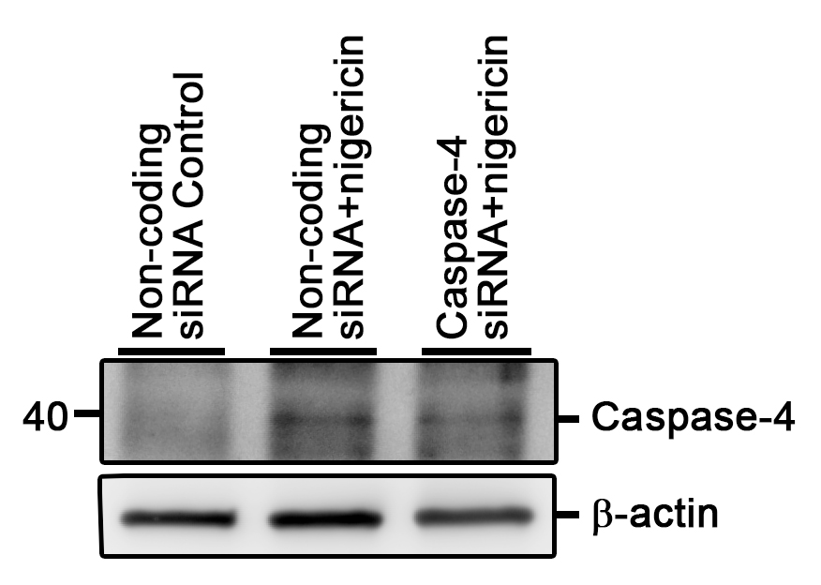
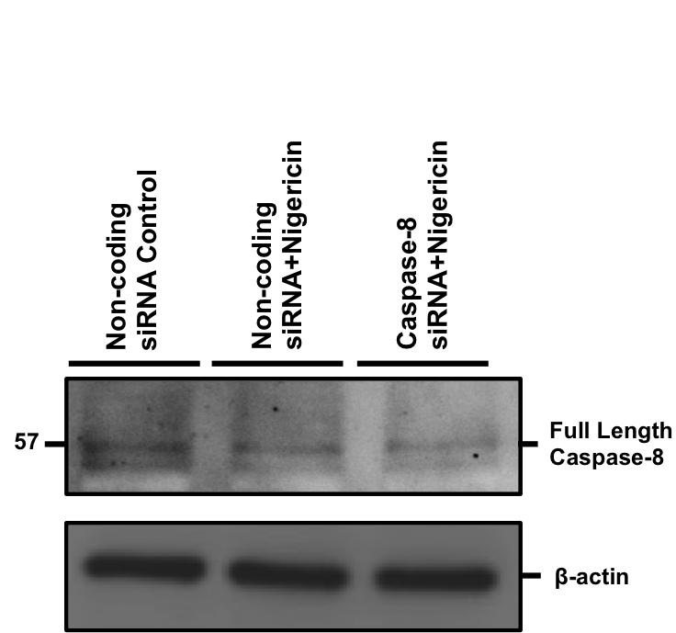
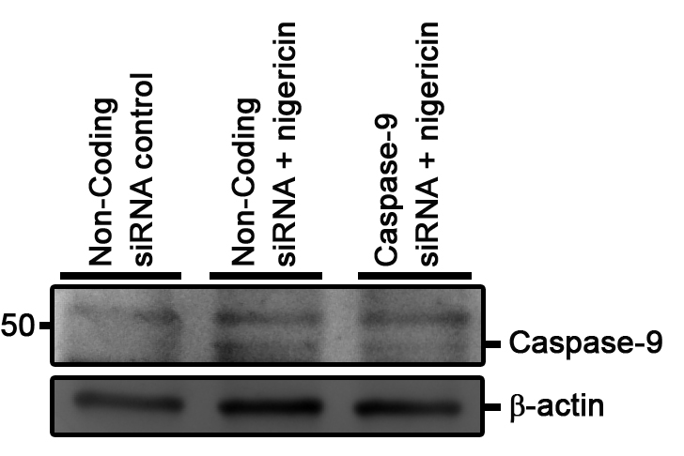
A.
B.
C.
Supplemental Figure 3
A.
B.
C.
Nigericin
D.
E.
F.
G.
H.
I.
J.
K.
L.
M.
N.
O.

Slide 5
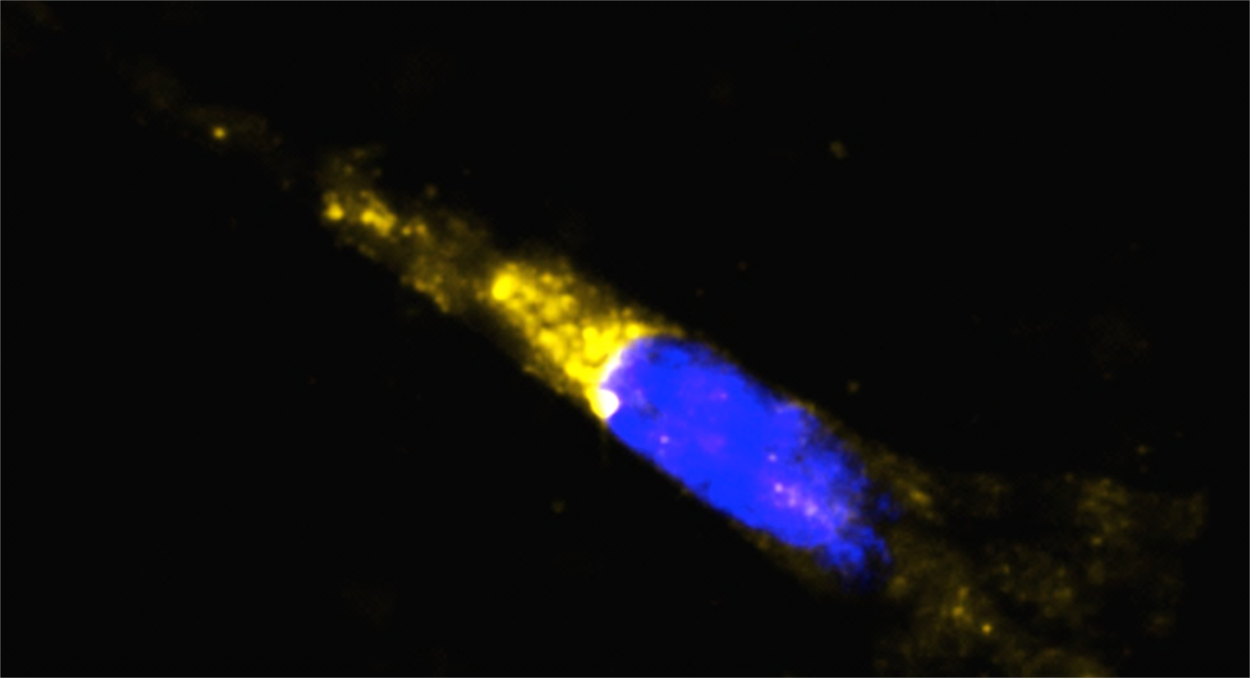
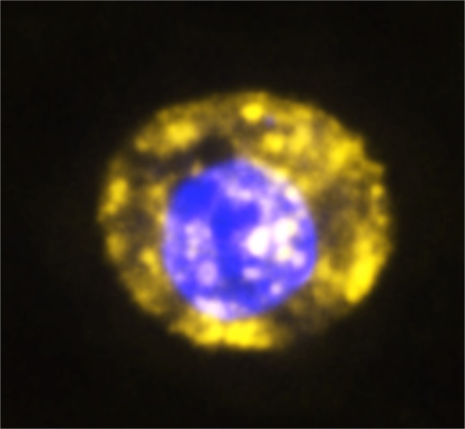
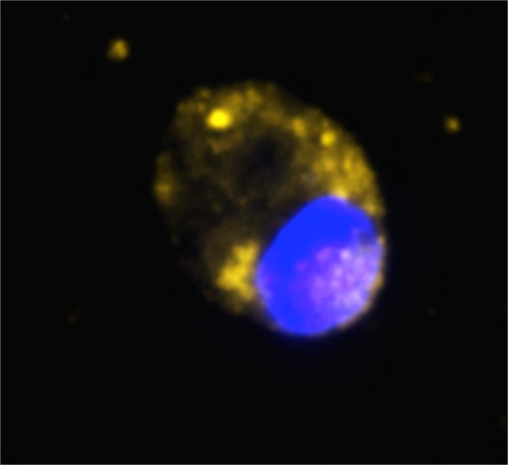
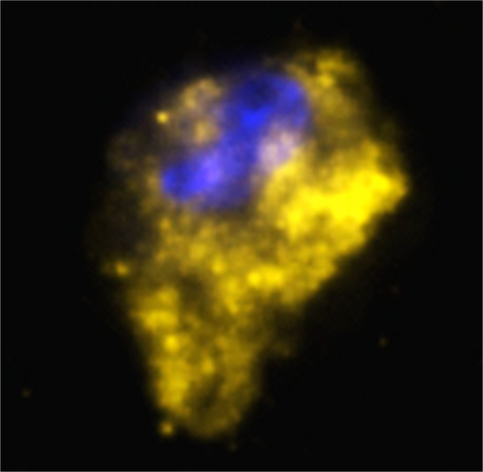
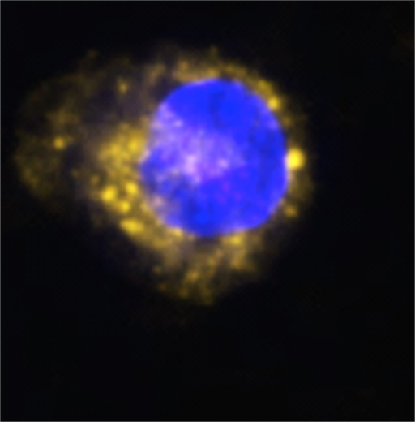
Supplemental Figure 4
A.
Control
Nigericin
Nigericin + VX-765
ATP
ATP + VX-765
i.
ii.
iii.
iii.
iv.
v.
Cleaved Caspase-7
vi.
B.
***
***

Slide 6
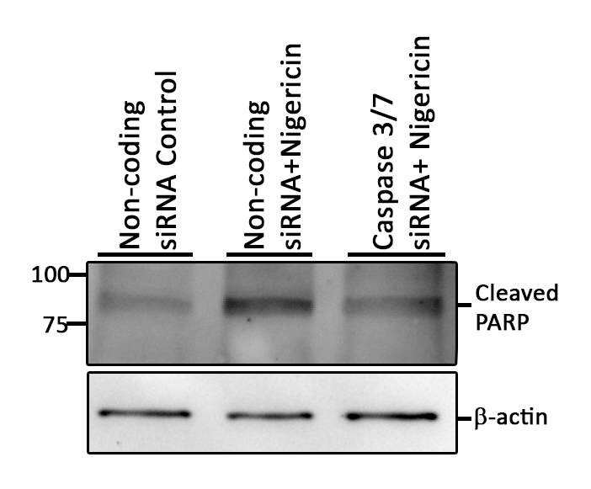
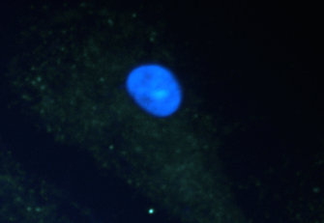
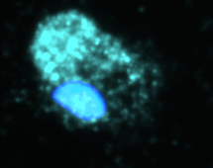
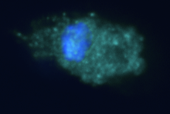
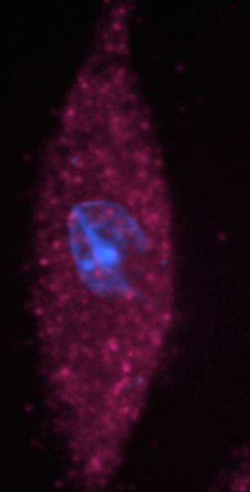
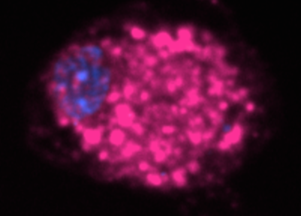
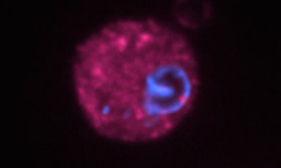
Supplemental Figure 5
A.
B.
Nigericin | - | + | +
NC siRNA | + | + | -
Casp3/7 siRNA | - | - | +
C.
Control
NC siRNA
Nigericin
NC siRNA
Nigericin Casp3/7 siRNA
i.
ii.
iii.
Cleaved DFF45
D.
****
****
Nigericin | - | + | +
NC siRNA | + | + | -
Casp3/7 siRNA | - | - | +
E.
F.
Control
NC siRNA
****
***
Nigericin
NC siRNA
Nigericin | - | + | +
NC siRNA | + | + | -
Casp3/7 siRNA | - | - | +
Nigericin
Casp3/7 siRNA

Slide 7
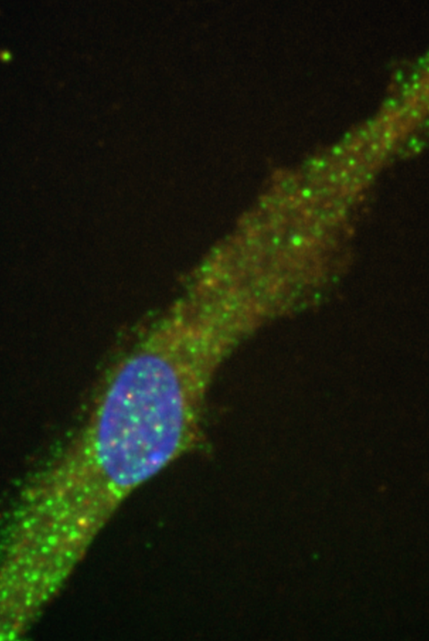
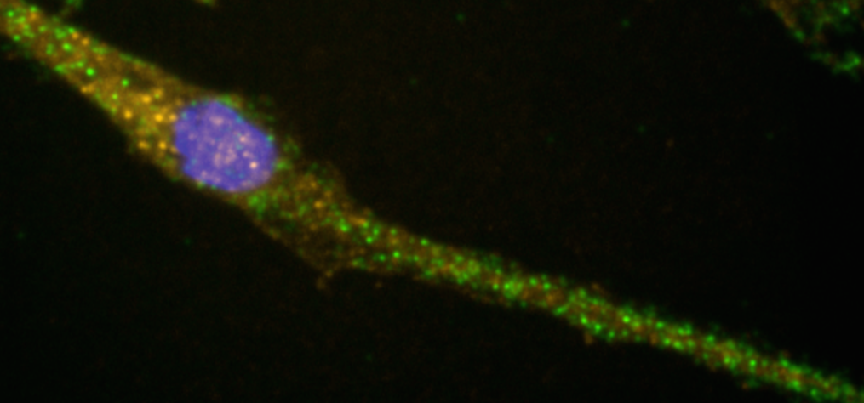
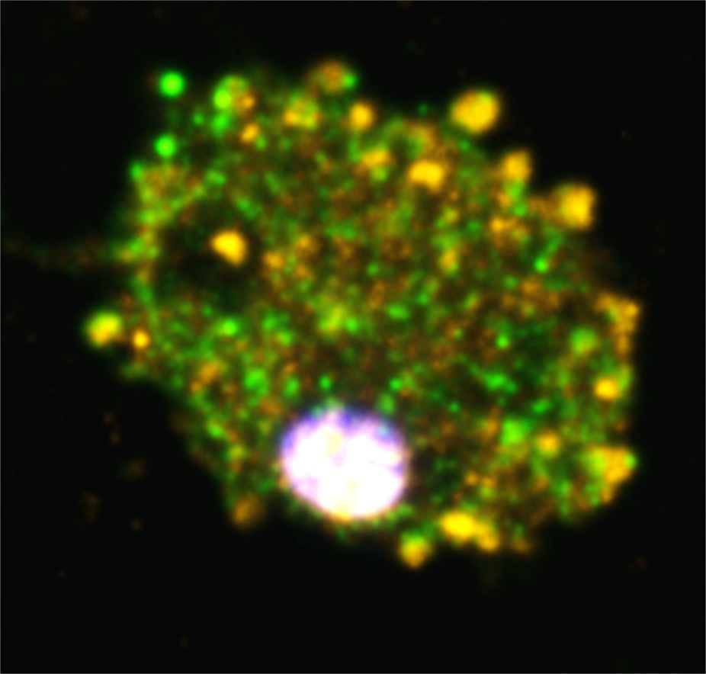
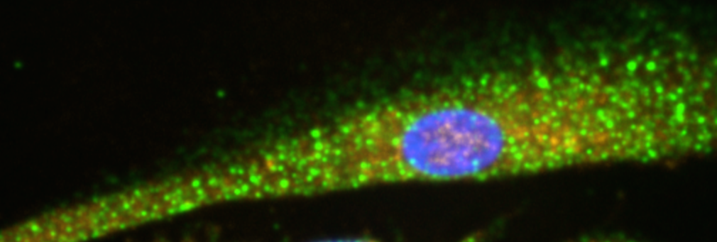
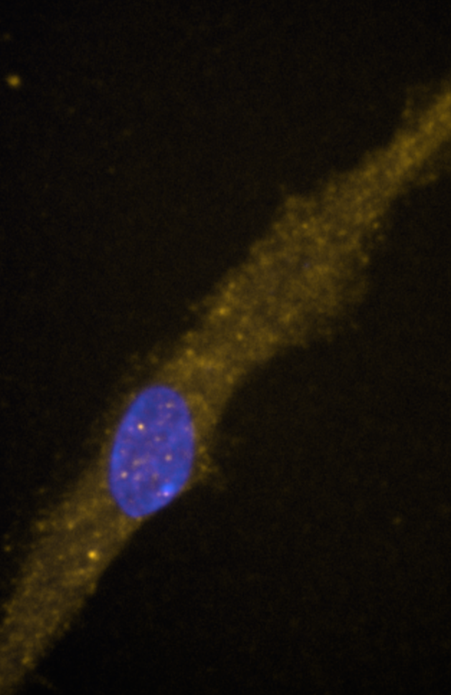
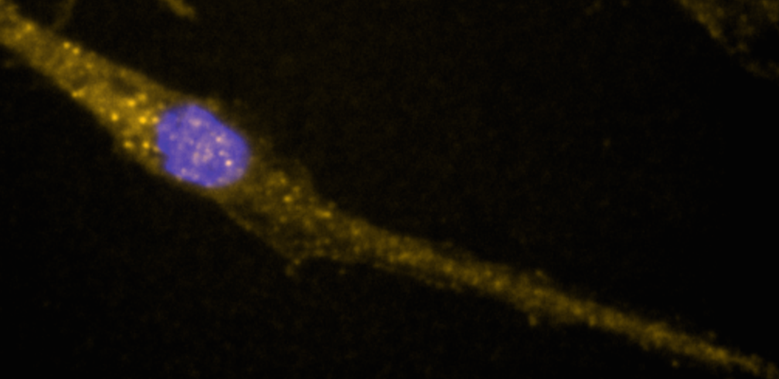
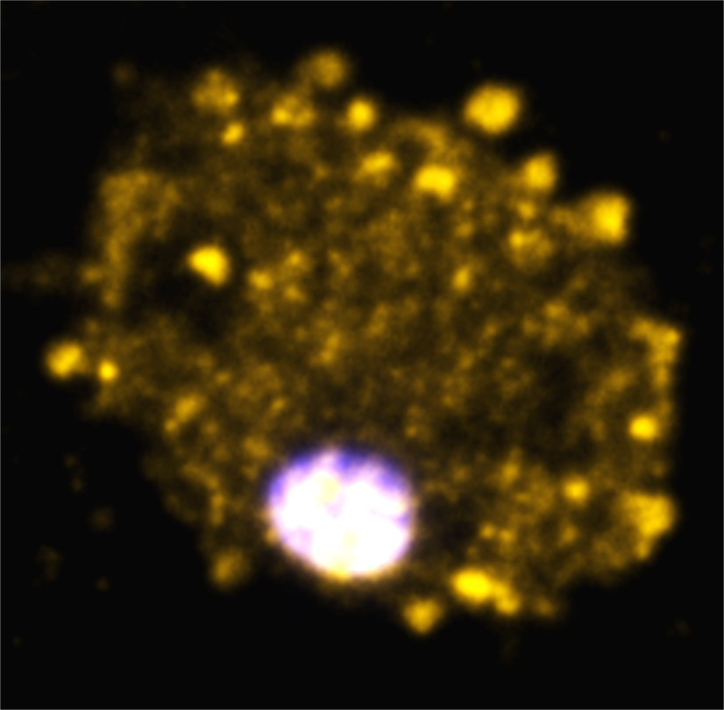
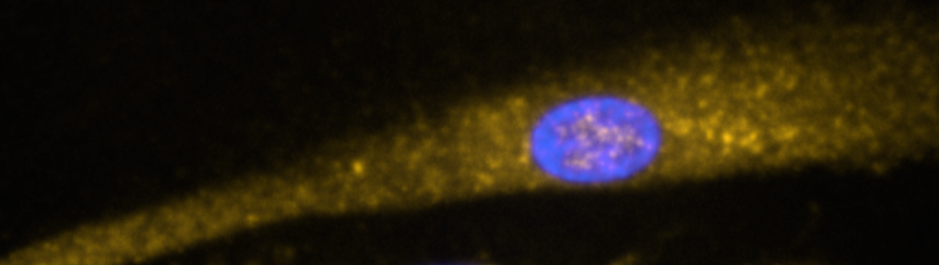
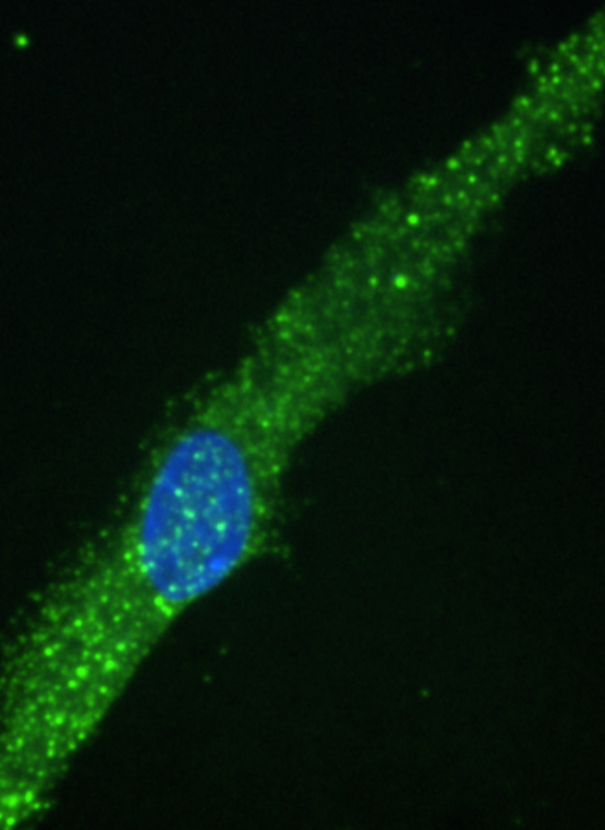
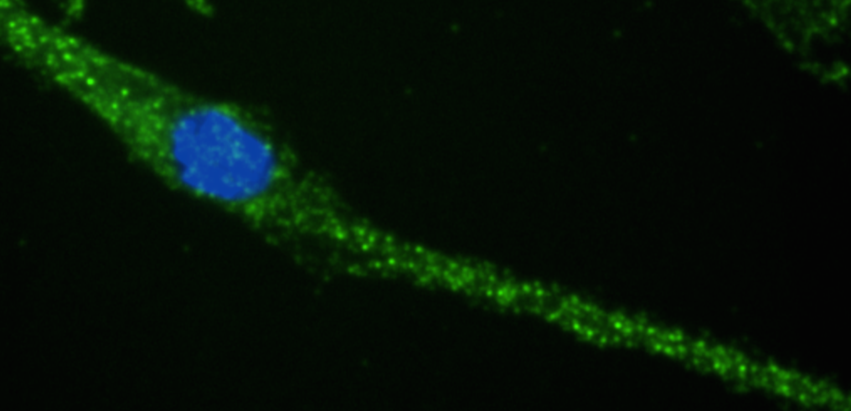
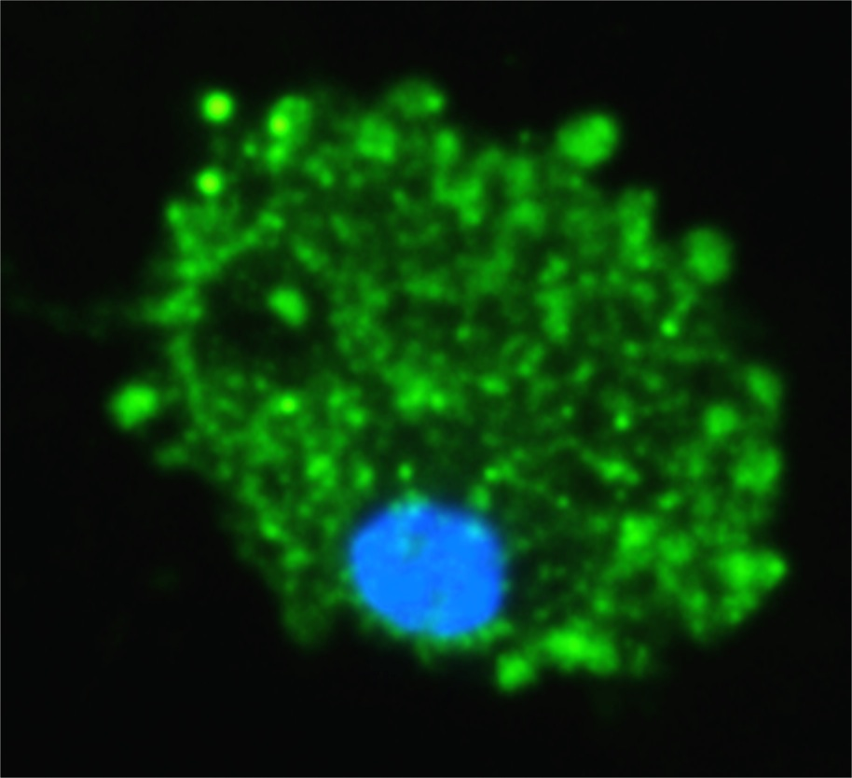
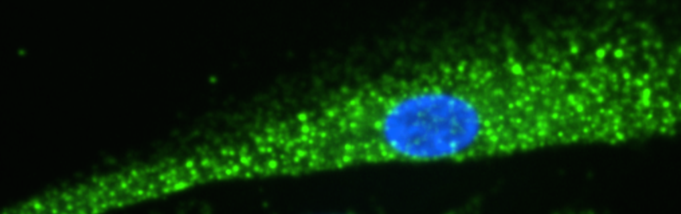
Supplemental Figure 6
A.
Control
Nigericin
Exogenous IL-1β
Exogenous IL-18
i.
ii.
iii.
iv.
Merge
v.
vi.
vii.
viii.
Cleaved Caspase-3
ix.
x.
xi.
xii.
GSDMD
B.
C.
E.
****
D.
NS
NS
Notes:
Aug 15 and aug 16 volocity library

Slide 8
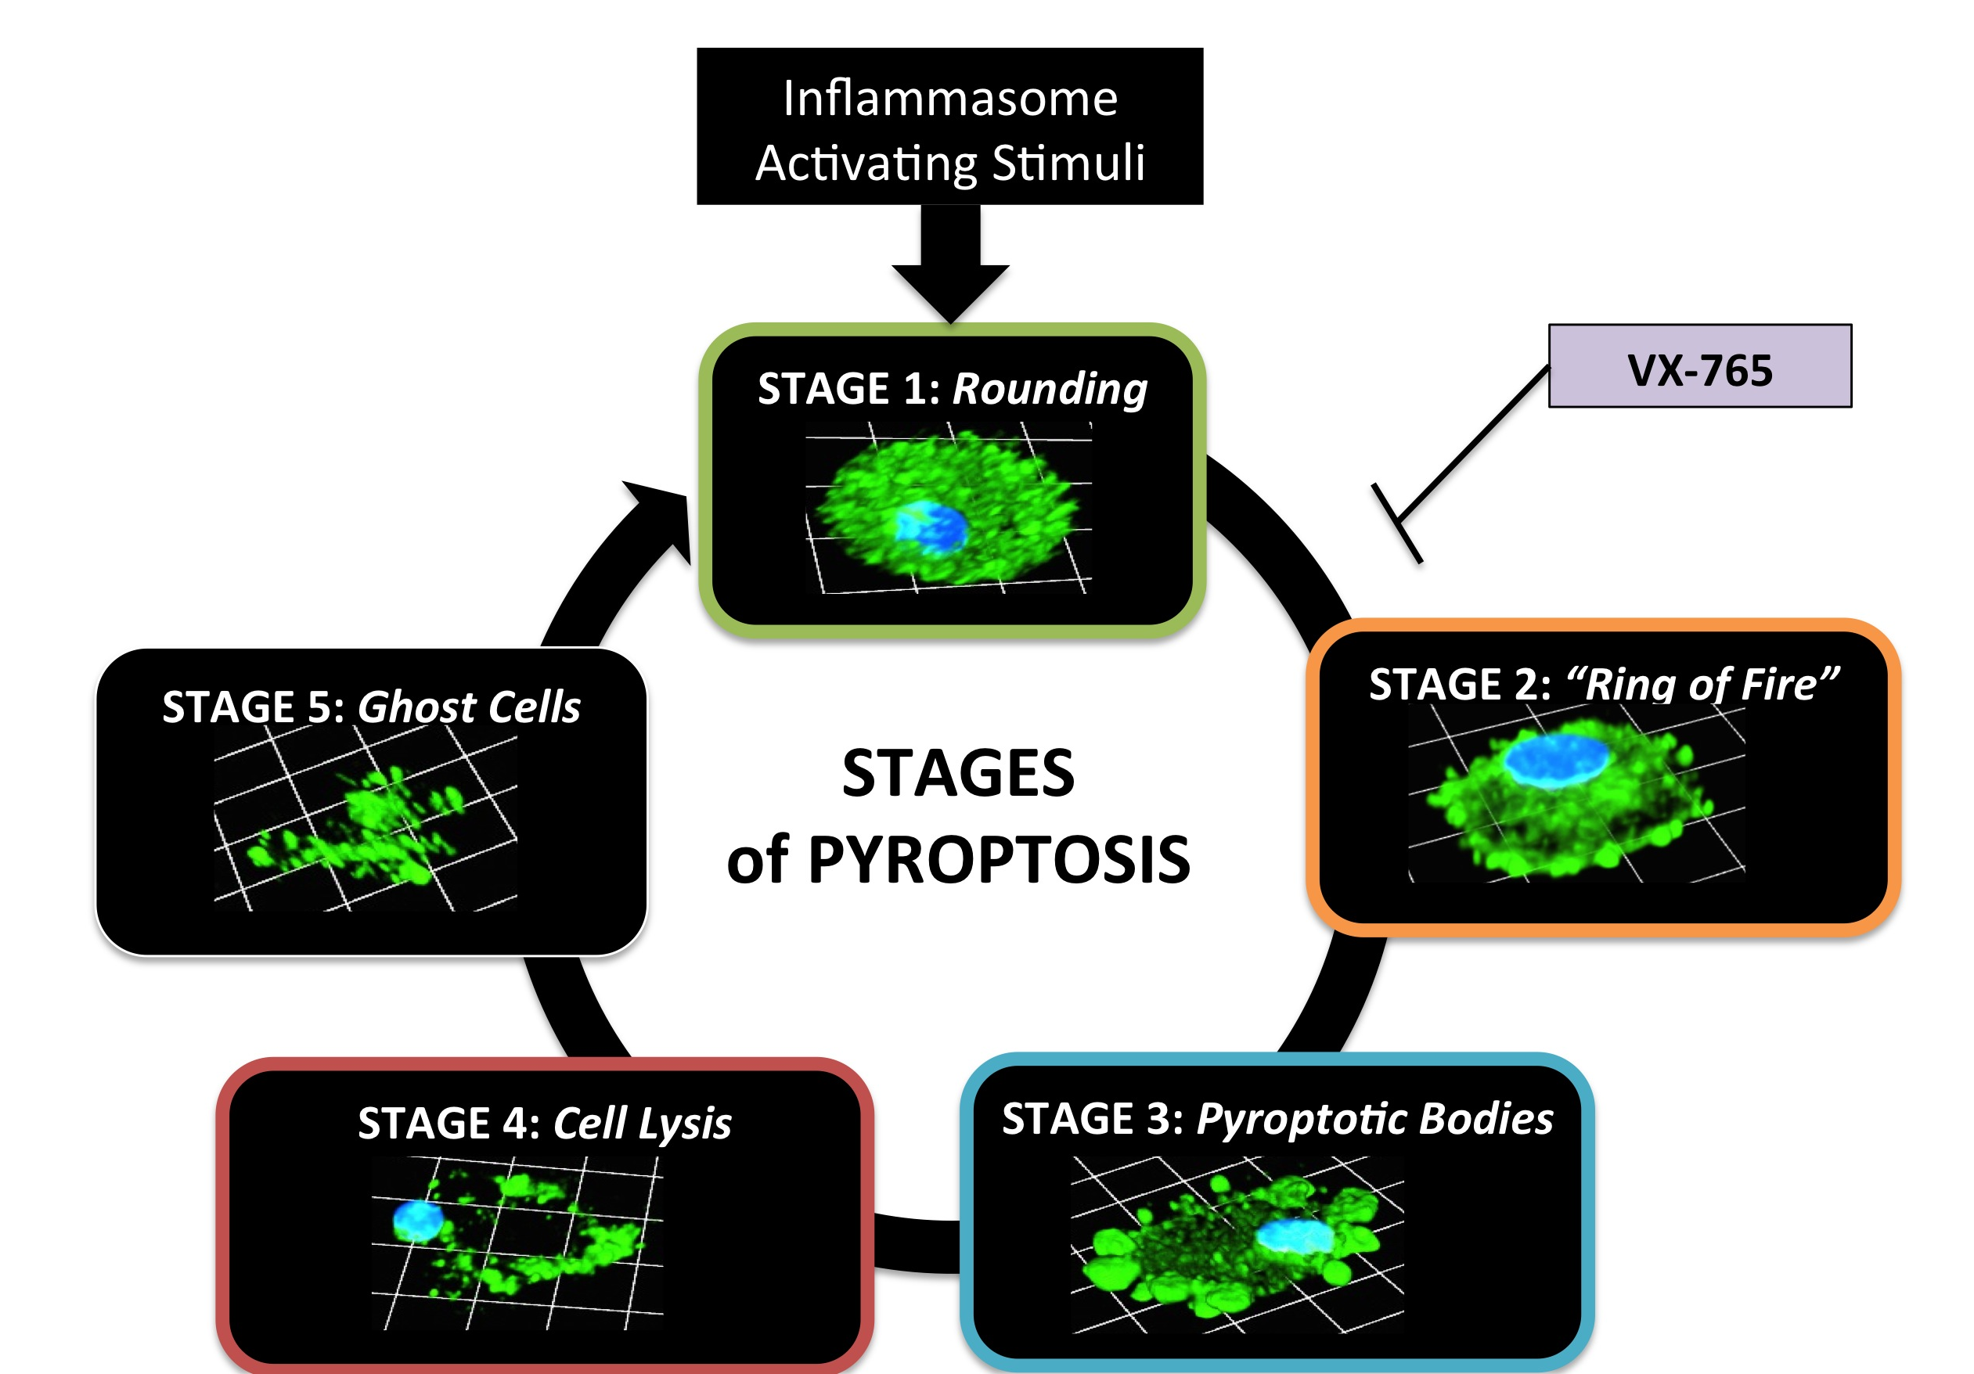
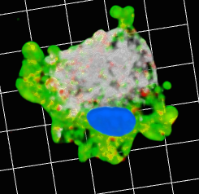
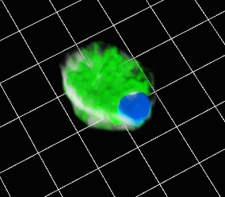
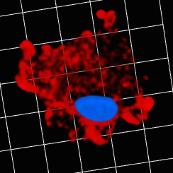
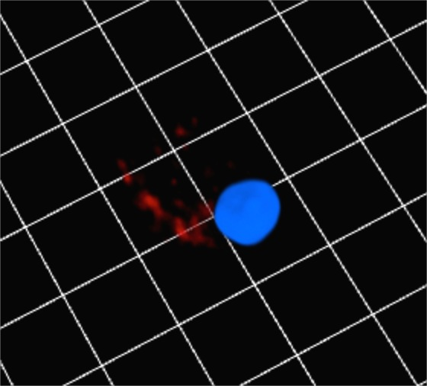
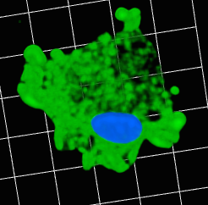
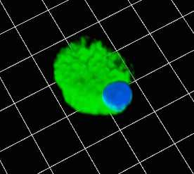
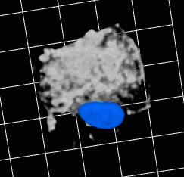
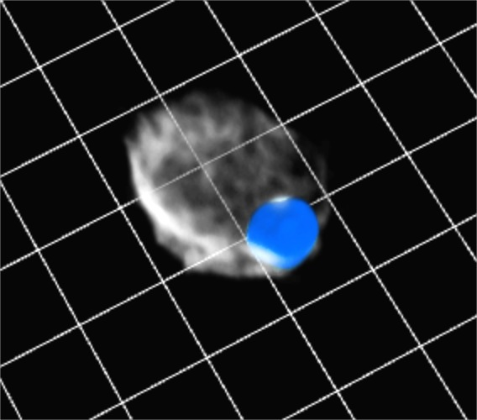
Supplemental Figure 7
A.
B.
**
Nigericin | + | +
VX-765 | - | +
C.
D.
Nigericin
Nigericin + VX-765
NS
i.
ii.
Merge
iv.
v.
Cleaved GSDMD
Nigericin | - | + | +
VX-765 | - | - | +
vii.
viii.
E.
**
Total GSDMD
x.
xi.
F-Actin
Nigericin | - | + | +
VX-765 | - | - | +

Slide 9

Supplemental Figure 8
A.
***
B.
***
***
Nigericin
Nigericin
C.
D.
***
***
***
E.
Nigericin
F.
Nigericin
****
****
****
**
Nigericin
Nigericin
G.
H.
Nigericin | + | + | + | +
NC siRNA | + | - | - | -
Casp3 siRNA | - | + | - | +
Casp7 siRNA | - | + | + | -
I.
NS
Nigericin | + | +
NC siRNA | + | -
Casp3/7 siRNA | - | +
Notes:
Figure 8: Pyroptotic body formation is reduced following caspase-3/7 inhibition and the caspase-3/7 substrate ROCK1 represents a putative connection between pyroptotic body formation and caspase-3/7 activation

Slide 10
Supplemental Figure 9
A.
B.
****
****
****
C.
D.
Nigericin
****
****
****
E.
F.
Nigericin
****
**
Nigericin
Nigericin

Slide 11






Supplemental Figure 10
A.
STAURO
VX-765
+ STAURO
B.
C.
i.
ii.
NS
***
Merge
iii.
iv.
Caspase-3
p17/19
v.
vi.
GSDMD

