Slide 1
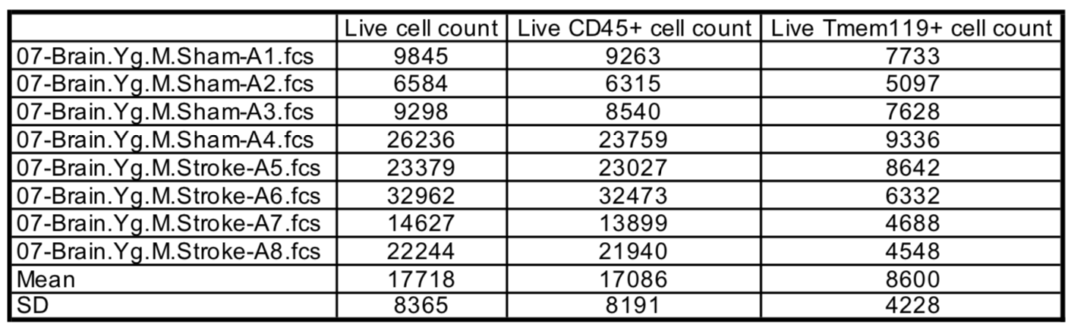
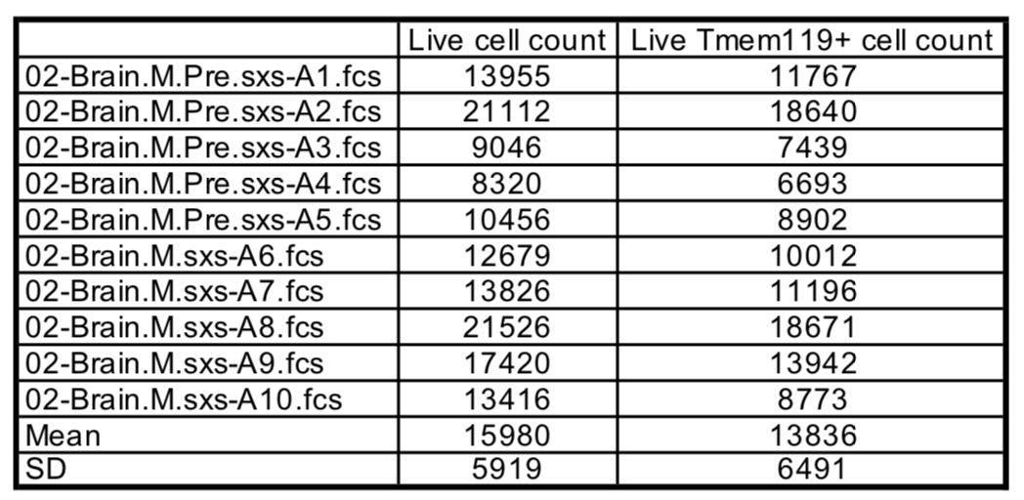
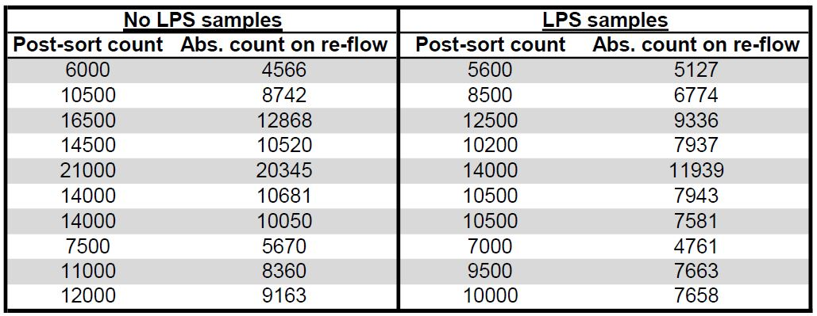
Supplementary Table 1.
(a)
(b)
(c)
Notes:
Supplementary Table 1- absolute cell counts for brain flow preps from automated volumetric data obtained from cytometers (Cytoflex S for Main Fig 1 and 2 and BD FACSMelody for Fig 5) for MCAO (a), CAA (b), and ex-vivo LPS on sorted MG (c) experiments.

