Slide 1
Supplementary Material
(1 Table and 3 Supplementary Figures)

Slide 2
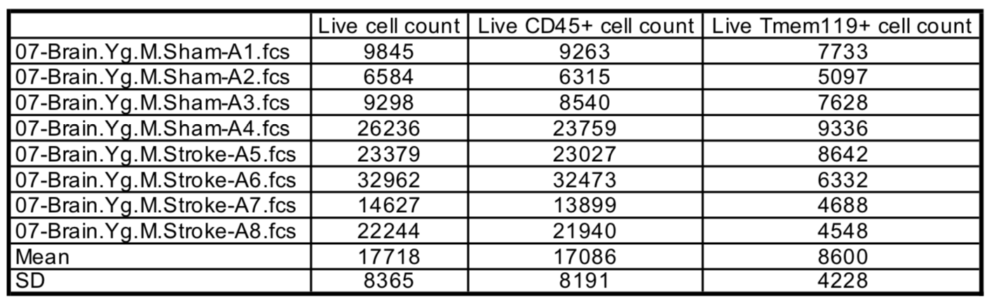
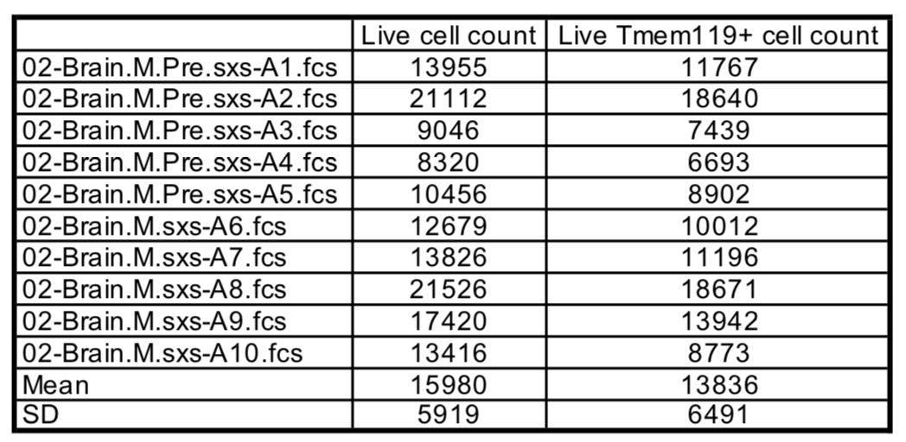
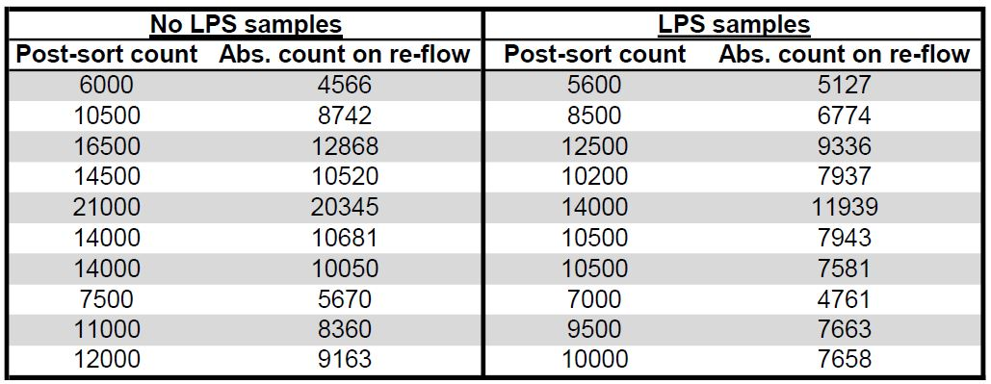
Supplementary Table 1.
(a)
(b)
(c)
Notes:
Supplementary Table 1- absolute cell counts for brain flow preps from automated volumetric data obtained from cytometers (Cytoflex S for Main Fig 1 and 2 and BD FACSMelody for Fig 5) for MCAO (a), CAA (b), and ex-vivo LPS on sorted MG (c) experiments.

Slide 3
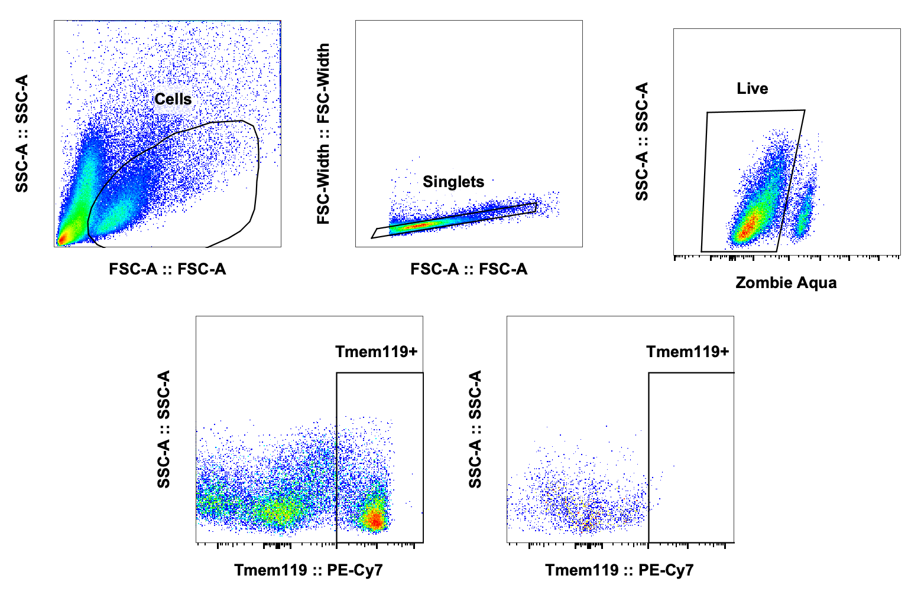
Supplementary Fig 1.
Representative Brain
FMO
Notes:
Supplementary Fig 1. Brain gating strategy for LiveTmem119+ cells using fluorescence minus one control for positive gating.

Slide 4
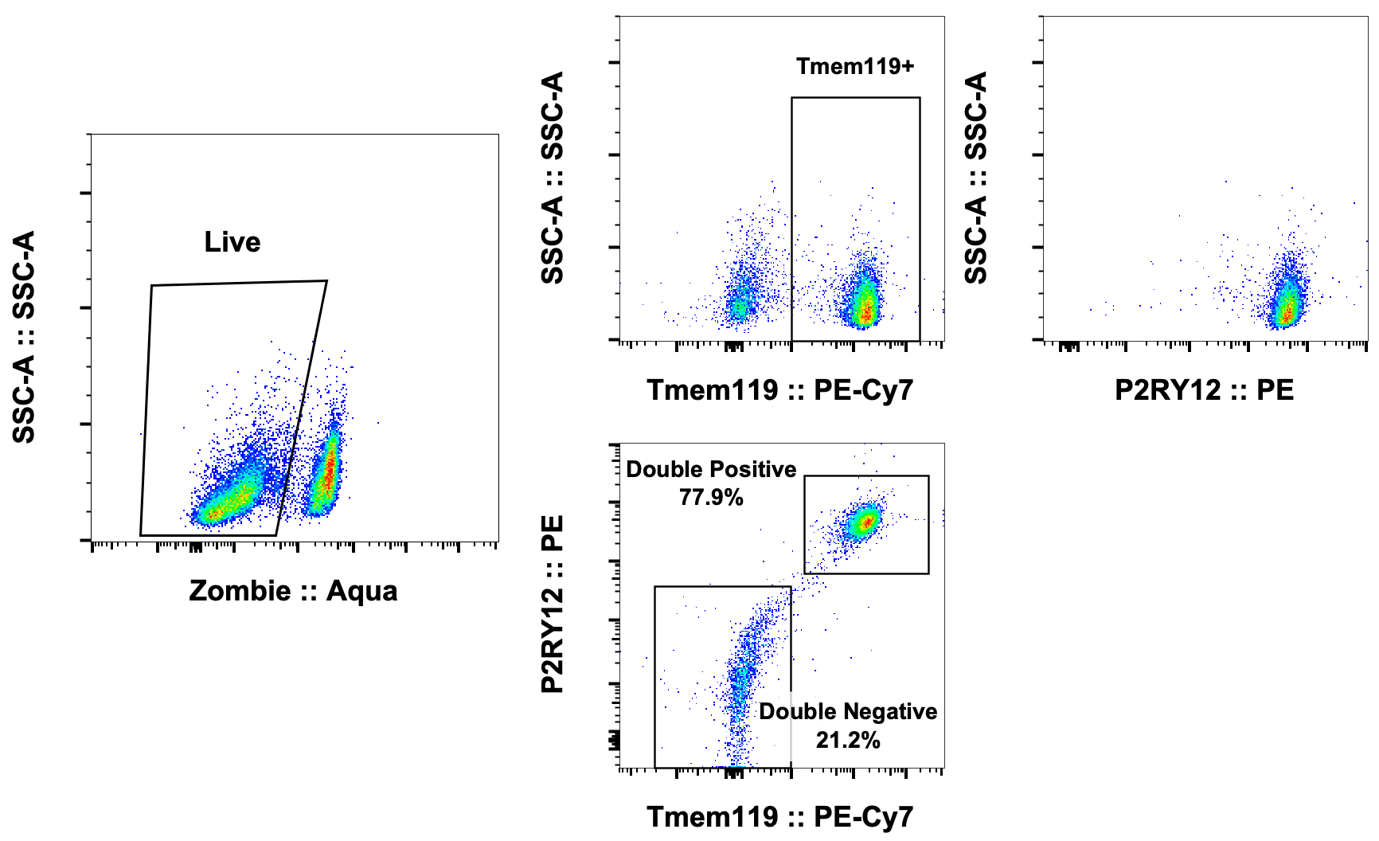
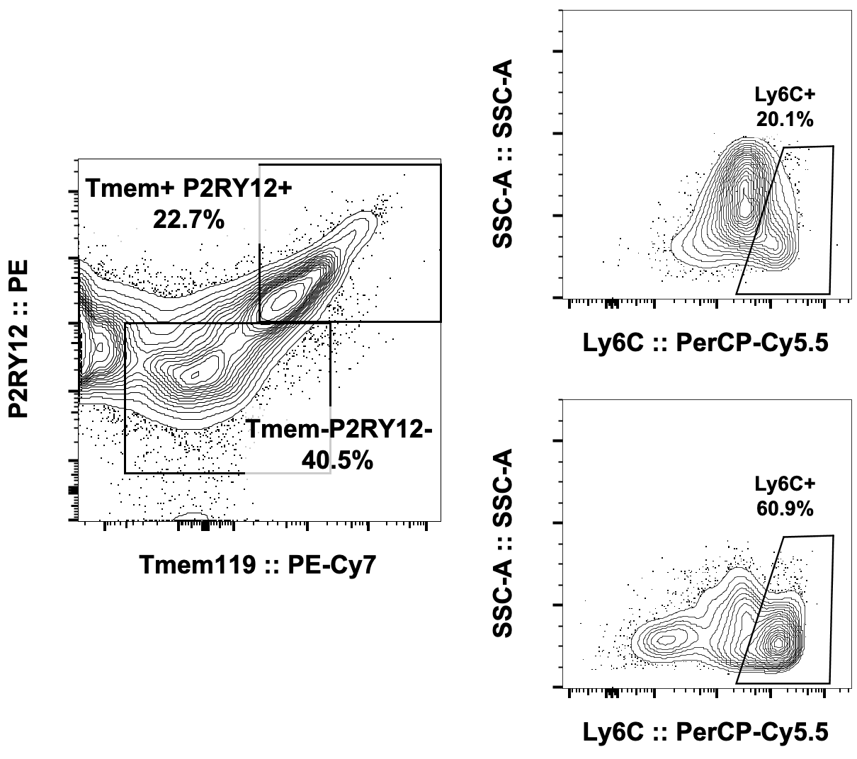
Supplementary Fig 2.
(a)
(b)
Notes:
Supplementary Fig 2. Evaluation of LiveTmem119+ population for P2RY12 indicates that all Tmem119+ cells are P2RY12+, as well (top plots) and vice versa (bottom plots) (a). Within the CD45highCD11b+ population, a small percentage of double positive for Tmem119 and P2RY12 were Ly6C+ while the Tmem119(-)P2RY12(-) were indeed predominantly Ly6C+, suggesting their peripheral origin (b).

Slide 5
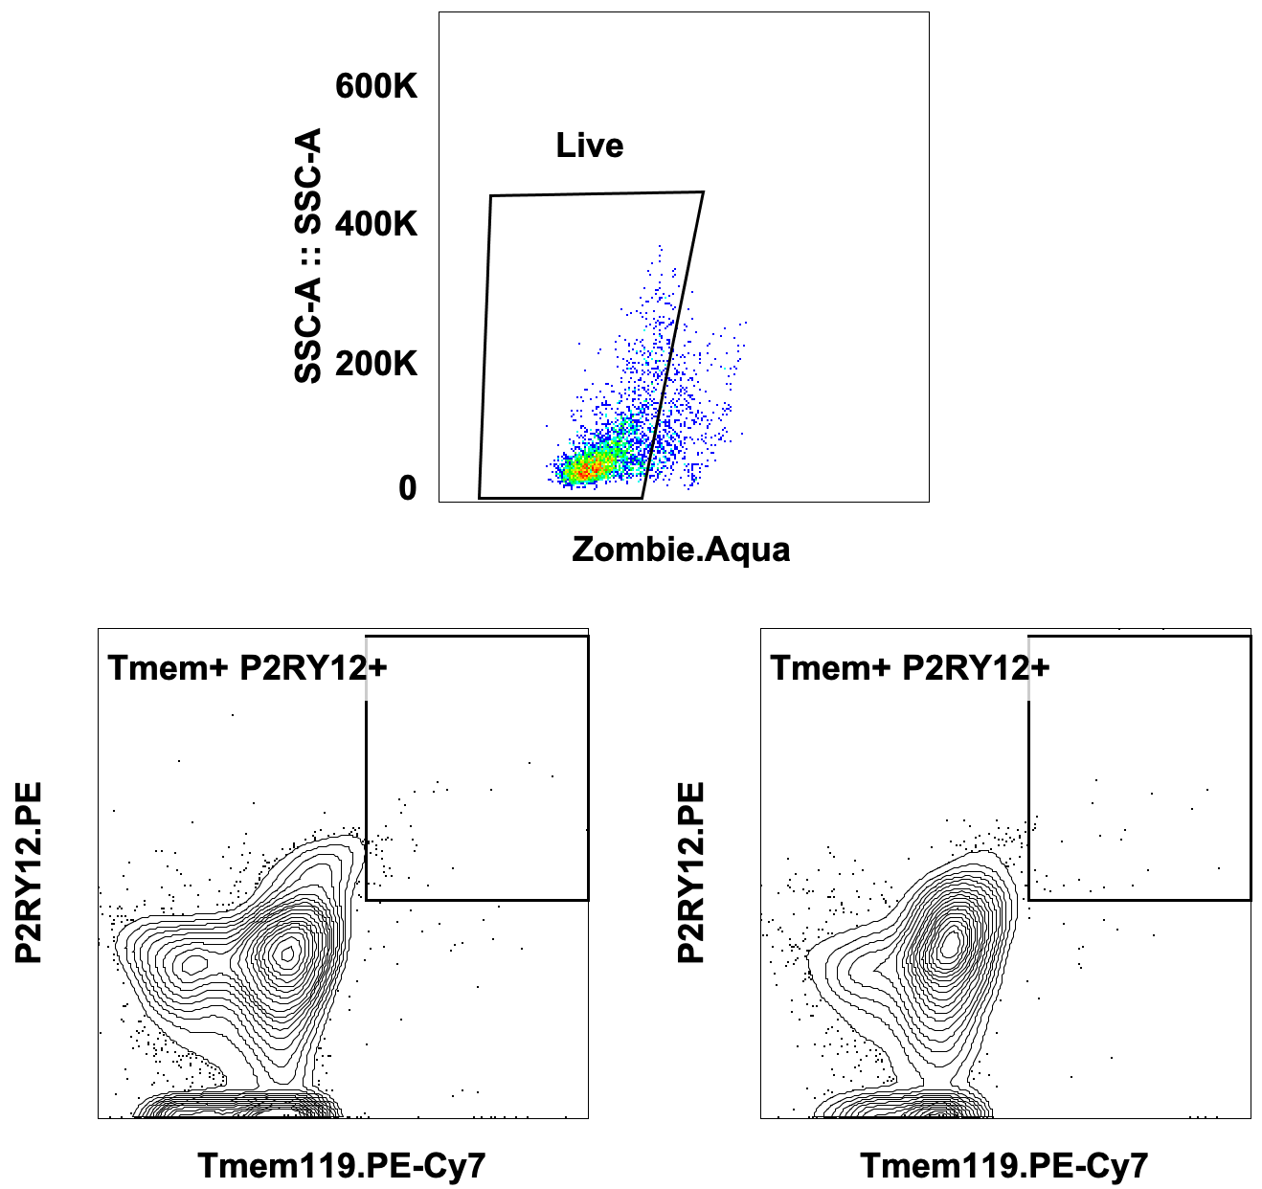
Supplementary Fig 3.
Blood
Sham
Stroke
Notes:
Supplementary Fig 3 – Blood Live cells from sham or stroke mice do not contain any significant Tmem119+P2RY12+ cells.

