Slide 1
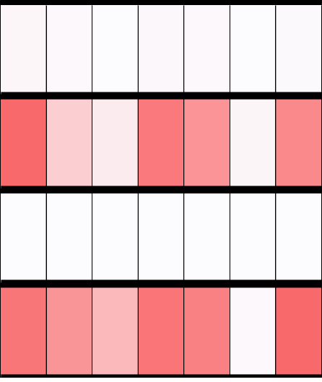
Figure S6.
Fibronectin (Fn1)
Transcript variant
1
2
3
4
5
6
7
NA
In vivo
LMD-sorted
RA
NA
In vitro
Primary
RA
(A.U.)
0
In vivo
0.3
0
In vitro
200

