Slide 1
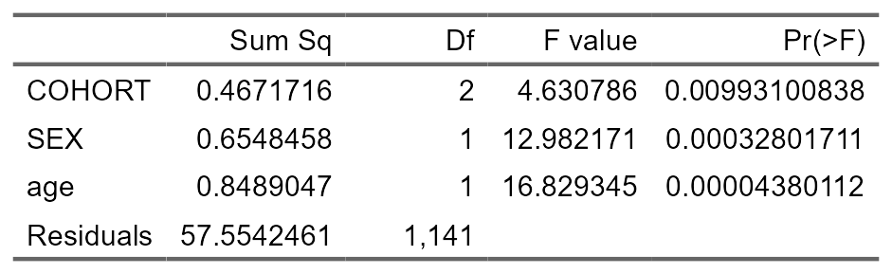
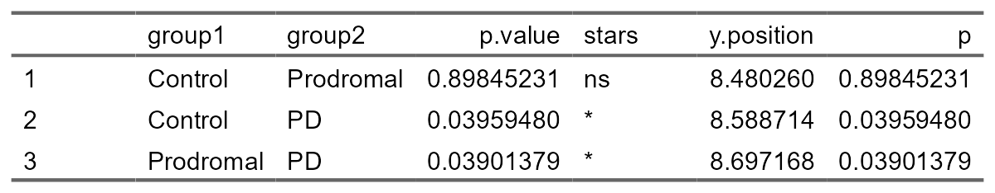
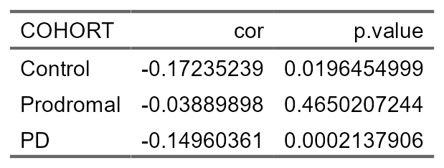
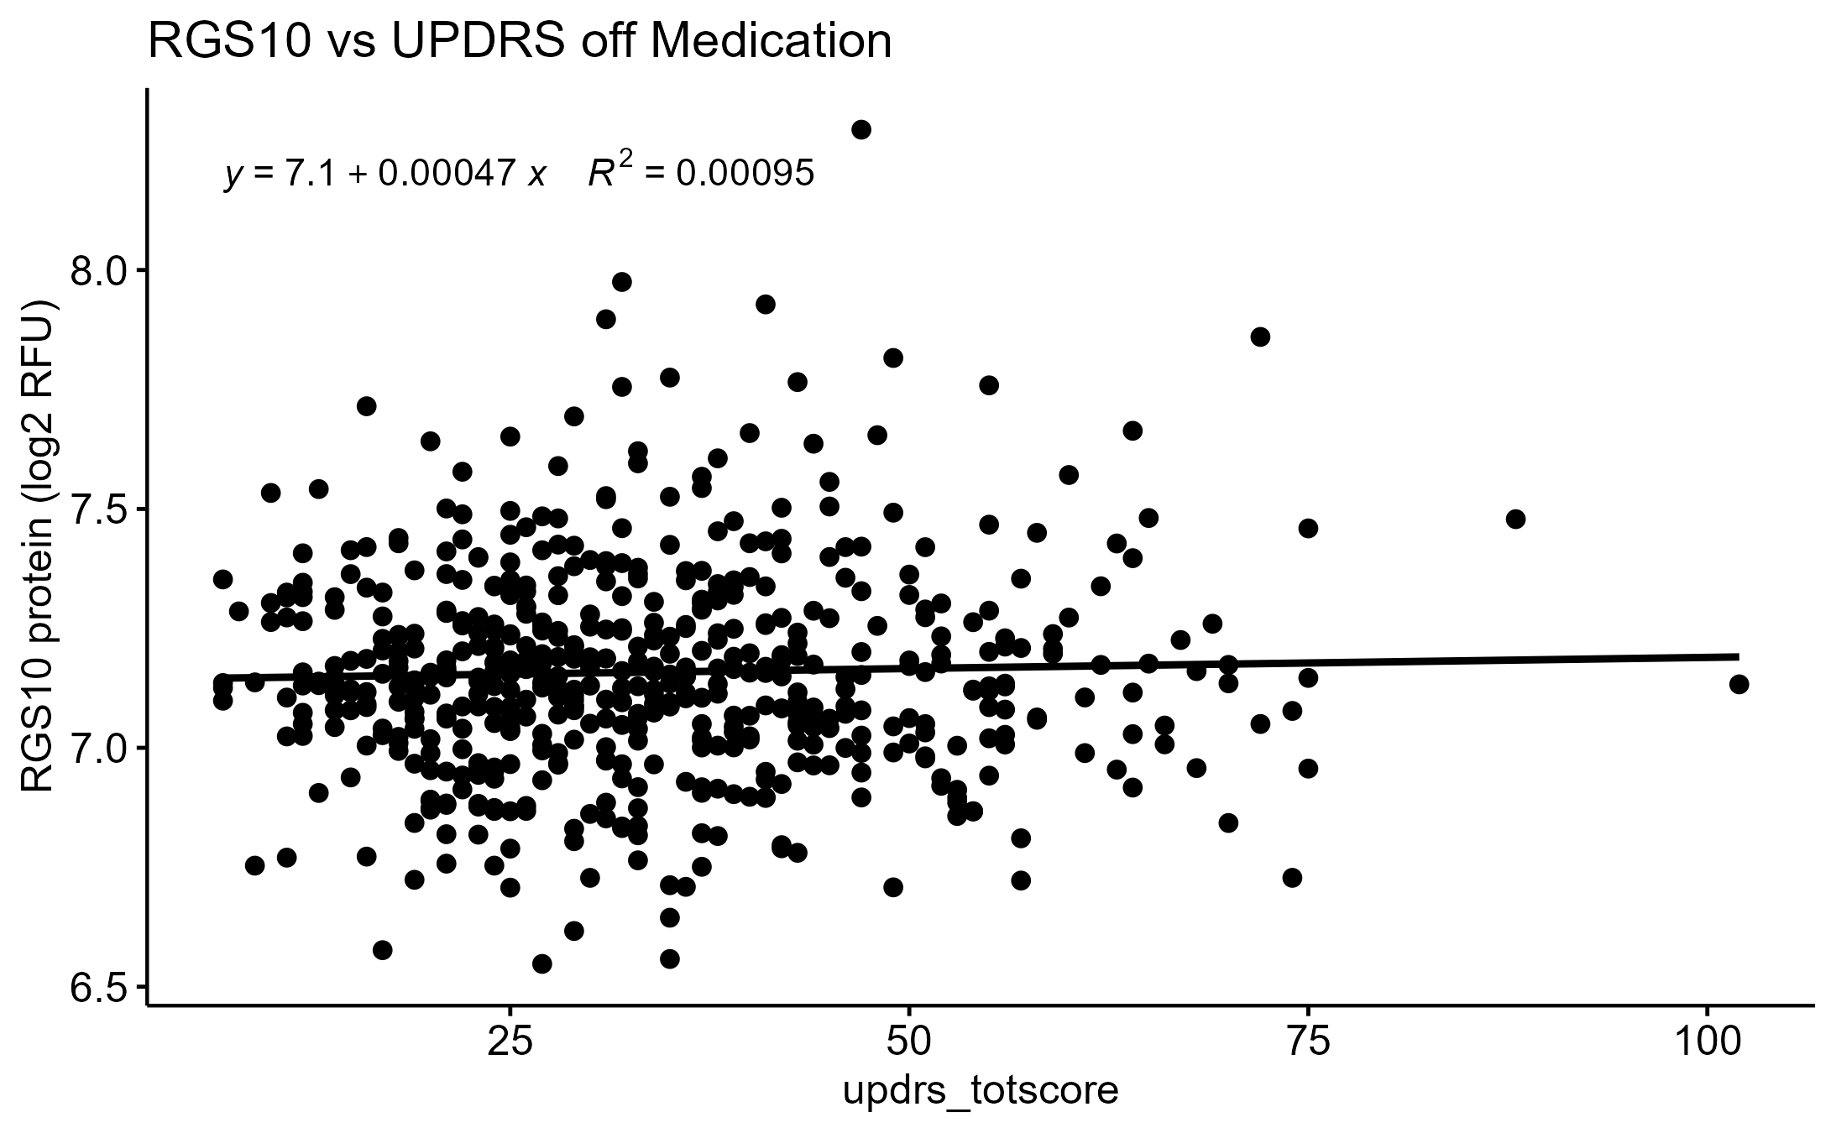
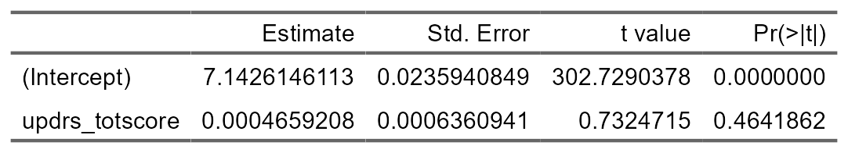
A
B
C
E
D
Group 1 | Group 1 | P Value | Stars
Control Male | Prodromal Male | 9.736e-01 | ns
Control Female | Control Male | 9.968e-01 | ns
Control Female | Prodromal Male | 8.571e-01 | ns
Control Female | PD Male | 8.391e-02 | ns
Control Male | PD Male | 1.039e-01 | ns
Prodromal Male | PD Male | 4.190e-01 | ns
Control Female | PD Female | 9.856e-01 | ns
PD Female | Control Male | 9.999e-01 | ns
PD Female | Prodromal Male | 9.761e-01 | ns
PD Female | PD Male | 2.226e-02 | *
Control Female | Prodromal Female | 9.993e-01 | ns
Prodromal Female | PD Female | 6.792e-01 | ns
Prodromal Female | Control Male | 8.999e-01 | ns
Prodromal Female | Prodromal Male | 3.281e-01 | ns
Prodromal Female | PD Male | 7.687e-05 | ***
F
G
Cohort |  | Control | Prodromal | PD
n |  | 186 | 355 | 617
PD Treatment |  | 0 | 1 | 175
Age | μ | 60.579 | 61.542 | 61.962
 | σ | 11.494 | 7.449 | 9.623
Sex | Male | 116 | 150 | 374
 | Female | 70 | 205 | 243
Supplementary Figure 1: Statistical Summary Tables for Demographics of Human Data. A) Main effect of patient cohort, sex, and age in RGS10 protein levels in the CSF. B) Table of post hoc analysis between patient cohorts of RGS10 protein levels. C) Statistical summary table for Pearson's correlation of RGS10 levels across age for each cohort. D) Statistical summary table for post hoc analysis of RGS10 levels/sex in each cohort. E) Correlation of RGS10 levels across total UPDRS scores with medication off. F) Statistical summary table for Pearson's correlation of RGS10 levels across total UPDRS scores off medication. (G) Summary of human participant demographics. PD treatment refers to individuals who are on dopaminergic medication or receiving deep brain stimulation for treating the symptoms of Parkinson’s disease.
Notes:
Inflammation markers of Interest (from lit and nanostring data)
-TNF
-IL6
-CCL2
-CD45
-CD8
-CD4
-MHCII
-LRRK2
-CXCL13
Perfusion provides false negative (loss of viability)

Slide 2
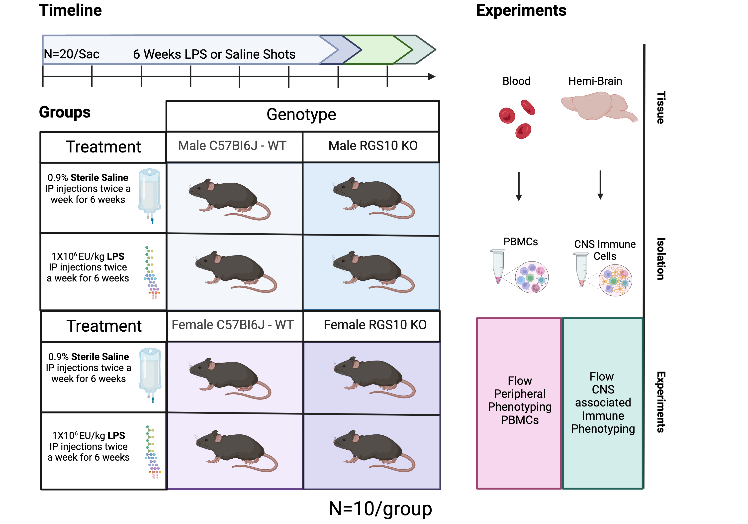
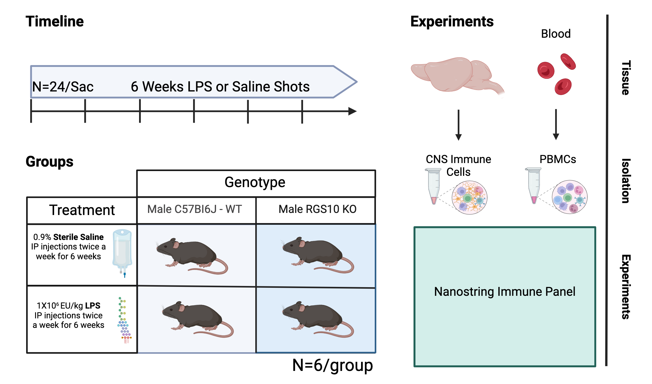
A
B
C
D
Supplemental Figure 2: Chronic systemic inflammation (CSI) paradigm experimental design schematics. A) Timeline, treatment, animals, and down-stream analyses performed for cohort 1. B) Weight of animals over the course of the CSI paradigm at each shot for cohort 1. C) Weight of spleens at harvest for each group in cohort 1. D) Timeline, treatment, animals, and down-stream analyses performed for cohort 2. Samples that are statistically different do not share the same letter. P values were P < 0.05 were considered significant. Created with BioRender.com
Notes:
Notes from Committee Meeting 5-23-24

Slide 3
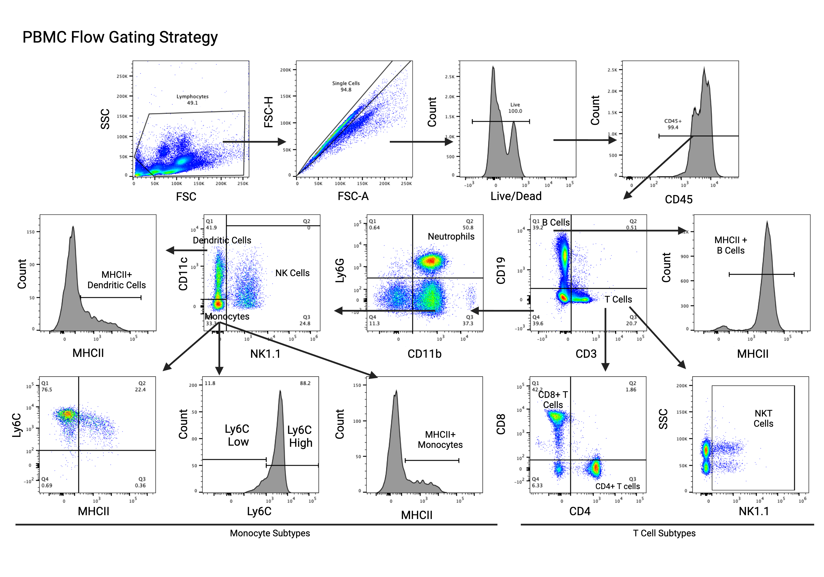
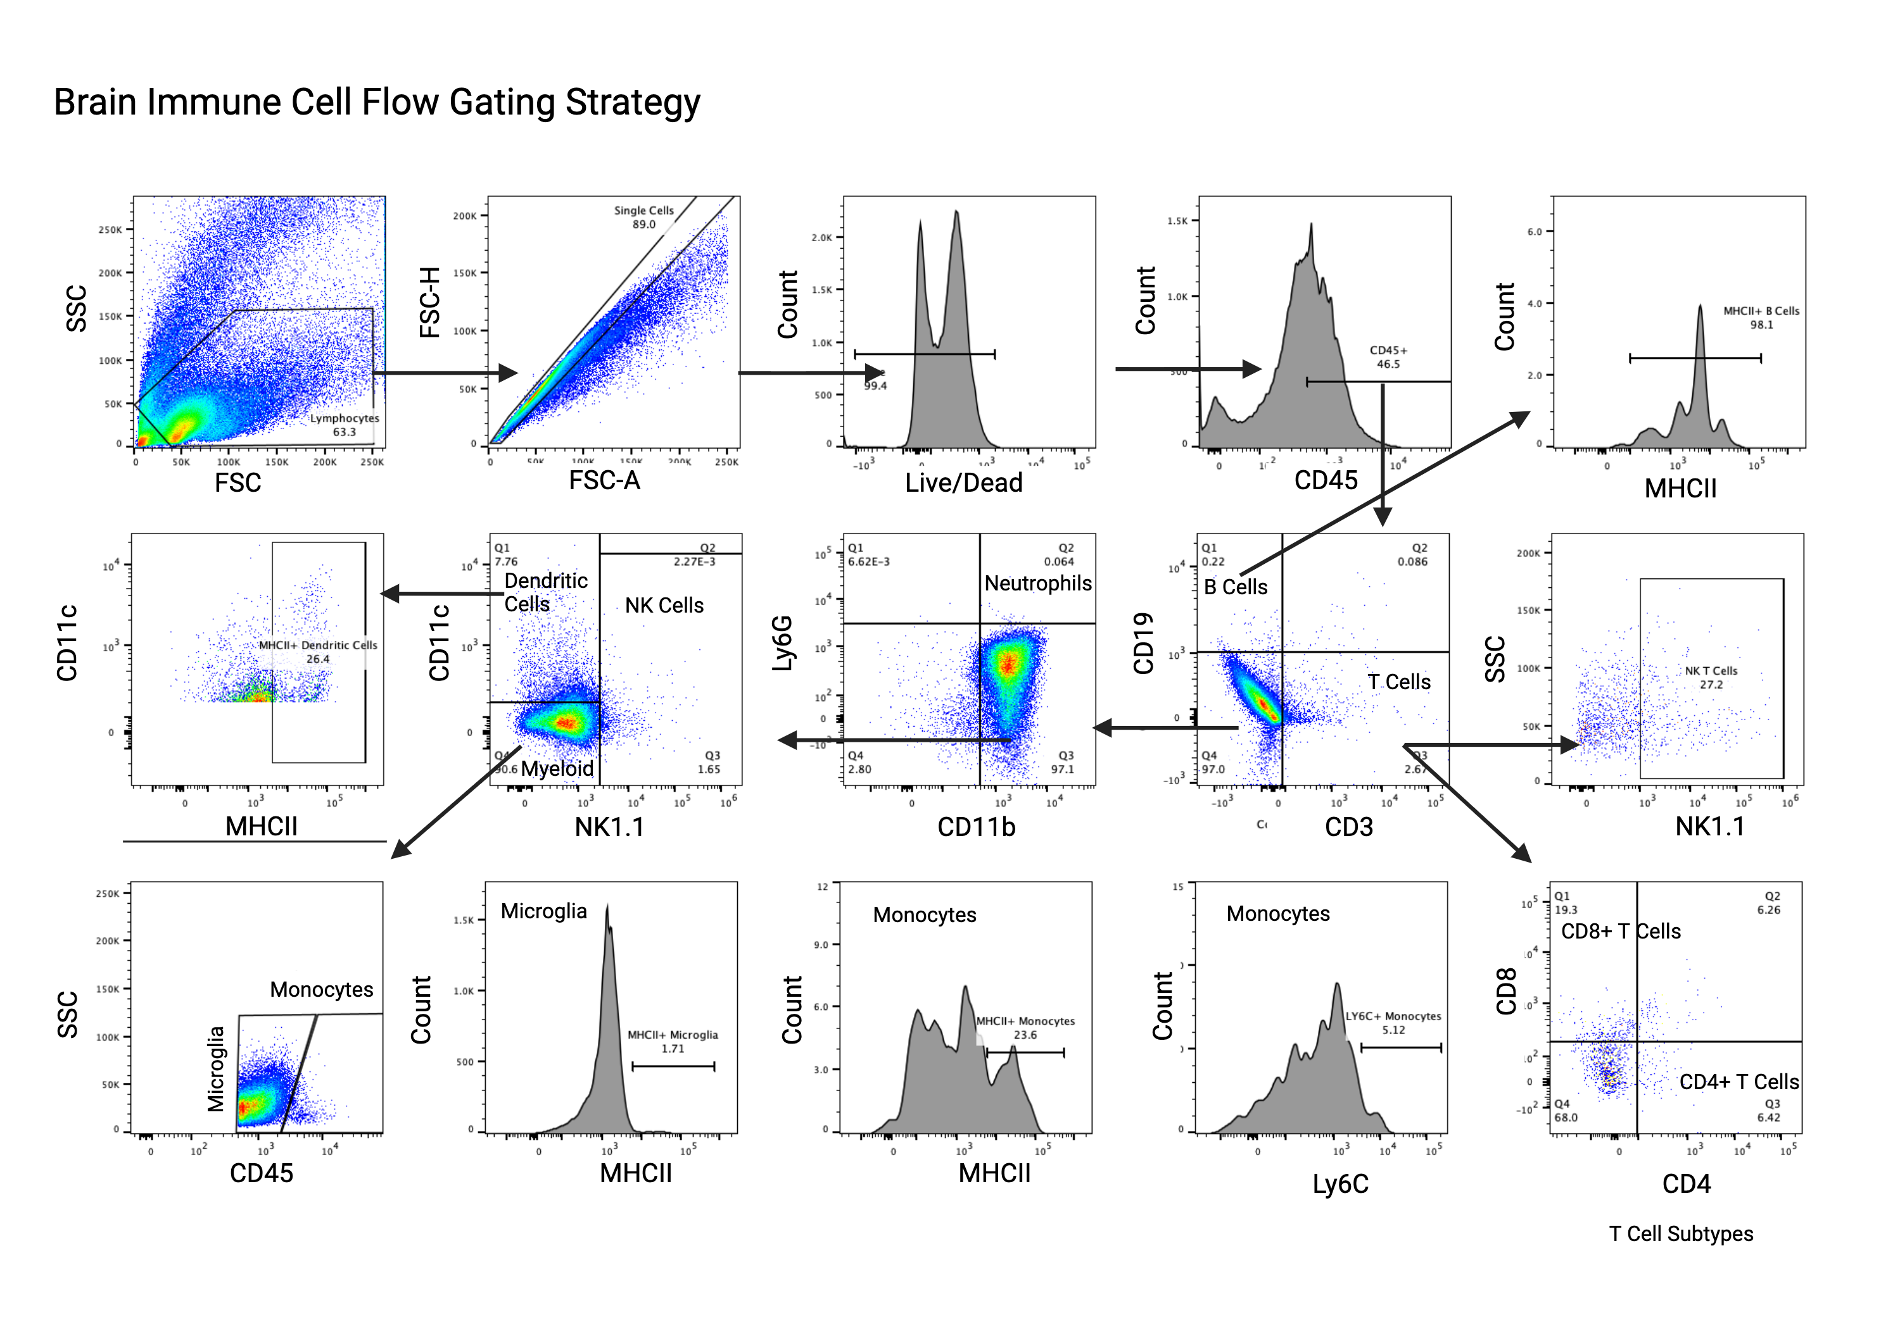
A
B
Supplemental Figure 3: Gating strategies for PBMCs and CNS-associated immune cells. A) Gating strategy for PBMCs. PBMC samples were run to capture 100,000 live events. PBMC samples that did not capture at least 70,000 events or not capture over 50,000 live CD45+ events were excluded from analyses. B) Gating strategy for CNS-associated immune cells. CNS-associated immune cell samples were run to capture 100,000 live events. CNS-associated immune cell samples that did not capture at least 70,000 events or not capture over 50,000 live CD45+ events were excluded from analyses.
Notes:
Notes from Committee Meeting 5-23-24

Slide 4
Counts of Circulating Immune Cells
Frequency and activation of PBMCs
A
B
C
D
E
F
G
H
Supplemental Figure 4: Total immune cell counts in PBMC samples. Mouse PBMCs were immunophenotyped via flow cytometry. Count of live cells in males (A) and females (E). Count of CD45+ cells in males(B) and females (F). Frequency of CD45 out of live cells in males (C) and females (G). MFI of CD45 on PBMCs in males (D) and females (H). Samples that are statistically different do not share the same letter. Significance for main effects is as follows: *p < 0.05, **p < 0.01, ***p < 0.001, ****p < 0.0001.
Notes:
Possible that BBB was restructed

Slide 5
Innate Immune cell Frequencies
Antigen Presenting Capacity
A
B
C
D
E
F
G
H
I
J
Inflammatory Monocyte subsets
L
M
N
O
P
Q
Supplemental Figure 5: Innate immune cell counts in PBMC samples. Male and female mouse PBMCs were immunophenotyped via flow cytometry. Count of natural killer cells in males (A) and females (F). Count of dendritic cells in males (B) and females (G). Count of monocytes in males (C) and females (H). Count of MHCII+ dendritic cells in males (D) and females (I). Count of MHCII+ monocytes in males (E) and females (J). Count of LY6C+ monocytes in males (L) and females (O). Count of LY6C-high monocytes in males (M) and females (P). Count of LY6C-low monocytes in males (N) and females (Q). Samples that are statistically different do not share the same letter. Significance for main effects is as follows: *p < 0.05, **p < 0.01, ***p < 0.001, ****p < 0.0001.
Notes:
Only one LPS KO phenotype in Blood flow = increased freq of dendritic cells in males
RGS10 F
-none
RGS10 M
-Increased LY6C expression
-Increased Freq of LY6C high Monocytes
-Decreased Freq of LY6C lo Monocytes
RGS10 Both
-NK Cells
LPS F
-Increased Neutrophils
-Decreased Monocytes
LPS M
-
LPS Both
-Increased DCs
-Increased Freq of MHCII+ DCs
-Increased NK cells
-Decreased expression of MHCII on Monocytes
-Decrease in LY6C expression on Monocytes
-Decreased in Freq of LY6C high monocytes
-Increase in Freq of LY6C lo Monocytes
Functional Innate Pathways effected
-Increased DC and DC AP
-Increased NK cells with treatment but less overall in Kos
-Decreased MO AP
-Increased Inflamed Male KO MOs
Make small summary table for these figures
Talk about RGS10 and NFKB relationship in dissucion
Saw the dicontamy of sexes and investigated nanostring

Slide 6
Adaptive Immune Cell Frequencies
A
B
C
D
T Cell Subsets
E
F
G
H
I
J
K
L
Supplemental Figure 6: Adaptive immune cell counts in peripheral blood. Male and female mice PBMCs were immunophenotyped via flow cytometry. A & C) Count of B cells. B & D) Count of T cells. Count of CD4+ cells in males (E) and females (I). Count of CD8+ cells in males (F) and females (J). Ratio of CD8/CD4 counts in males (G) and females (K). Counts of NK1.1+ cells in males (H) and females (L). Samples that are statistically different do not share the same letter. Significance for main effects is as follows: *p < 0.05, **p < 0.01, ***p < 0.001, ****p < 0.0001
Notes:
RGS10 F
-none
RGS10 M
-Less CD3 on T cells
-Less CD4 on T cells
-Less CD8 on T Cells
RGS10 Both
-Less CD19 on B Cells
-Less CD4+ T Cells
LPS F
-more CD45 in F
-Increased T cells in F
LPS M
-Increased MHCII on M B cells
-Decreased CD8 in M
LPS Both
-decreased B cells in M and F
-Increased NKT in M and F

Slide 7
Adaptive Immune Cell Frequencies
A
B
C
D
T Cell Subsets
E
F
G
H
I
J
Supplemental Figure 7: Geometric mean fluorescent Intensity (MFI) of adaptive immune cells in the peripheral circulation. Male and female mice PBMCs were immunophenotyped via flow cytometry A & C) MFI of CD19 on B cells. B & D) MFI of CD3 on T cells. MFI of CD4 on T cells in males (E) and females (H). MFI of CD8 on T cells in males (F) and females (I). MFI of NK1.1 on T cells in males(G) and females (J). H-J). Samples that are statistically different do not share the same letter. Significance for main effects is as follows: *p < 0.05, **p < 0.01, ***p < 0.001, ****p < 0.0001.
Notes:
RGS10 F
-none
RGS10 M
-Less CD3 on T cells
-Less CD4 on T cells
-Less CD8 on T Cells
RGS10 Both
-Less CD19 on B Cells
-Less CD4+ T Cells
LPS F
-more CD45 in F
-Increased T cells in F
LPS M
-Increased MHCII on M B cells
-Decreased CD8 in M
LPS Both
-decreased B cells in M and F
-Increased NKT in M and F

Slide 8
Count of Live CNS-associated Immune Cells
A
B
Count of CD45+ CNS-associated Immune Cells
C
D
Supplemental Figure 8: Total CNS-associated immune cell counts. Mouse CNS-associated immune cells were immunophenotyped via flow cytometry. Count of live cells in males (A) and females (B). Count of CD45+ cells in males (C) and females (D). Samples that are statistically different do not share the same letter. Significance for main effects is as follows: *p < 0.05, **p < 0.01, ***p < 0.001, ****p < 0.0001.
Notes:
Possible that BBB was restructed

Slide 9
Innate Immune Cell Frequencies
A
B
C
D
E
F
G
H
Antigen Presenting Frequency
Activated Monocytes
I
J
K
O
L
M
N
P
Supplemental Figure 9: Counts of Innate immune cells in the CNS. Male and female mouse CNS-associated immune cells were immunophenotyped via flow cytometry. A & E) Count of dendritic cells out of CD45+ cells. B & F) Count of natural killer cell out of CD45+ cells. I & L) Count of MHCII+ dendritic cells. J & M) Count of MHCII+ monocytes. K & N) Count of MHCII+ microglia. O & P) Count of LY6C+ monocytes. Significance for main effects is as follows: *p < 0.05, **p < 0.01, ***p < 0.001, ****p < 0.0001.
Notes:
cytokines completment Decrease trafficing of meyloid cells Increased Il10 receptors Increased TLR and RIG1 signaling pathways actiavtion and trafficing of lymphocytes Impaired lympohcyte engagement
Be prepared to explain why we don’t have staining
RGS10 dyresulation immune cell frequencies – dysregulation of immune cells (cannoncal relationship is lost) chaotic response
RGS10 deficicny dysregulates immunity in the brain with CSI
RGS10 is a critical regulator of central peripheral crosstalk and immune frequencies in response to chronic inflammatory stress

Slide 10
Adaptive Immune Cell Frequencies
A
B
C
D
T Cell Subsets
E
F
G
H
I
J
K
L
Supplemental Figure 10: Counts of CNS-associated adaptive immune cells. Male and female mice CNS-associated immune cells were immunophenotyped via flow cytometry. A & C) Count of B cells. B & D) Count of T cells. Count of CD4+ cells in males (E) and females (I). Count of CD8+ cells in males (F) and females (J). Ratio of CD8/CD4 counts in males (G) and females (K). Counts of NK1.1+ cells in males (H) and females (L). Samples that are statistically different do not share the same letter. Significance for main effects is as follows: *p < 0.05, **p < 0.01, ***p < 0.001, ****p < 0.0001.
Notes:
RGS10 F
-none
RGS10 M
-Less CD3 on T cells
-Less CD4 on T cells
-Less CD8 on T Cells
RGS10 Both
-Less CD19 on B Cells
-Less CD4+ T Cells
LPS F
-more CD45 in F
-Increased T cells in F
LPS M
-Increased MHCII on M B cells
-Decreased CD8 in M
LPS Both
-decreased B cells in M and F
-Increased NKT in M and F

Slide 11
A
B
DEGs in the Blood
C
D
DEGs in the Brain
Supplemental Figure 11: Differentially expressed genes (DEGs) within LPS treatment and RGS10 KO genotype in the brain-associated immune cells and PBMCs of male mice. RNA from mouse PBMCs and brain immune cells were run on the Nanostring nCounter immune panel. A) Volcano plot of DEGs of RGS10 KO Saline vs B6 LPS. In PBMCs B) Volcano plot of DEGs of RGS10 LPS vs RGS10 KO Saline in PBMCs. C) Volcano plot of DEGs of RGS10 KO LPS vs B6 LPS in brain immune cells. D) Volcano plot of DEGs of RGS10 LPS vs RGS10 KO Saline in brain immune cells.
Notes:
Massive upregulation of NK cytotoxicity
Shift to M1 phenotype
Impaired lymphocyte differentiation/maturation
Impaired lymphocyte engagement and activation
Inflammation markers of Interest (from lit and nanostring data)
-TNF
-IL6
-CCL2
-CD45
-CD8
-CD4
-MHCII
-LRRK2
-CXCL13

Slide 12
Antibody | Dilution | Laser | Filter | Color | Animal | Isotype | Clone | Company | Catalog
CD3 | 1-100 | 561 | 610/20 600LP | PE-eflour 610 | Armenian Hamster anti Mouse | IgG | 145-2C11 | Thermo Fisher Scientific | 61-0031-82
CD4 | 1-200 | 637 | 780-60 750LP | APC-Cy7 | Rat anti Mouse | IgG2b k | GK1.5 | BioLegend | 100414
CD8a | 1-100 | 405 | 780-60 750LP | Brilliat Violet 786 | Rat anti Mouse | IgG2a k | 53-6.7 | BD Biosciences | 563332
CD11b | 1-100 | 355 | 820/60 770LP | Brilliant Ultraviolet 805 | Rat anti Mouse | IgG2b k | M1/70 | BD Biosciences | 741934
CD11c | 1-50 | 637 | 670/30 635LP | Alexa Flour 647 | Armenian Hamster anti Mouse | IgG | N418 | BioLegend | 117312
CD19 | 1-50 | 355 | 670/30 635LP | Brilliant Ultraviolet 661 | Rat anti Mouse | IgG2a k | 1D3 | BD Biosciences | 565076
CD45 | 1-20 CNS 1-200 Periphery | 488 | 515/20 505LP | FITC | Rat anti Mouse | IgG2b k | 30-F11 | BioLegend | 103108
LY6C | 1-100 | 488 | 670/30 635LP | PerCP | Rat anti Mouse | IgG2c k | HK1.4 | BioLegend | 128028
LY6G | 1-100 | 561 | 710/50 690LP | PE-Cy5.5 | Rat anti Mouse | IgG2b | RB6-8C5 | Abcam | Ab25055
MHCII | 1-100 | 405 | 610/20 600LP | Brilliant Violet 605 | Rat anti Mouse | IgG2b k | M5/114.15.2 | BioLegend | 107639
NK1.1 (CD161) | 1-50 | 405 | 710/50 690LP | SuperBright 702 | Mouse anti Mouse | IgG2a k | PK136 | Thermo Fisher Scientific | 67-5941-82
Live/Dead | 5ul/sample | 355 | 515/30 450LP | Live/Dead Fixable Blue | Anti all species | IgG | N/A | Thermo Fisher Scientific | L34962
CD16/CD32 Block | 1-20 | N/A | N/A | N/A | Rat anti mouse | IgG2aλ | 93 | Fisher Scientific | 5012440
Brilliant Stain Buffer | Diluent to bring up to volume | N/A | N/A | N/A | N/A | N/A | N/A | BD Biosciences | 563794
Table 1: Flow Antibody Cocktail. Table of Antibodies used for flow cytometry.
Notes:
Notes from Committee Meeting 5-23-24

