Slide 1
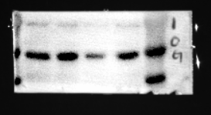
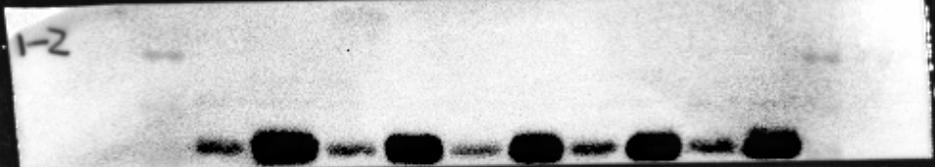
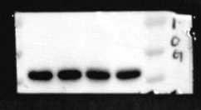
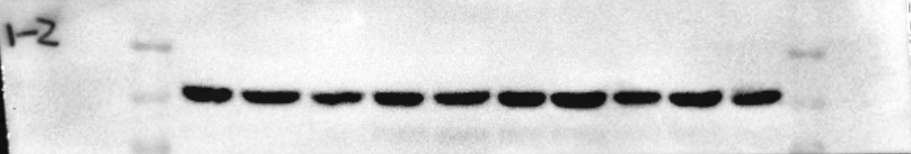
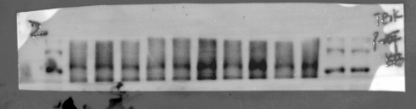
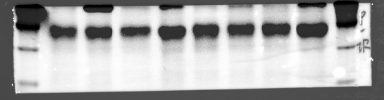
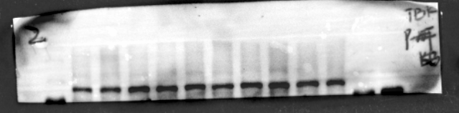
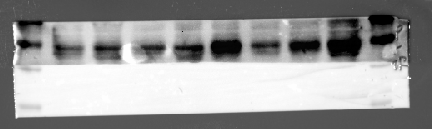
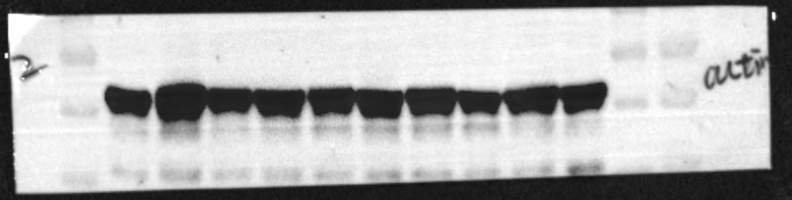
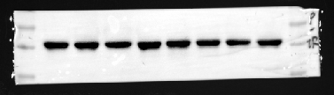
Figure 1E
Figure 1G
A C A C
A
C
A
C
A
C
A
C
A
C
------70kd
------55kd
------40kd
55kd
cGAS
STING
40kd
35kd
------70kd
------55kd
------40kd
55kd
β-actin
β-actin
40kd
35kd
Figure 1K
Figure 1I
A C A C A C A C
A C A C A C A C A C
------55kd
------40kd
------35kd
p-TBK1
-----130kd
------100kd
------70kd
p-IRF3
IRF3
------55kd
------40kd
------35kd
TBK1
-----130kd
------100kd
------70kd
------55kd
------40kd
------35kd
------55kd
------40kd
------35kd
β-actin
β-actin
A:Con C:Tg
The rectangular selected area serves as the application blots for the main text.

Slide 2
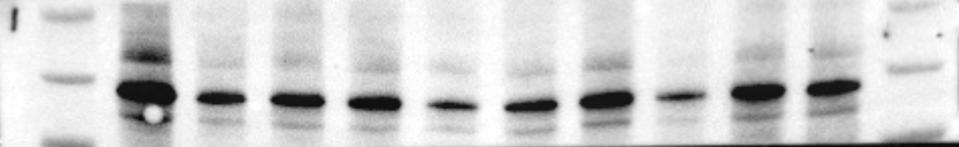
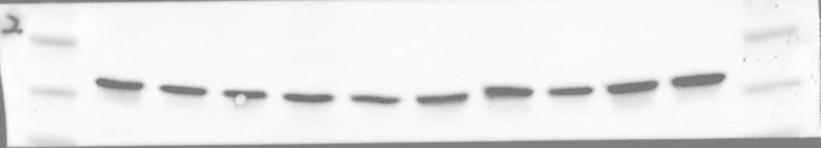
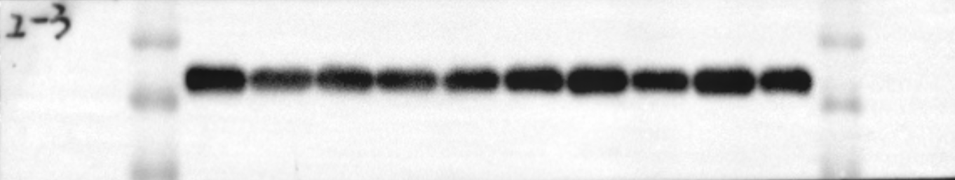
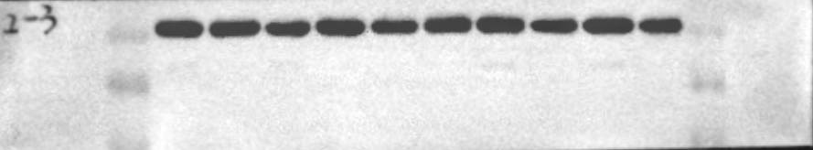
Figure 1M
A
C
A
C
A
C
A
C
A
C
PSD95
100kd
70kd
55kd
β-actin
40kd
Figure 1O
40kd
SYN
35kd
40kd
β-actin
35kd
A:Con C:Tg
The rectangular selected area serves as the application blots for the main text.

Slide 3
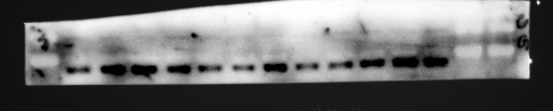
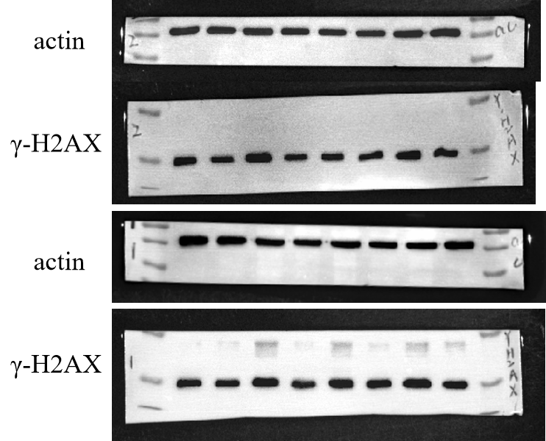

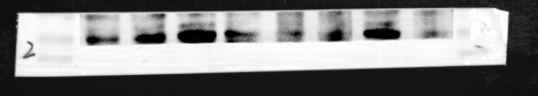

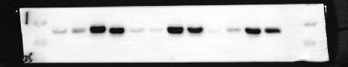
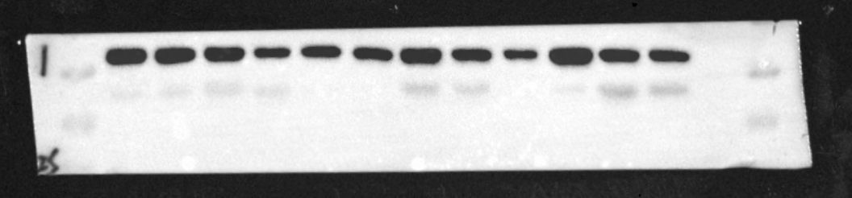
Figure 2F
Figure 2G
A B C D A B C D A B C D
------70kd
------55kd
A B C D A B C D
cGAS
------55kd
------40kd
----35kd
β-actin
------40kd
-
A B C D A B C D
------25kd
------15kd
------10kd
cGAS
------55kd
------40kd
β-actin
------55kd
------40kd
------55kd
------40kd
------35kd
A B C D A B C D A B C D
STING
------40kd
------35kd
------25kd
------15kd
------10kd
β-actin
------40kd
------35kd
A:Con; B:Con+RU.521; C:Tg; D:Tg+RU.521; X:other experiment;

Slide 4


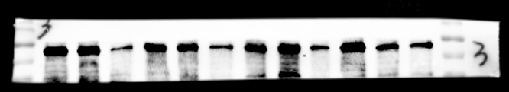
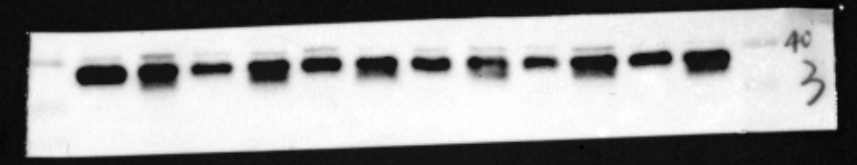
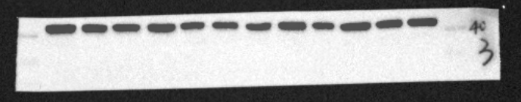
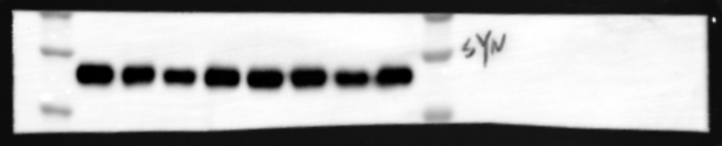

Figure 2W
A B C D A B C D
-----130kd
------100kd
------70kd
PSD95
β-actin
------40kd
------35kd
A B C D A B C D X X X X
-----130kd
------100kd
------70kd
PSD95
------40kd
------35kd
SYN
β-actin
------40kd
------35kd
A B C D A B C D
------55kd
------40kd
------35kd
SYN
------55kd
------40kd
------35kd
β-actin
A:Con; B:Con+RU.521; C:Tg; D:Tg+RU.521; X:other experiment;

Slide 5

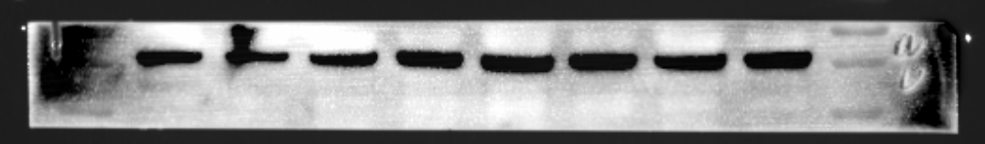
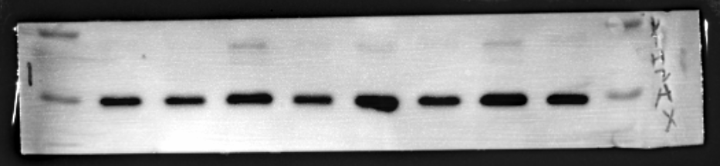

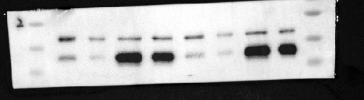
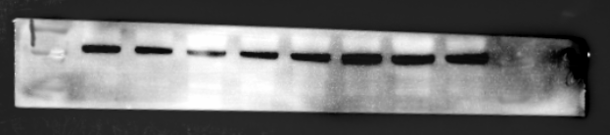
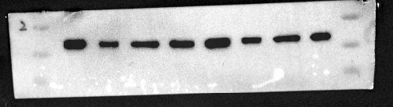
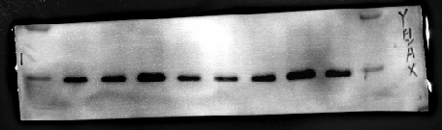
Figure 3B
Figure 3D
A B C D A B C D
A B C D A B C D
------55kd
------40kd
------35kd
STING
------40kd
------35kd
β-actin
------25kd
------15kd
β-actin
------40kd
-
------35kd
γ-H2AX
------55kd
------40kd
------35kd
STING
------55kd
------40kd
------35kd
β-actin
------55kd
------40kd
------35kd
β-actin
------25kd
------15kd
γ-H2AX
A:Con; B:Con+H151; C:Tg; D:Tg+H151

Slide 6
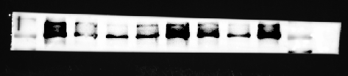
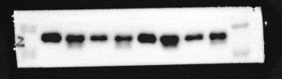

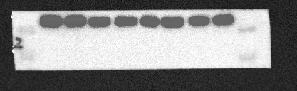
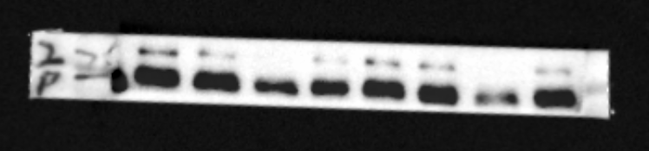
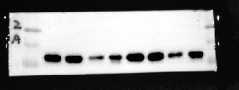
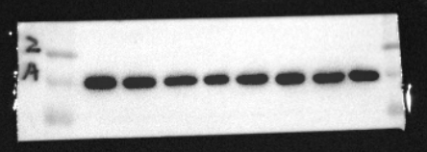
Figure 3T
A B C D A B C D
PSD95
------100kd
------70kd
SYN
------40kd
------35kd
------55kd
------40kd
------35kd
β-actin
β-actin
------40kd
------35kd
PSD95
------100kd
------70kd
------55kd
------40kd
------35kd
SYN
------55kd
------40kd
------35kd
β-actin
A:Con; B:Con+H151; C:Tg; D:Tg+H151

Slide 7

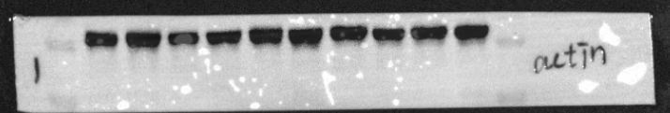
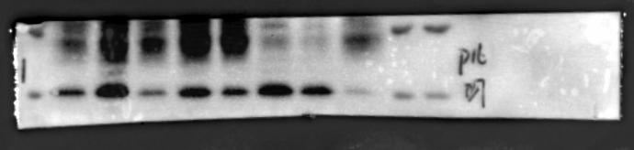
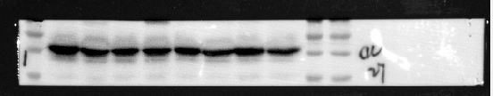
Figure 5D
A C A C A C A C A C
P53
------70kd
------55kd
β-actin
------40kd
------35kd
Figure 5F
A C A C A C A C
------25kd
-----15kd
P16
β-actin
------55kd
------40kd
------35kd
A:Con C:Tg
The rectangular selected area serves as the application blots for the main text.

Slide 8
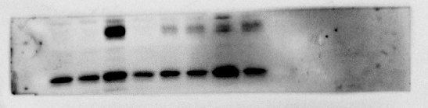
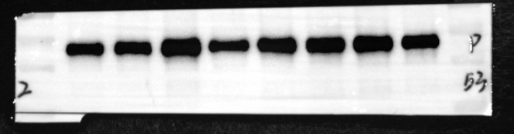
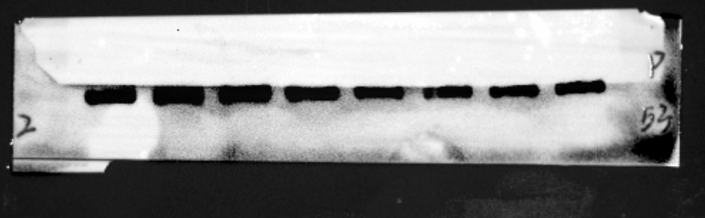
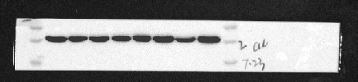
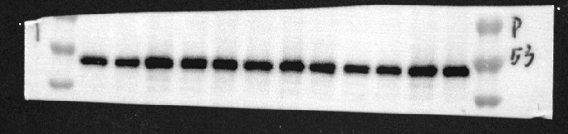
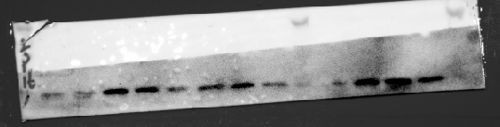
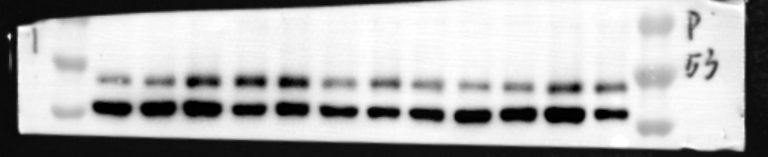
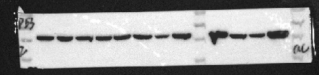
Figure 6E
A B C D A B C D
A B C D A B C D
------25kd
-----15kd
------70kd
------55kd
------40kd
P16
P53
------70kd
------55kd
------40kd
β-actin
β-actin
------55kd
------40kd
------35kd
A B C D A B C D A B C D
P53
------70kd
------55kd
------40kd
A B C D A B C D A B C D
------25kd
-
-----15kd
------70kd
------55kd
------40kd
β-actin
P16
-----70kd
------55kd
------40kd
-----35kd
β-actin
A:Con; B:Con+RU.521; C:Tg; D:Tg+RU.521; X:other experiment

Slide 9
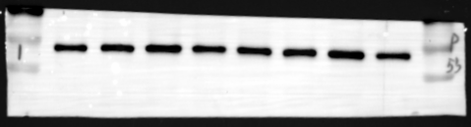
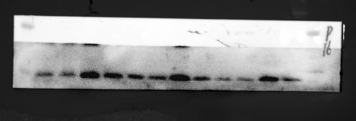
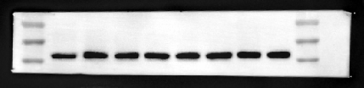
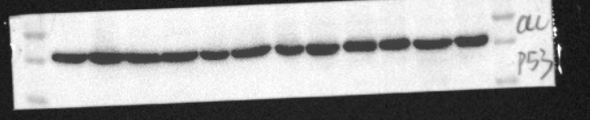



Figure 7E
A B C D A B C D
A B C D A B C D A B C D
------70kd
------55kd
------40kd
------25kd
-
-----15kd
P53
P16
β-actin
------70kd
------55kd
------40kd
------55kd
------40kd
------35kd
β-actin
P16
------25kd
-
-----15kd
------55kd
------40kd
------35kd
P53
------55kd
------40kd
------35kd
β-actin
A:Con; B:Con+H151; C:Tg; D:Tg+H151

