Slide 1
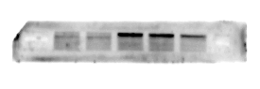
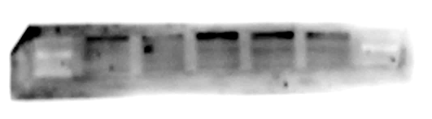
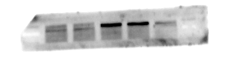
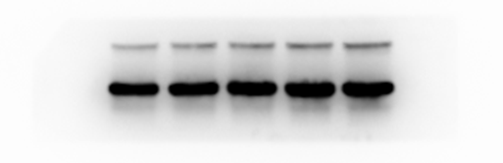
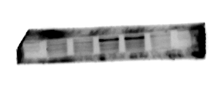
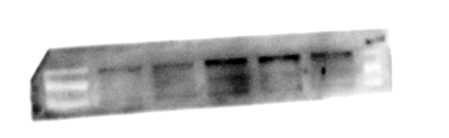

Figure.8A-p-JAK2,p-STAT3,GAPDH
① | ② | ③
④ | ⑤ | ⑥
p-JAK2
130kD
p-STAT3
85kD
GAPDH
37kD

Slide 2
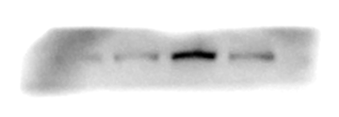
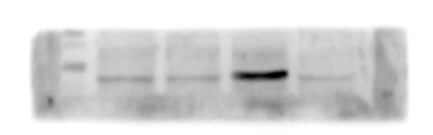
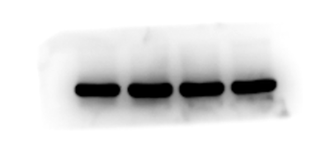
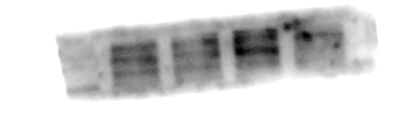
Figure.8B-p-JAK2,p-STAT3,GAPDH
① | ② | ③
④ | ⑤ | ⑥
p-JAK2
130kD
p-STAT3
85kD
GAPDH
37kD

