Slide 1
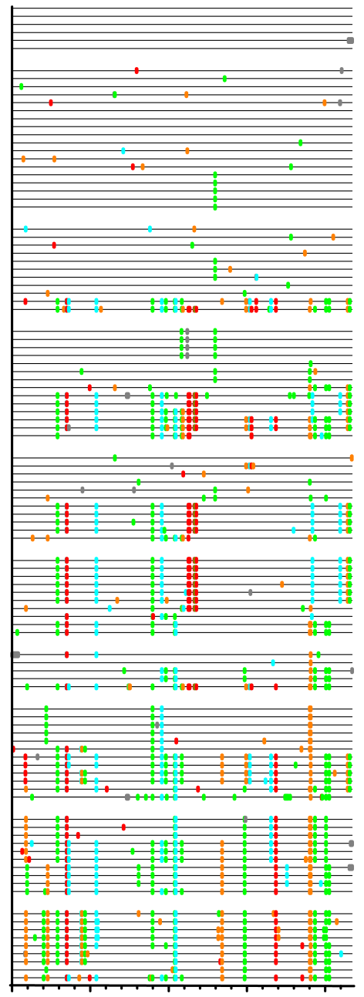
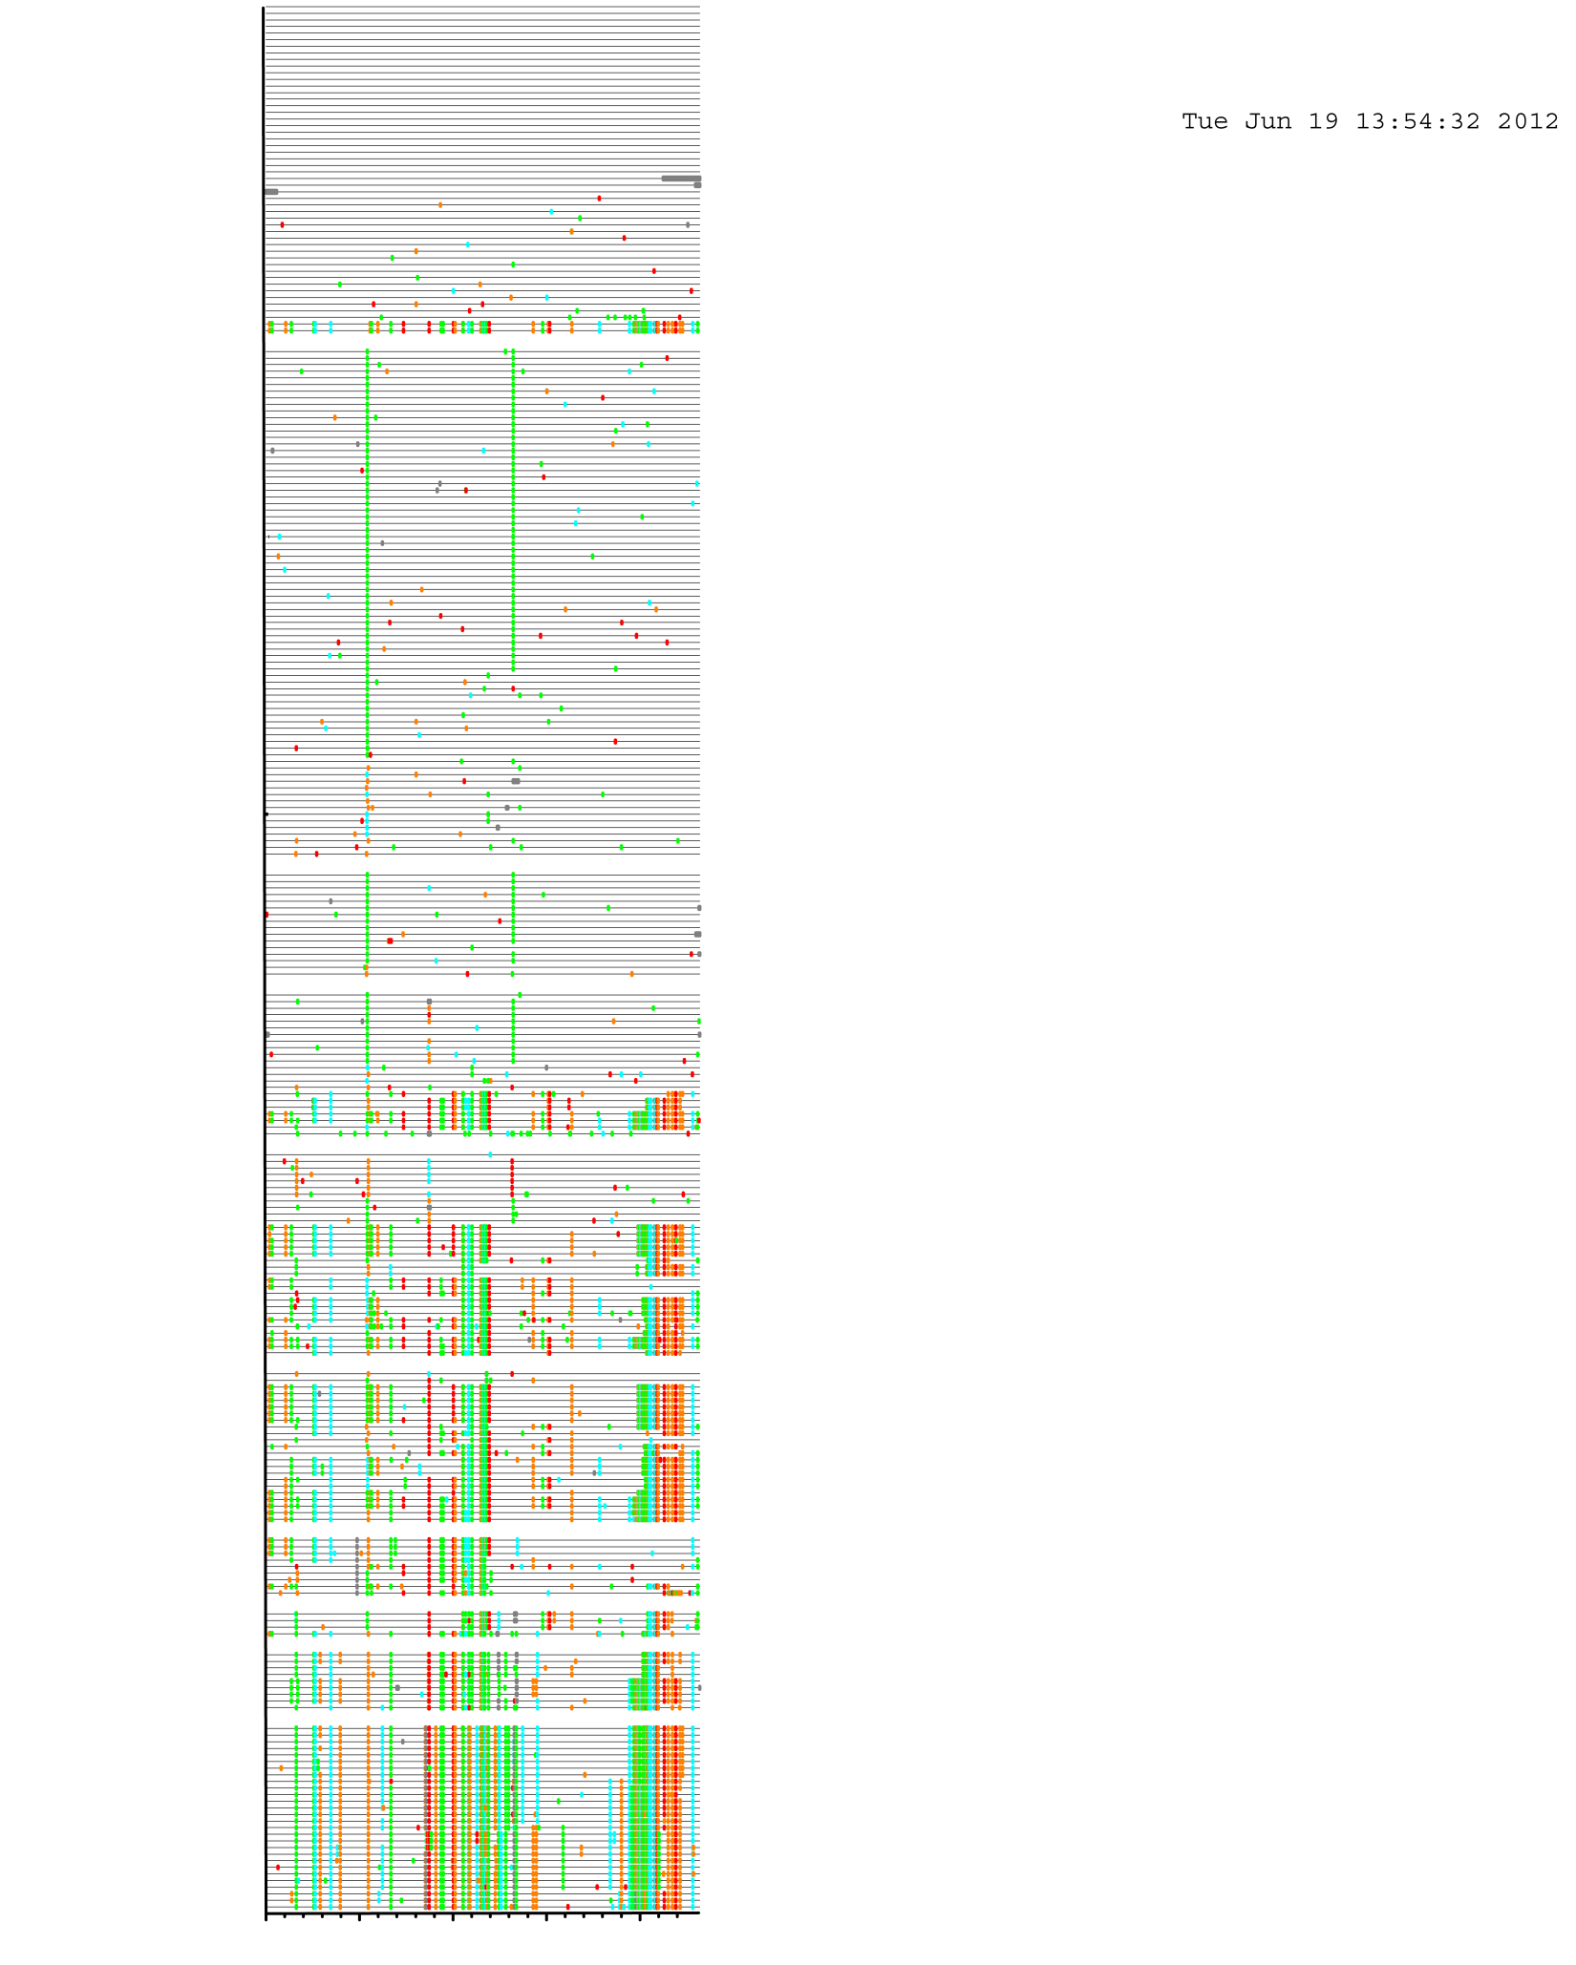

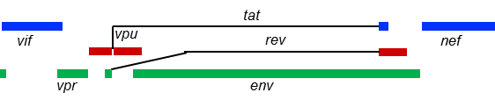
5’ half
Day post
screening
3’ half
Day post
screening
0
A
T
G
C
0
21
Gaps
minor
minor
28
35
42
21
49
134
28
197
35
442
42
49
134
197
442

