Slide 1
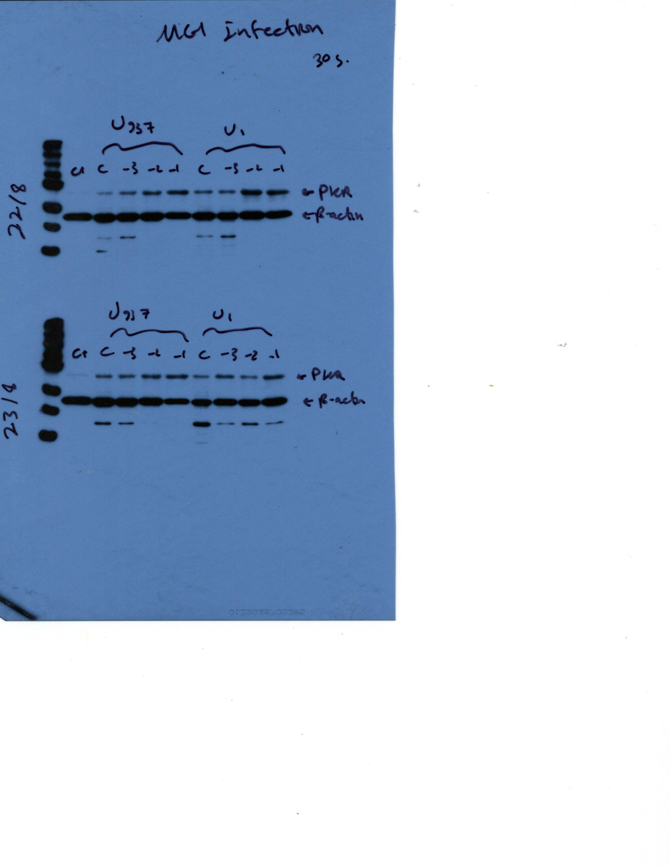
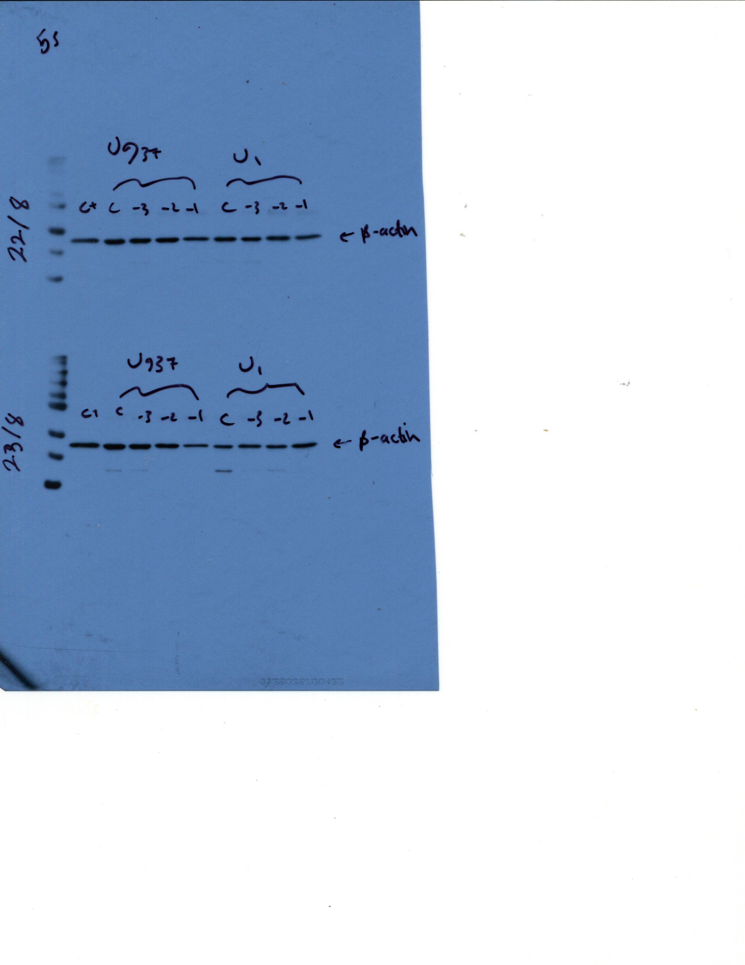


A.
U937
U1
PKR
~68kDa
β-Actin
~42kDa
B.
HL60
OM10.1
PKR
~68kDa
β-Actin
~42kDa
Notes:
Additional File 1
Constitutive PKR expression was higher in OM10.1 cells than in HL60 cells, but similar between U937 and U1 cells. Basal expression of PKR was assessed in A. U937 and U1 cells (n=5) and B. HL60 and OM10.1 cells (n=4) by Western Blot using primary (sc-6282, Santa Cruz Biotechnology, Dallas, TX, USA) and secondary antibodies (HAF007, R&D Systems, Minneapolis, MN, USA). β-actin was used as the loading control. Representative blots are shown.

