Slide 1
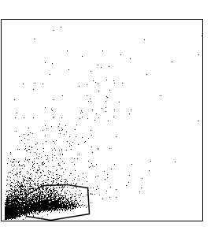
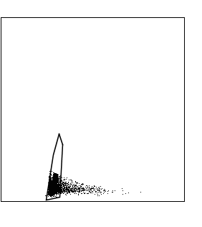
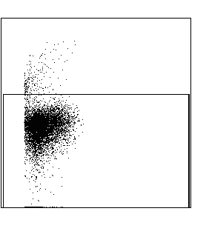
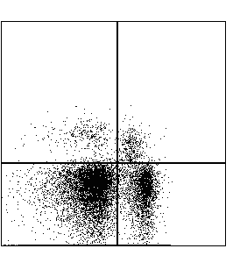
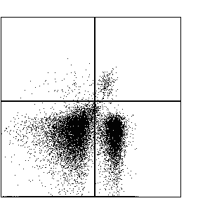
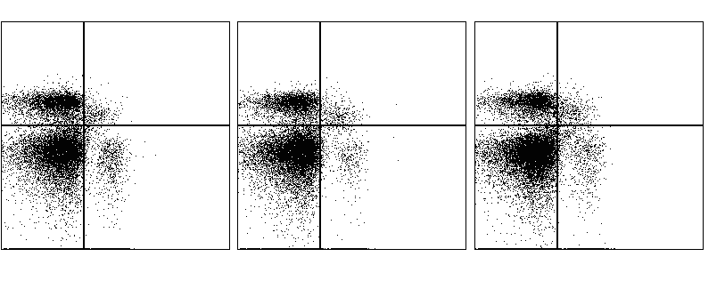
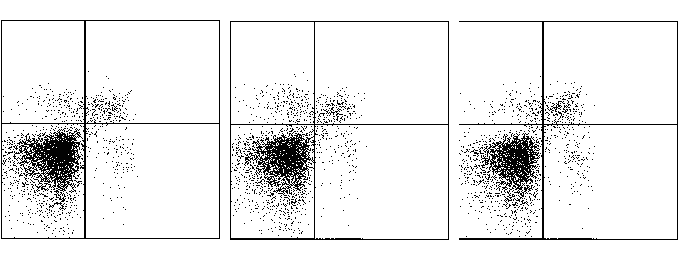
Lymphocytes
Singlets
Viable cells
3% 1%
1% 1%
SSC-A
SSC-H
viability
NK1.1
CD1d tet
62% 34%
64% 35%
FSC-A
SSC-W
FSC-A
CD3
CD3
Naive FV FV + αGalCer
38.0 1.0
30.5 1.0
27.8 1.3
CD3
57.1 4.0
66.0 2.5
67.3 3.6
1.0 1.2
0.6 1.2
1.8 1.4
CD1d tet
96.3 1.5
96.4 1.8
94.5 2.4
NK1.1

