Slide 1
50bp DNA ladder
HERV-E

Slide 2
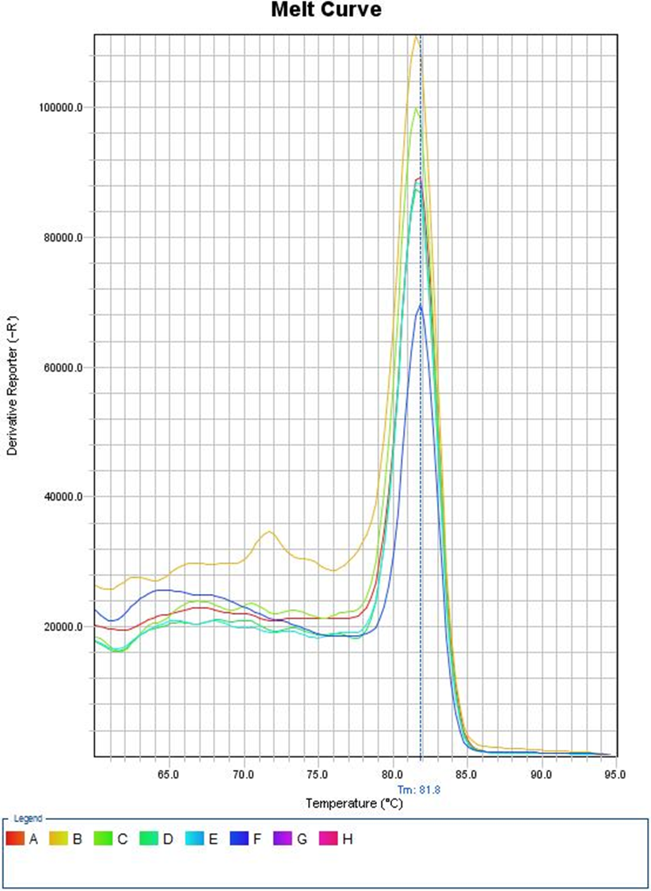
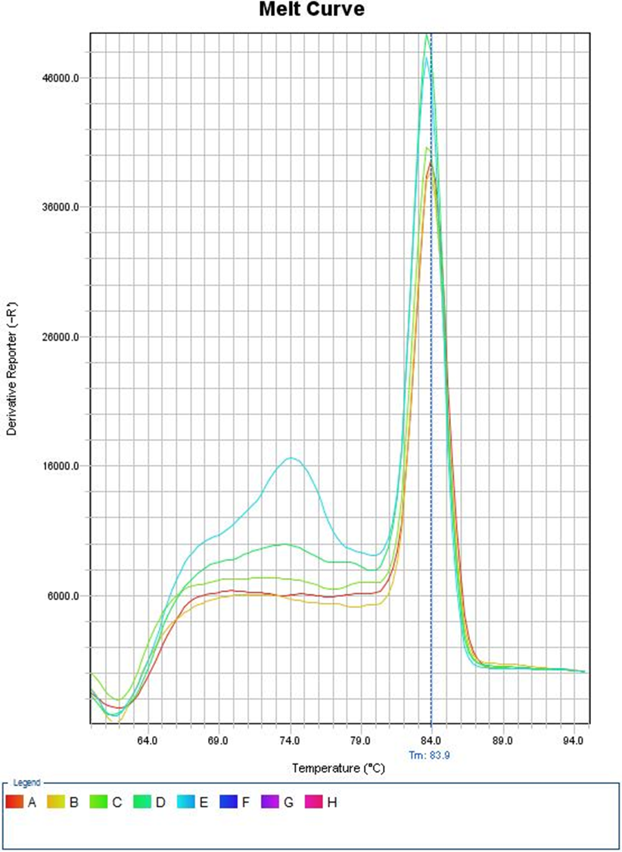
A
B

