Slide 1
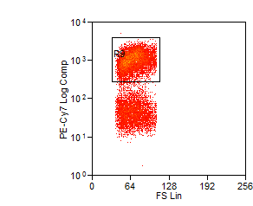
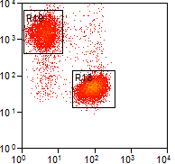
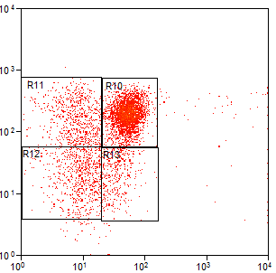
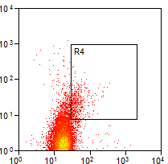
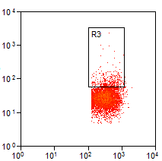
A B C
CD3
CD4
CCR7
Central memory
Naive
Effector
memory
EMRA
FS
CD8
CD45RA
D
E
Foxp3
Regulatory
T cells
PTK7
Recent thymic emigrants
CD25
CD45RA
Supplementary Figure 1. Gating strategy for T cell subset distribution.

Slide 2
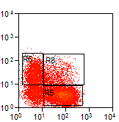
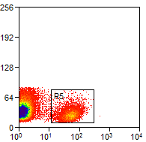
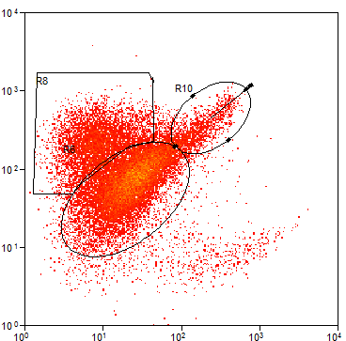
B
Switched
memory
Unswitched memory
A
Naive
FS
IgD
C
CD24
Regulatory
B cells
CD19
CD38
Supplementary Figure 2 Gating strategy for B cell subset distribution

Slide 3
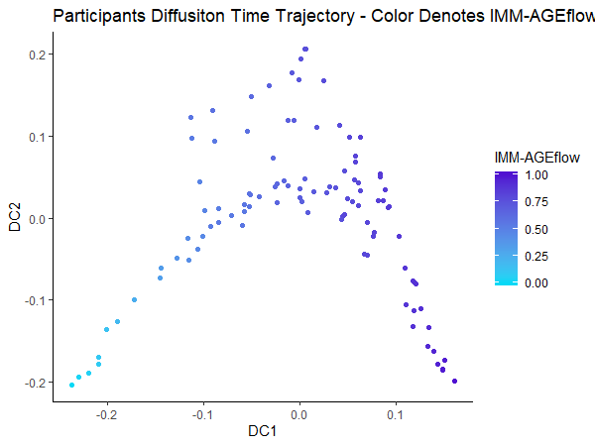
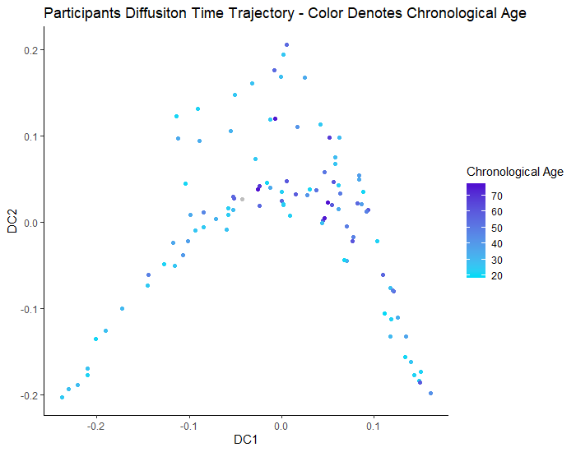
A
B
p = .02
R² = .12
p = .91
R² = .004
C
D
Supplementary Figure 3. IMM- AGE trajectory in traumatic injury patients

