Slide 1
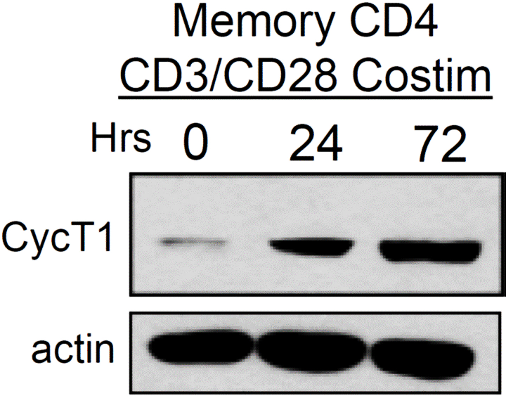
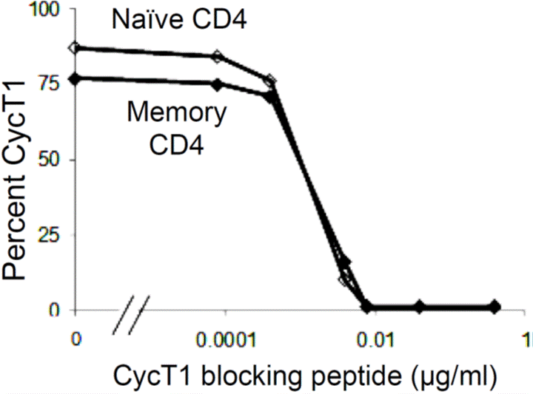
Additional file 1
A
B
Cyclin T1 expression (72 hrs Costim)

