Slide 1
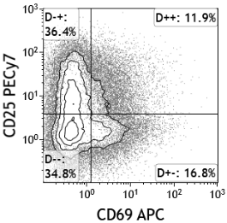
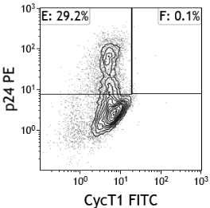
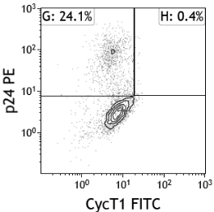
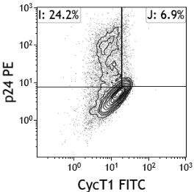
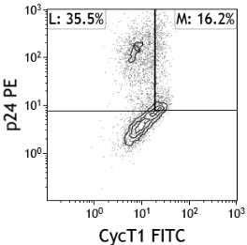
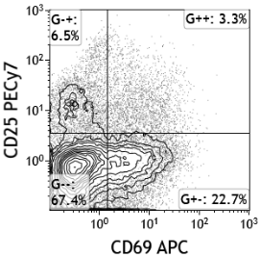
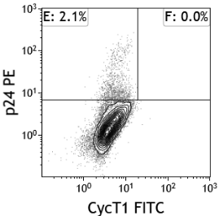
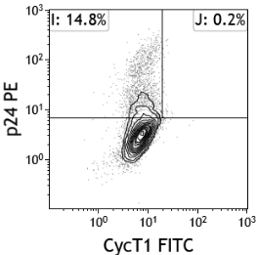
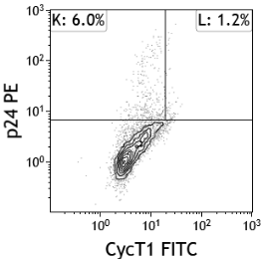
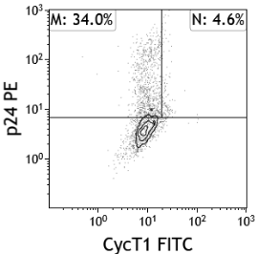
Additional file 3
A
CD3 alone
Gated on:
CD69-CD25-
CD69+CD25-
CD69-CD25+
CD69+CD25+
CD25
CD69
IL2 alone
Gated on:
CD69-CD25-
CD69+CD25-
CD69-CD25+
CD69+CD25+
CD25
CD69
B
IL2 alone
CD3 alone
*
*
*
*
*
*
*
*
*
*

