Slide 1
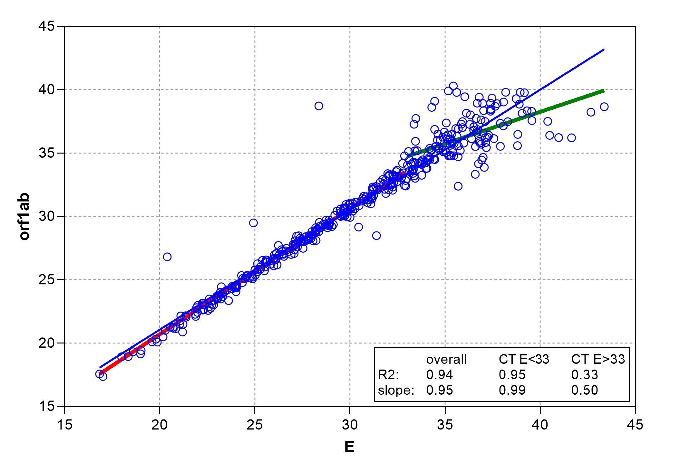
Supplemental figure 1

