Slide 1
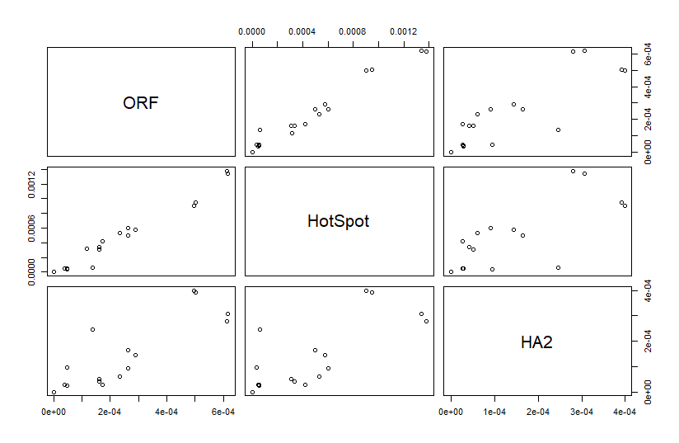
a
b
c
d
e
f
Supplementary Fig S1.

