Slide 1
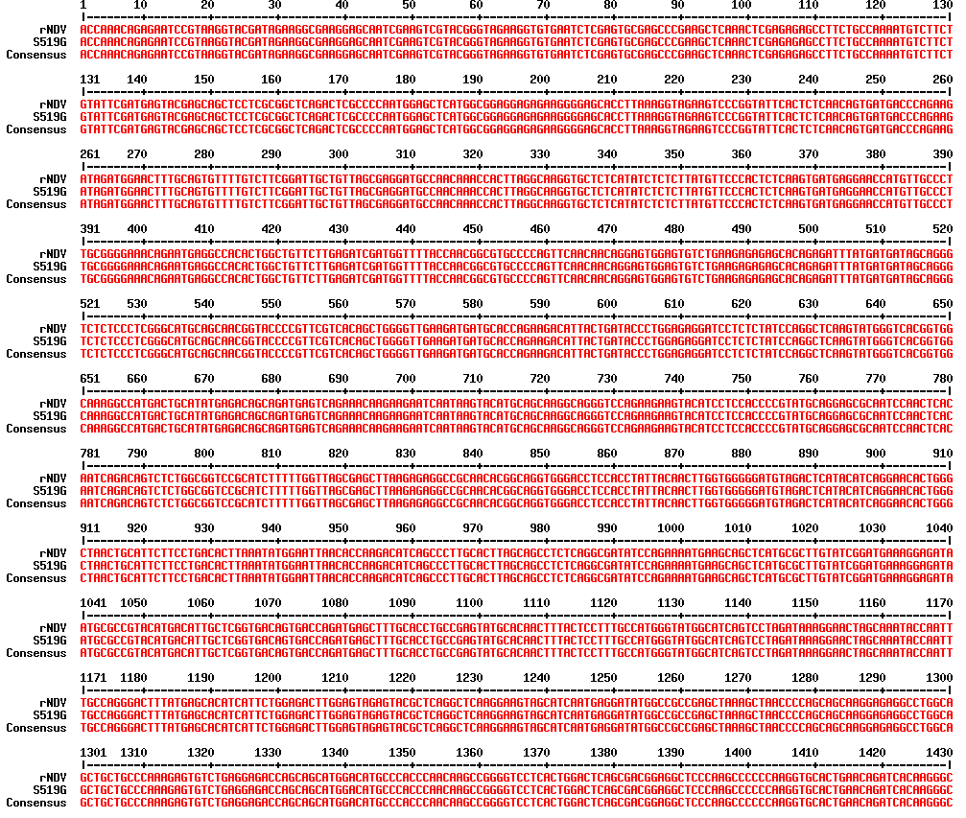
rNDV; rNDV VG/GA
S519G; The S519G mutant rNDV

Slide 2
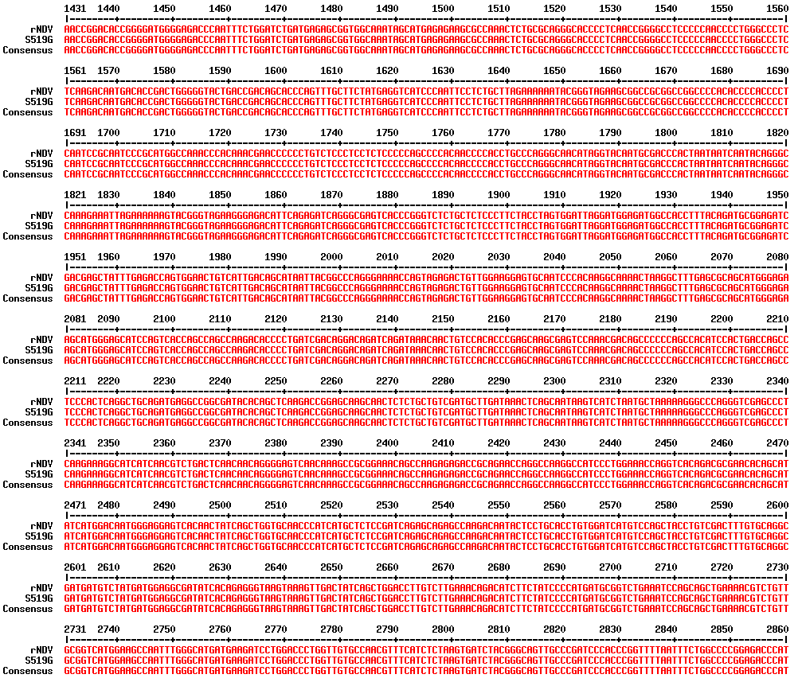
rNDV; rNDV VG/GA
S519G; The S519G mutant rNDV

Slide 3
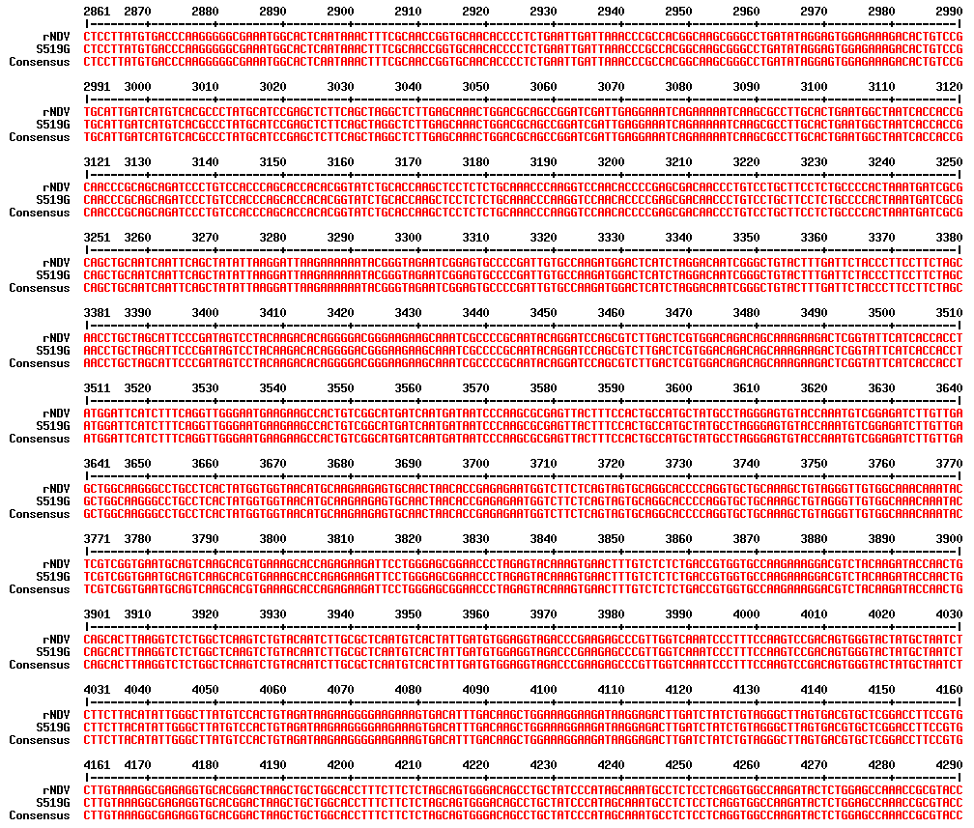
rNDV; rNDV VG/GA
S519G; The S519G mutant rNDV

Slide 4
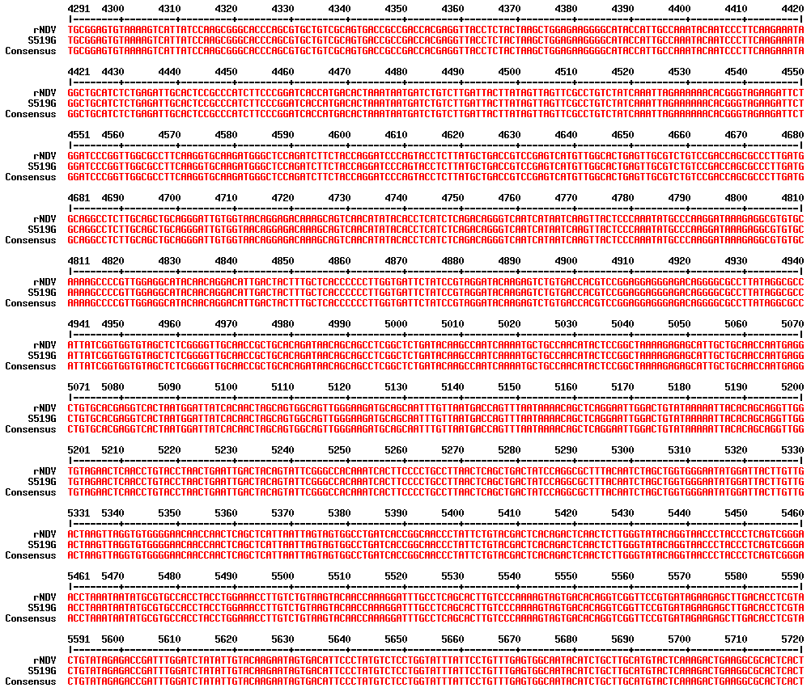
rNDV; rNDV VG/GA
S519G; The S519G mutant rNDV

Slide 5
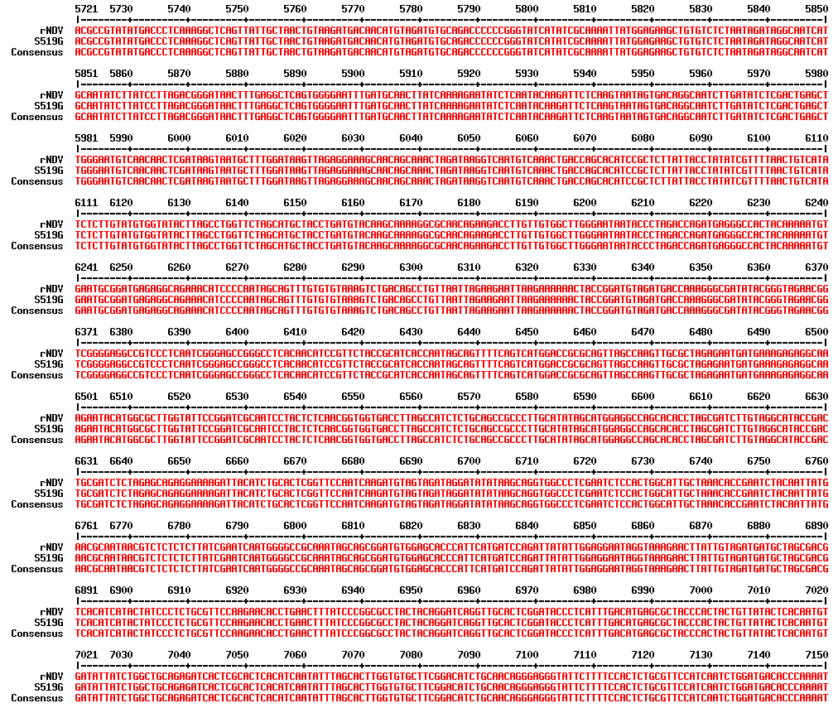
rNDV; rNDV VG/GA
S519G; The S519G mutant rNDV
H domain

Slide 6
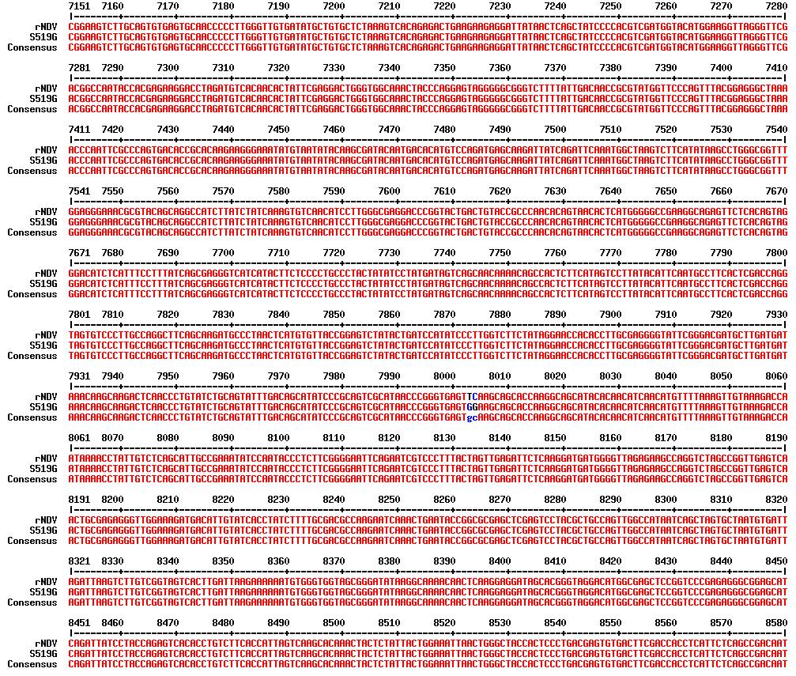
rNDV; rNDV VG/GA
S519G; The S519G mutant rNDV
c
H domain
S519G

Slide 7
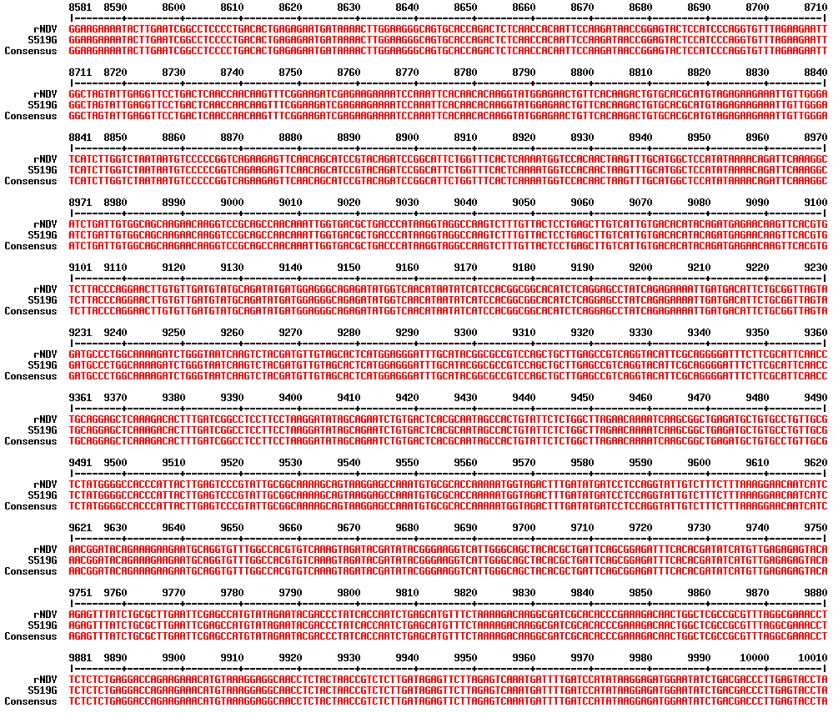
rNDV; rNDV VG/GA
S519G; The S519G mutant rNDV

Slide 8
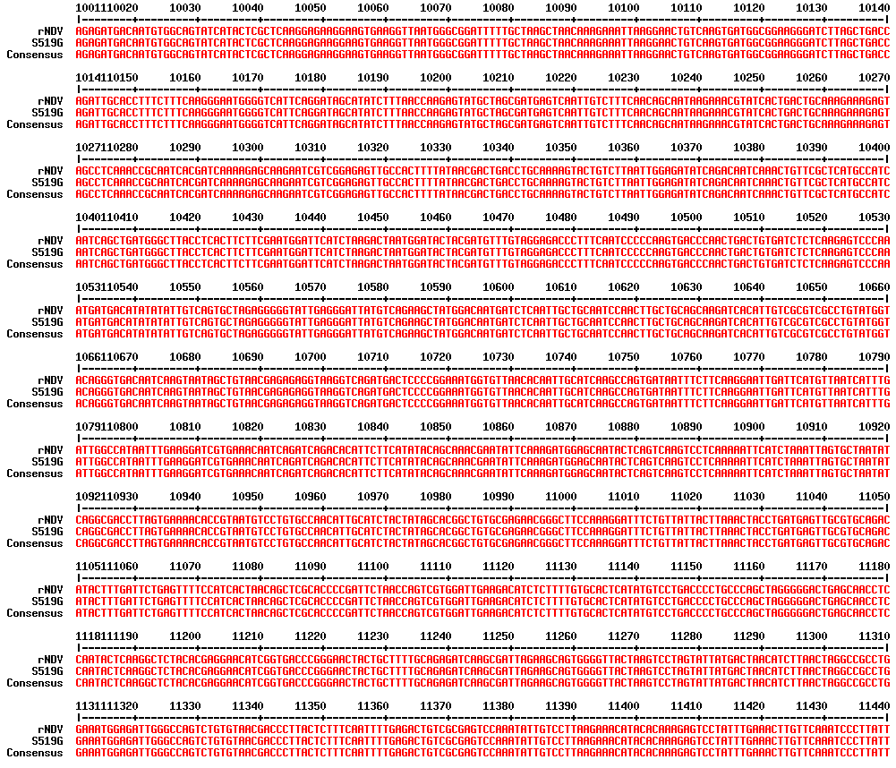
rNDV; rNDV VG/GA
S519G; The S519G mutant rNDV

Slide 9
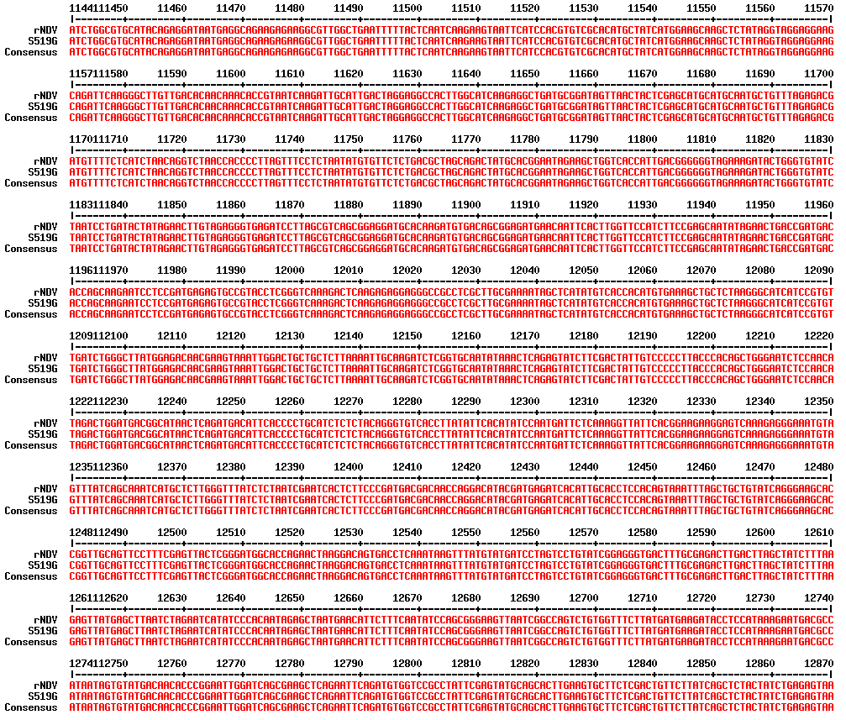
rNDV; rNDV VG/GA
S519G; The S519G mutant rNDV

Slide 10
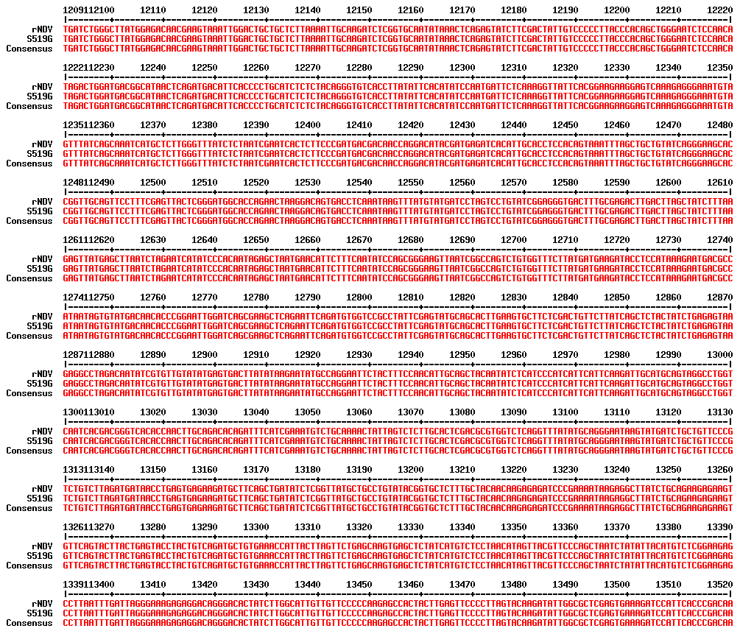
rNDV; rNDV VG/GA
S519G; The S519G mutant rNDV

Slide 11
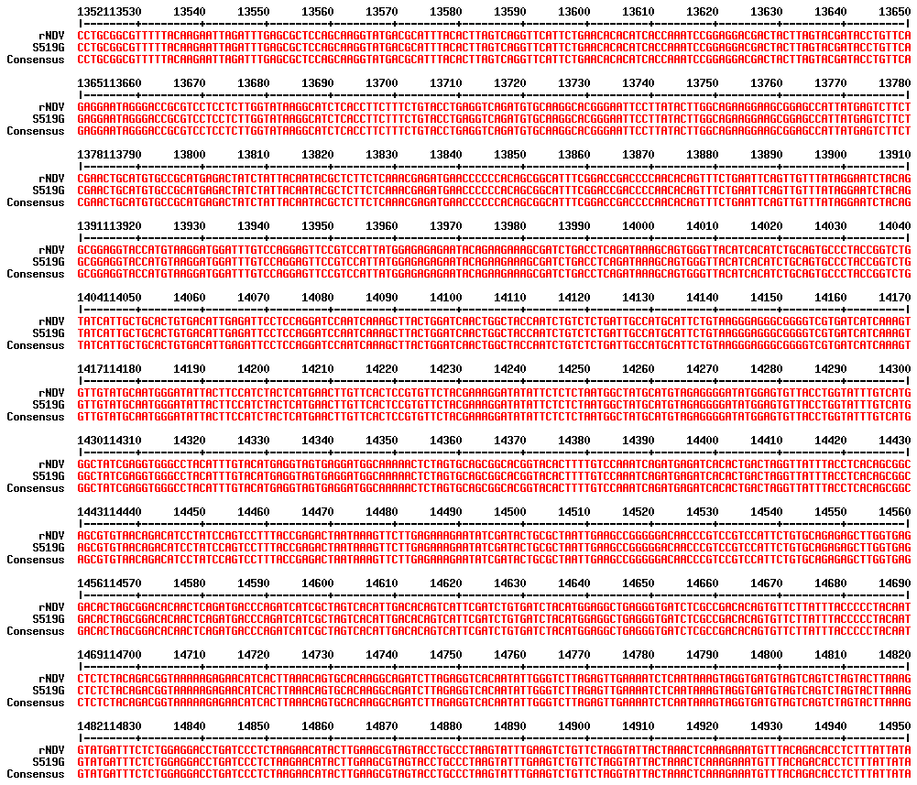
rNDV; rNDV VG/GA
S519G; The S519G mutant rNDV

Slide 12
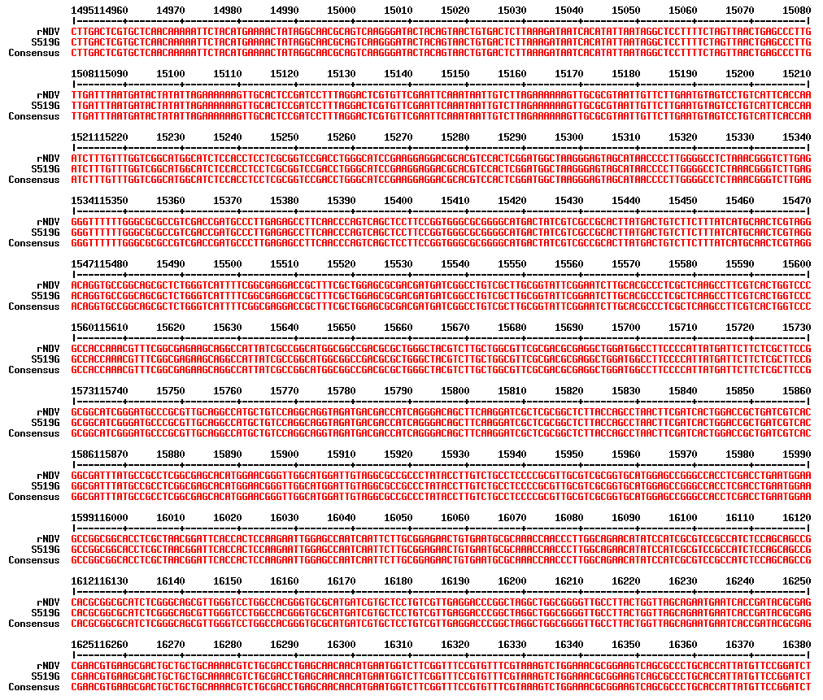
rNDV; rNDV VG/GA
S519G; The S519G mutant rNDV

Slide 13
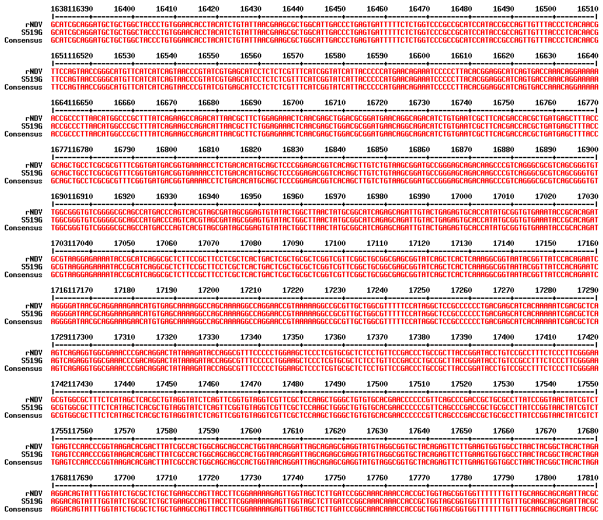
rNDV; rNDV VG/GA
S519G; The S519G mutant rNDV

Slide 14
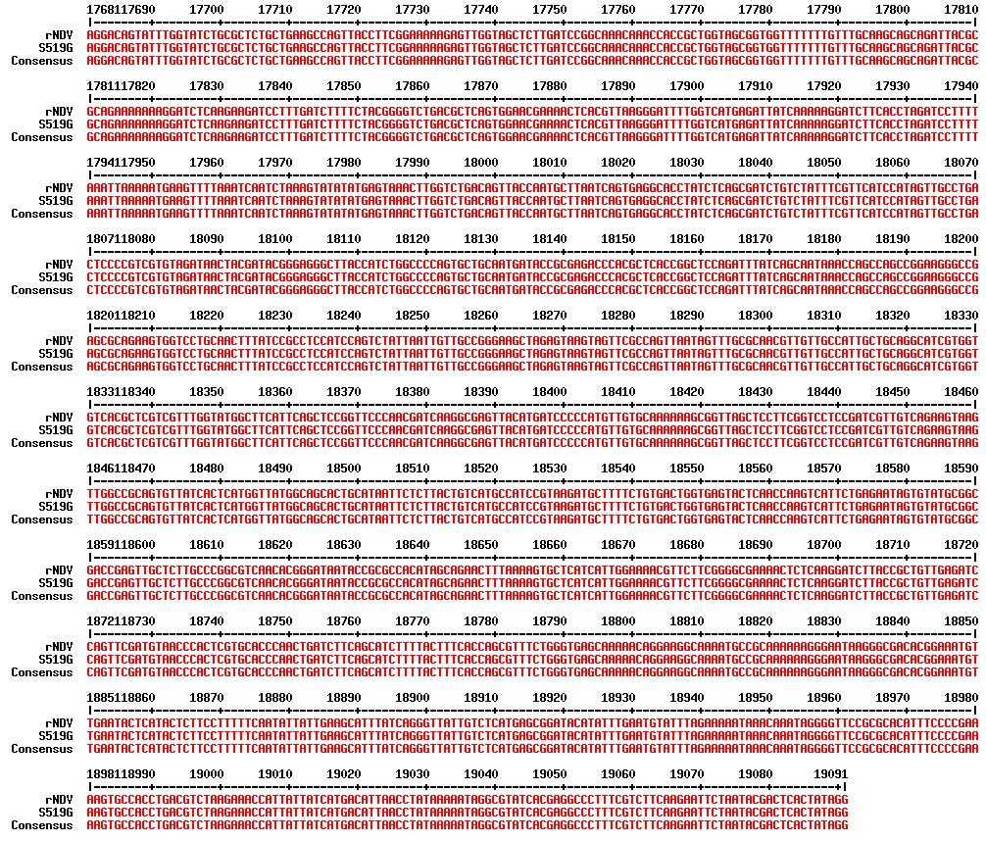
rNDV; rNDV VG/GA
S519G; The S519G mutant rNDV

