Slide 1
S1 Figure
a)
Human ALKBH2: primer targets
intron 1
exon 1
exon 2
exon 3
ALKBH2 pre-mRNA
(92 bp)
ALKBH2 mRNA
(122 bp)
b)
Human ALKBH3 and ALKBH3-AS1: primer targets
intron 2
exon 2
exon 3
exon 4
exon 6
ALKBH3 pre-mRNA
(195 bp)
ALKBH3 mRNA
(75 bp)

Slide 2
S2 Figure
a)
ALKBH1
ALKBH2
*
**
ALKBH3
ALKBH5
***
*
ALKBH6
ALKBH7
**
*
ALKBH8
FTO
****

Slide 3
S2 Figure
b)
M | Yes Blot^{tm} Western Marker I (SMOBIO Technology, Inc., Hsinchu, Taiwan)
Original image of ALKBH2
Original image of ALKBH3
M
(1)
(2)
(3)
(4)
(5)
(6)
(7)
(8)
M
(1)
(2)
(3)
(4)
(5)
(6)
(7)
(8)
30 kDa
40 kDa
20 kDa
30 kDa
Original image of β-actin
M
(1)
(2)
(3)
(4)
(5)
(6)
(7)
(8)
50 kDa
(1) | Jurkat
(2) | CEM
(3) | Molt4
(4) | MT1
(5) | MT2
(6) | MT4
(7) | HUT102
(8) | TLOm1
40 kDa

Slide 4
S2 Figure
c)
Tax
HBZ
*

Slide 5
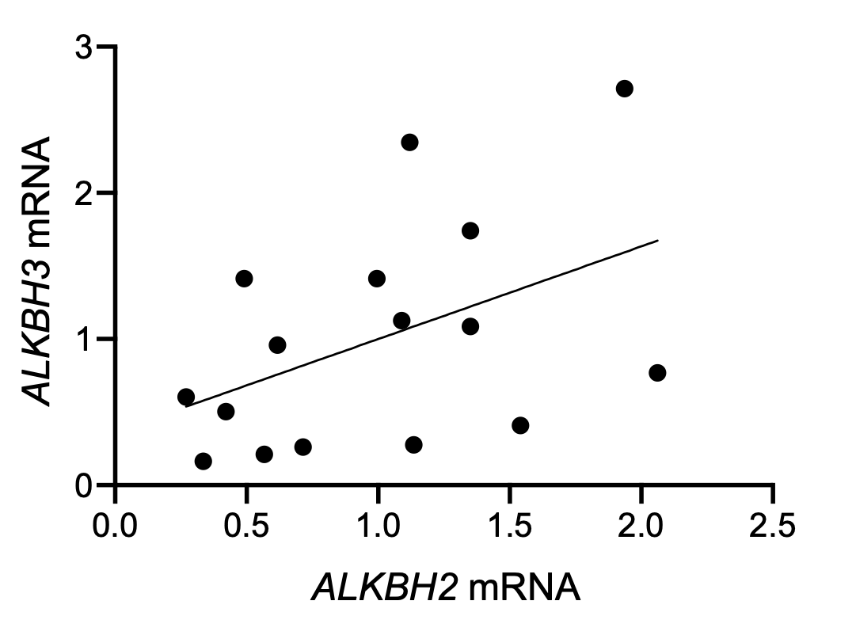
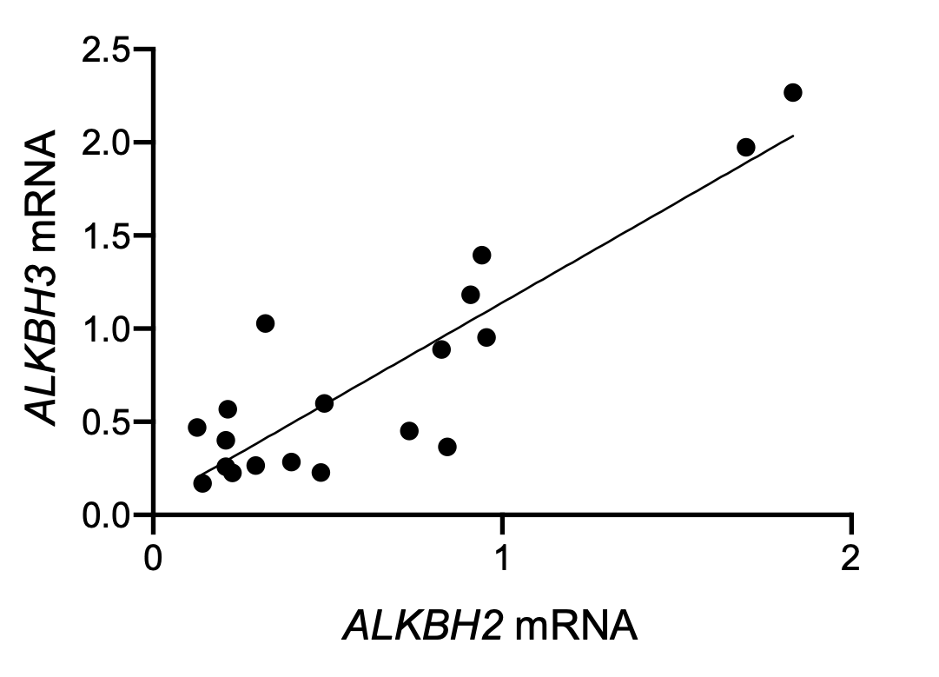
S3 Figure
a)
b)
ALKBH2 vs ALKBH3 mRNA (HC)
ALKBH2 vs ALKBH3 mRNA (AC and ATL)
p = 0.0768, R = 0.2068
****p < 0.0001, R = 0.7782

Slide 6
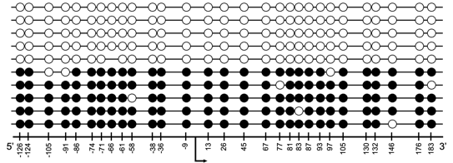
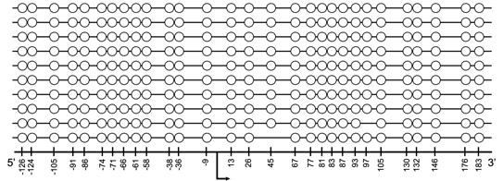
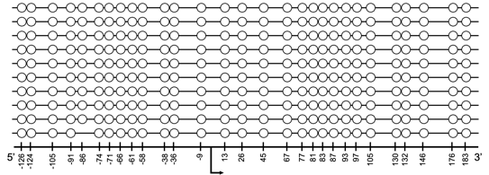
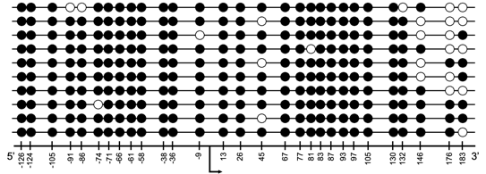
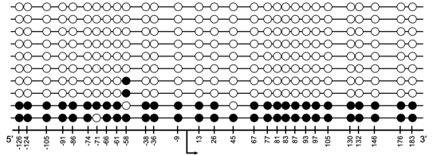
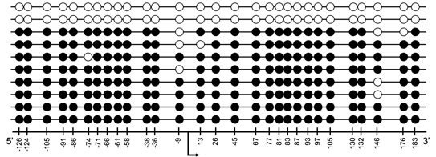
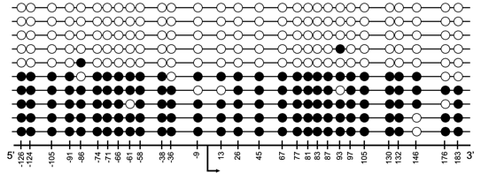
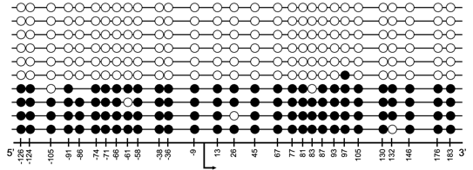
S4 Figure
a)
CEM
Molt4
TSS
TSS
Jurkat
TSS
MT1
MT2
TSS
TSS
MT4
HUT102
TSS
TSS
TLOm1
TSS

Slide 7
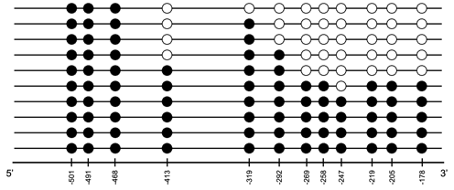
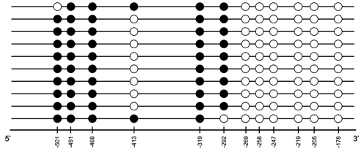
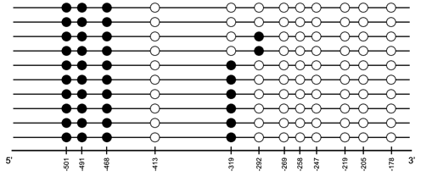
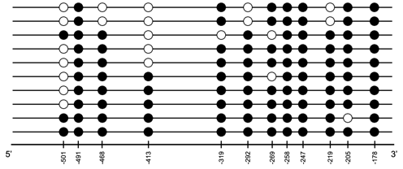
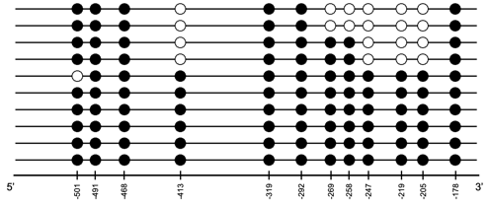
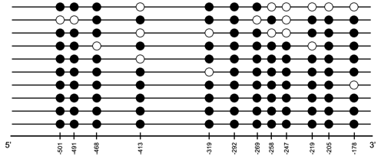
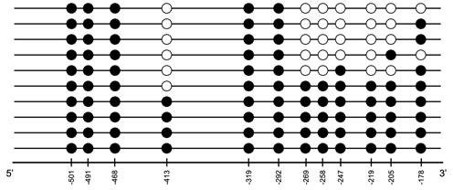
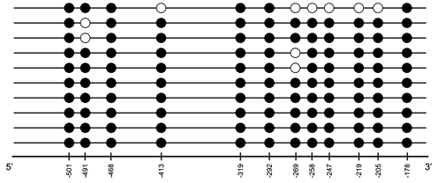
S4 Figure
b)
CEM
Molt4
Jurkat
MT1
MT2
MT4
HUT102
TLOm1

Slide 8
S5 Figure
cg14908875
(-319 from TSS)
cg21125143
(-269 from TSS)
P
D
N
P
D
N
cg26579032
(-247 from TSS)
cg26985203
(+661 from TSS)
P
D
N
P
D
N

