Slide 1
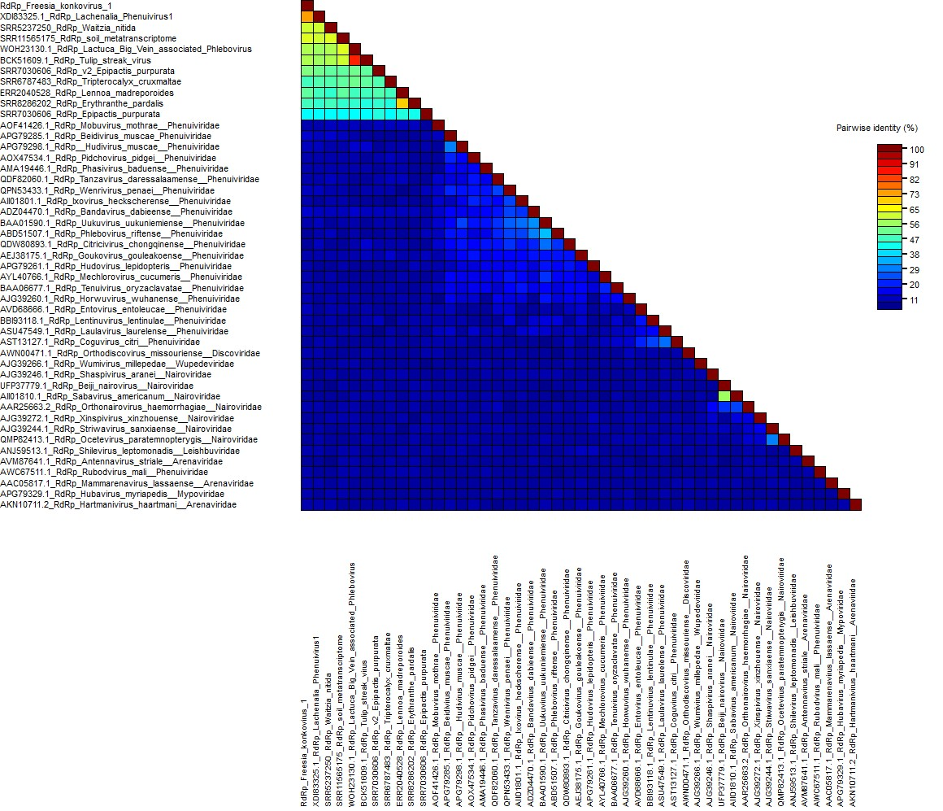
Additional file 7. Identity matrix of RNA-dependent RNA polymerase amino acid sequences of selected viral species belonging to the Hareavirales order, the official species and the newly discovered species tentatively belonginh to the Konkoviridae family (for which the RNA-2 full CDS has been obtained), obtained by Sequence Demarcation Tool (SDT) v.1.2

