Slide 1
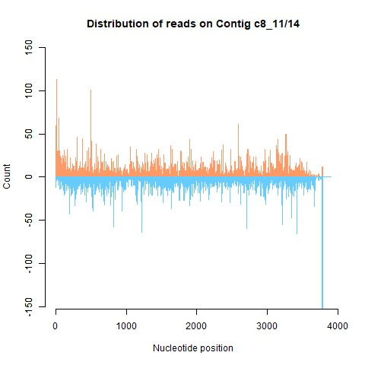
Additional file 3. Mapping of reads on the contig c8_11/14 representing FraYV-1, identified in this work. Orange indicates reads mapping on plus polarity and light blue indicates the reads mapping on minus polarity.

