Slide 1
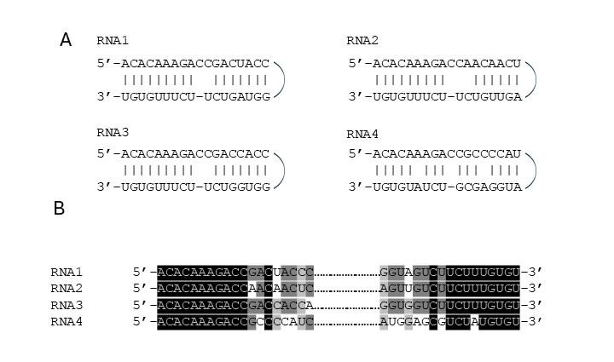
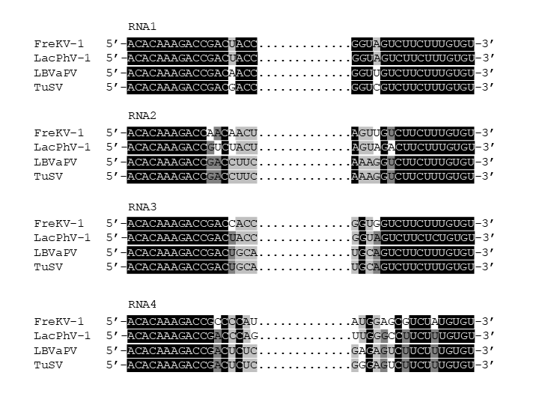
C
Additional file 6. Analyses of FreKV-1 genomic RNA termini. A) Alignment of FreKV-1 terminal sequences of genomic RNAs. B) Panhandle structures formed by the 5’ and 3’ termini of FreKV-1 genomic RNAs. C) Alignment of the genomic RNA termini of FreKV-1, LacPhV-1, LBVaPV and TuSV, which are all official/putative members of the Konkoviridae family. The black, dark gray, and light gray backgrounds correspond to base consensus to 4, 3, and 2 RNA segments, respectively.

