Slide 1
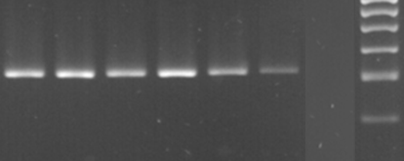
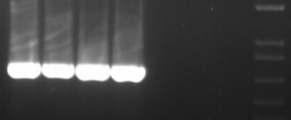
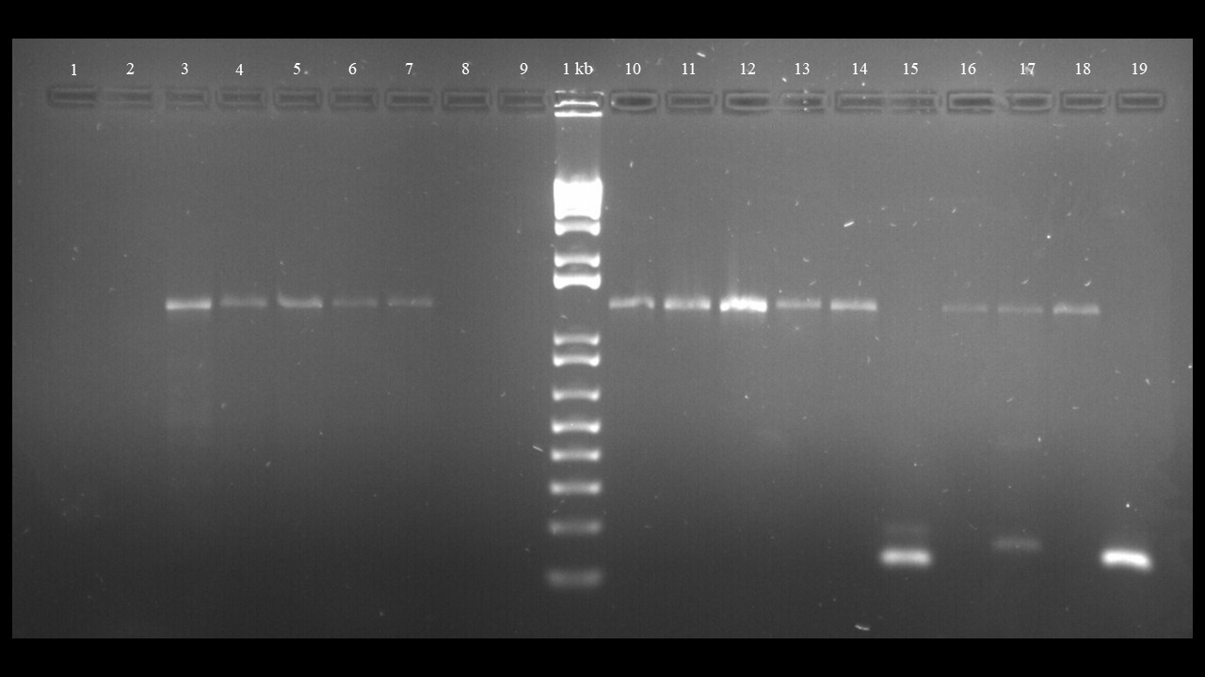
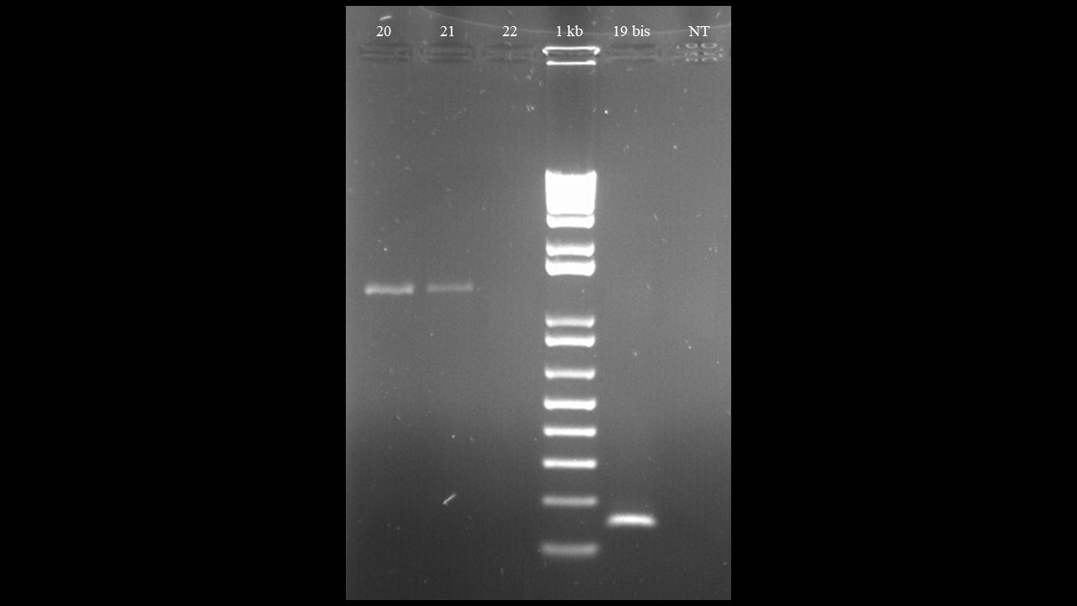
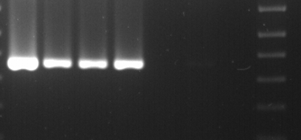
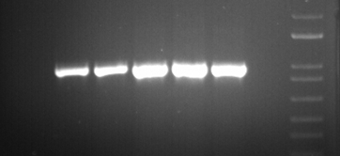
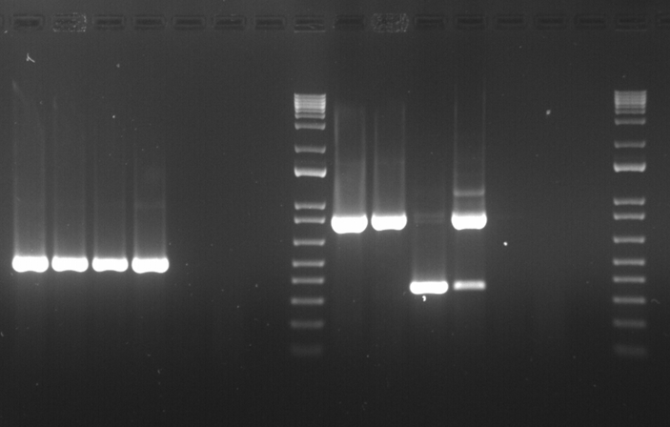
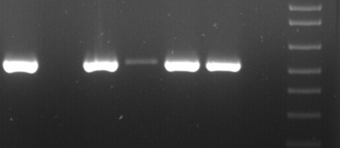
Additional file 4. RT-PCR validation with specific primers of viruses previously identified by RNA-seq analysis. Fr2, Fr6, Fr8, Fr14, Fr20, Fr21 are the six individual necrotic freesia leaves samples pooled for the 2022 RNA-seq analysis.
Fr2 Fr6 Fr8 Fr14 Fr20 Fr21 nt 1kb
Fr2 Fr6 Fr8 Fr14 Fr20 Fr21 nt 1kb
- 329nt
- 701nt
FreMV
FreKV-1 RNA1
- 1325nt
- 369nt
FreSV
FreKV-1 RNA2
- 994nt
- 465nt
BYMV
FreKV-1 RNA3
- 524nt
- 845nt
FreYV-1
FreKV-1 RNA4
368nt defective RNA

