Slide 1
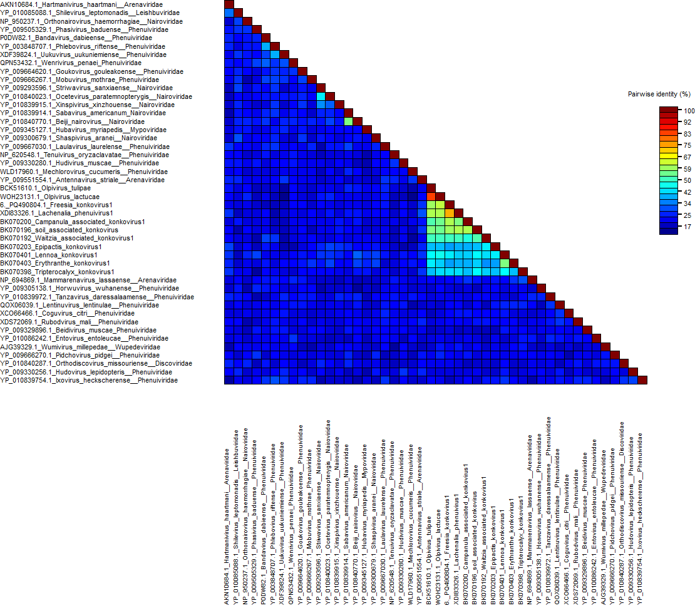
Additional file 9. Identity matrix of nucleocapsid amino acid sequences of selected viral species belonging to the Hareavirales order, the official species and the newly discovered species tentatively belonging to the Konkoviridae family (for which the RNA-2 full CDS has been obtained), obtained by Sequence Demarcation Tool (SDT) v.1.2

