Slide 1
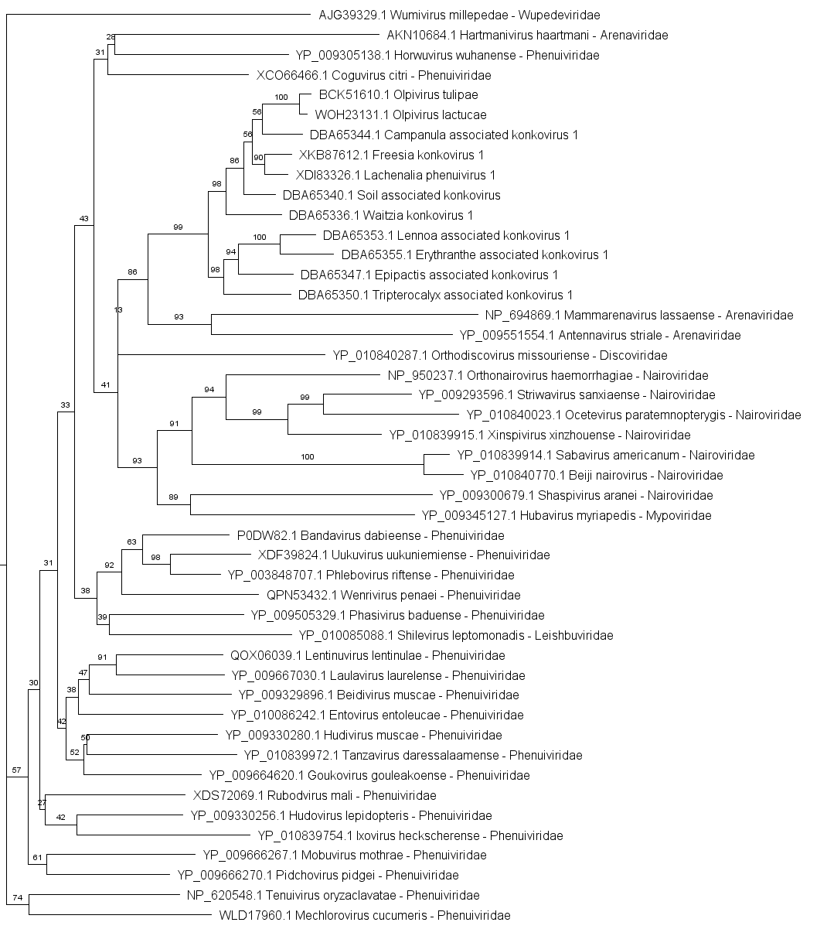
Konkoviridae
Additional file 8. Maximum likelihood phylogenetic tree inferred using IQ-TREE based on the nucleocapsid amino acid sequences of selected viral species belonging to the Hareavirales order, the official species in Konkoviridae family and the newly discovered species tentatively belonging to the Konkoviridae family (for which the RNA-2 full CDS has been obtained). Node values represent ultrafast bootstrap supports (UFBoot) calculated from 1,000 replicates, with values ≥70% considered well supported. The best-fit substitution model (VT+F+R3) was automatically selected by ModelFinder.

