Slide 1
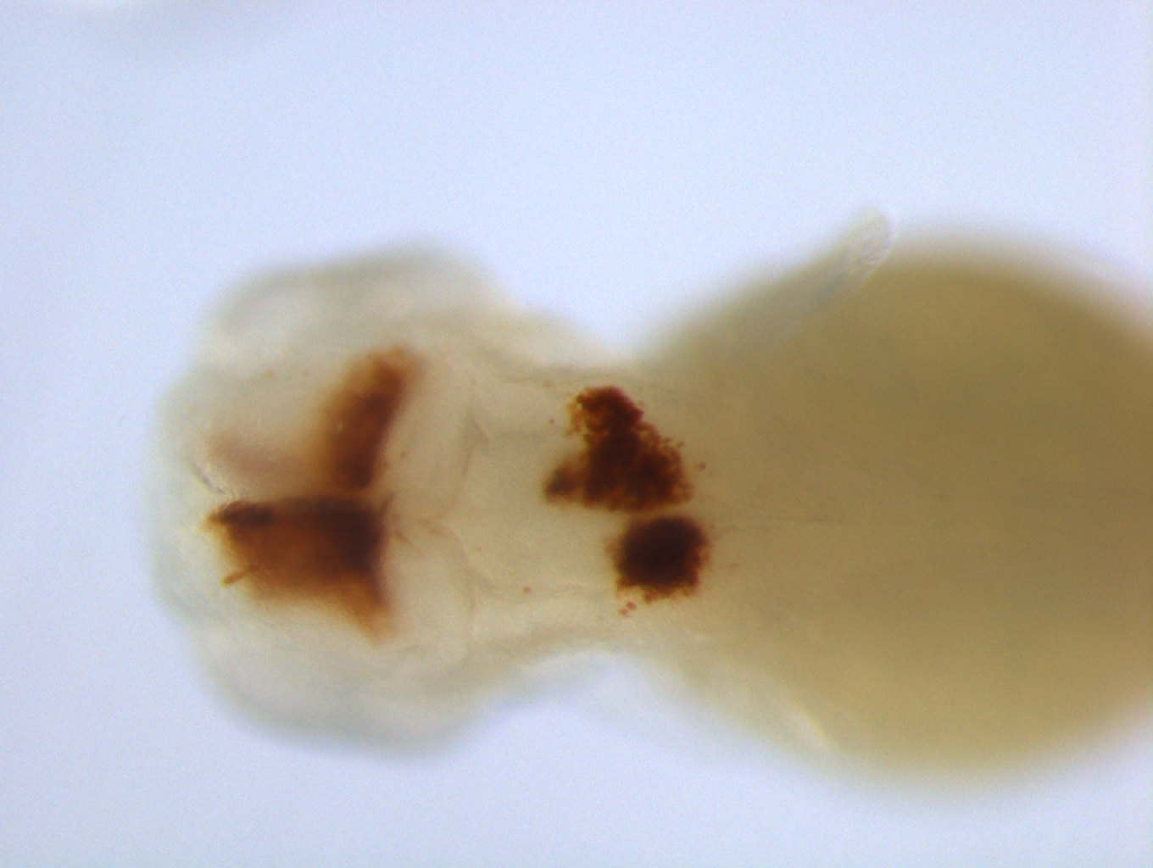
Grade | detail
C0 | Normal
C1 | The proportion of hemorrhagic area is ＜10%.
C2 | The proportion of hemorrhagic area ranges from 10% to 20%
C3 | The proportion of hemorrhagic area＞20%
Supplementary Figure S1. Schematic diagram illustrating the severity of intracranial hemorrhage in embryos after BTZ treatment. The overall brain area is outlined with yellow dashed lines, and the hemorrhagic area is outlined with red dashed lines. Scale bar: 50 µm.

Slide 2
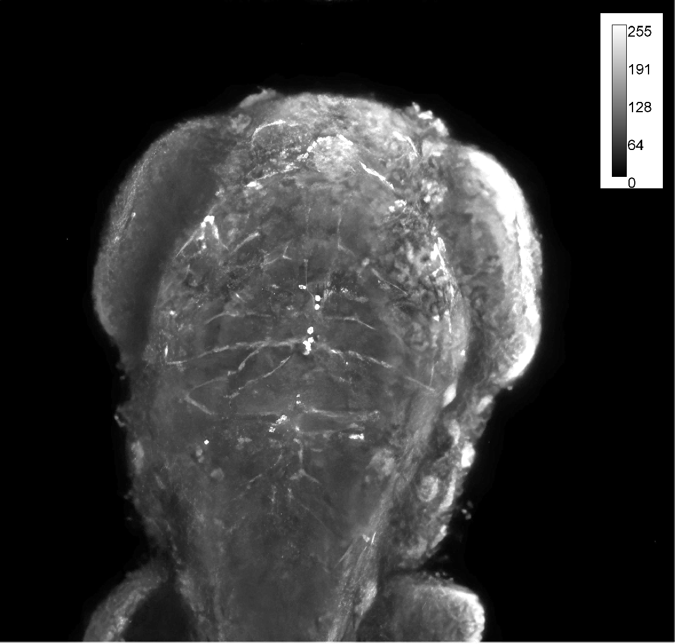
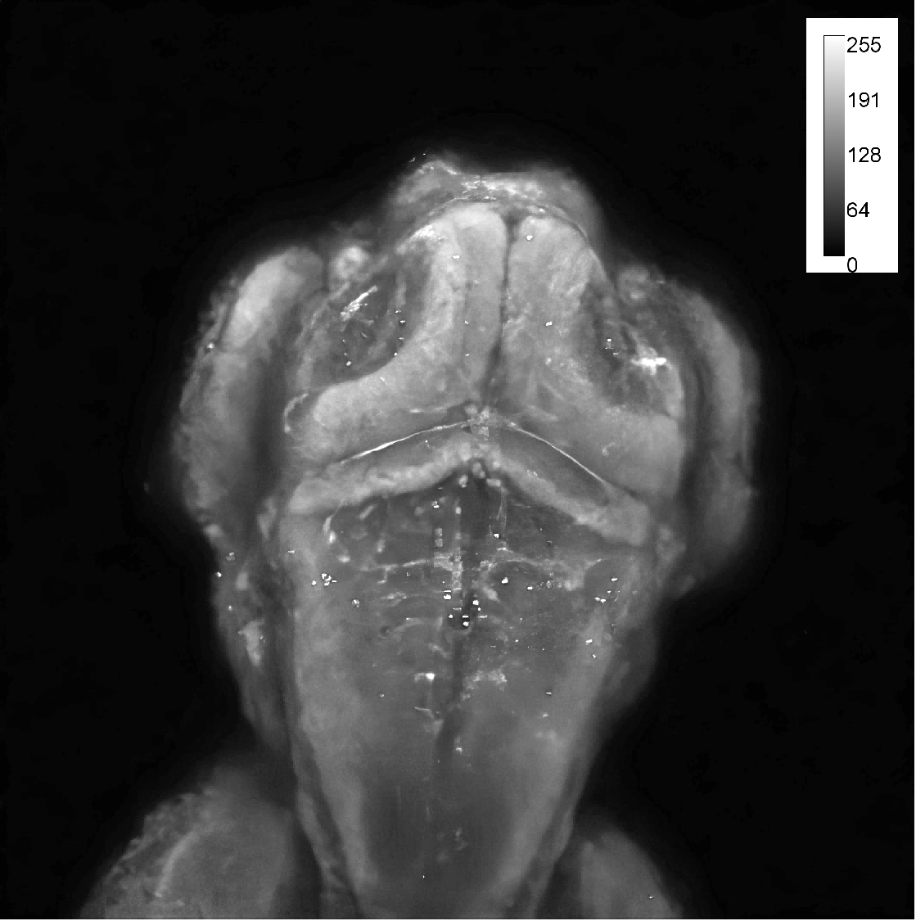
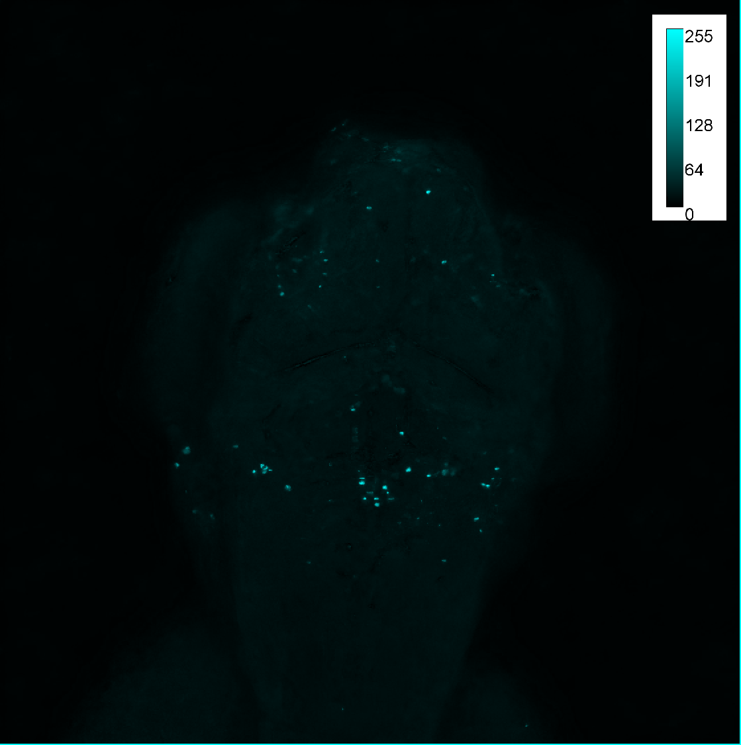
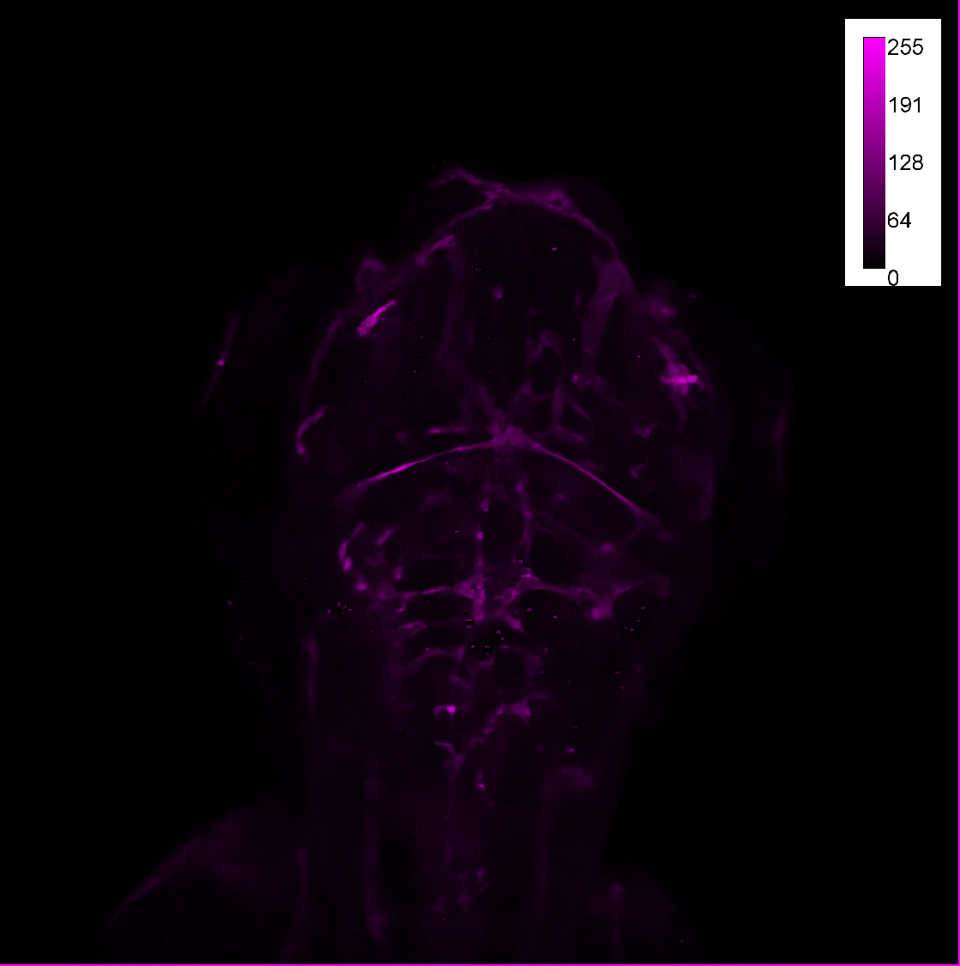
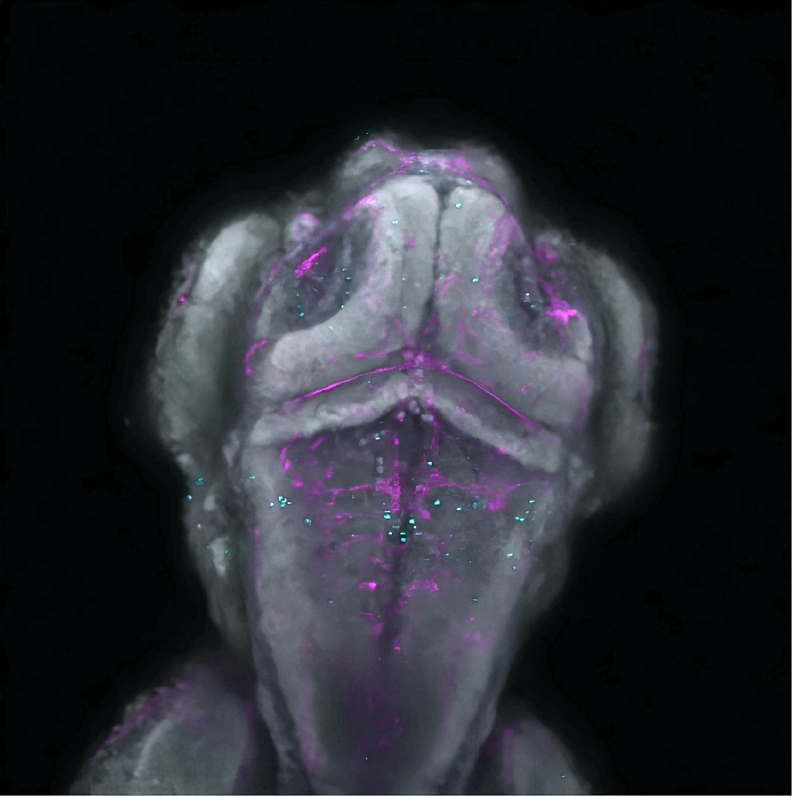
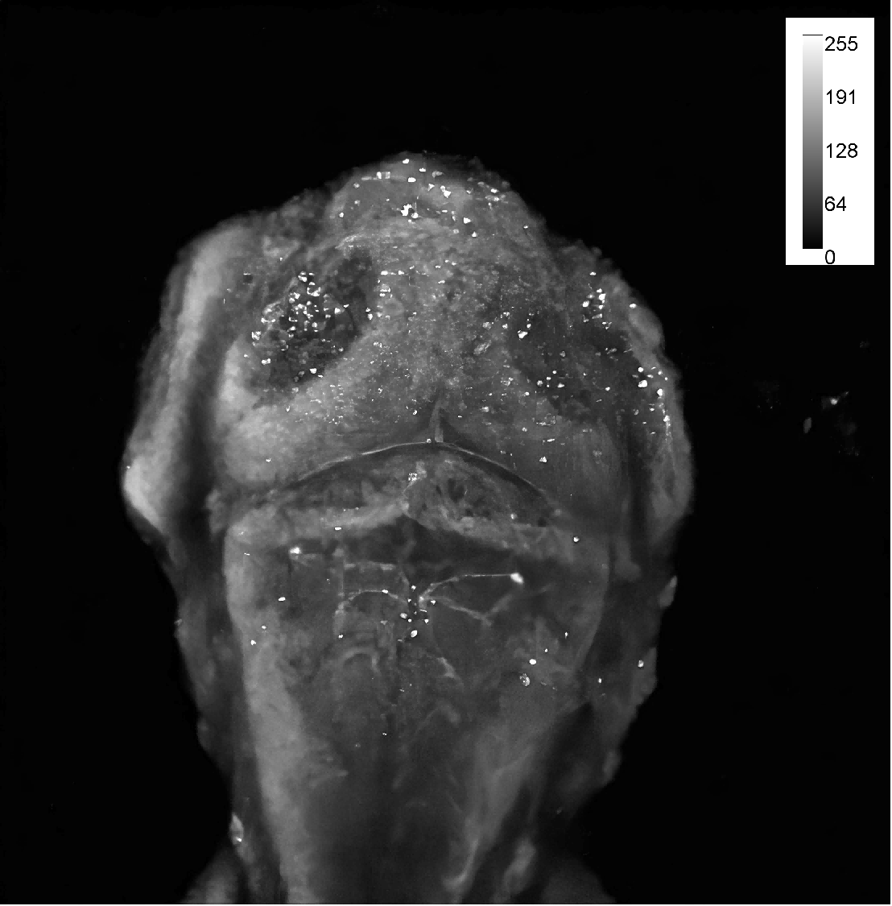
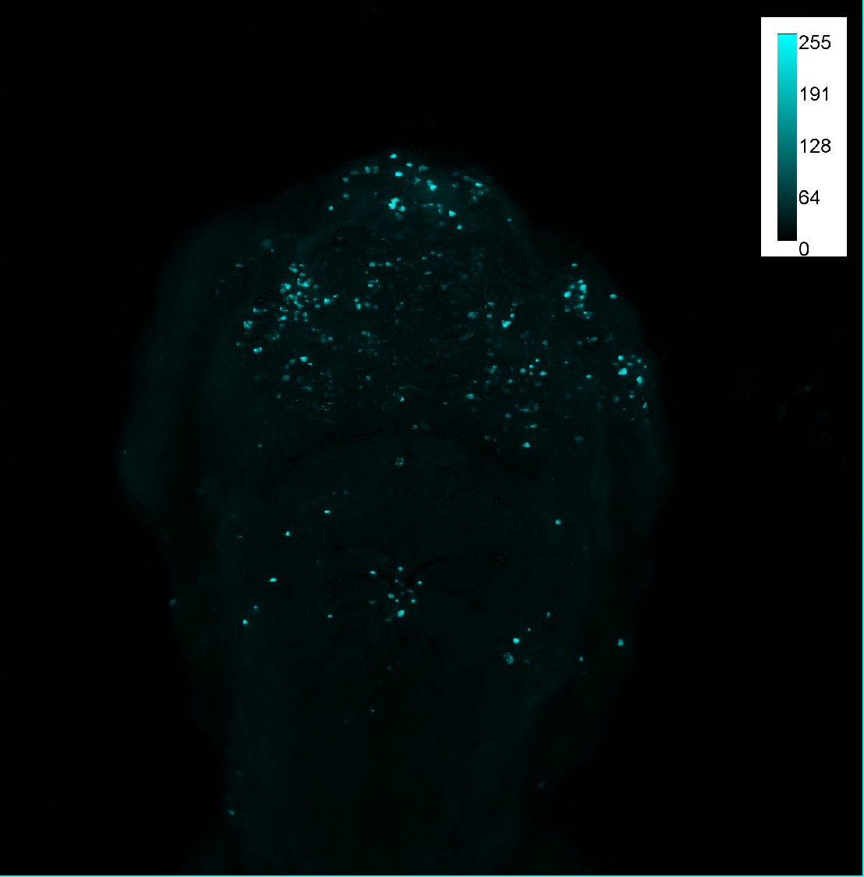
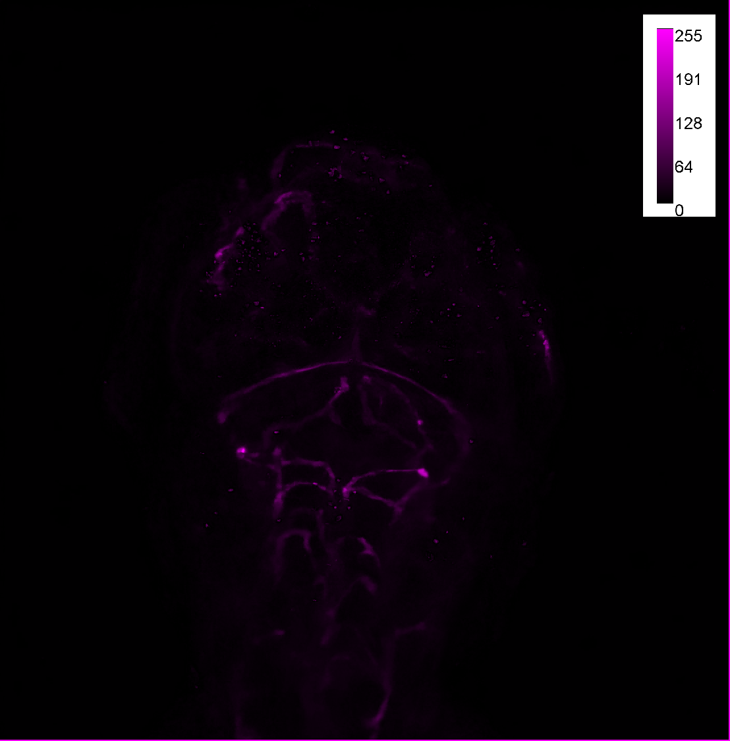
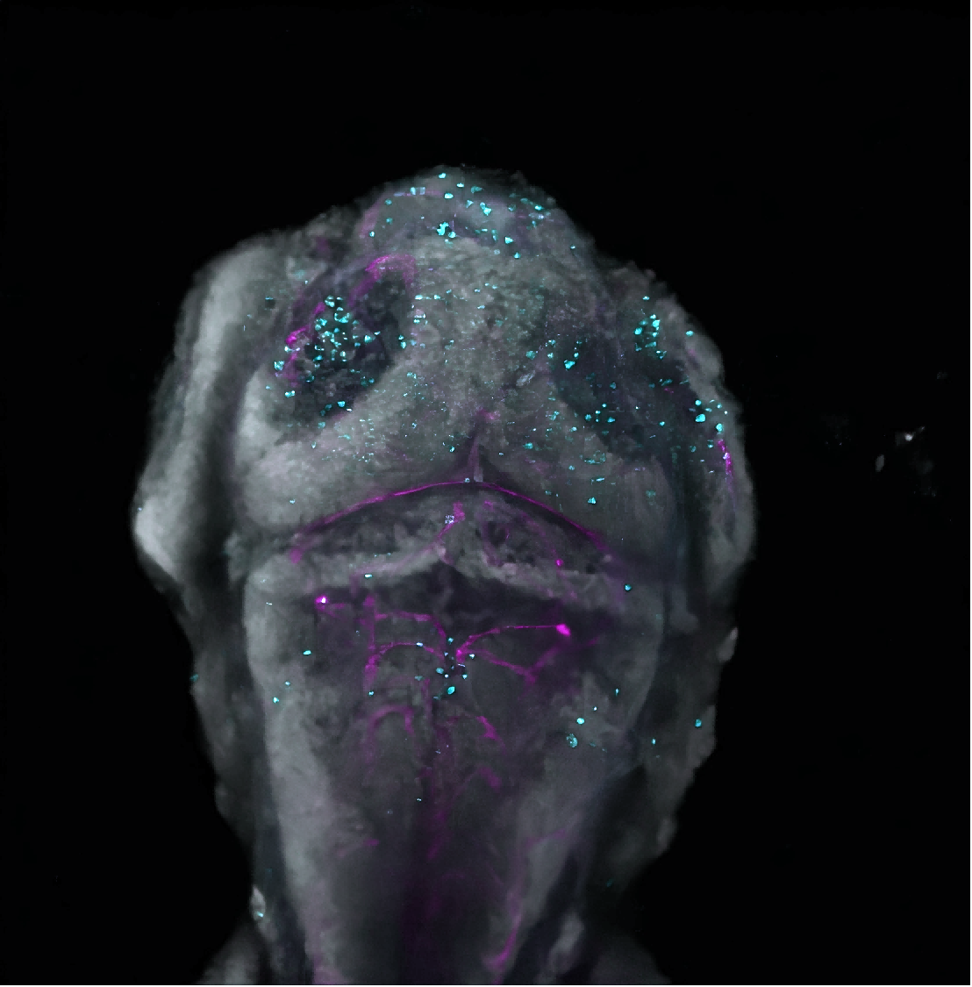
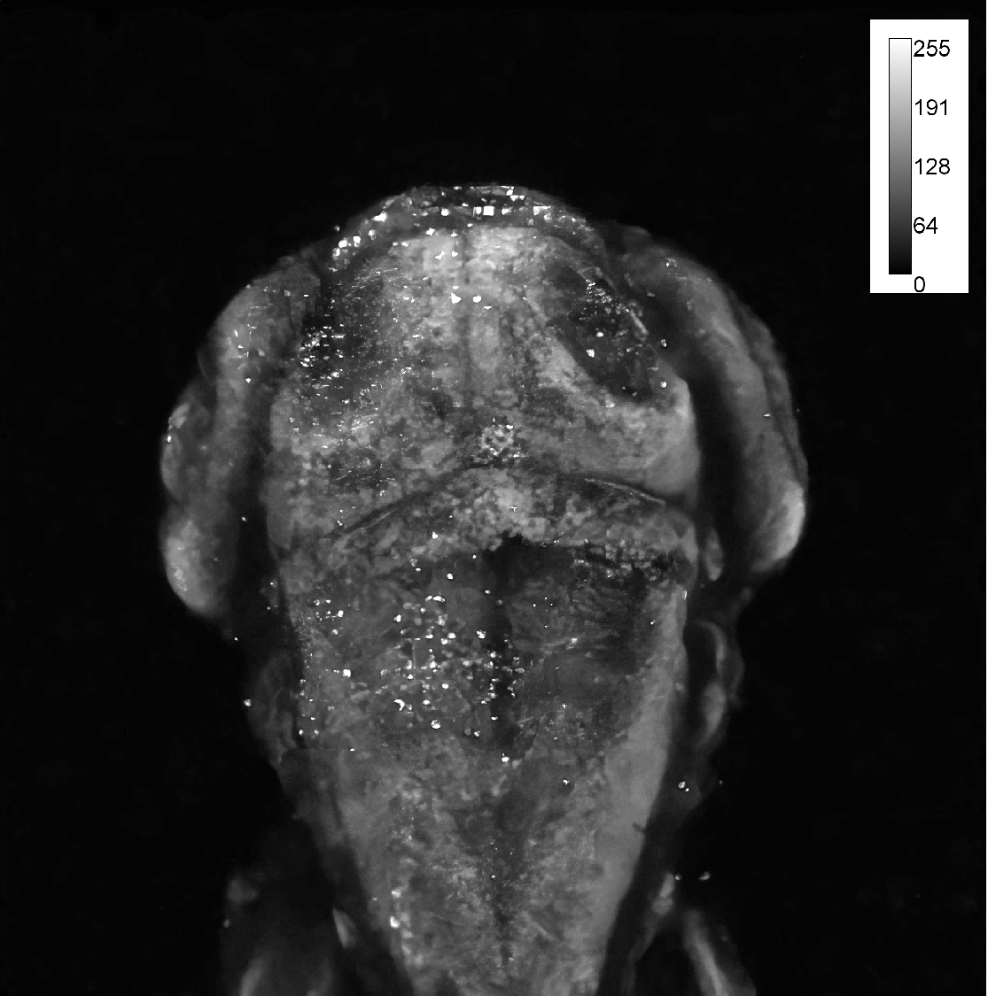
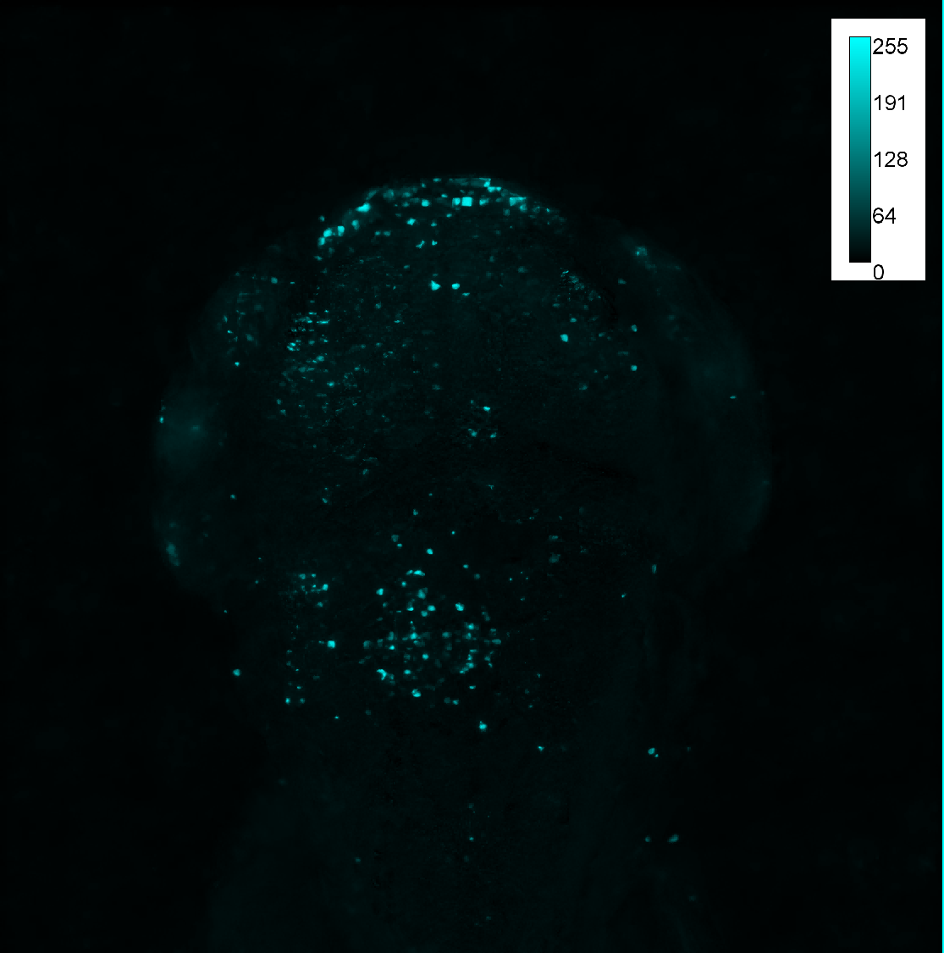
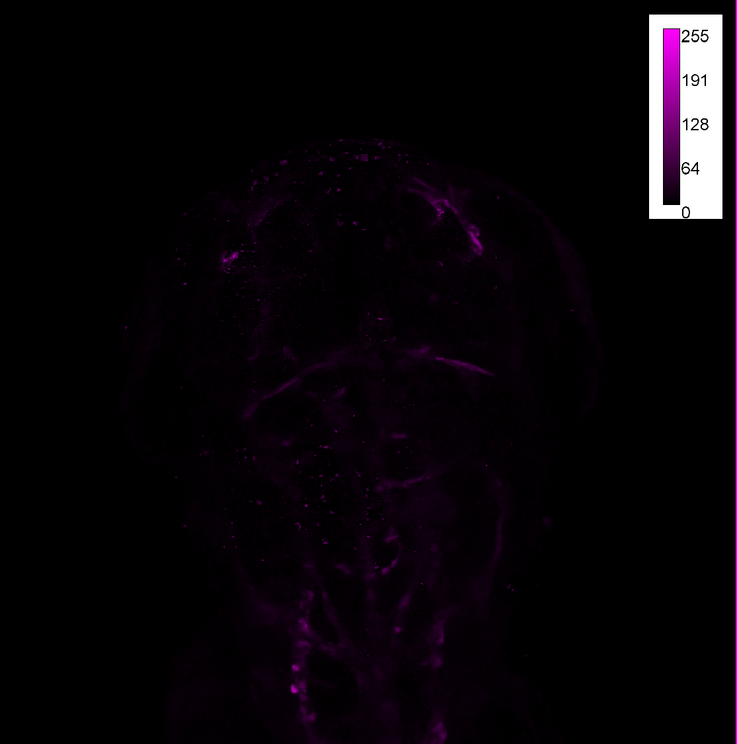
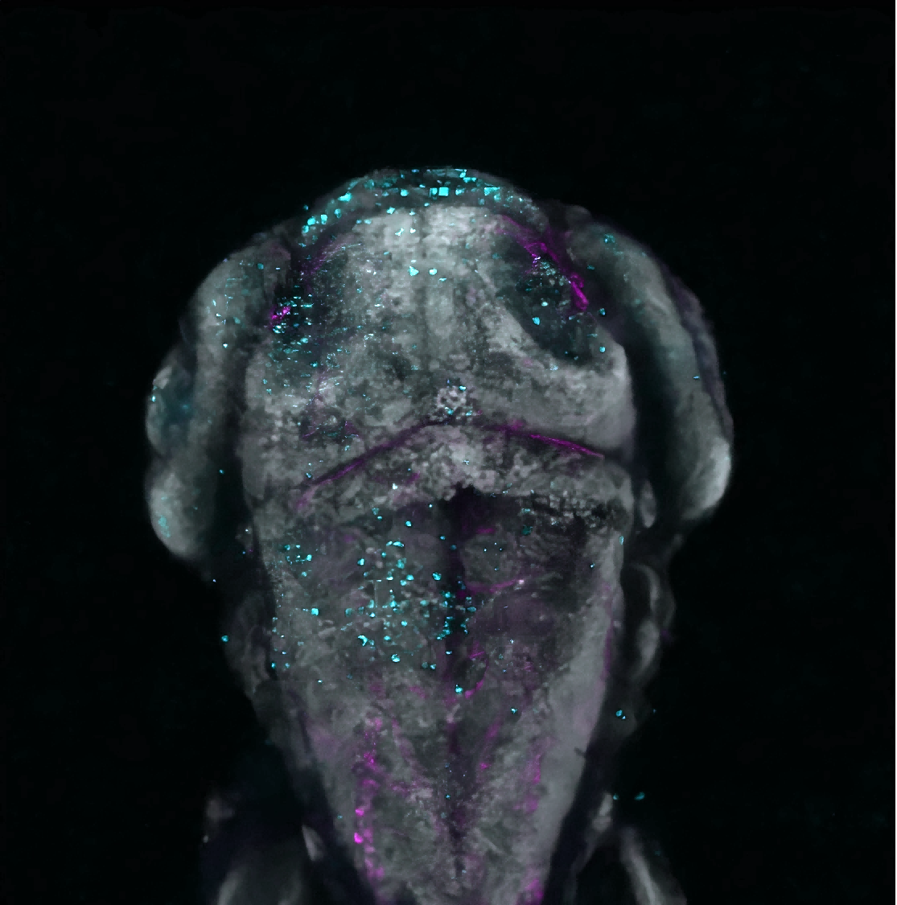
DAPI
TUNEL
Tg(kdrl:mCherry)
Merge
Control
4 mg/L
4.5 mg/L
Supplementary Figure S2. TUNEL staining co-localizes with cerebrovascular endothelial cells following BTZ exposure. Scale bar: 50 µm.
5 mg/L

Slide 3
Control-72hpf
5 mg/L-72hpf
Control-96hpf
5 mg/L-96hpf
Supplementary Figure S3. Intracranial hemorrhage in zebrafish embryos treated with BTZ for 72 hours resolves after 24 hours. Scale bar: 50 µm.

Slide 4
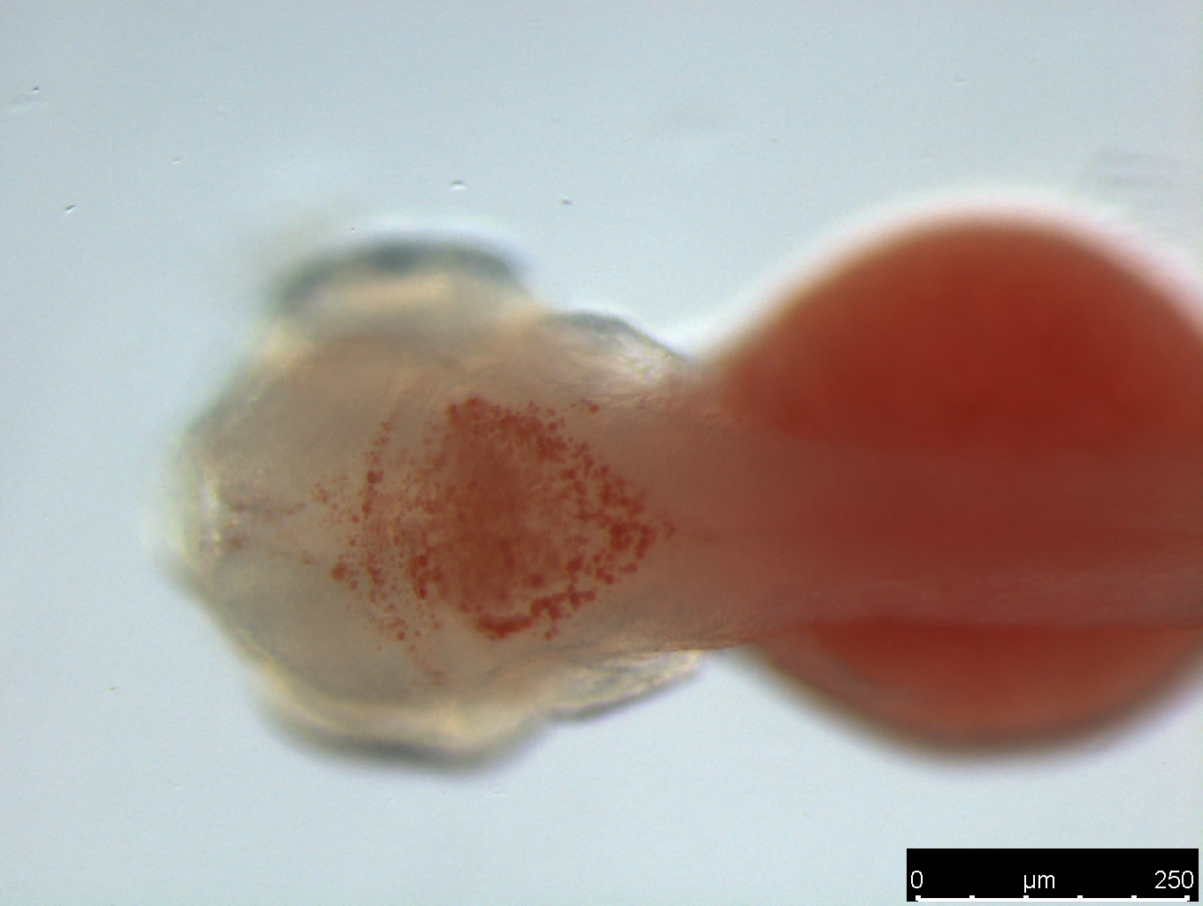
A
B
Supplementary Figure S4. (A) The entire brain region is outlined with a yellow dashed line, while the stained area is outlined with a red dashed line. (B) Quantitative analysis of the Oil Red O staining results following BTZ treatment. Scale bar: 250 µm.

