Slide 1
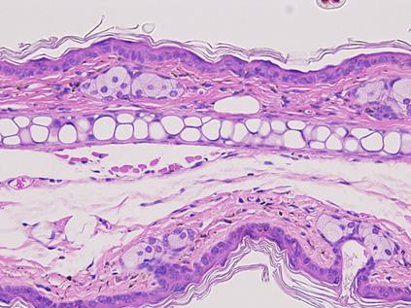
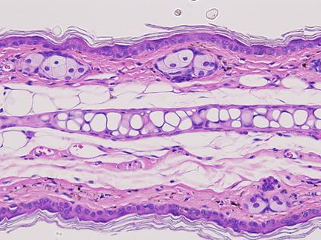
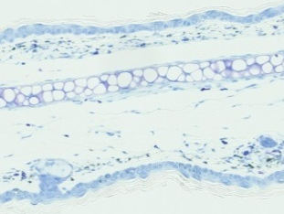
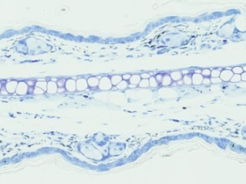
A
B
PBS
nSP30
350
PBS
nSP30
300
Ear thickness (μm)
HE
250
200
0
5
10
15
20
25
30
C
Day
D
4
4
4
TB
3
3
3
2
Inflammatory cell infiltration (score)
Scab formation (score)
Acanthosis (score)
2
2
1
1
1
0
PBS
nSP30
0
PBS
nSP30
0
PBS
nSP30
E
F
10
100
8
80
6
60
Mast cells per HPF
Total IgE (ng ml⁻¹)
4
40
2
20
N. D.
N. D.
0
PBS
nSP30
0
PBS
nSP30
Additional file 1. Effects of nSP30 nanoparticles alone on skin. (A) Effect of topical treatment with nSP30 alone on ear thickness in NC/Nga mice. (B, C) Histology of ear sections stained with (B) hematoxylin and eosin (HE) or (C) toluidine blue (TB). Scale bar, 50 μm. (D) Scores for several symptoms characteristic of AD as evaluated in HE-stained sections. (E) Mast cell infiltration evaluated in TB-stained sections as the number of mast cells per high-power (i.e., 400×) field. (F) Total IgE concentration at 24 h after the final treatment. N. D., not detected (<33 ng mL^{–1}). Data are given as means ± SEMs (n = 5).
Additional file 1. Hirai et al.

