Slide 1
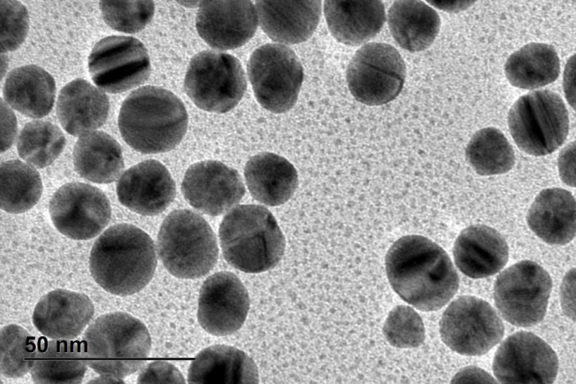
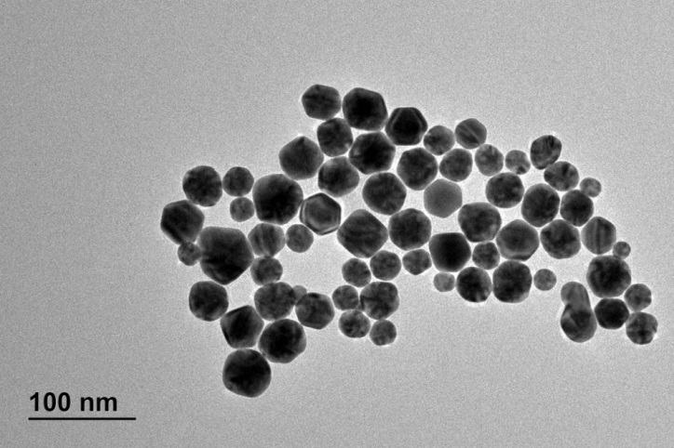
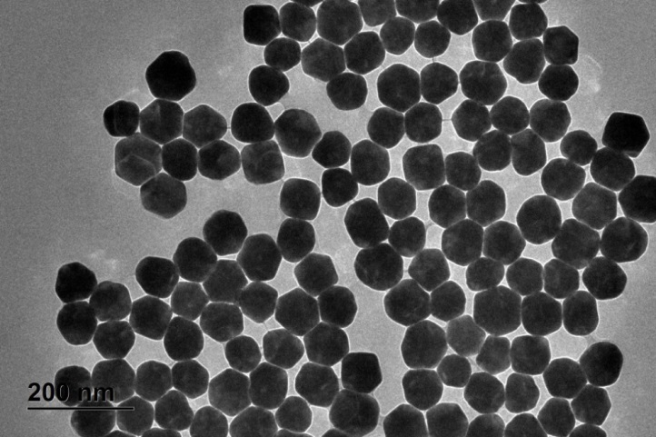
A
B
CO20
CO 40
CO 80
C
D
E
F
Figure S1a: HR-TEM images and quantitative particle size distribution analysis of (A-B) CO20 ; (C-D) CO40 ; and (E-F) CO80 gold NPs.

Slide 2
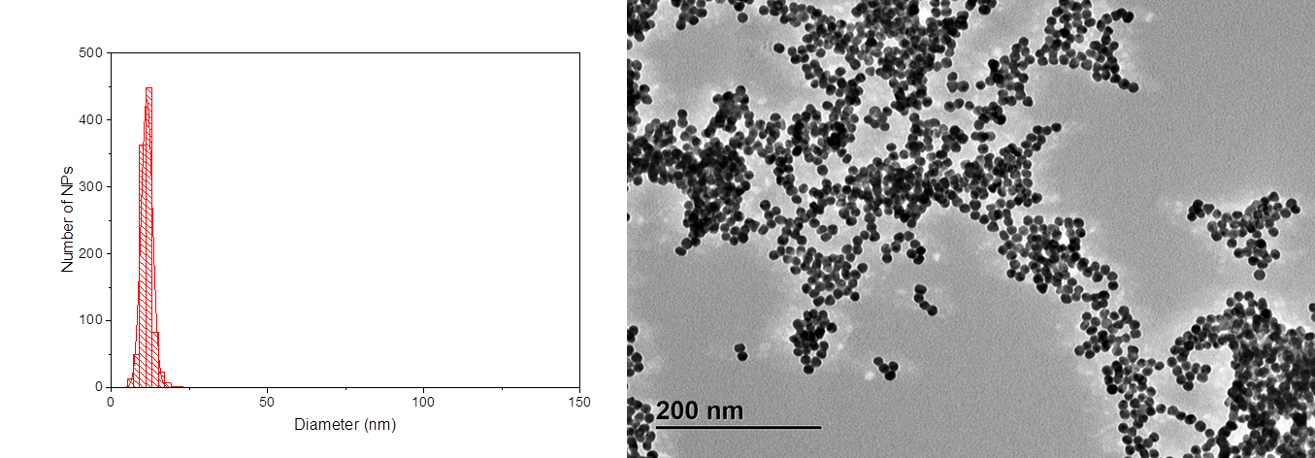
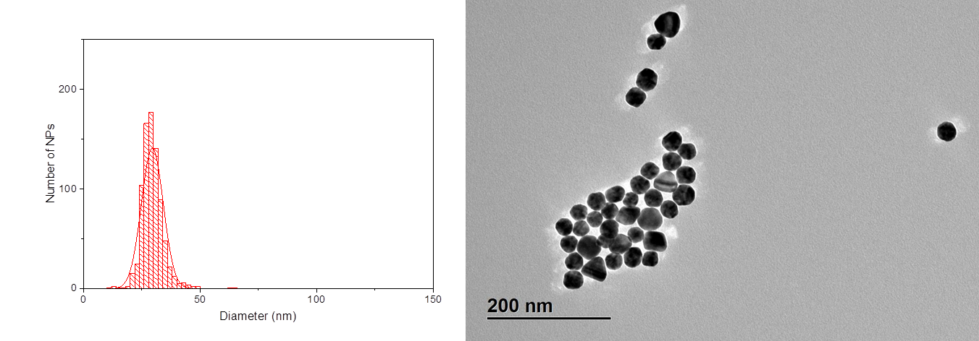
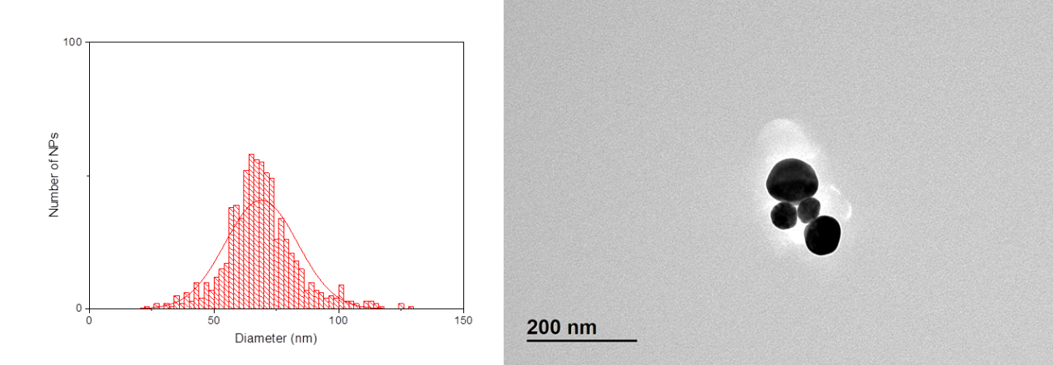
A
B
HM15
HM35
HM75
C
D
E
F
Figure S1b: HR-TEM image and quantitative particle size distribution analysis of (A-B) HM15 ; (C-D) HM35 ; and (E-F) HM75 gold NPs.

Slide 3
HM15
HM35
HM75
S2a : CLS size distribution intensity curves. HM series

Slide 4
CO20
CO40
CO80
S2b: CLS size distribution intensity curves. CO series

Slide 5
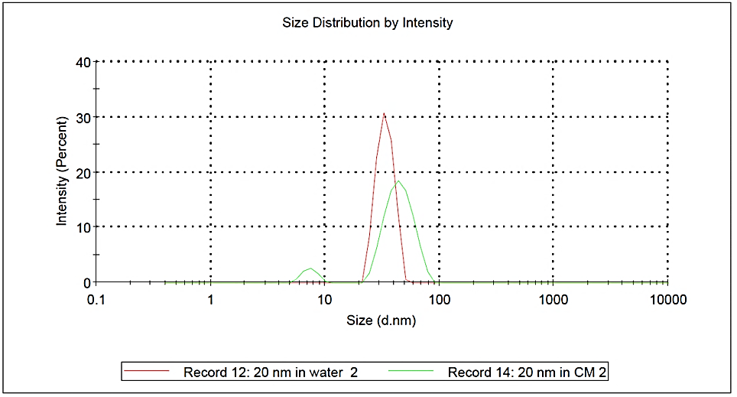
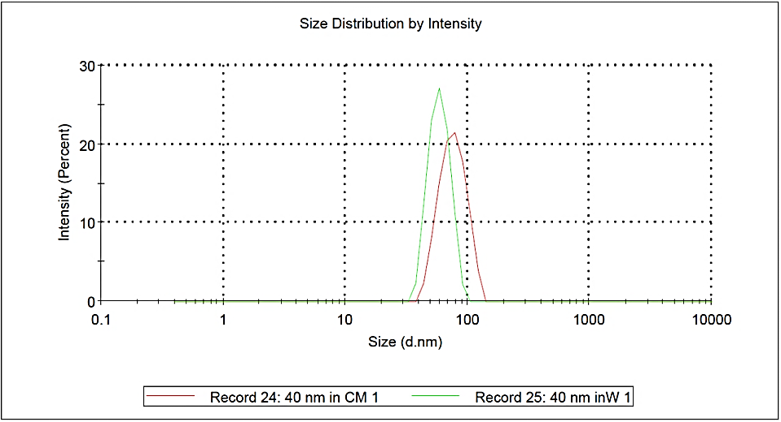
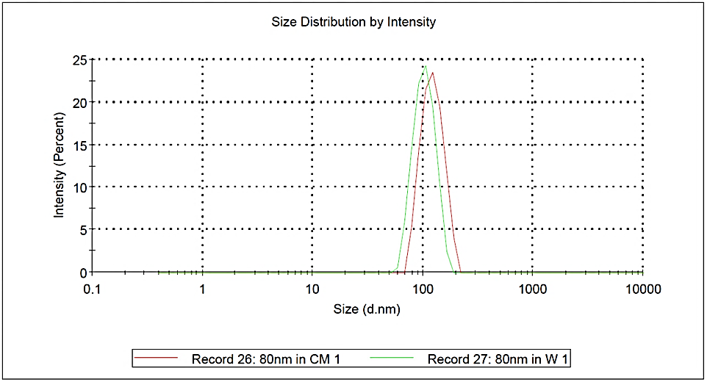
CO20
CO40
CO80
Figure S3a: DLS size distribution intensity curves for the two sets of particles in water and CCM. CO series

Slide 6
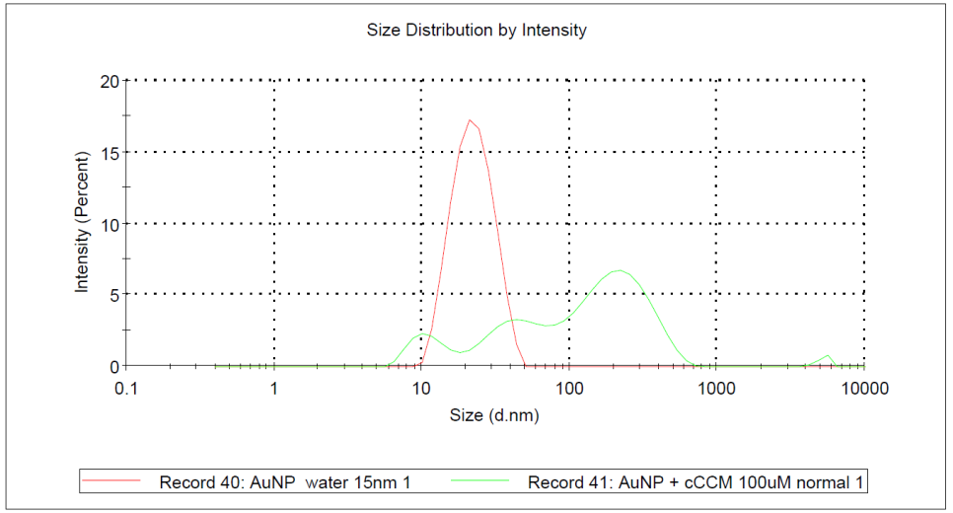
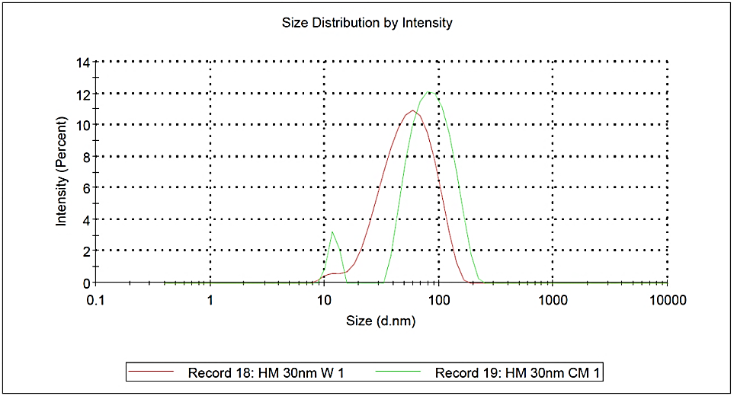
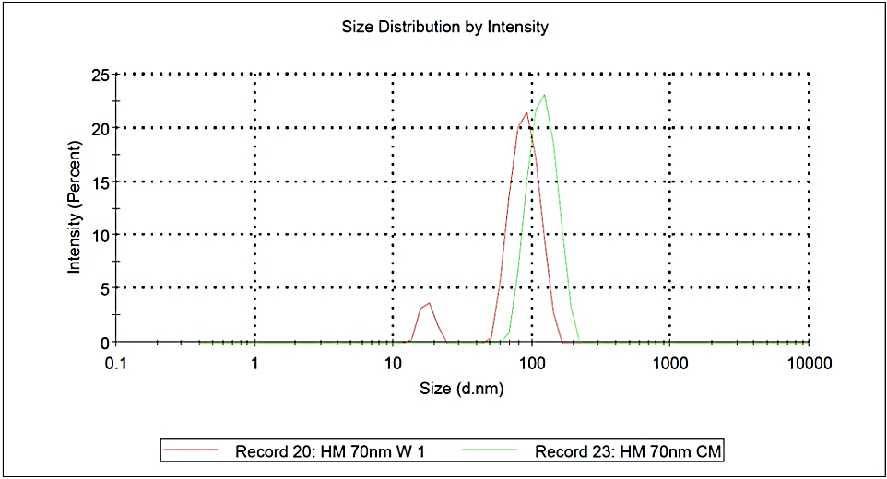
HM15
HM35
HM75
Figure S3b: DLS size distribution intensity curves for the two sets of particles in water and CCM. HM series

Slide 7
Figure S4a, : CLS sedimentation times for HM set of NPs in water and CCM.

Slide 8
Figure S4b : CLS sedimentation times for CO set of NPs in water and CCM

Slide 9
Figure S5a: UV-vis absorbance spectra of the HM set of NPs measured in water and CCM.

Slide 10
Figure S5b : UV-vis absorbance spectra of the CO set of NPs measured in water and CCM

Slide 11
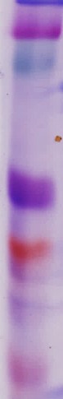
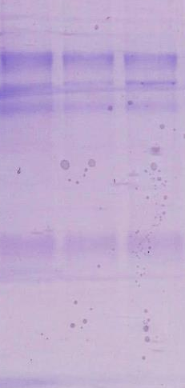
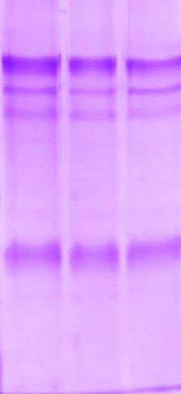

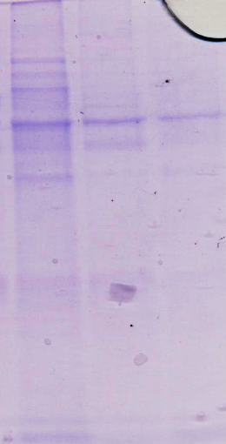
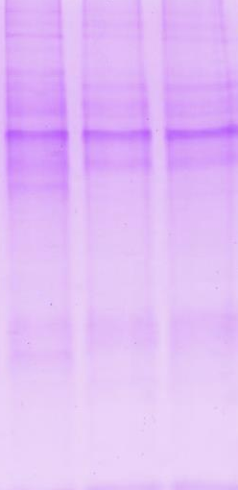
kDa
201
126
91
39
32
17
M CO20 CO40 CO80 CO20 CO40 CO80
t = 0
t = 72h
kDa
201
126
91
39
32
17
M HM15 HM35 HM75 HM15 HM35 HM75
t = 0
t = 72 h
Figure S6 : SDS page images of protein corona isolated from CO and HM series NPs at t = 0 and t = 72 hours.

Slide 12



HM15 HM45 HM75 HM15 HM45 HM75 M
kDa
201
126
91
39
32
17
t= 0
t = 72 h
conditioned CCM
CO20 CO40 CO80 CO20 CO40 CO80 M
kDa
201
126
91
39
32
17
t = 0
t = 72 h
conditioned CCM
Figure S7 : SDS page images of protein corona isolated from CO and HM series NPs at t = 0 and t = 72 hours. Cell culture medium was conditioned with A549 for 72 hours.

Slide 13
Figure S8 a: bright field image of A549 cell culture

Slide 14
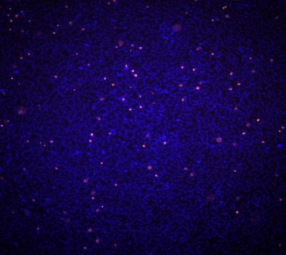
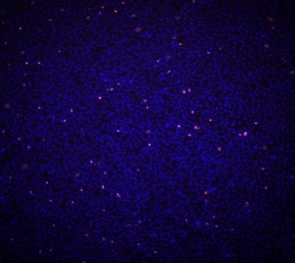
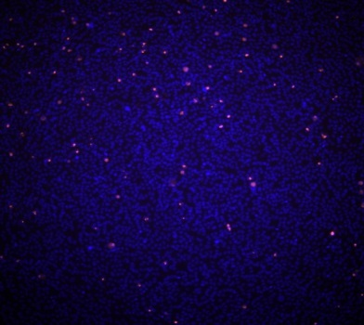
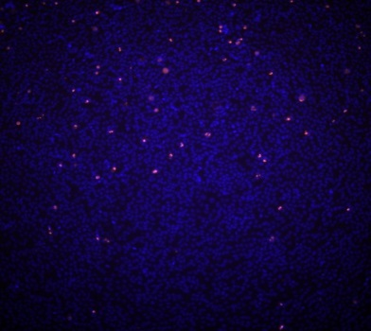
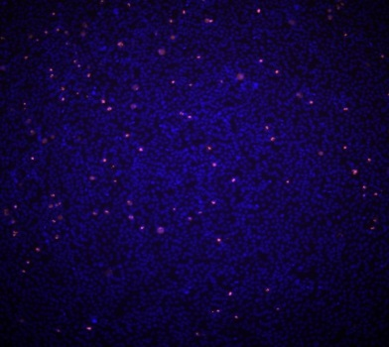
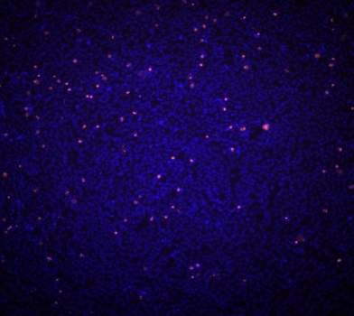
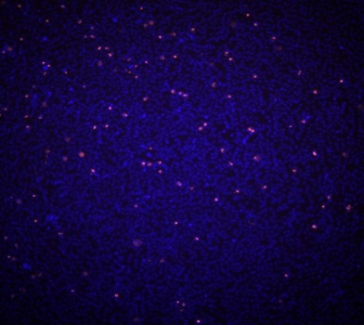
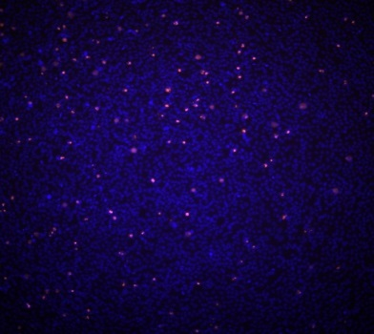
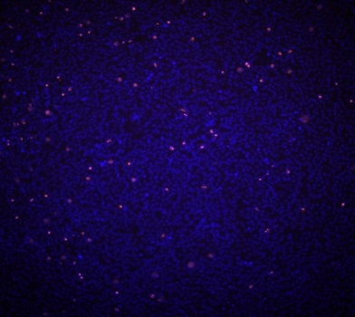
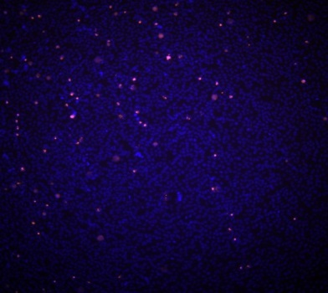
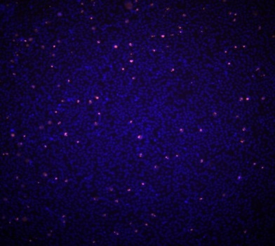
Time (h) 0 1 3
6 20 24
28 44 48
52 68 72
Fig. S8 b: Fluorescence images of the cell monolayer stained by Hoechst/PI stained for viability and counting.

Slide 15
HM15
HM35
HM75
CO20
CO40
CO80
Fig. S8c. Cell monolayer integrity monitoring by statistical analysis of viability measurements of the cell monolayer exposed to different gold NPs. The ratio of living cells/ dead cells of the exposed A549 cells was analyzed with the IN Cell Analyzer 2200 in triplicates for each of the eleven time points.

Slide 16
HM 75 with cells
0
HM 75 w.o cells
0
72 h
72 h
CO80 with cells
0
CO80 w.o cells
0
72 h
72 h
Figure S9a: Raw UV-vis spectra measured for the CO80 and HM75 in CCM at different time points.

Slide 17
CO20 with Cells
CO20 without Cells
HM15 with Cells
HM15 without Cells
Figure S9b: Raw UV-vis spectra measured for the CO20 in CCM at different time points.

Slide 18
CO40 with Cells
CO40 without cells
HM35 with cells
HM35 without cells
Figure S9c: Raw UV-vis spectra measured for the CO40 and HM35 in CCM at different time points.

Slide 19
CO20 with Cells
0
CO20 without cells
0
72 h
72 h
CO40 with Cells
0
CO40 without cells
0
72 h
72 h
CO80 with Cells
0
CO80 without cells
0
72 h
72 h
Fig S10a: UV-vis spectra measured for all Co NP sizes. Each time point spectrum is an average of three different samples measurements..

Slide 20
HM15 with cells
HM15 without cells
0
0
72 h
72 h
HM35 with cells
0
HM35 without cells
0
72 h
72 h
HM75 with cells
HM75 without cells
0
0
72 h
72 h
Fig S10b: UV-vis spectra measured for all HM NP sizes. Each time point spectrum is an average of three different samples measurements.

Slide 21
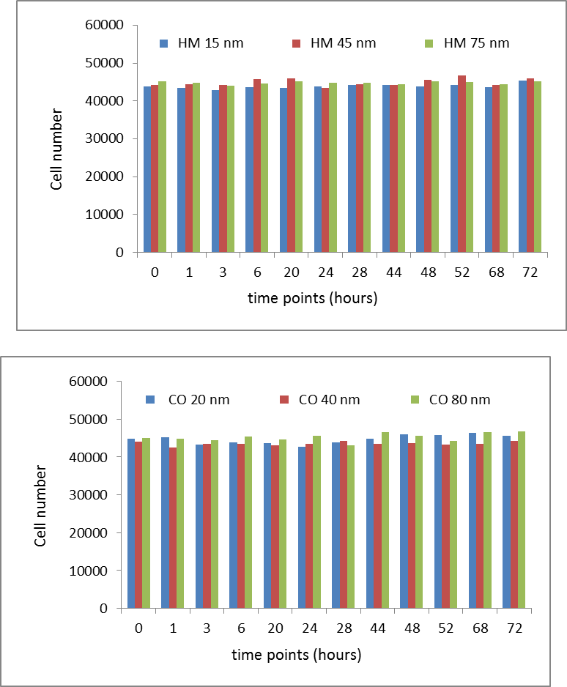
Fig. S11 Number of cells per well plotted versus time point counted in automatic with the IN Cell Analyser 2200 Imaging System of the Hoechst stained nuclei from a square area of the bottom of the 96 well.

Slide 22
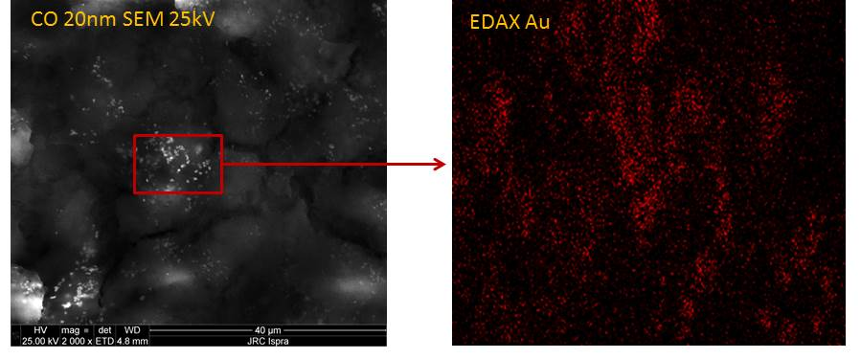
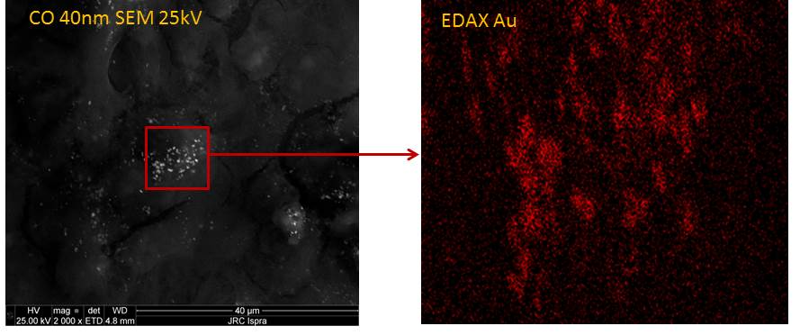
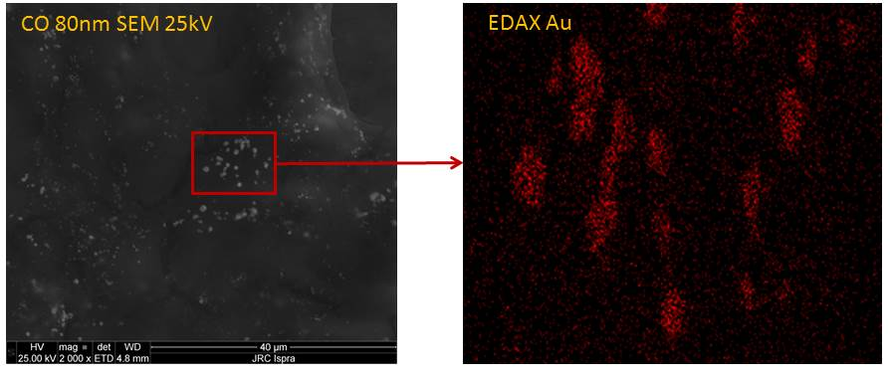
S12. SEM and EDX analysis
Fig. S12a. SEM picture on the A549 cells treated with different NP sizes on the left. On the right are the EDX – Au maps for gold NPs from the selected regions of the SEM pictures.

Slide 23
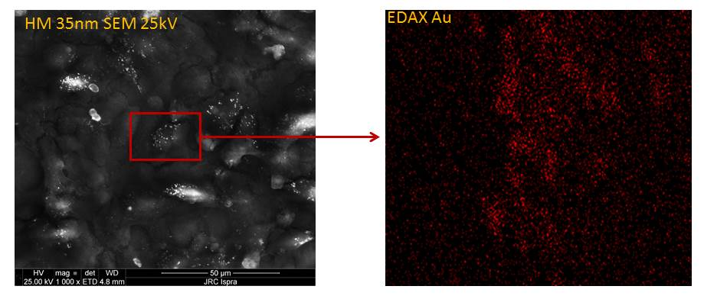
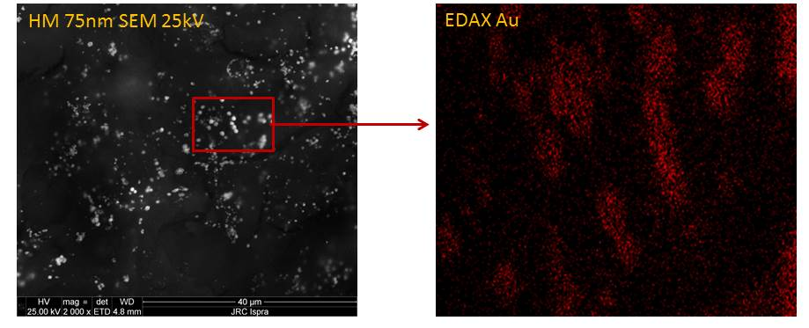
Fig. S12b. SEM picture on the A549 cells treated with different NP sizes on the left. On the right are the EDX – Au maps for gold NPs from the selected regions of the SEM pictures.

