Slide 1
A
Supplemental Figure 1: Changes in weight after single and multiple CB, O₃ and CB+O₃ inhalation exposures.

Slide 2
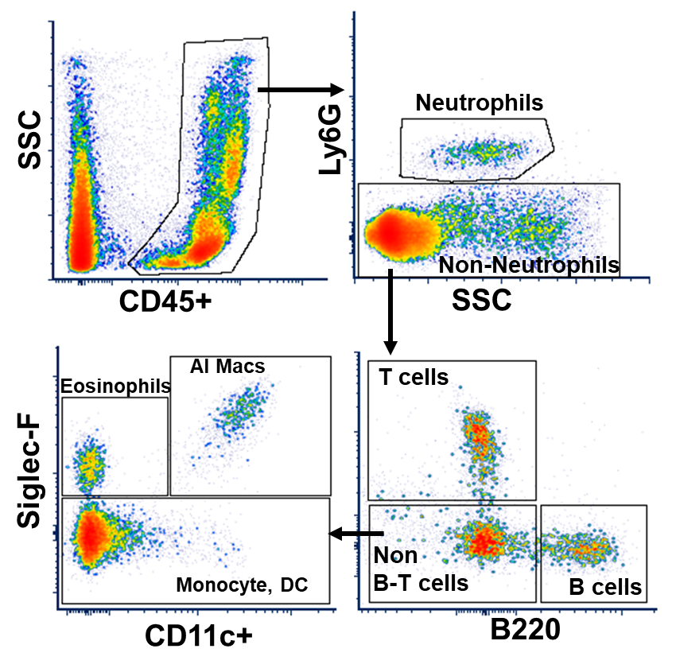
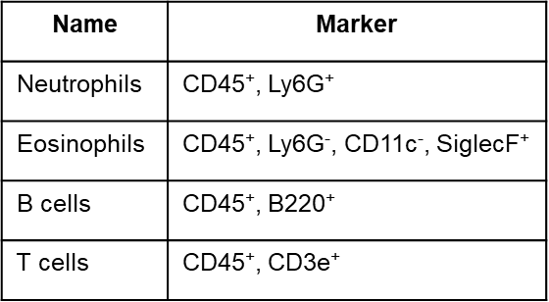
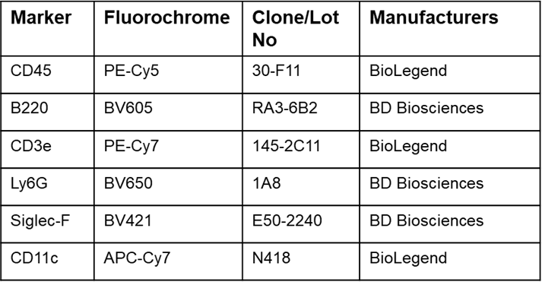
A
B
C
Supplemental Figure 2: Gating strategy for identifying inflammatory cells in lungs. A) Flow gating strategy to detect cell types in lungs after air, CB, O₃ or CB+O₃ exposure either for 3 h for one day or four days. B) Inflammatory cells identification markers. C) Inflammatory cell markers, conjugated fluorochrome, clone and vendors

Slide 3
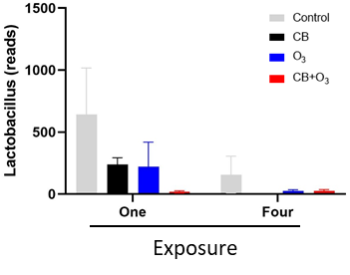
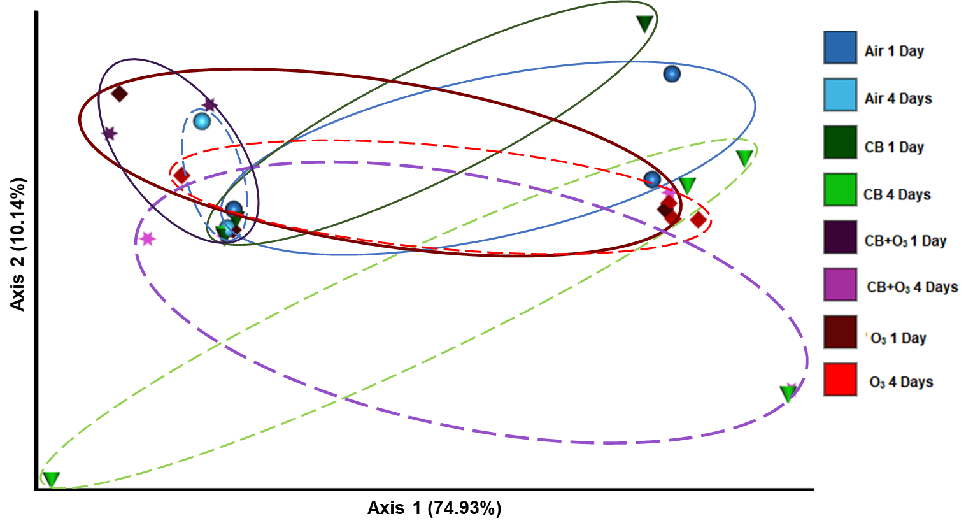
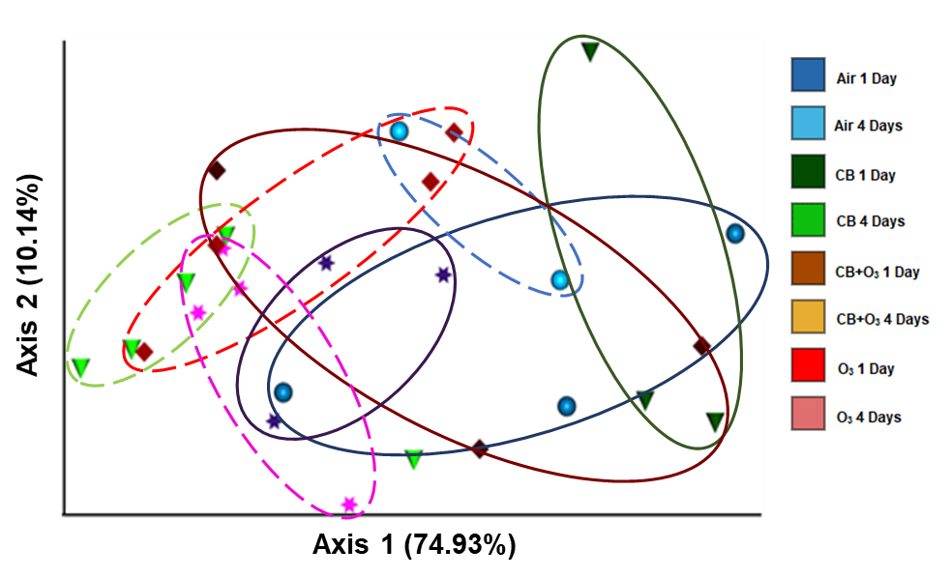
A
B
C
Supplemental Figure 3: Exposure induce changes in bacterial community in the lungs. A) Alterations in the Lactobacillus in response to inhalation exposure in the lungs. B, C) Principle Co-ordinate analysis of lung microbial community, Bray-Curtis, and Unweighted Unifrac, respectively. Data are presented as mean ± standard error of mean (SEM) and analyzed by Two-way Analysis of Variance (ANOVA) followed by Tukey’s post hoc test. The Kruskal-Wallis test was performed to determine the statistical significance of diversity index. n = 3-5.

Slide 4
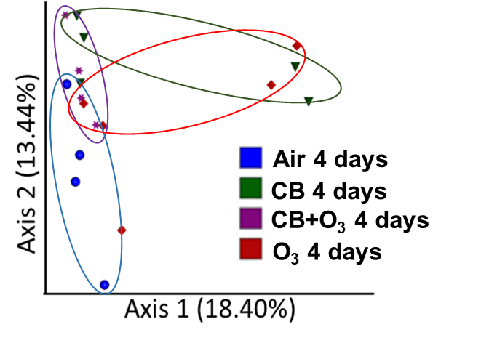
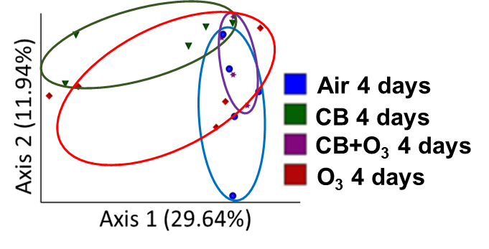
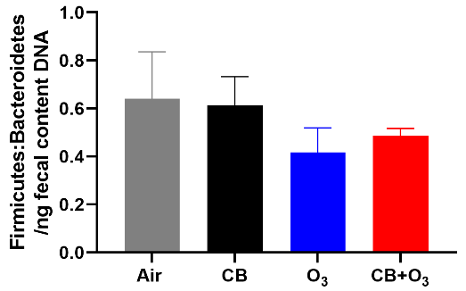
A
B
C
D
Supplemental Figure 4: Exposure induce changes in beta diversity indices in colon contents microbiome. A-C) Principle Co-ordinate analysis of colon content microbial community, Bray-Curtis, Jaccard distance and Unweighted Unifrac, respectively. D) Alterations in the Firmicutes to Bacteroidetes ratio in the colon content.*p ≤ 0.05. The Kruskal-Wallis test was performed to determine the statistical significance of diversity index. Data are presented as mean ± standard error of mean (SEM) and analyzed by One-way Analysis of Variance (ANOVA) followed by Tukey’s post hoc test. n = 3-5.

Slide 5
A
Supplemental Figure 5: Correlation analysis of absolute bacterial load in the colon contents to oxidative stress. n = 3-5.

Slide 6
Table 1: Primers used for qRT-PCR and QIAcuity One digital PCR
Gene | Forward Sequence | Reverse Sequence
18s | 5’-GTA ACC CGT TGA ACC CCA TT-3’ | 5’-CCA TCC AAT CGG TAG TAG CG-3’
Duox2 | 5’-GAG AAA GGC TGT GAC CAA GCA G-3’ | 5’-TCA CGC ACT TGC TGG GAT GAG T-3’
p22 | 5’-CTG AGC TTC AGC CGA GAG TAC A-3’ | 5’-TTC TGT CGC TGT TCC TGC TTC G-3’
GPX1 | 5’-CGC TCT TTA CCT TCC TGC GGA A-3’ | 5’-AGT TCC AGG CAA TGT CGT TGC G-3’
GPX2 | 5’-TGT GGC TAC CTA TTG CGG TCT G-3’ | 5’-TTG TCT CCT GGT TCT TGC TTT CC-3’
GPX3 | 5’- ATC CTG CCT TCT GTC CCT GCT C-3’ | 5’-TGG TGA GGG CTC CAT ACT CGT A-3’
GPX4 | 5’- CCT CTG CTG CAA GAG CCT CCC-3’ | 5’-CTT ATC CAG GAC CAT GTG C-3’
Nrf2 | 5’-ATA CGC AGG AGA GGT AAG AAT AAA GTC-3’ | 5’-AGA GAG TAT TCA CTG GGA GAG TAA GG-3’
Ho-1 | 5’-CAC TCT GGA GAT GAC ACC TGA G-3’ | 5’-GTG TTC CTC TGT CAG CAT CAC C-3’
GCG | 5’- CCT TCA AGA CAC AGA GGA GAA CC-3’ | 5’- CTG TAG TCG CTG GTG AAT GTG C-3’
GLP1R | 5’-CGG AGT GTG AAG AGT CTA AGC G-3’ | 5’- ATG GCT GAA GCG ATG ACC AAG G-3’
CCK | 5’-TAG CGC GAT ACA TCC AGC AGG T-3’ | 5’-GGT ATT CGT AGT CCT CGG CAC T-3’
PYY | 5’-GCC ACT ACC TCA ACC TGG TCA C-3’ | 5’-TCG CTG TCG TCT GTG AAG AGC A-3’
QIAcuity One digital PCR primers
Total Bacteria | 5’-TCC TAC GGG AGG CAG CAG T-3’ | 5’-GGA CTA CCA GGG TAT CTA ATC TT-3’
Bacteroidetes | 5’-GGT TCT GAG AGG AGG TCC C-3’ | 5’-GCT GCC TCC CGT AGG AGT-3’
Firmicutes | 5’-GGA GYA TGT GGT TTA ATT CGA AGC A-3’ | 5’-AGC TGA CGA CAA CCA TGC AC-3’

Slide 7
Table 2: Aerosol characterization
Parameters | Median Diameter
SMPS/APS | CB- 82.9 nm (2.46) – 84.6 nm (2.47) CB+O₃- 84.5 nm (2.49) – 84.6 nm (2.50)
ELPI+ | CB- 64.5 nm (2.12) – 55 nm (2.13) CB+O₃- 74.4 nm (2.20) – 74.5 nm (2.22)
Moudi | CB- 0.90 nm (2.60) – 0.96 nm (2.62) CB+O₃- 0.97 nm (2.73) – 1.10 nm (3.06)

Slide 8
Table 3: Heat-map statistics of inflammatory cells
 | Day 1 |  |  |  |  | Day 4 |  |  |  |  | Inflammatory Cells
Air | CB |  | O₃ |  | CB+O₃ | CB |  | O₃ |  | CB+O₃
4.593±0.22 | 4.813±0.71 |  | 8.844±2.16 |  | 7.613±.483 | 3.283±.374 |  | 3.608±.3152 |  | 7.415±.976 | Neutrophils
(n=4) | (n=4) |  | (n=3) |  | (n=5) | (n=4) |  | (n=4) |  | (n=4)
1.412±.284 | 2.566±.478 |  | 1.916±.498 |  | 1.139±.348 | 2.897±.324 |  | 5.967±.2395 |  | 6.114±.239 | Eosinophils
(n=4) | (n=4) |  | (n=3) |  | (n=5) | (n=4) |  | (n=4) |  | (n=4)
23.06±1.72 | 38.78±1.28 |  | 25.62±1.11 |  | 29.89±1.70 | 31.34±1.41 |  | 34.93±.7869 |  | 31.68±2.11 | B cells
(n=4) | (n=4) |  | (n=3) |  | (n=5) | (n=4) |  | (n=4) |  | (n=4)
19.67±0.66 | 18.46±0.36 |  | 10.66±1.33 |  | 14.55±.300 | 17.38±.377 |  | 14.28±3774 |  | 14.98±.385 | T cells
(n=4) | (n=4) |  | (n=3) |  | (n=5) | (n=4) |  | (n=4) |  | (n=4)

Slide 9
Table 4: Heat-map statistics of mRNA expression

