Slide 1
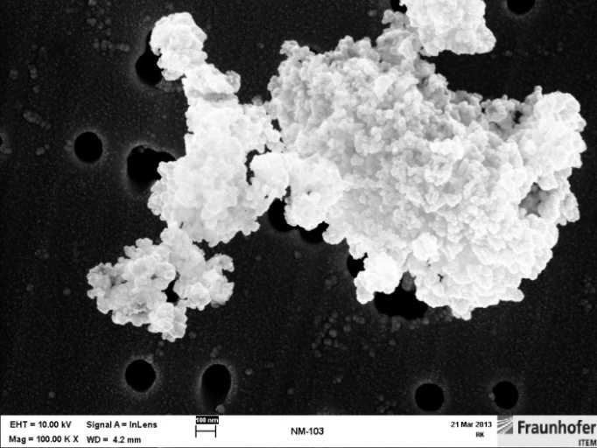
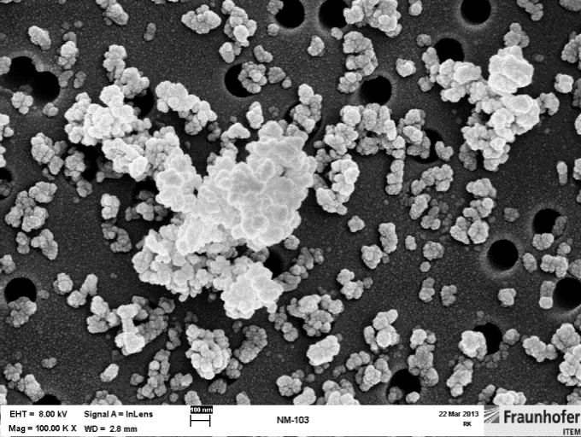
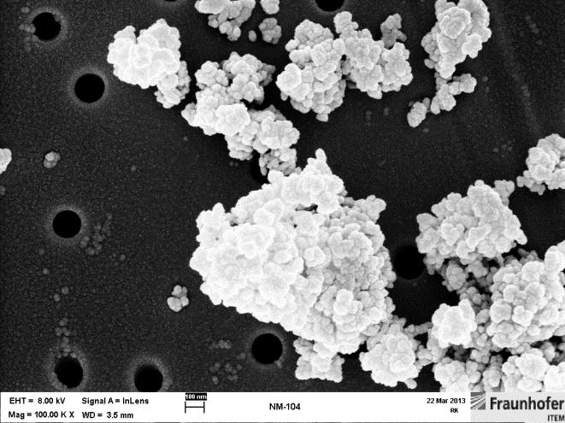
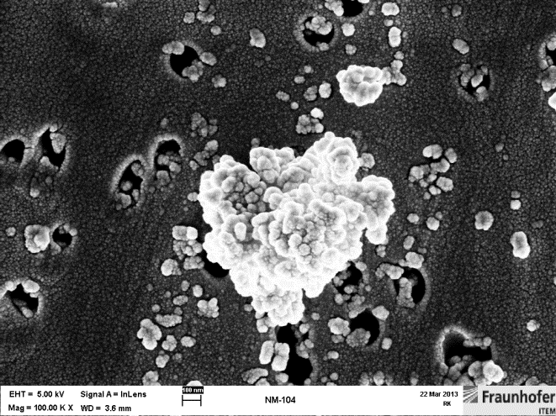
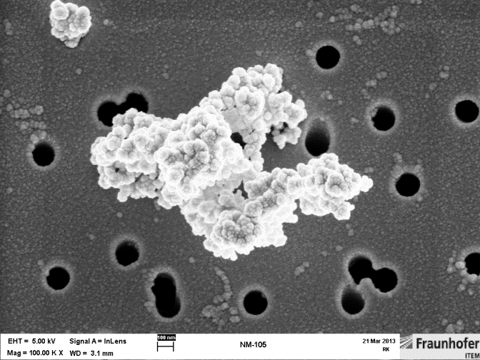
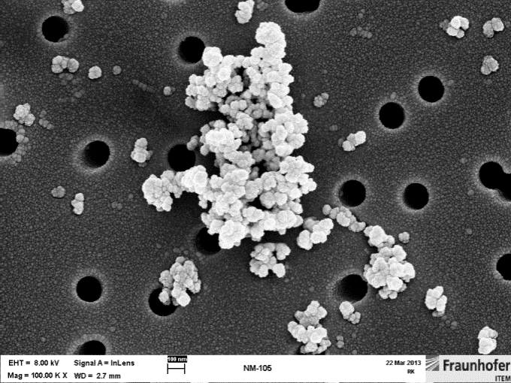
Supplement figure 1:
SEM images of test item powders at 100,000x magnification
Agglomerate
Agglomerate + individual particles
TiO₂ NM-103
TiO₂ NM-103
TiO₂ NM-104
TiO₂ NM-104
TiO₂ NM-105
TiO₂ NM-105

Slide 2
Supplement figure 2:
Lung wet weights
Absolute lung weights
Relative lung weights
3 mg/m³ exposure groups
12 mg/m³ exposure groups
48 mg/m³ exposure groups
Significances to the concurrent control groups.
Dunnett's test. Statistic calculated in the laboratory information management system Provantis 8.

Slide 3
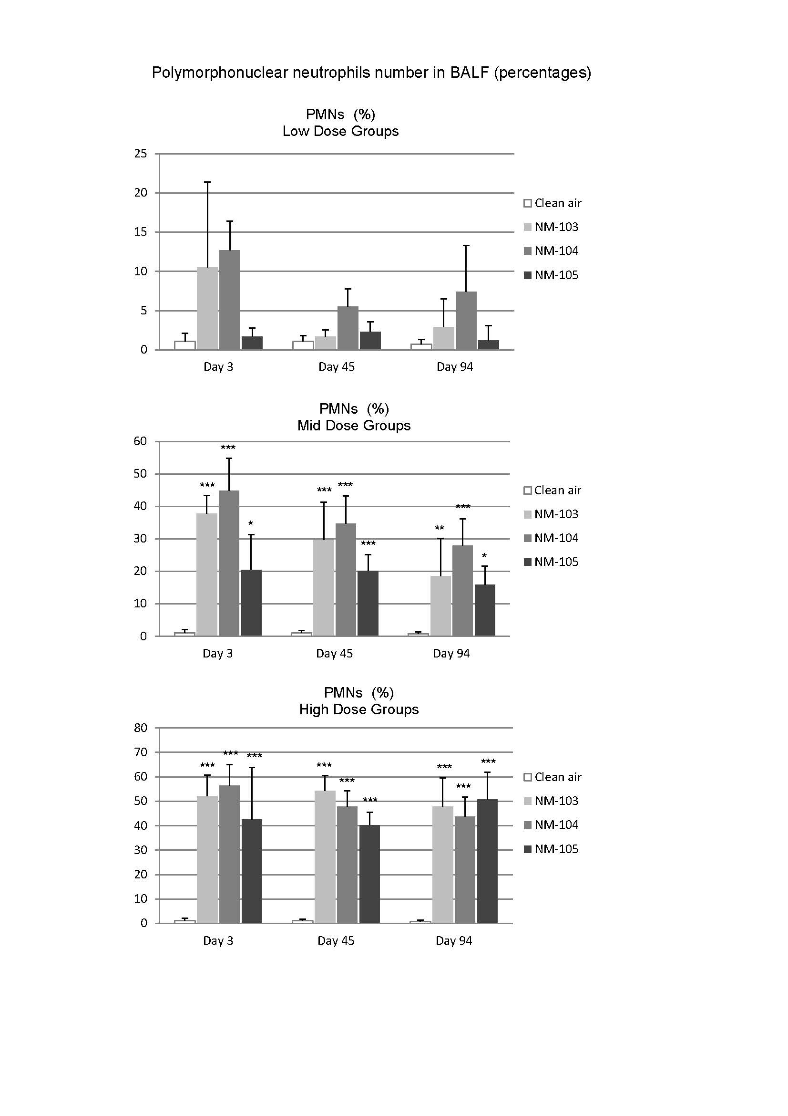
Supplement figure 3:
*
**
*
***
Significances to the concurrent control groups.
Dunnett's test. Statistic calculated in the laboratory information management system Provantis 8.

Slide 4
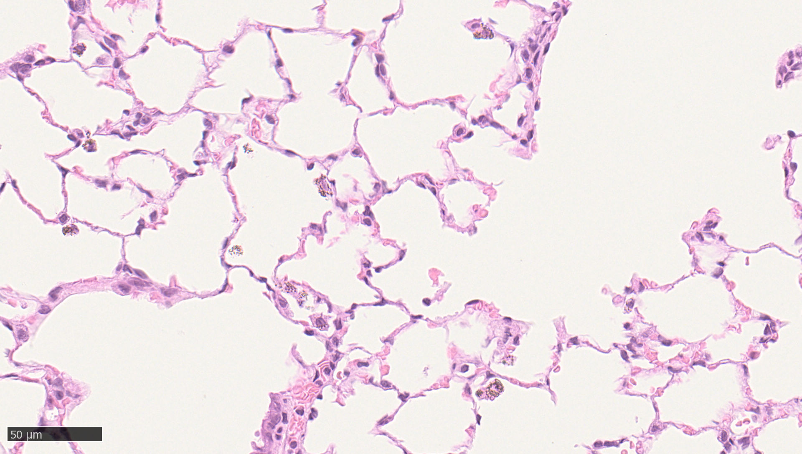
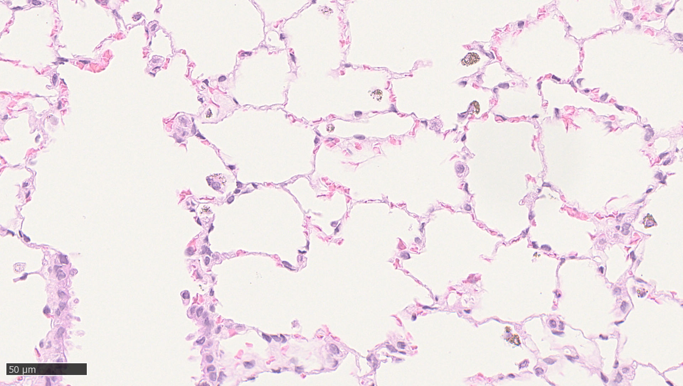
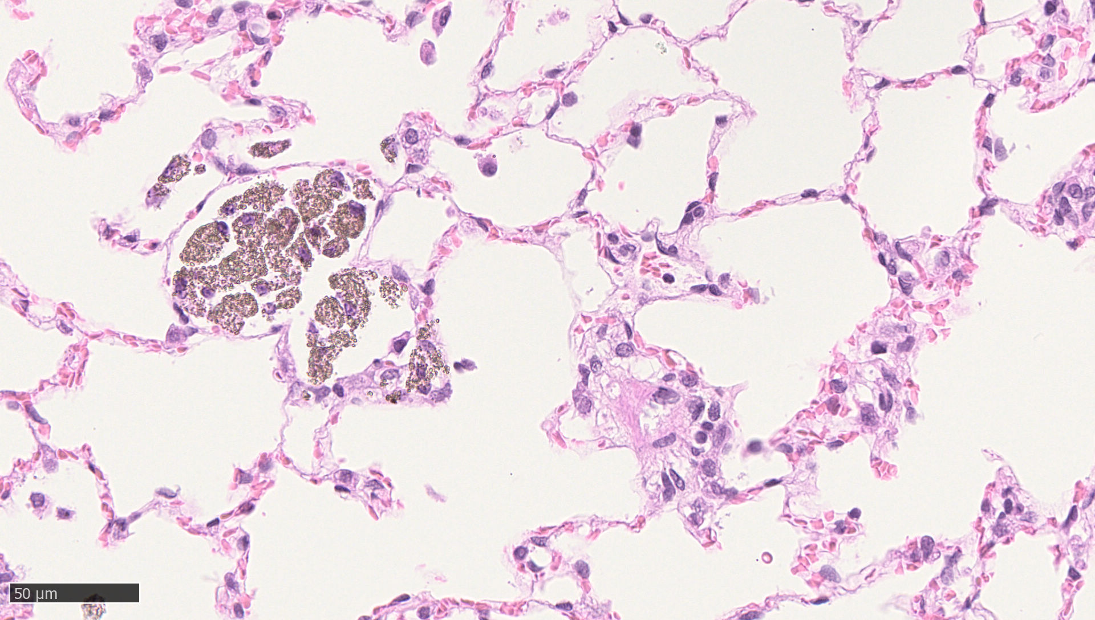
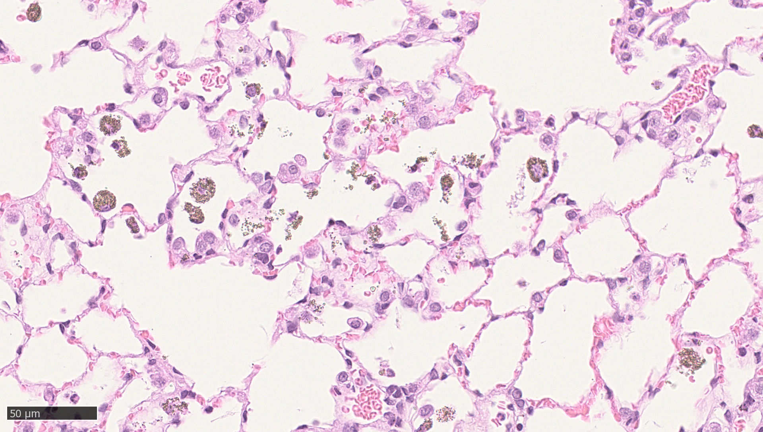
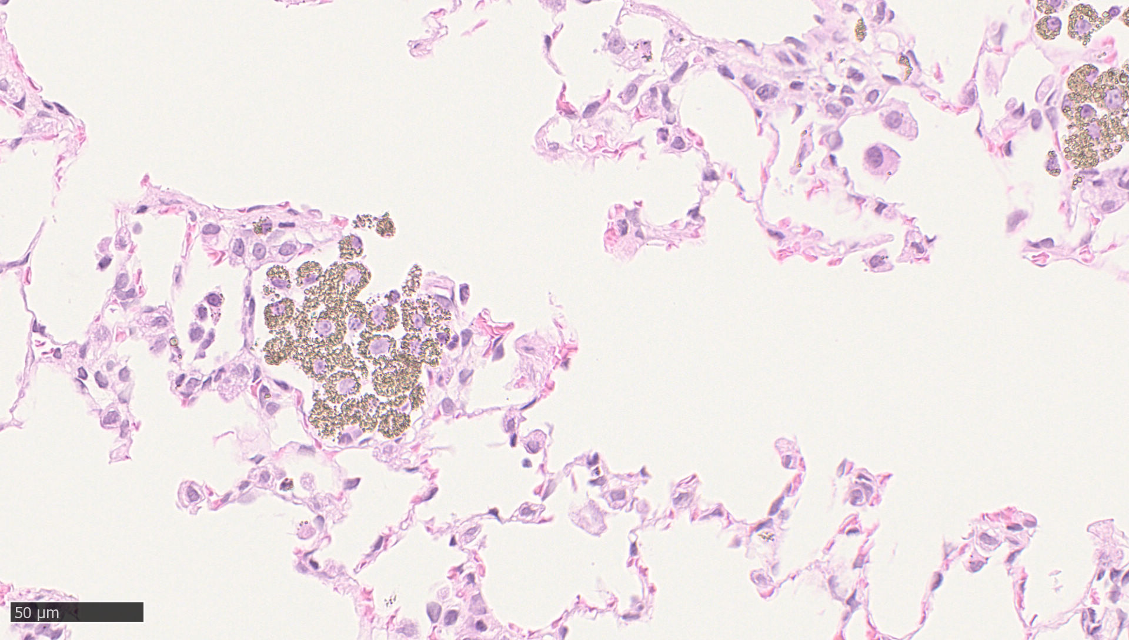
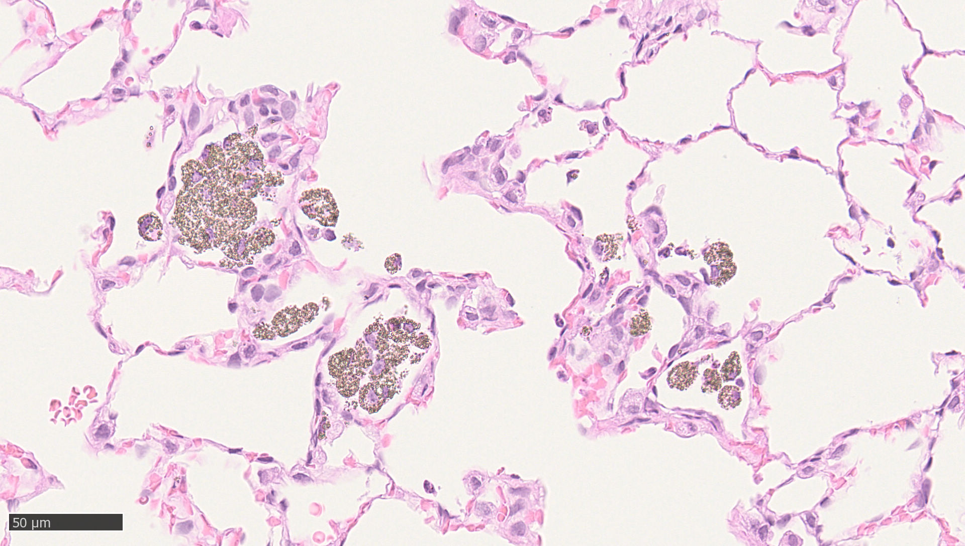
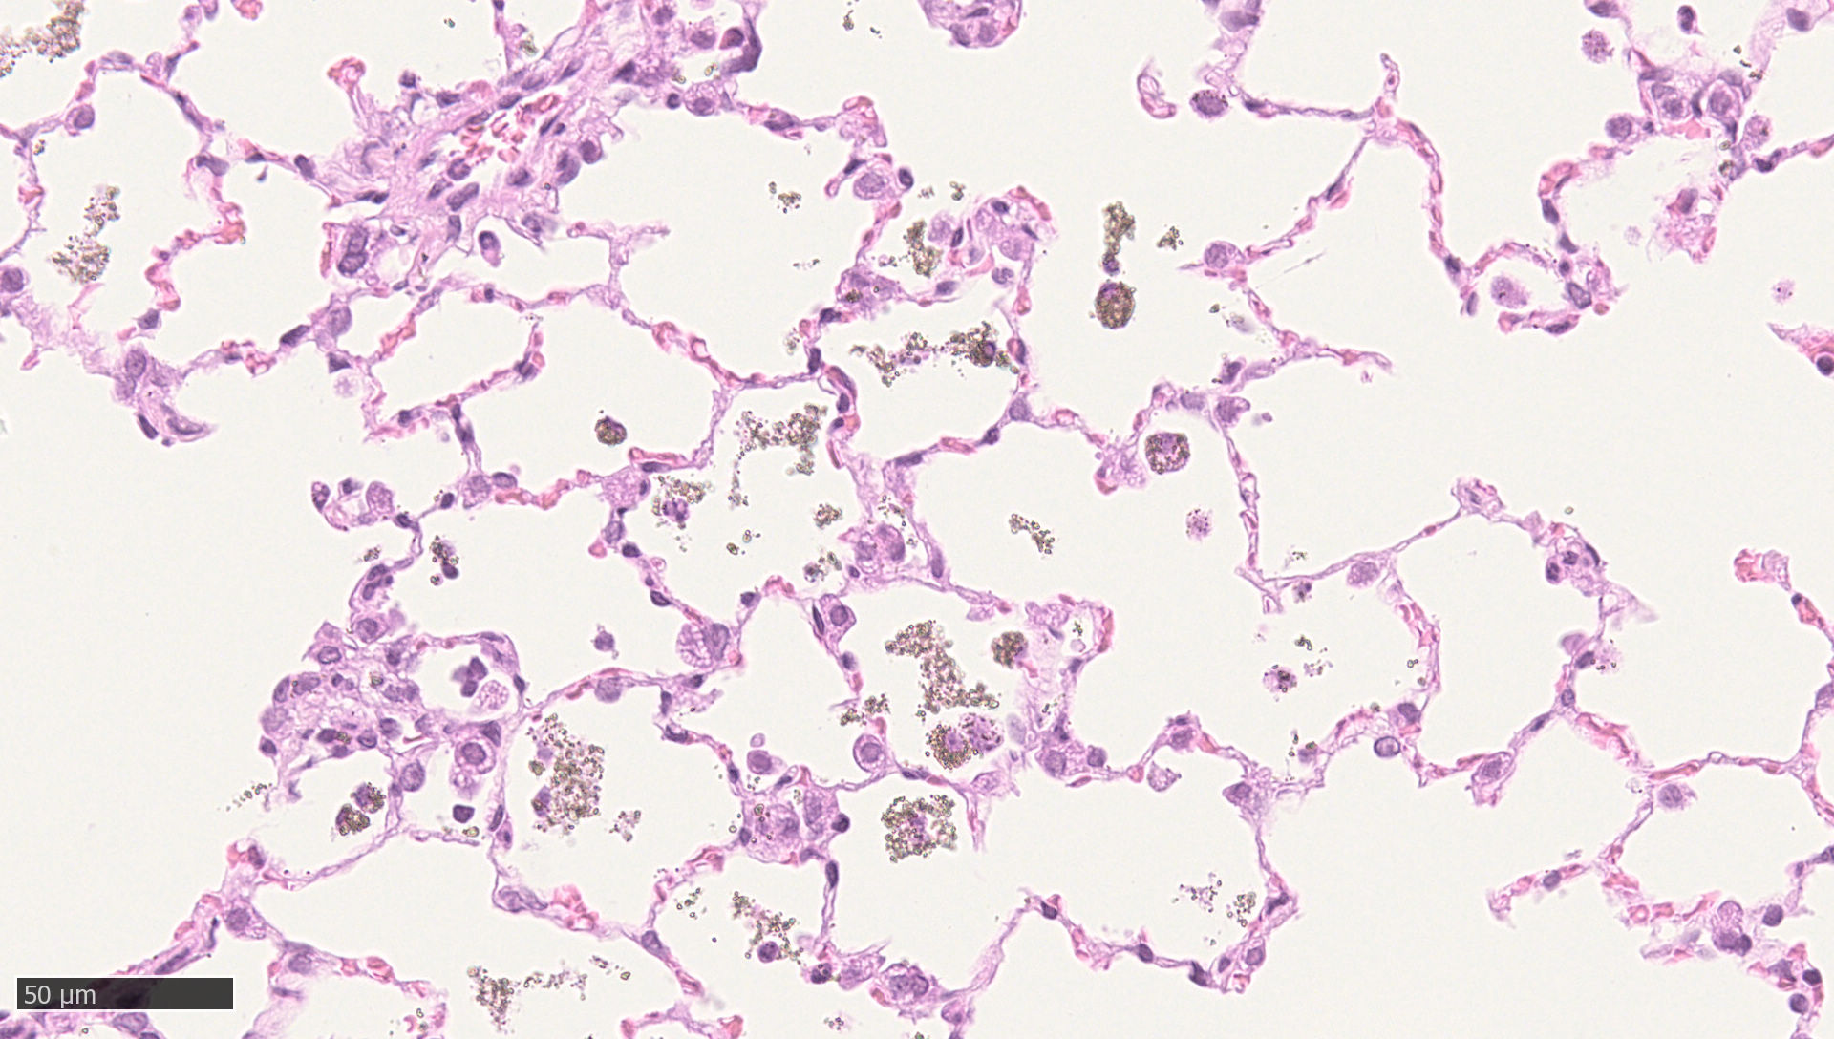
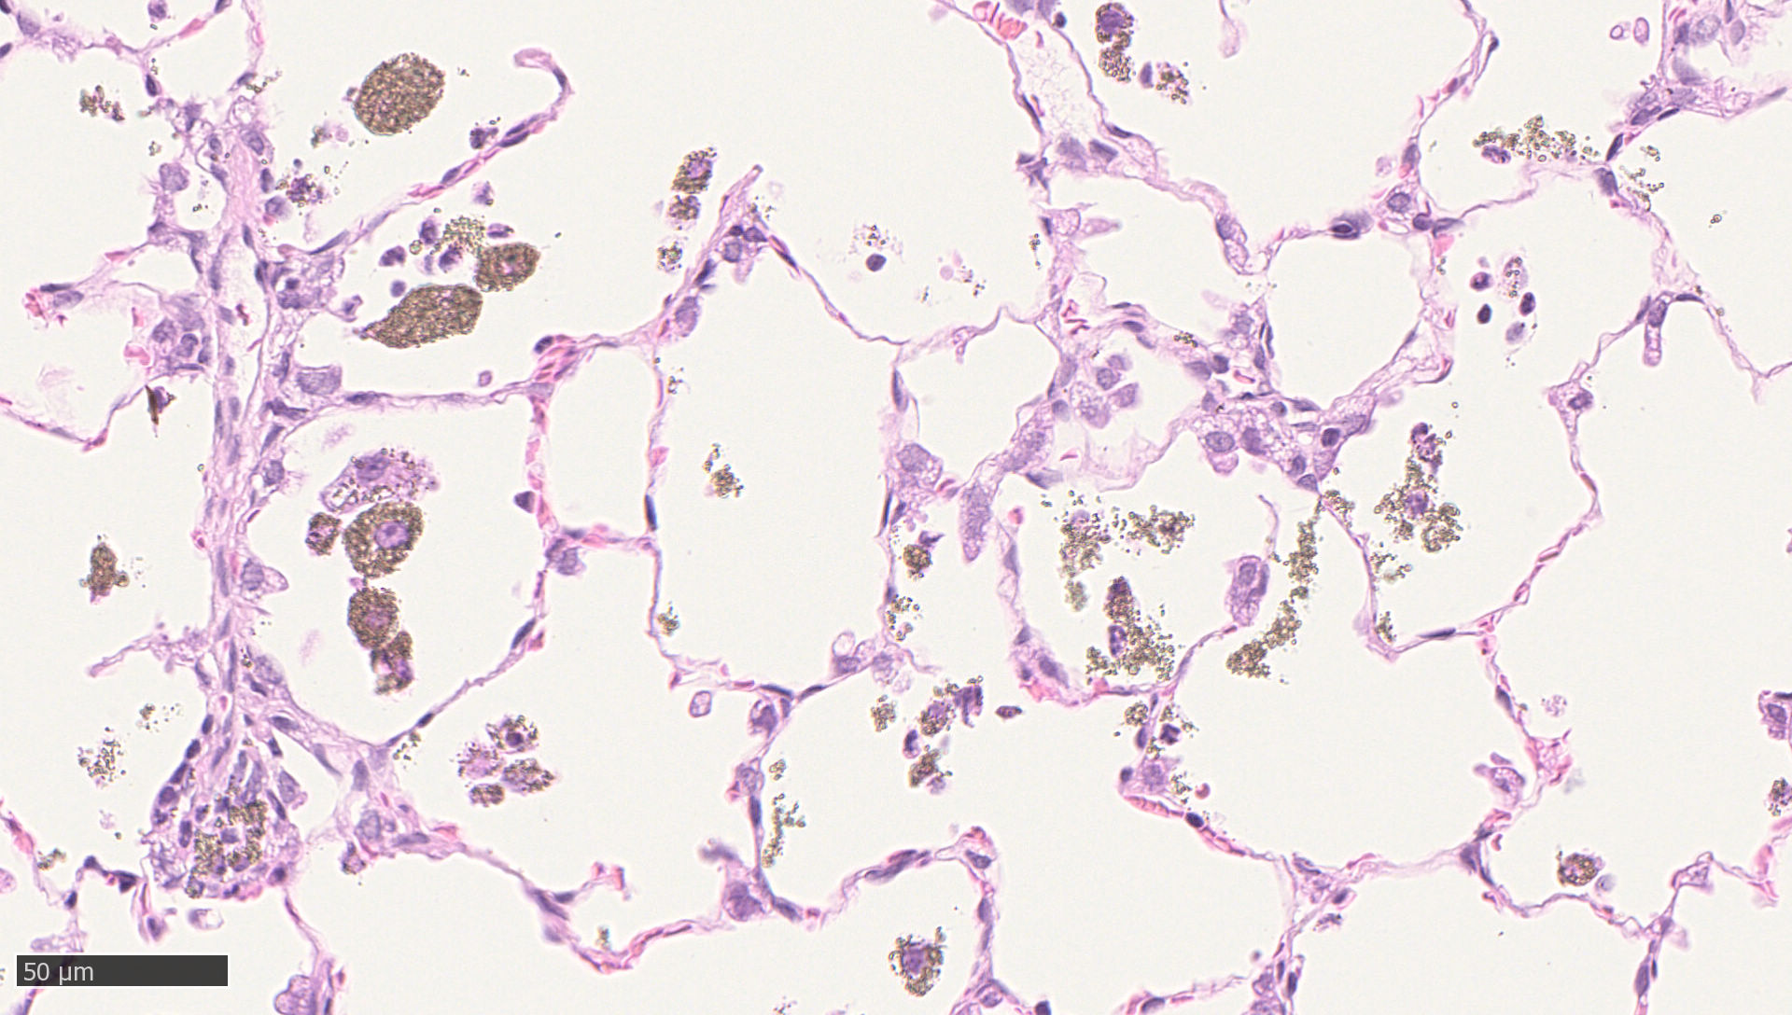
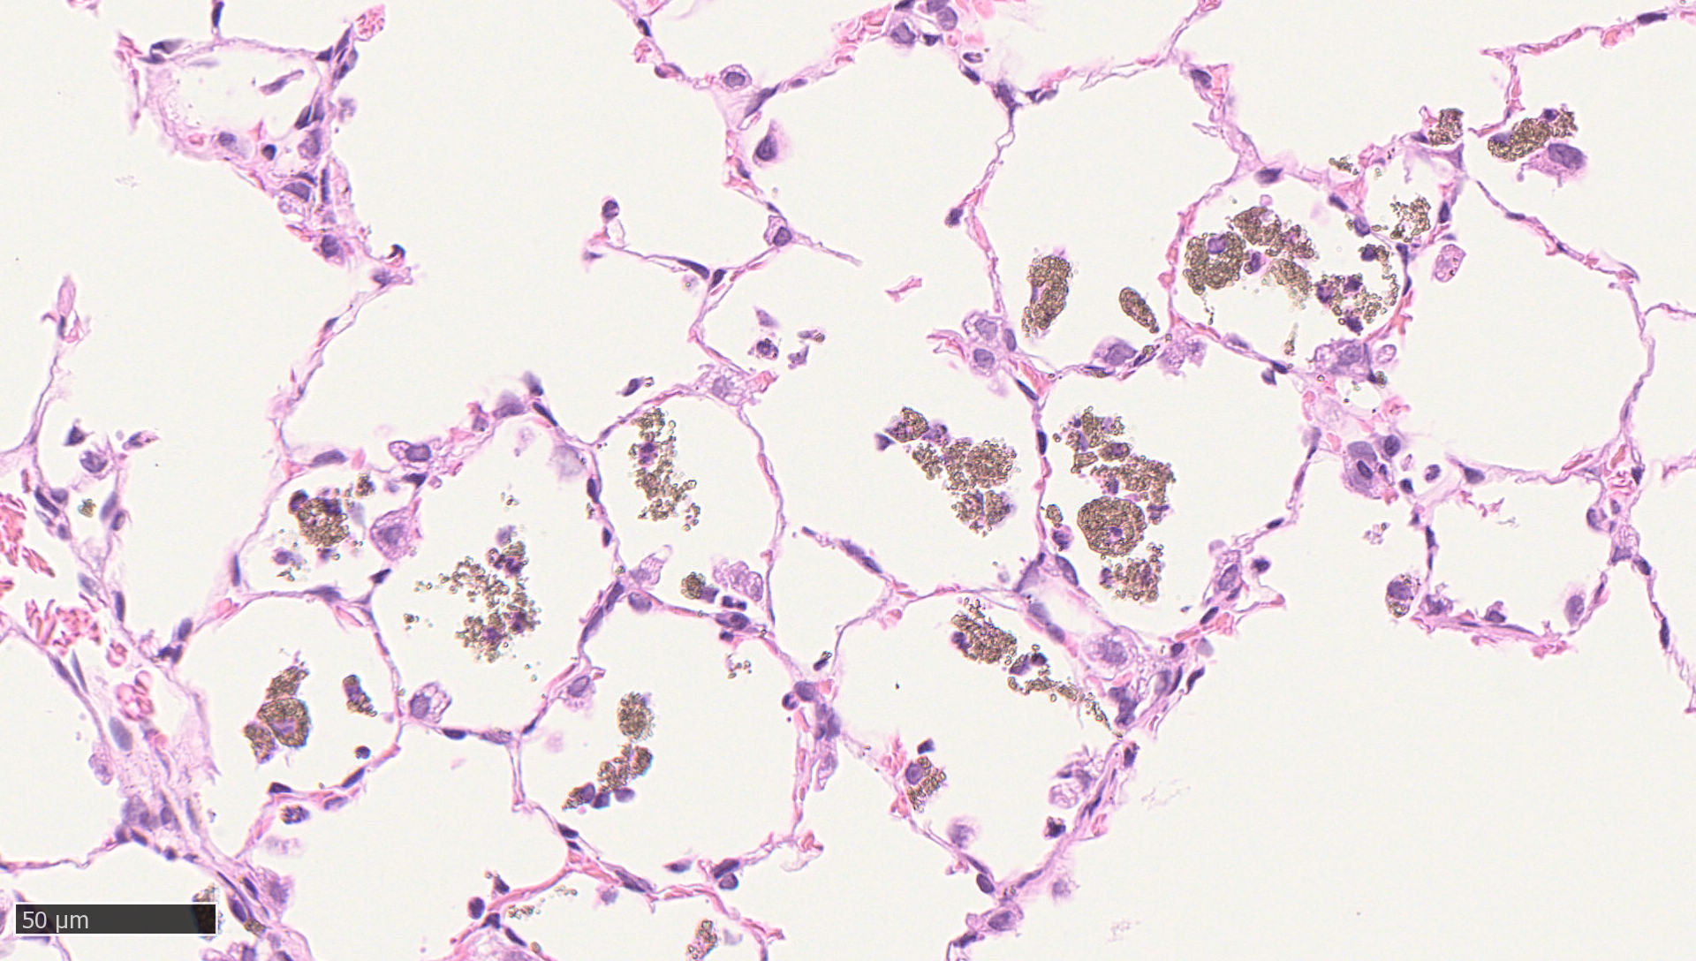
Supplement figure 4:
Exemplary light microscopic images of lung
NM-103
3 days exposure free
45 days exposure free
94 days exposure free
Low (3 mg/m³) exposure concentration
Mid (12 mg/m³) exposure concentration
High (48 mg/m³) exposure concentration

Slide 5
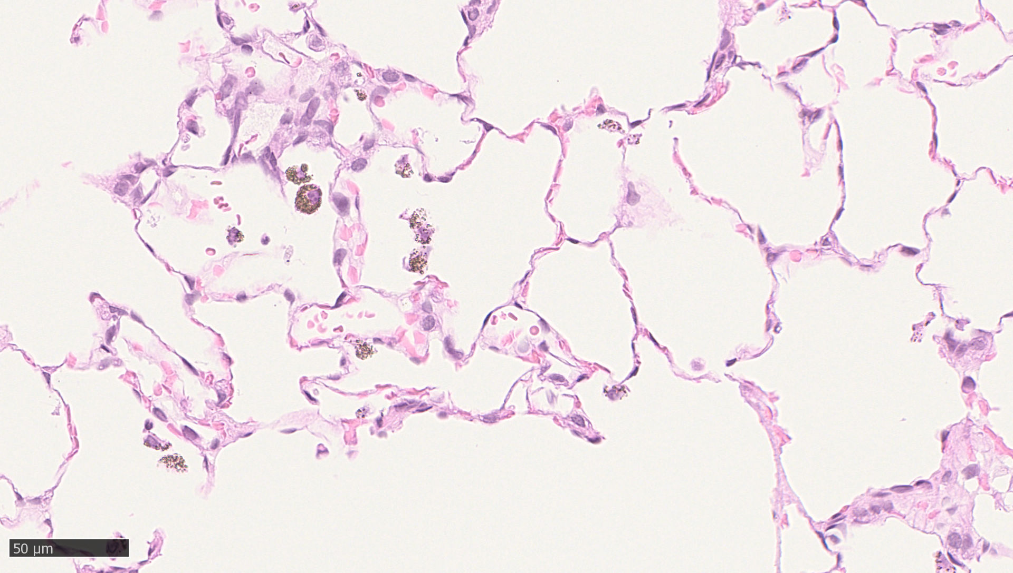
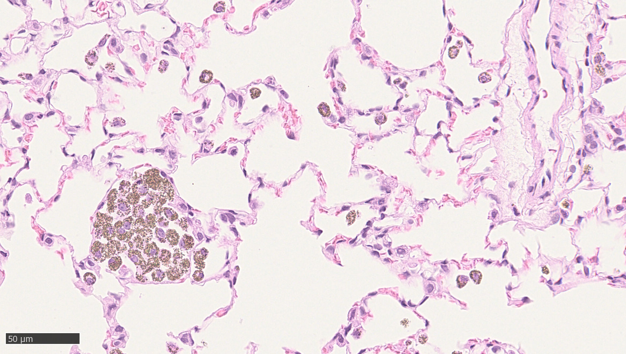
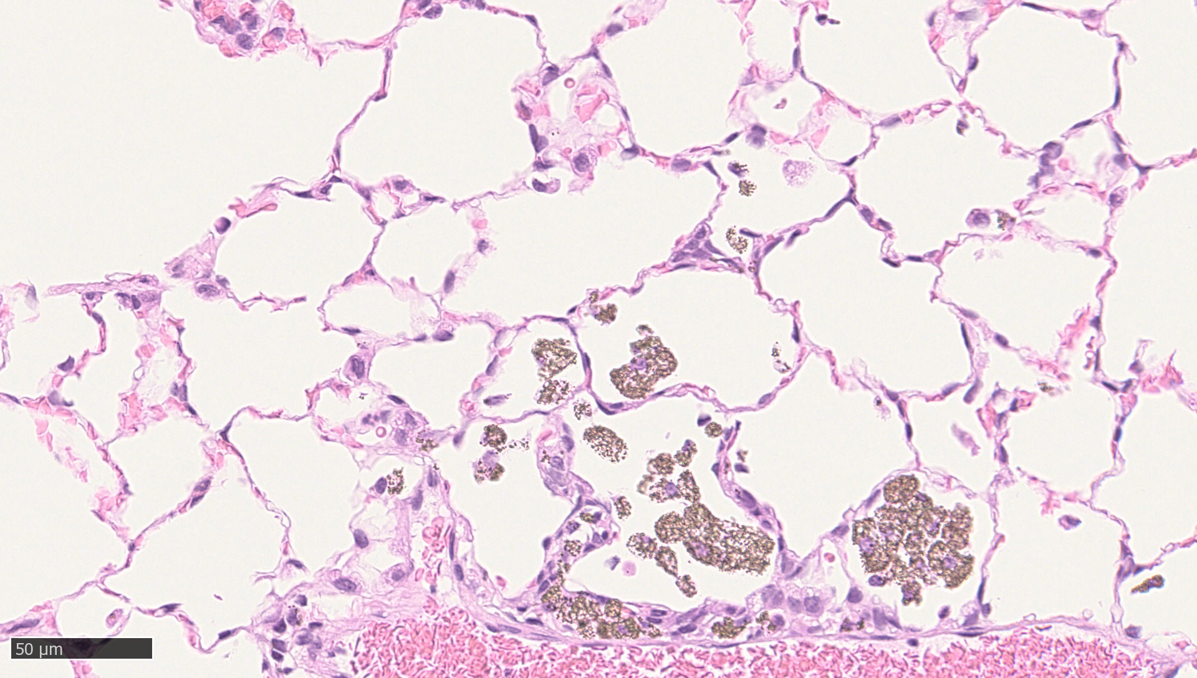
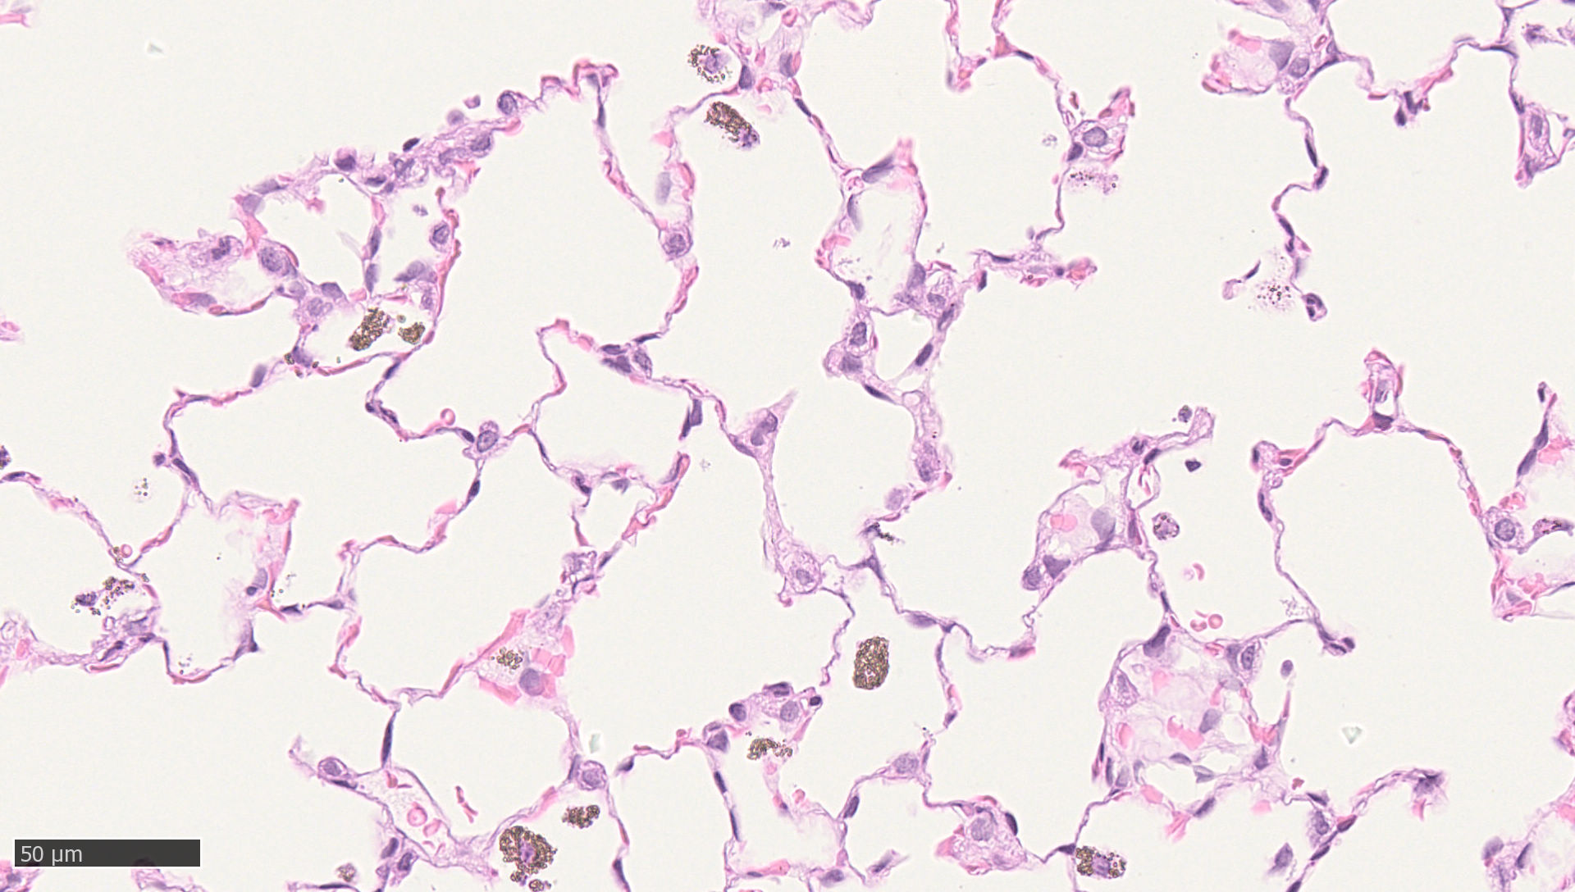
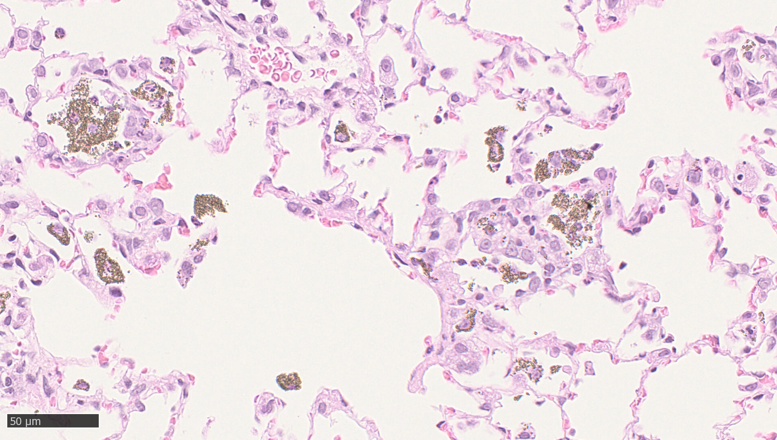
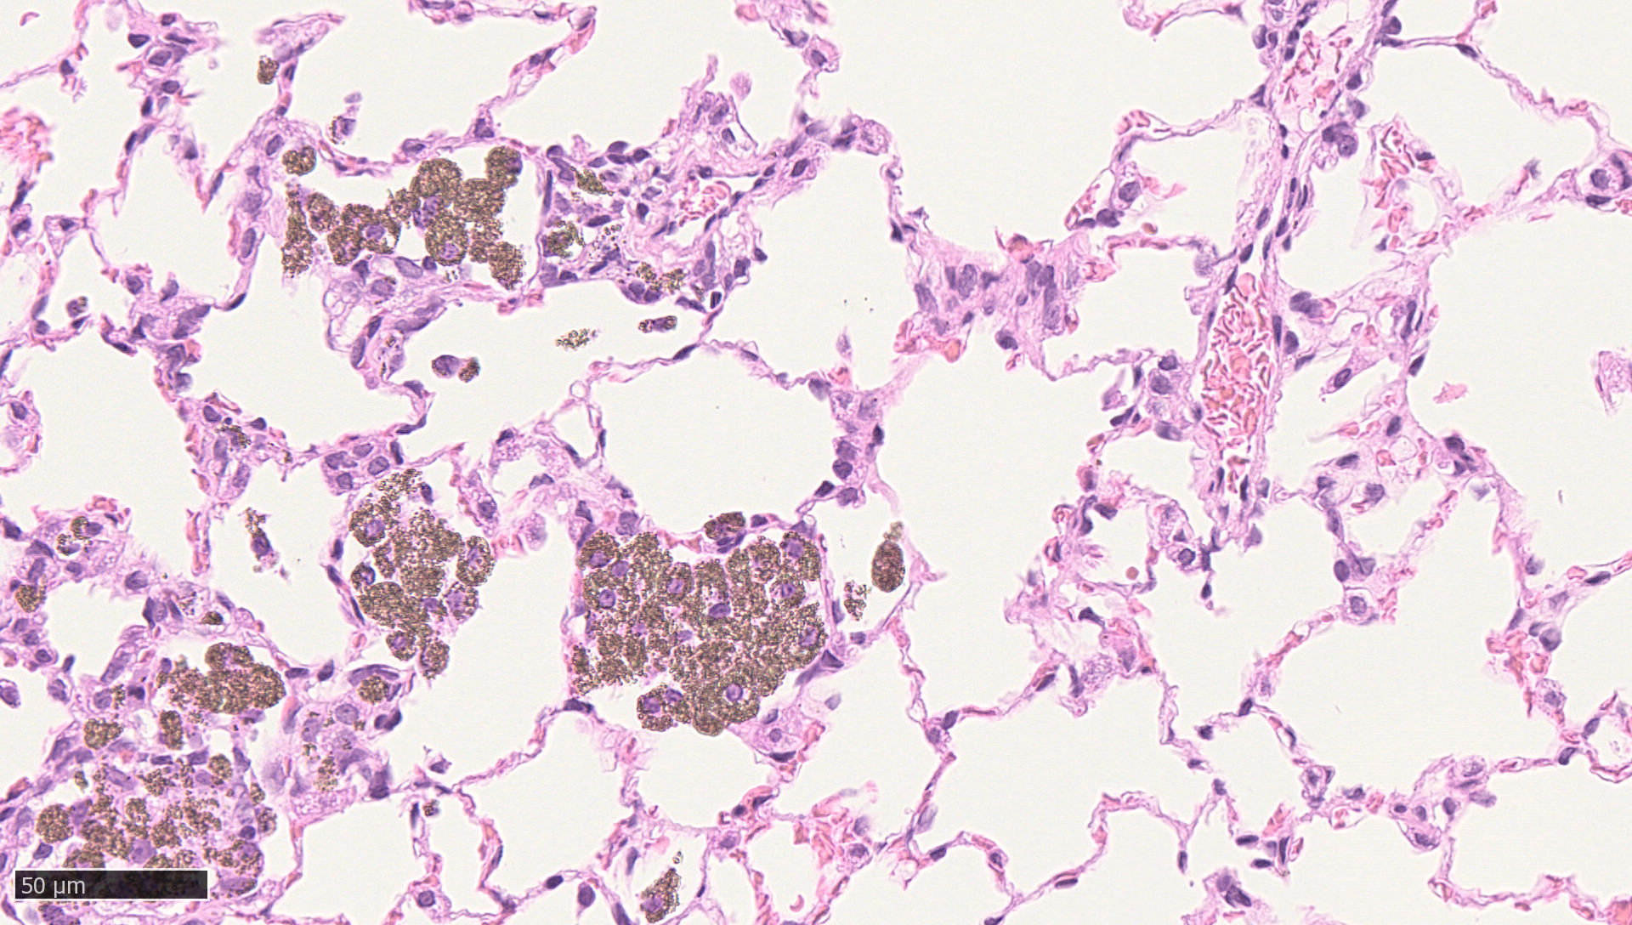
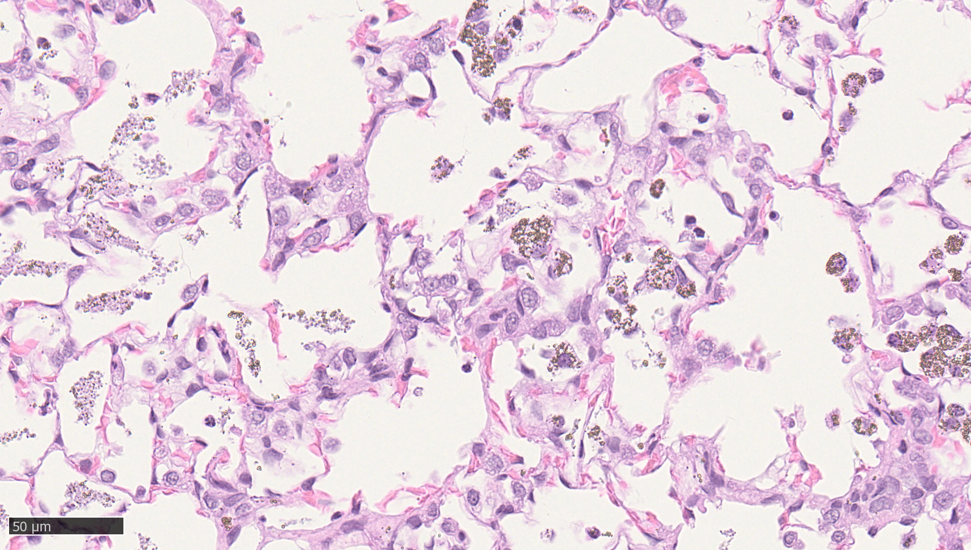
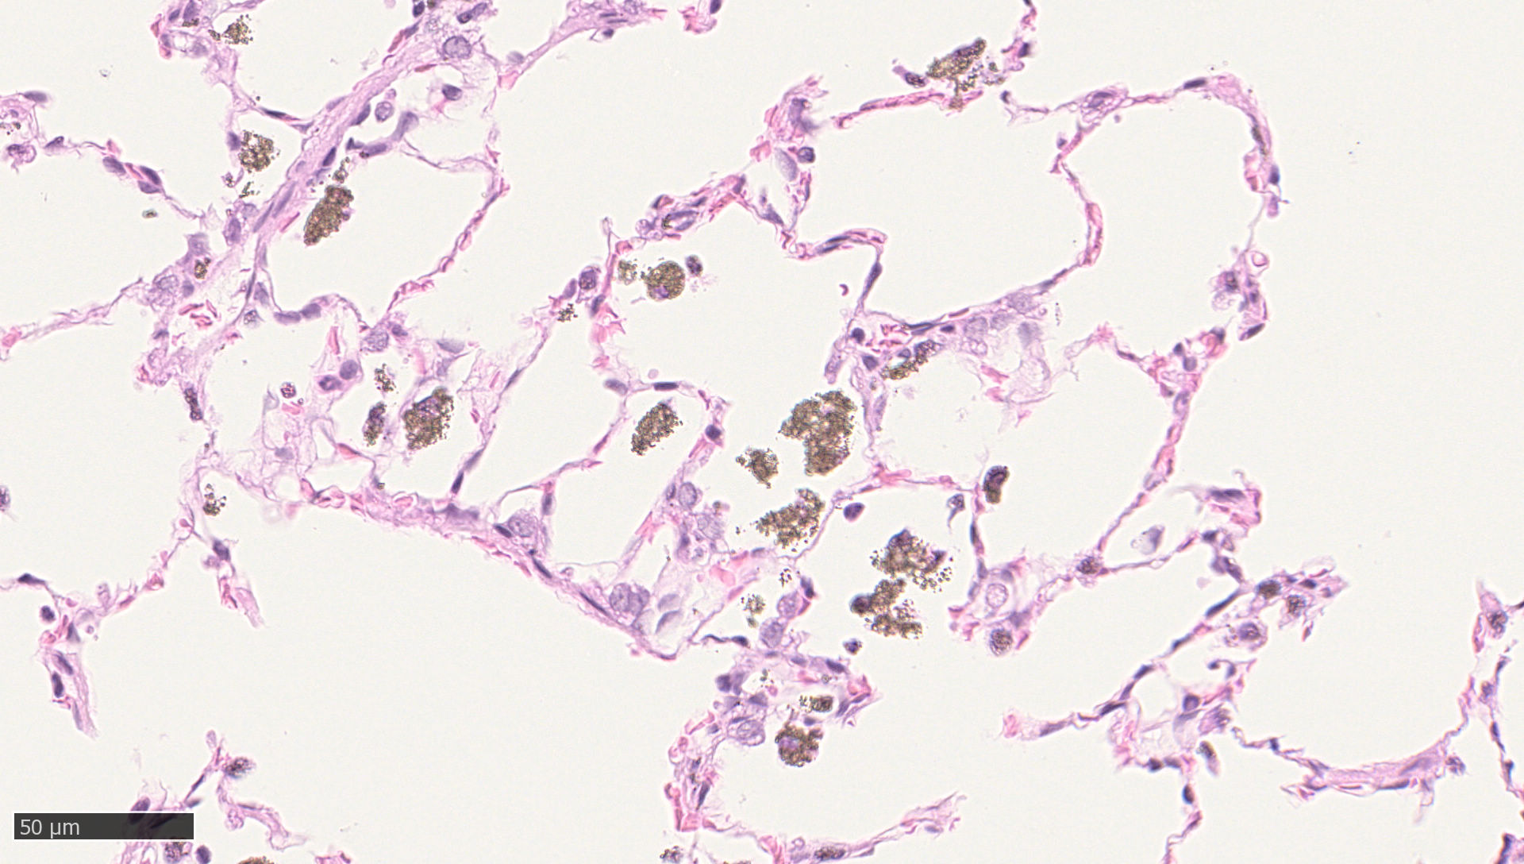
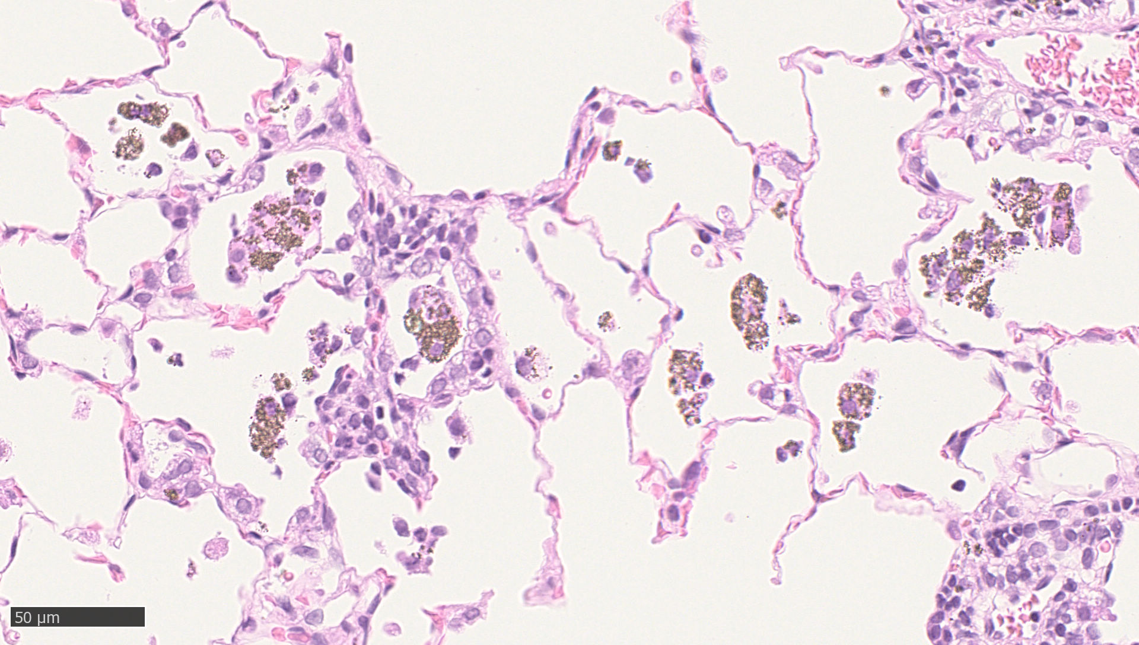
Supplement figure 5:
Exemplary light microscopic images of lung
NM-104
3 days exposure free
45 days exposure free
94 days exposure free
Low (3 mg/m³) exposure concentration
Mid (12 mg/m³) exposure concentration
High (48 mg/m³) exposure concentration

Slide 6
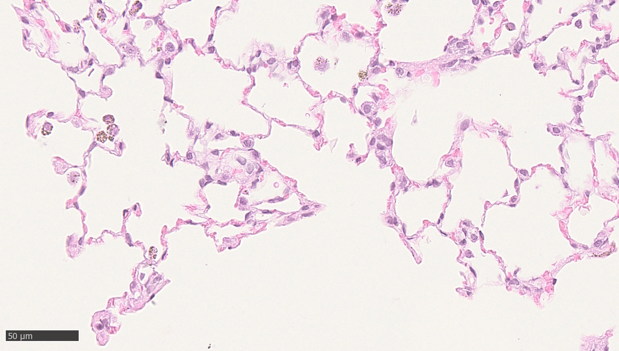
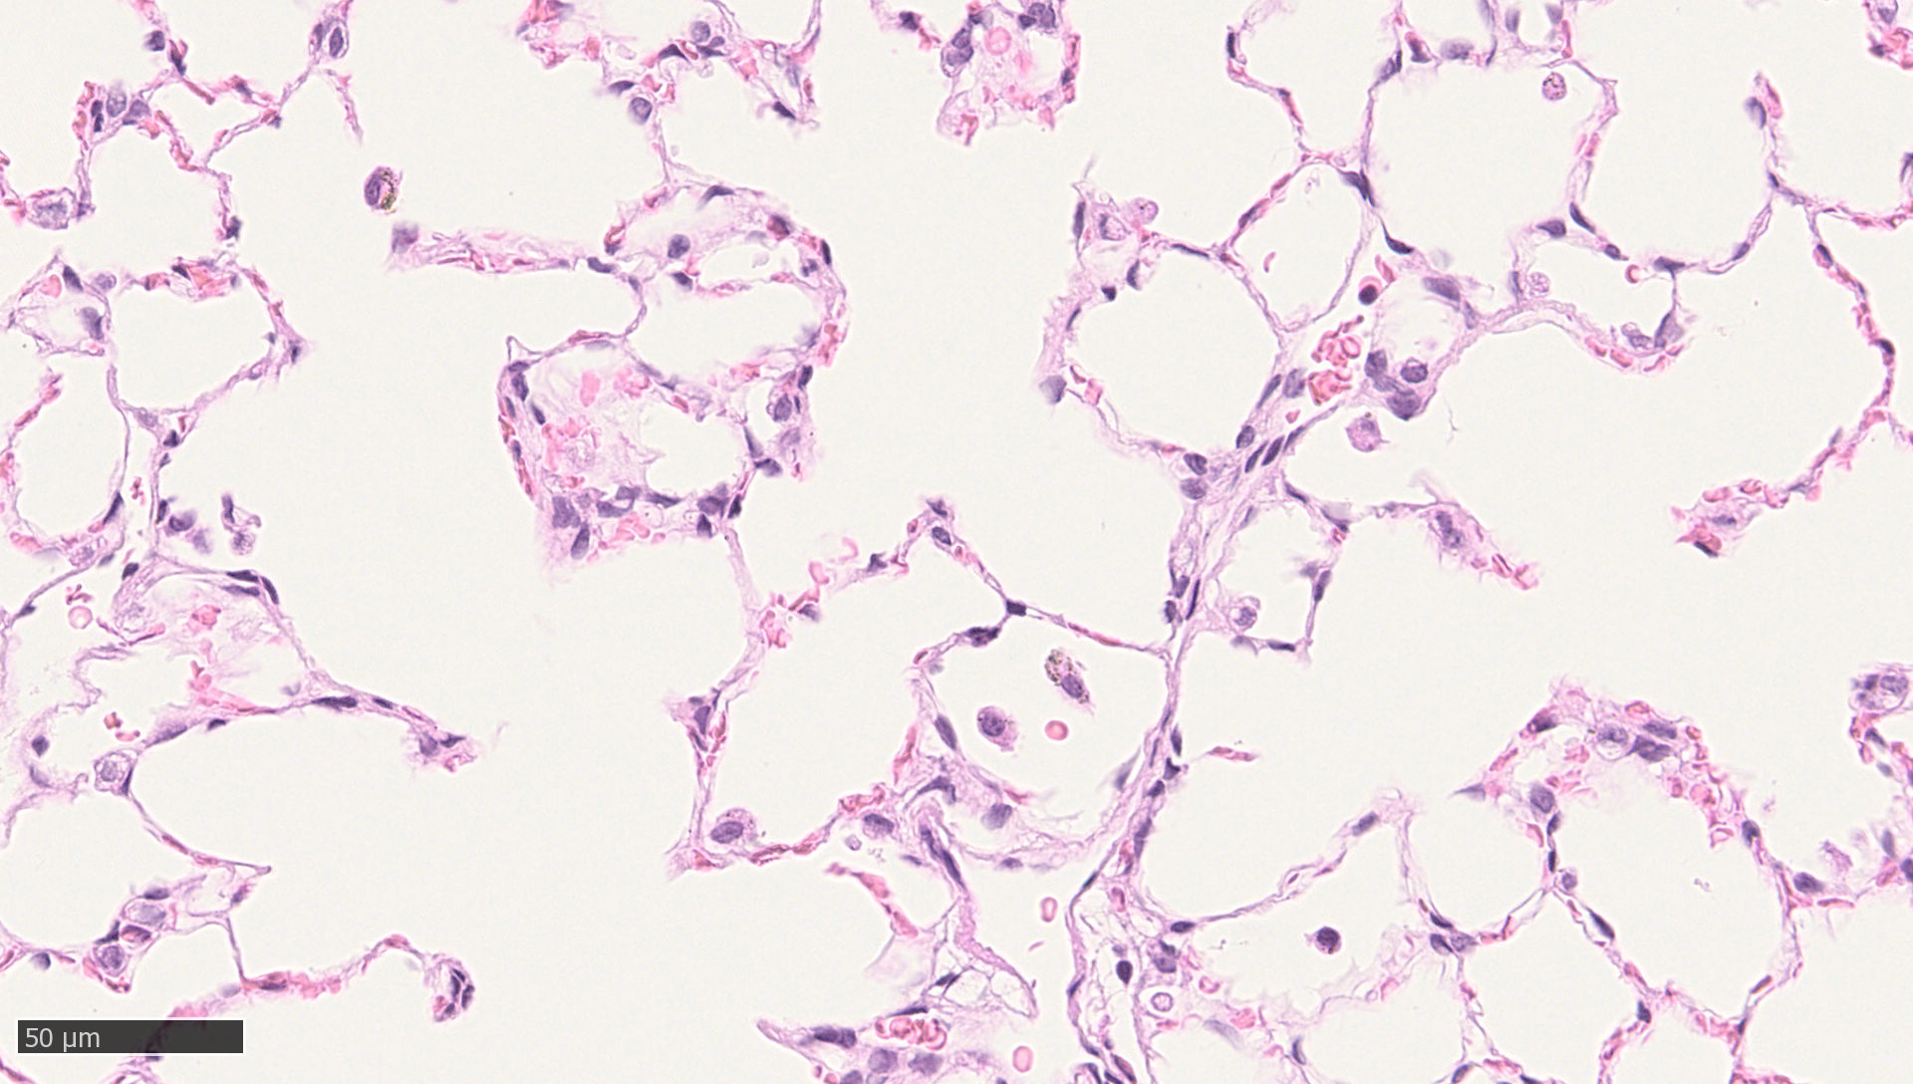
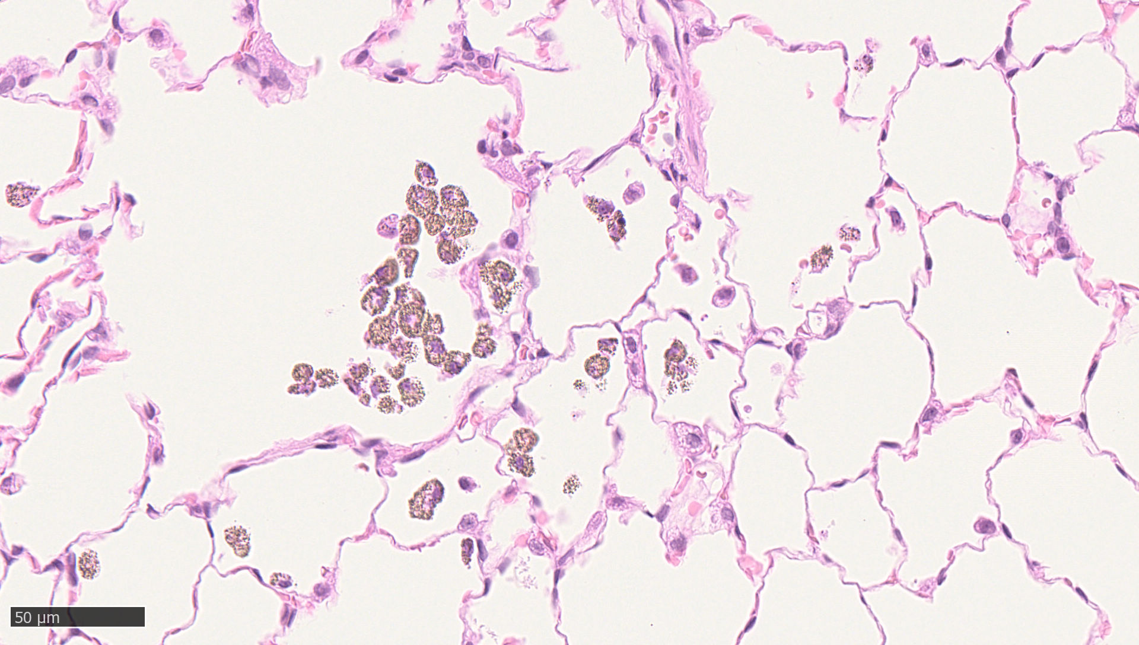
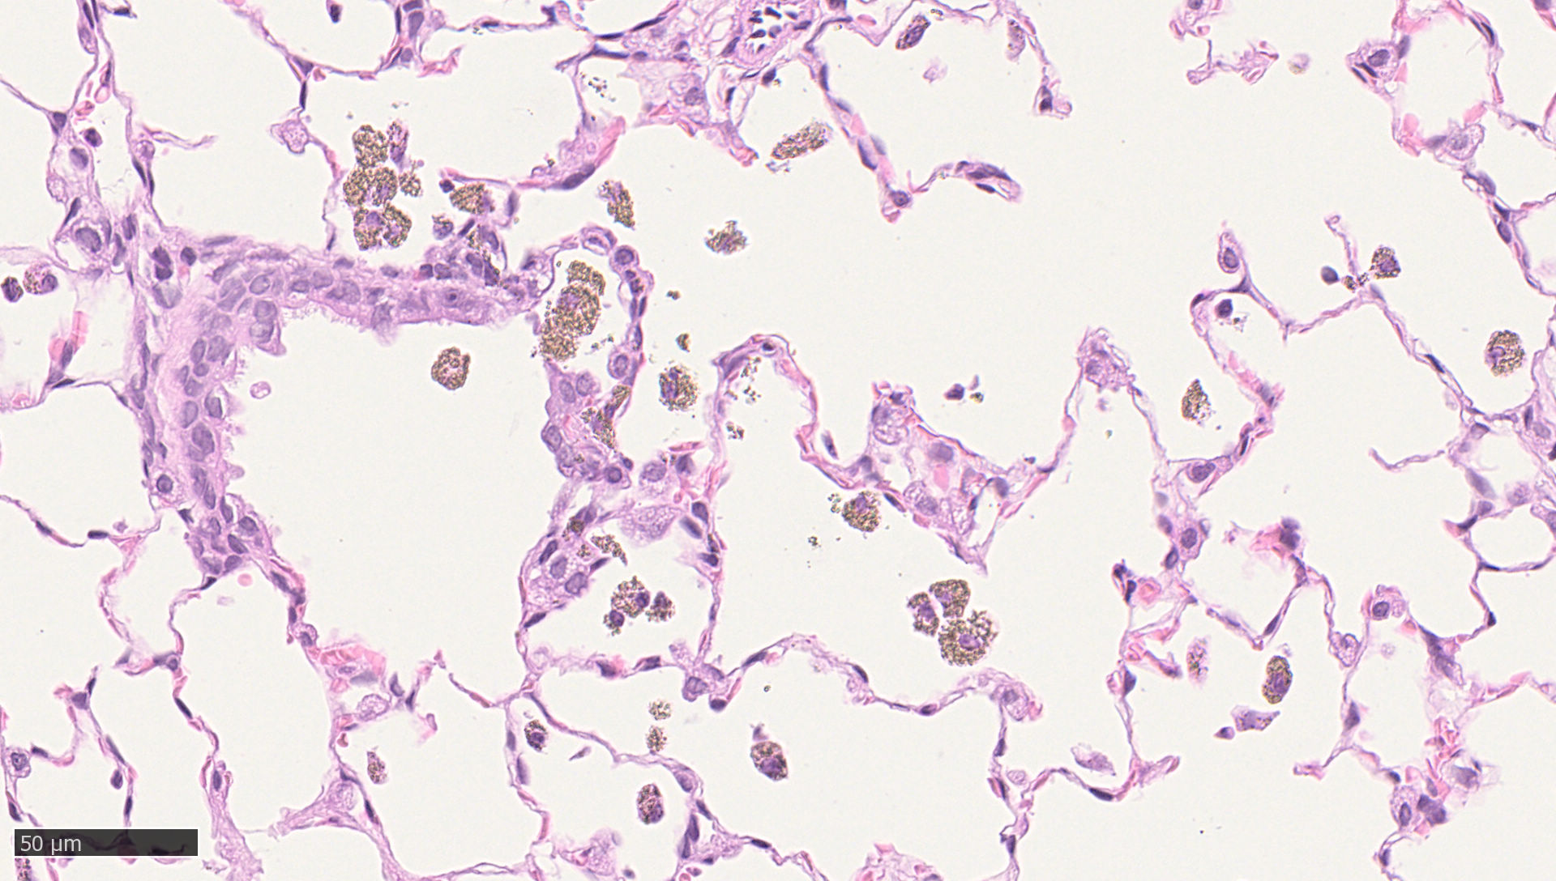
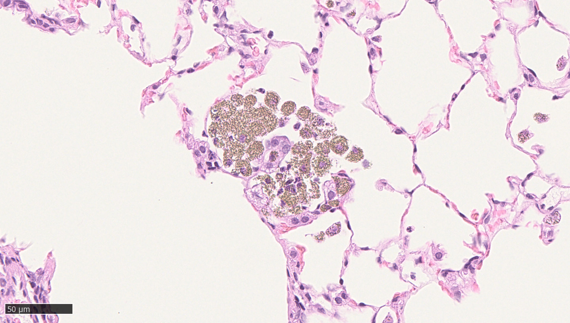
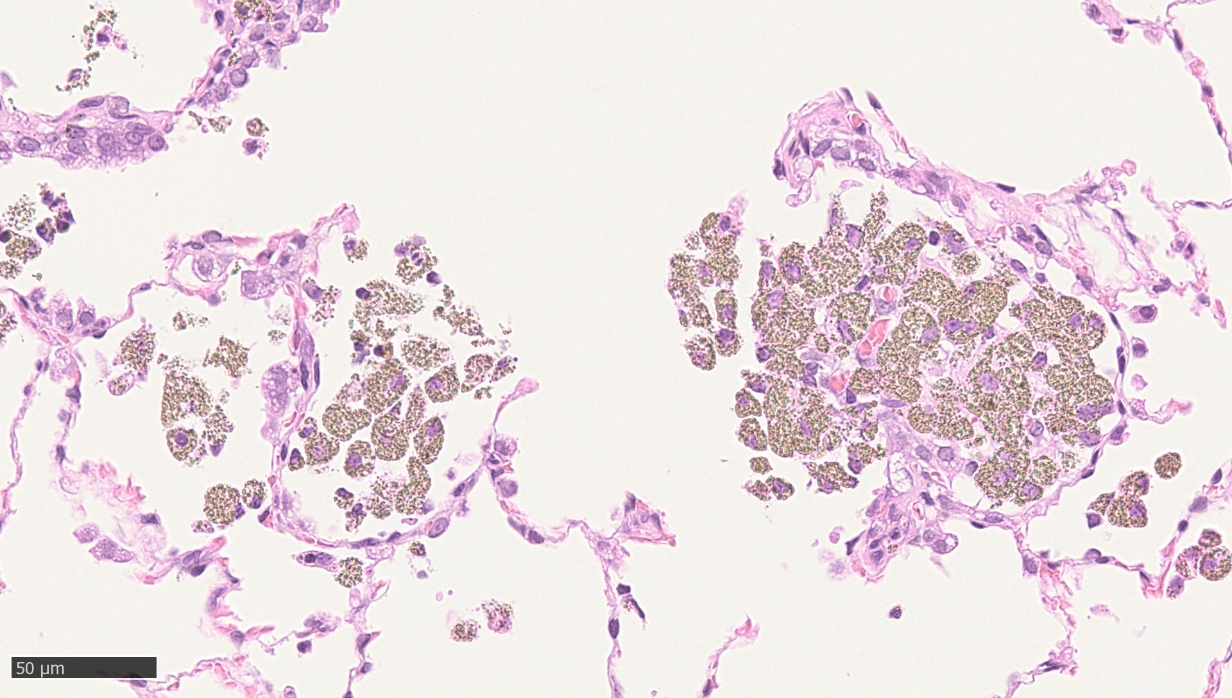
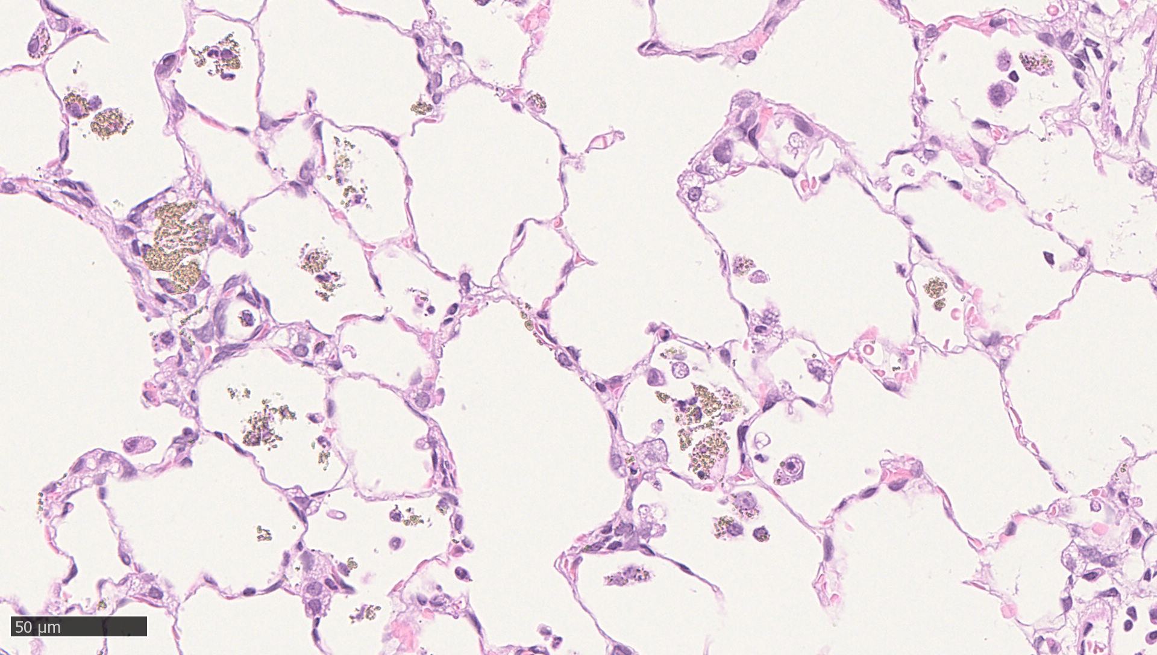
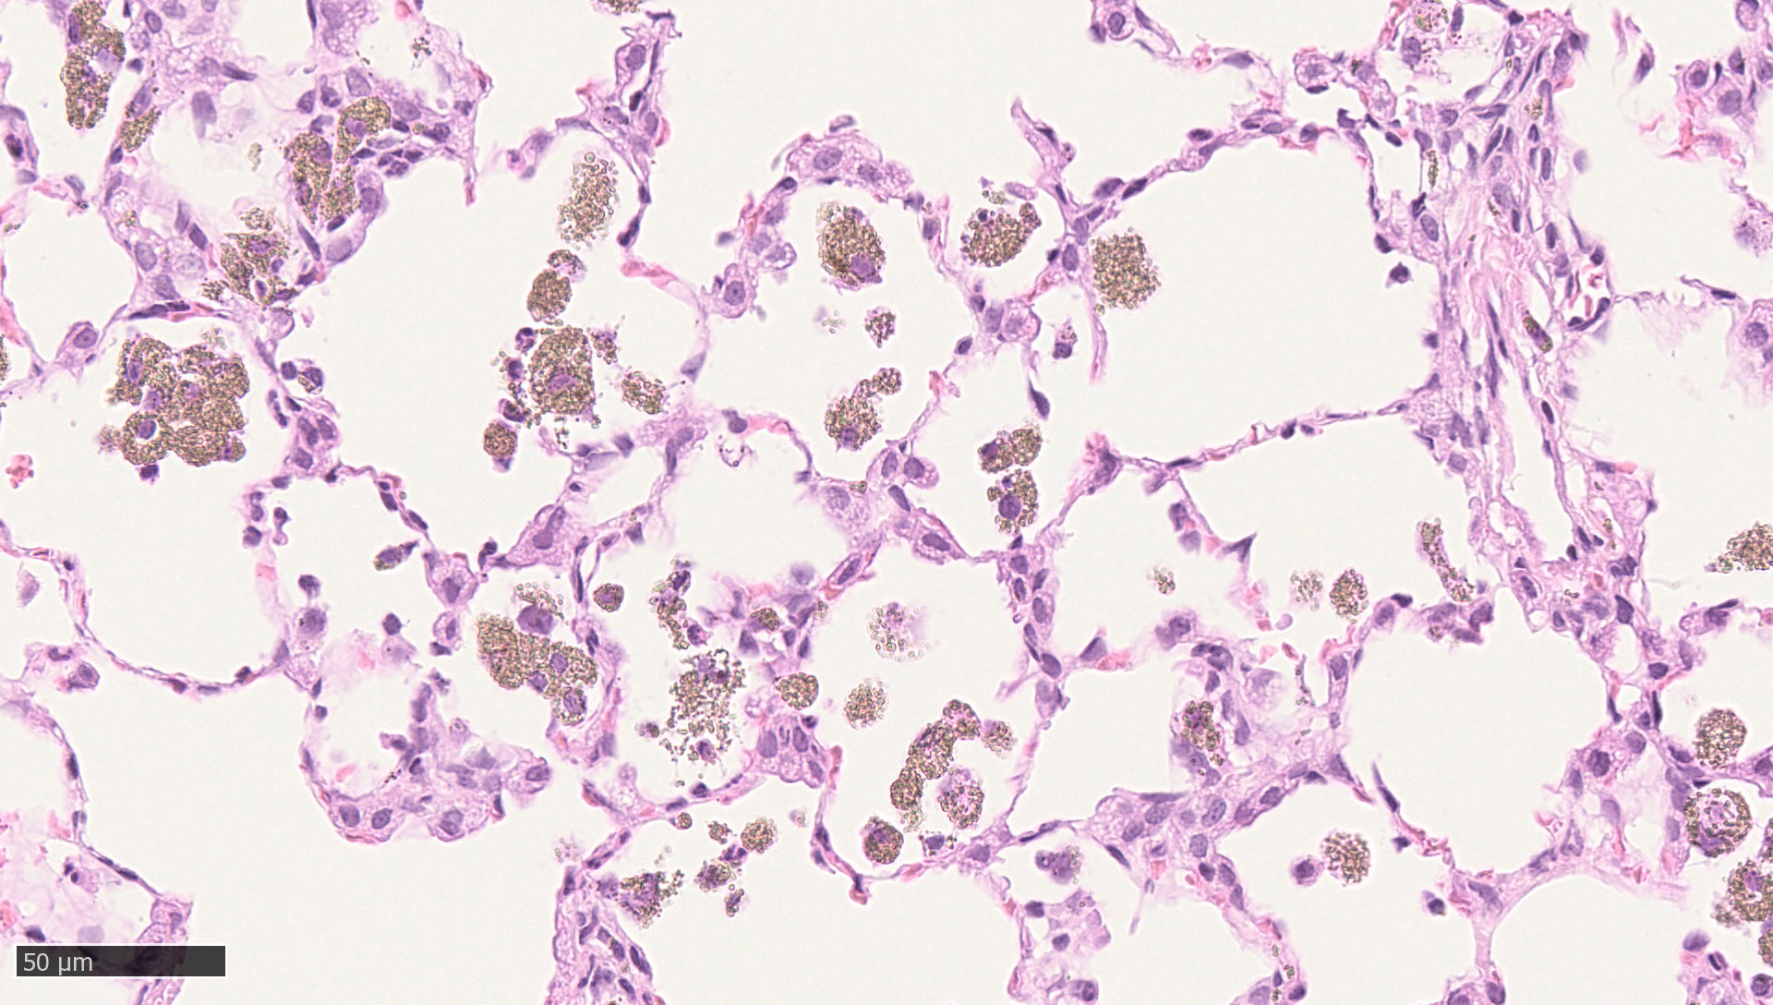
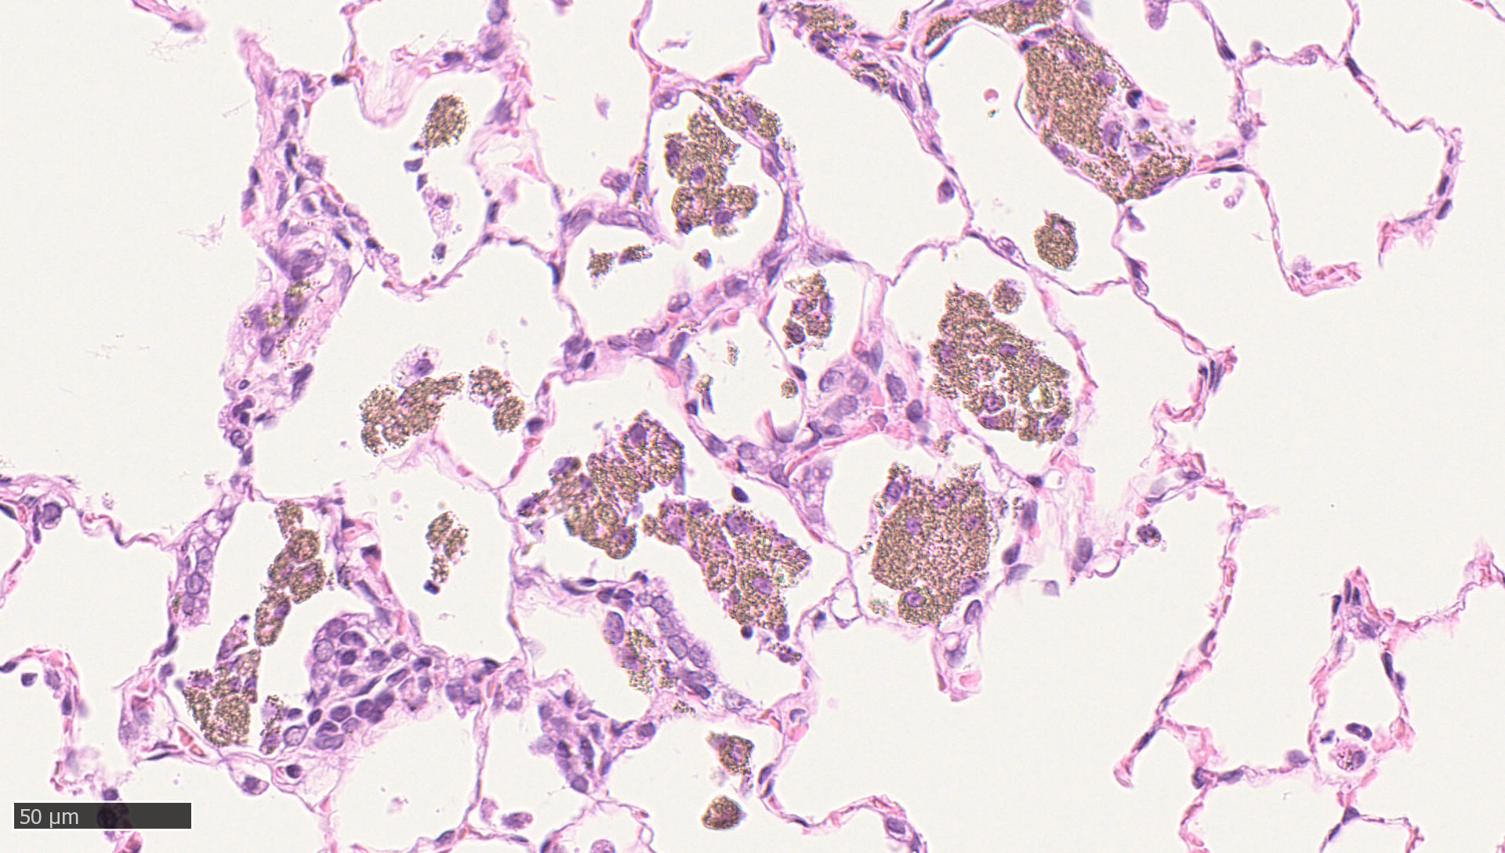
Supplement figure 6:
Exemplary light microscopic images of lung
NM-105
3 days exposure free
45 days exposure free
94 days exposure free
Low (3 mg/m³) exposure concentration
Mid (12 mg/m³) exposure concentration
High (48 mg/m³) exposure concentration

Slide 7
Supplement figure 7:
There is a statistically significant influence of the exposure free day (p<0.01) on the lung volume (animals grow during the exposure free period and with that the lung volume increase).
Kruskal-Wallis ANOVA performed with Statistica Version 13 (TIBCO Software Inc).

Slide 8
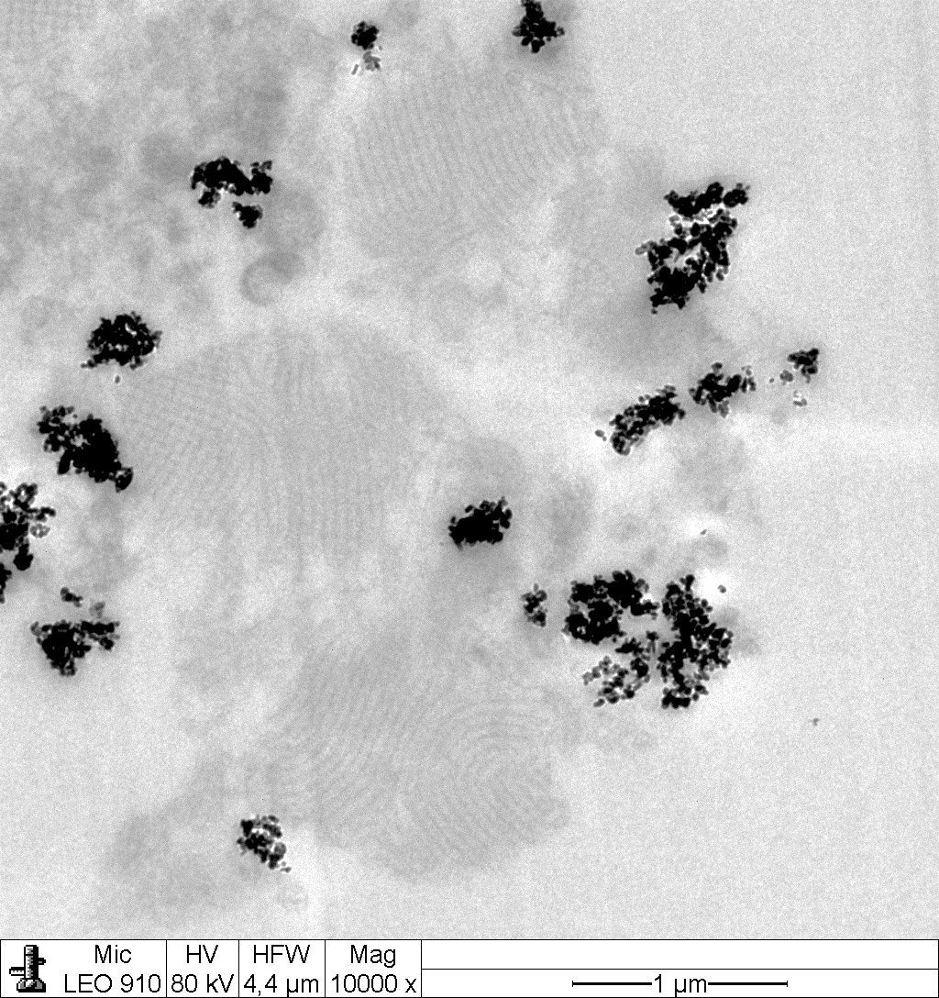
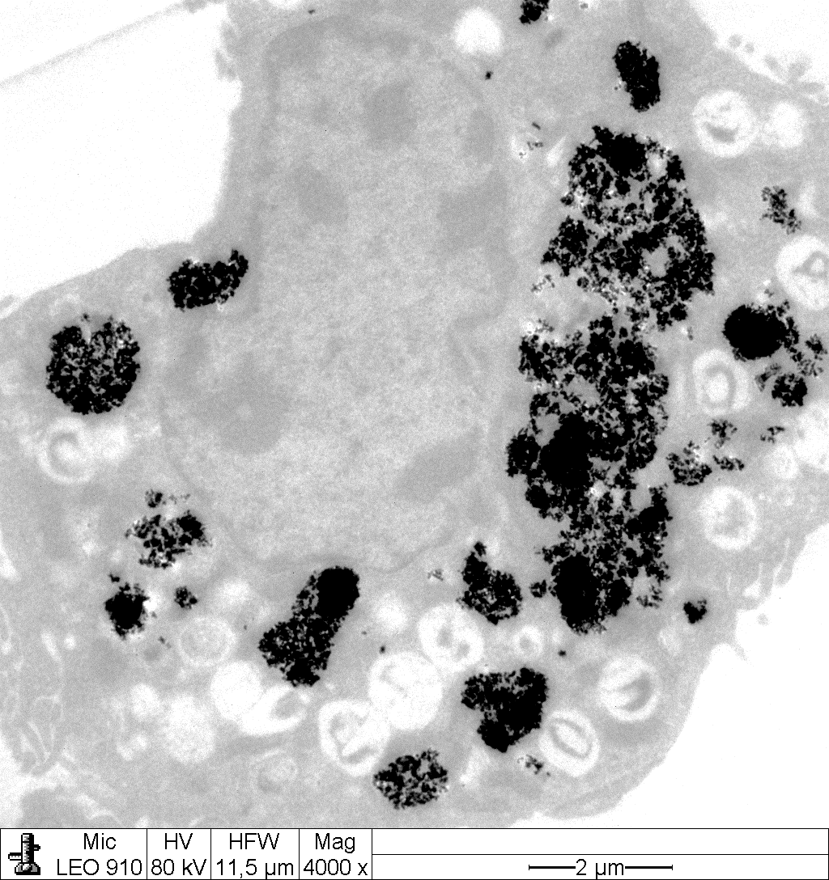
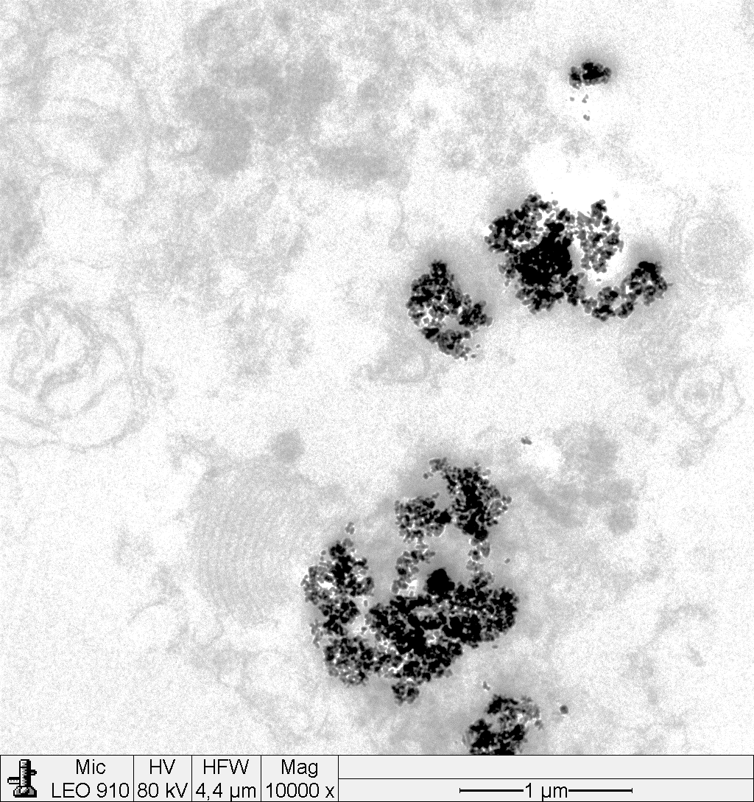
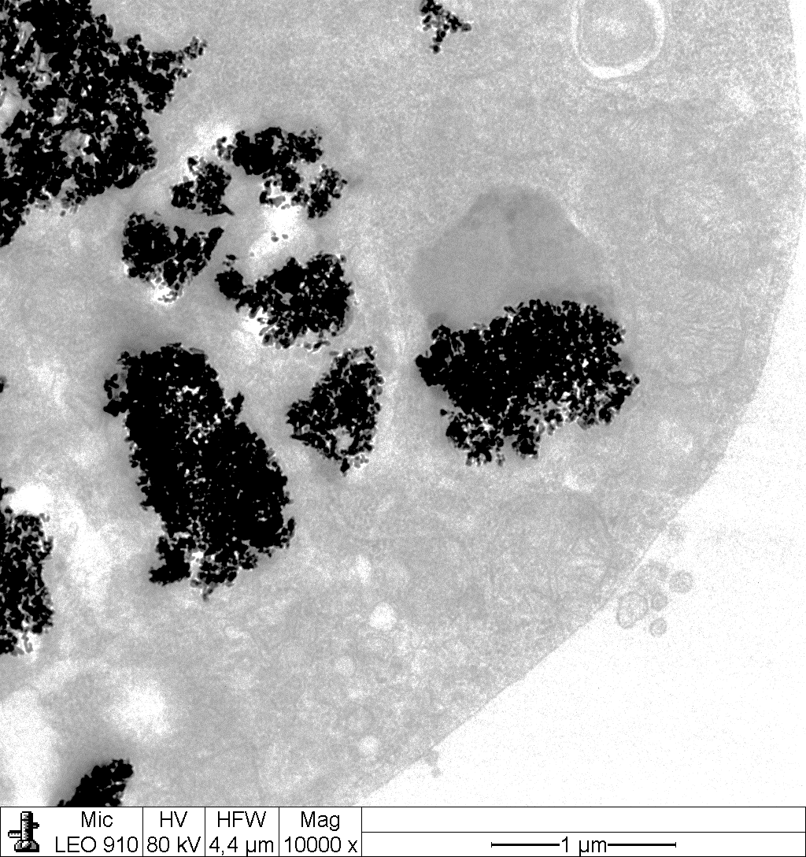
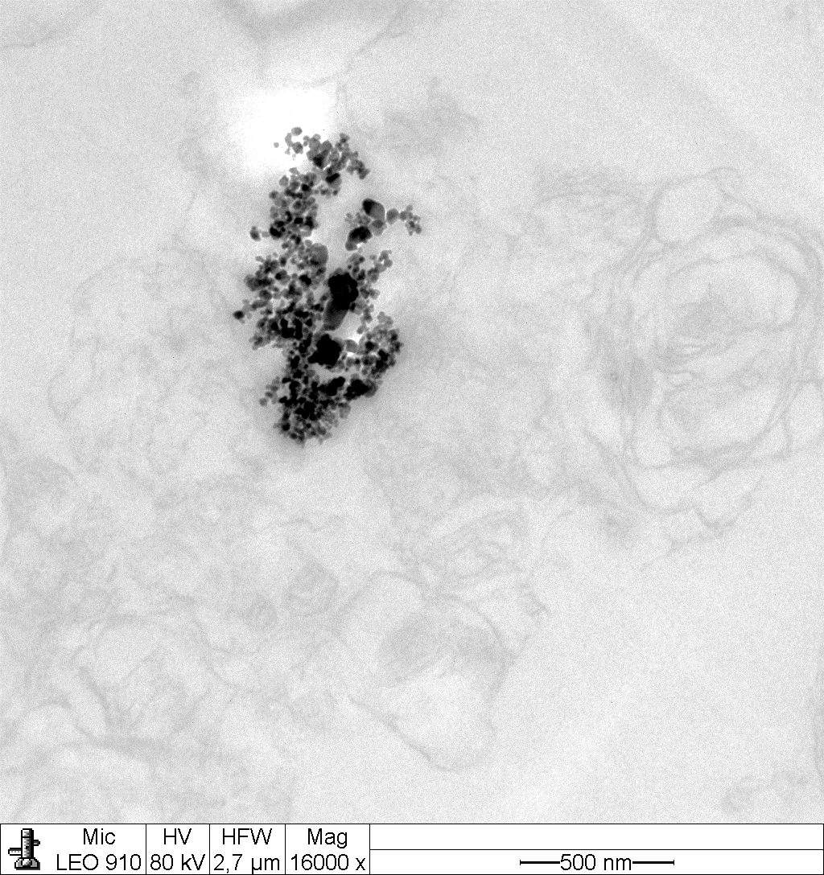
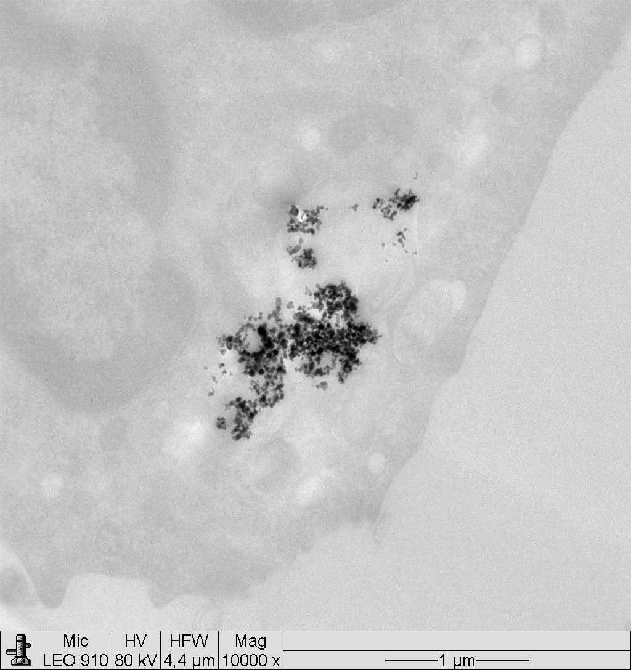
Supplement figure 8: Exemplary transmission electron microscopic images of lung
Particles attached to surfactant and cell debris
Particles within macrophage
NM-103
Particles attached to surfactant and cell debris
NM-104
Particles within macrophage
Particles attached to surfactant and cell debris
Particles within macrophage
NM-105

