Slide 1
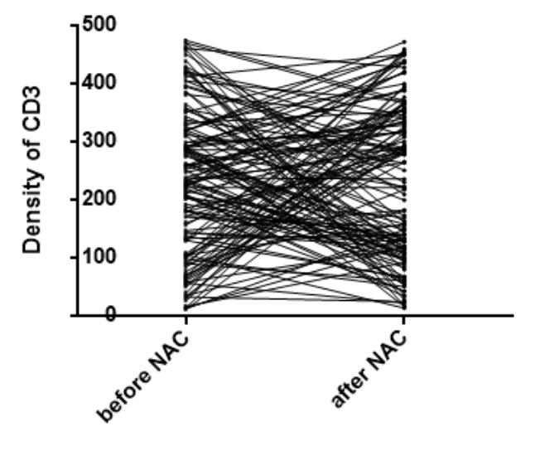
A
Supplement Fig1. A. The density of CD3 before and after NAC
Notes:
Supplement Fig1

Slide 2
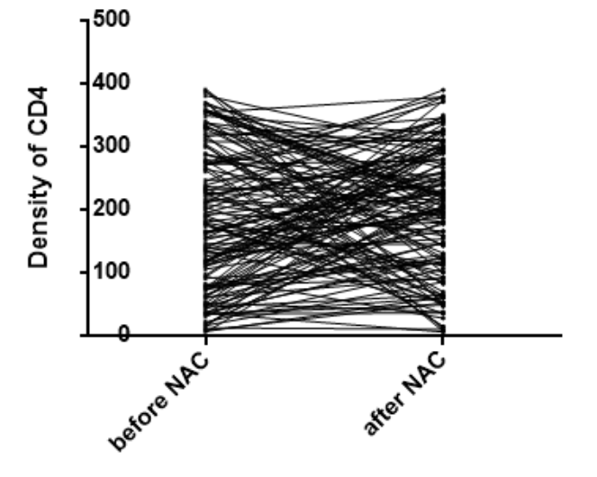
B
Supplement Fig1.B The density of CD4 before and after NAC

Slide 3
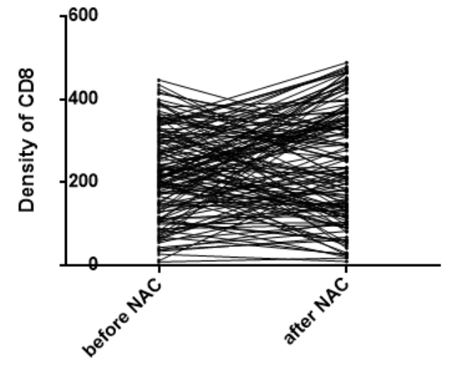
C
Supplement Fig1.C The density of CD8 before and after NAC

Slide 4
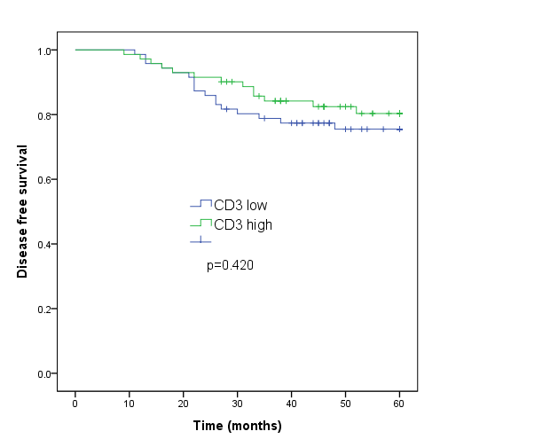
A
Supplement Fig2. A. Kaplan-Meier curves for disease free survival of cervical cancer patients classified according to CD3 density after NAC.
Notes:
Supplement Fig2. Kaplan-Meier curves for disease free survival of cervical cancer patients classified according to CD3 density after NAC.

Slide 5
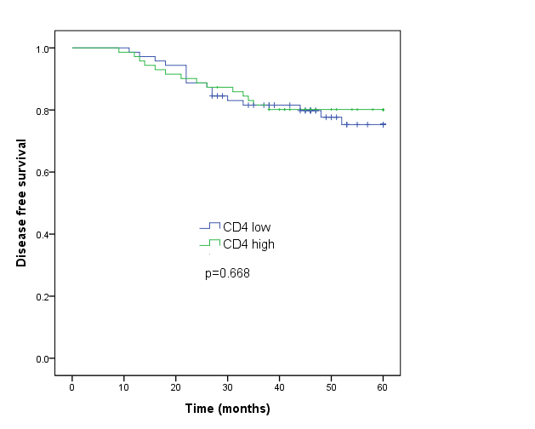
B
Supplement Fig2.B. Kaplan-Meier curves for disease free survival of cervical cancer patients classified according to CD4 density after NAC.
Notes:
Supplement Fig2. Kaplan-Meier curves for disease free survival of cervical cancer patients classified according to CD4 density after NAC.

Slide 6
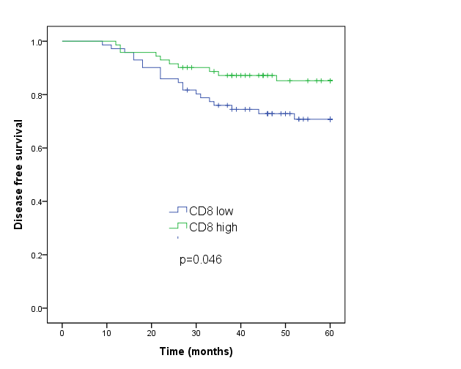
C
Supplement Fig2.C. Kaplan-Meier curves for disease free survival of cervical cancer patients classified according to CD8 density after NAC.

