Slide 1
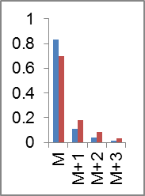
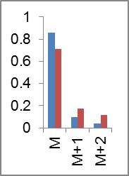
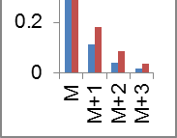
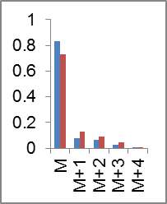
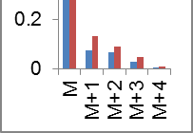
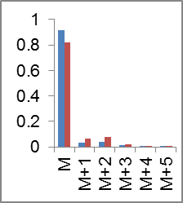
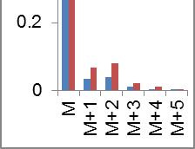
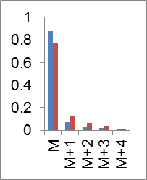
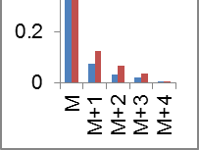
Additional file 8: Figure S4
7%
PEP
9%
15%
20%
¹³C₃
Pyruvate
Alanine
Aspartate (3TMS): m/z 306
Fragment contains 3 carbons.
¹³C₂
Alanine (3TMS): m/z 188
Fragment contains 2 carbons.
Aspartate
Oxaloacetate
Citrate
7%
12%
Malate
2-Oxoglutarate
Glutamate
4%
9%
Fumarate
Malate (3TMS): m/z 245
Fragment contains 4 carbons.
Succinate
5%
Glutamate (3TMS): m/z 348
Fragment contains 5 carbons.
9%
Fumarate (2TMS): m/z 245
Fragment contains 4 carbons.

