Slide 1
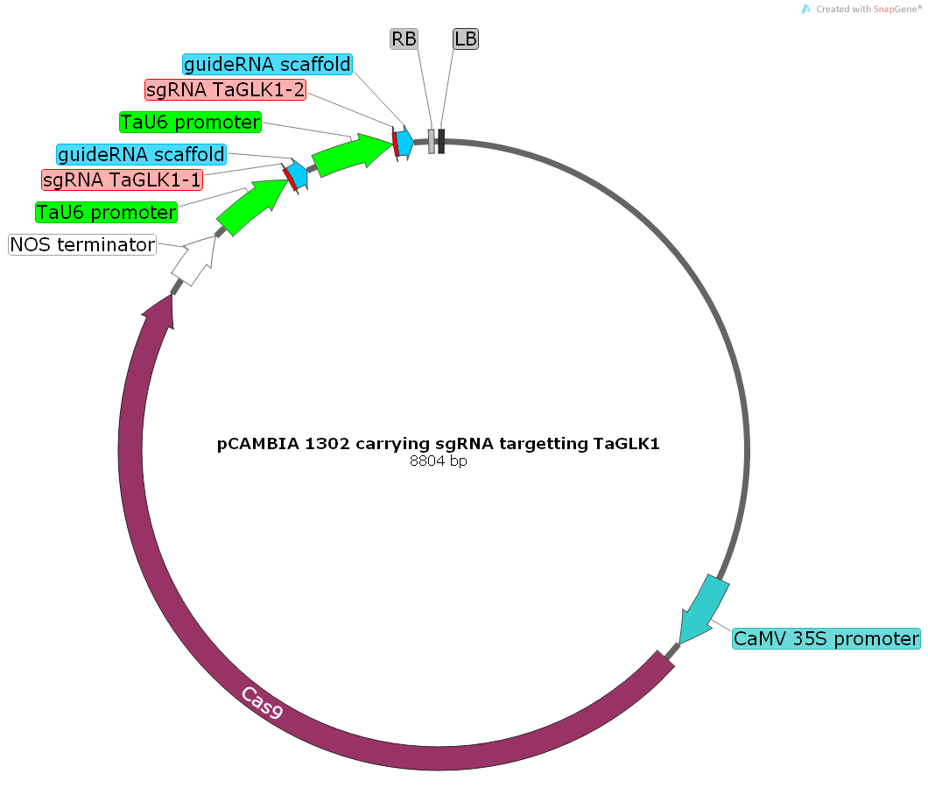
guide RNA scaffold
RB
sgRNA-2
LB
TaU6 promoter
guide RNA scaffold
sgRNA-1
KpnI
TaU6 promoter
NOS Terminator
EcoRI
pCAMBIA 1302 carrying Cas9 and two sgRNA targeting TaNFXL1
8804 bp
35S promoter

