Slide 1
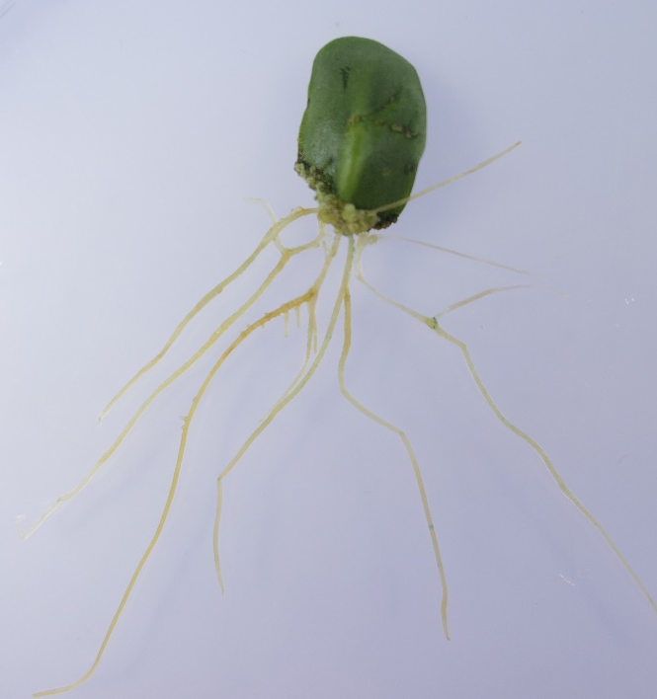
Empty Vector
Figure S1 GUS staining of the negative control samples which were transformed with empty vector pFGC5941.

Slide 2
a
ab
ab
b
Figure S2 The hairy root length after inoculating in different media.

Slide 3
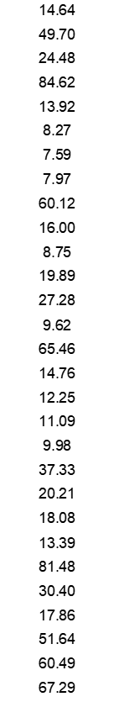
Table S1 Copy number of 35S in transgenic hairy root events estimated by ddPCR
Event ID
Lectin copy number
Ratio (35S/Lectin)

Slide 4
Table S2 Primers and probes used in droplet digital PCR for copy number determination of transgenic hairy root events
Name
Gene
Sequence 5’-3’
Amplicon size (bp)
LEC-F
Lectin
GCCCTCTACTCCACCCCCA
118
LEC-R
Lectin
GCCCATCTGCAAGCCTTTTT
LEC-probe
Lectin
FAM-AGCTTCGCCGCTTCCTTCAACTTCAC-BHQ1
35-F
35S
CGACAGTGGTCCCAAAGA
74
35-R
35S
AAGACGTGGTTGGAACGTCTTC
35-probe
35S
FAM-TGGACCCCCACCCACGAGGAGCATC-BHQ1

