Slide 1



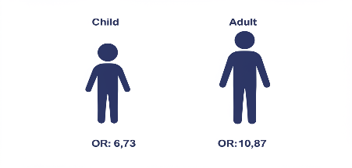
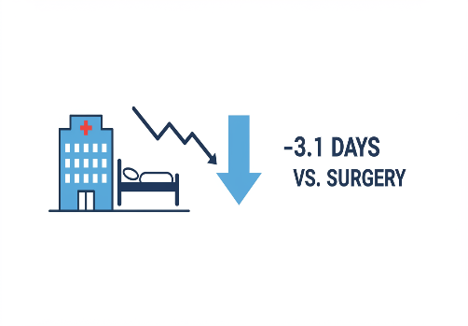
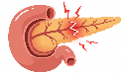
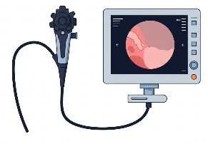

ERCP for Traumatic Pancreatic Injury: Key Findings
A Systematic Review & Meta-Analysis Summary
S
T
E
P
S
SUSPICION
(Problem & Injury)
TREATMENT
EFFICACY
POPULATION
SAFETY
TPI: Rare, Critical Condition
High Morbidity & Mortality Risk
Focus: Pancreatic Duct Disruption (DPDS)
Diagnosis Often Challenging / Delayed
ERCP: Diagnostic & Therapeutic Modality
Minimally Invasive Approach
Evidence Base: Meta Analysis
  (15 Studies; 1,823 Patients)
High Clinical Success Rate: 89% (Pooled)
Improves Duct Integrity Significantly
  OR: 9.17 (95% CI: 6.73–12.49)
Statistically Significant Finding
Broad Efficacy: Adults & Pediatrics
Adult Population OR: 10.87
Pediatric Population OR: 6.73
(Consider success rates across populations)
Complication Rate: 4-17%
  Predominantly: Pancreatitis, Bleeding
Low Associated Mortality: <5%
Key Benefit: Reduced Hospital Stay
  (Mean: -3.1 days vs. Surgery)
Notes:
ERCP demonstrates high efficacy (89% success) and safety in managing traumatic pancreatic injuries, based on a meta-analysis of 1,823 patients. It significantly improves pancreatic duct integrity (OR 9.17) across pediatric (OR 6.73) and adult (OR 10.87) populations. Compared to surgery, this minimally invasive technique reduces hospital stay by approximately 3 days with low morbidity and mortality.

