Slide 1
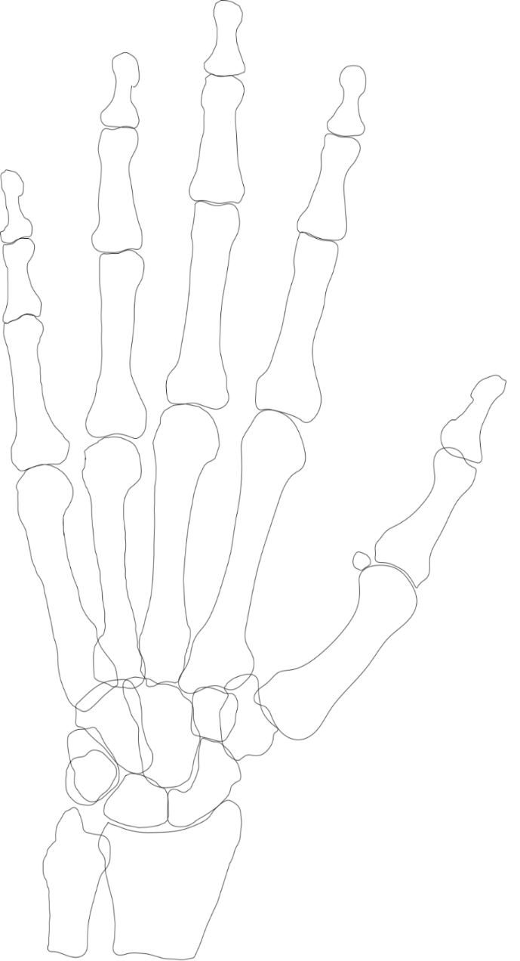
Boys
All hand fractures
Girls
Ray V
Ray IV
Ray III
Ray II
Ray I
Ray V
Ray IV
Ray III
Ray II
Ray I
n=211
n=444
160 (36%)
62 (14%)
64 (14%)
45 (10%)
85 (19%)
82 (39%)
35 (17%)
30 (14%)
21 (10%)
35 (17%)
24 (5%)
9 (4%)
Phalangeal
Phalangeal
17 (4%)
6 (1%)
11 (5%)
2 (1%)
Distal
12 (3%)
5 (2%)
9 (2%)
5 (1%)
Distal
8 (4%)
69 (16%)
7 (2%)
31 (15%)
2 (1%)
7 (3%)
Middle
Middle
285 (64%)
41 (9%)
15 (3%)
37 (18%)
17 (8%)
17 (4%)
14 (3%)
178 (84%)
20 (5%)
14 (7%)
11 (5%)
10 (5%)
175 (39%)
Proximal
110 (52%)
76 (17%)
Proximal
15 (3%)
54 (26%)
7 (3%)
131 (30%)
Metacarpal
5 (2%)
Metacarpal
11 (2%)
48 (11%)
25 (12%)
1 (0%)
21 (10%)
16 (4%)
20 (5%)
3 (1%)
62 (14%)
9 (4%)
22 (5%)
7 (3%)
Carpal
Carpal
4 (1%)
1 (0%)
28 (6%)
3 (1%)
8 (4%)
1 (0%)
2 (0%)
18 (4%)
7 (3%)

