Slide 1
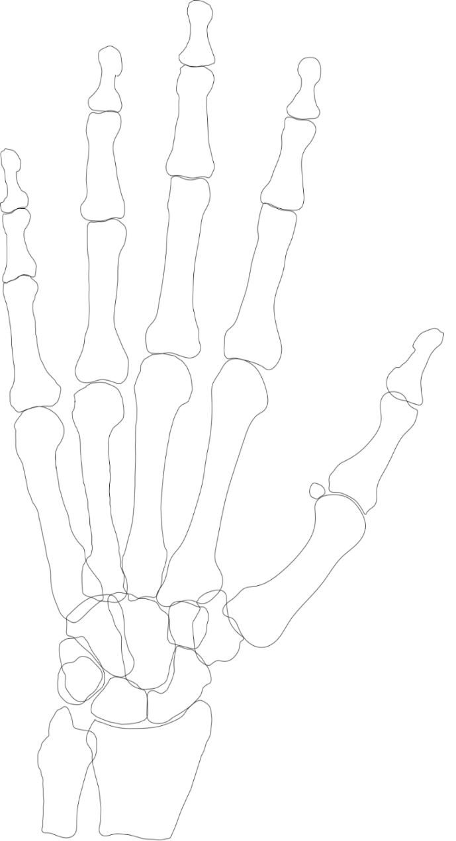
Left
All hand fractures
Right
Ray V
Ray IV
Ray III
Ray II
Ray I
Ray I
Ray II
Ray III
Ray IV
Ray V
n=312
136 (40%)
34 (10%)
n=343
106 (34%)
42 (13%)
58 (19%)
32 (10%)
56 (18%)
55 (16%)
36 (10%)
64 (19%)
16 (5%)
17 (5%)
Phalangeal
8 (3%)
20 (6%)
Phalangeal
3 (1%)
5 (1%)
Distal
10 (3%)
7 (2%)
Distal
45 (14%)
2 (1%)
7 (2%)
7 (2%)
55 (16%)
7 (2%)
9 (3%)
6 (2%)
Middle
Middle
234 (75%)
42 (13%)
18 (6%)
36 (10%)
14 (4%)
147 (47%)
21 (7%)
15 (4%)
7 (2%)
229 (67%)
Proximal
19 (6%)
12 (4%)
138 (40%)
12 (3%)
Proximal
69 (22%)
61 (18%)
16 (5%)
6 (2%)
60 (19%)
96 (28%)
Metacarpal
5 (1%)
Metacarpal
11 (4%)
26 (8%)
11 (3%)
43 (13%)
8 (3%)
10 (3%)
11 (3%)
54 (16%)
17 (5%)
14 (4%)
15 (4%)
Carpal
Carpal
18 (6%)
1 (0%
18 (5%)
1 (0%)
1 (0%)
3 (1%)
3 (1%)
16 (5%)
3(1%)
9 (3%)
1 (0%)
2 (1%)

