Slide 1
1297 citations identified by initial search of MEDLINE and EMBASE databases (1946-2018]) in which the text word “frail*” and “card*” or “coronar*” and “surg*” were mentioned in the title or abstract
1219 ineligible on basis of
title and abstract screening
78 retrieved for full text review
59 Excluded based on:
31 - Conference abstract only
20 - Study design
3 - Outcomes not reported
5 - Procedures not primarily
CABG or valve surgery
19 observational studies were included
Supplementary Figure 1

Slide 2
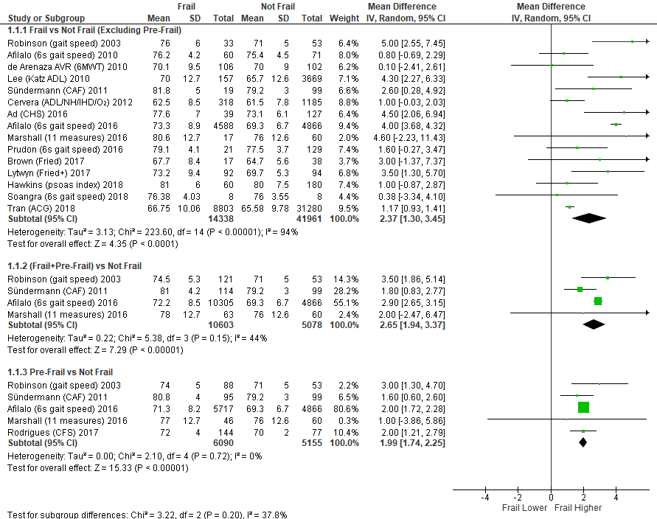
Supplementary Figure 2

Slide 3
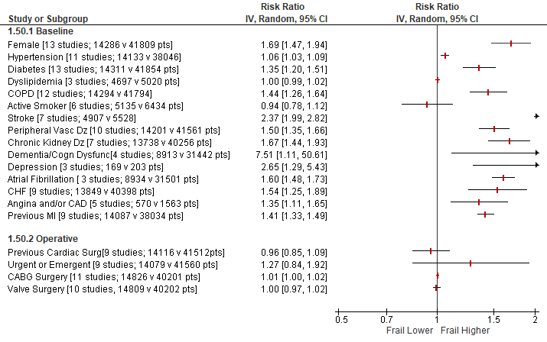
Supplementary Figure 3

Slide 4
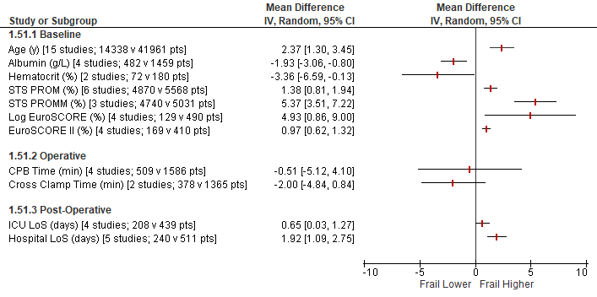
Supplementary Figure 4

Slide 5
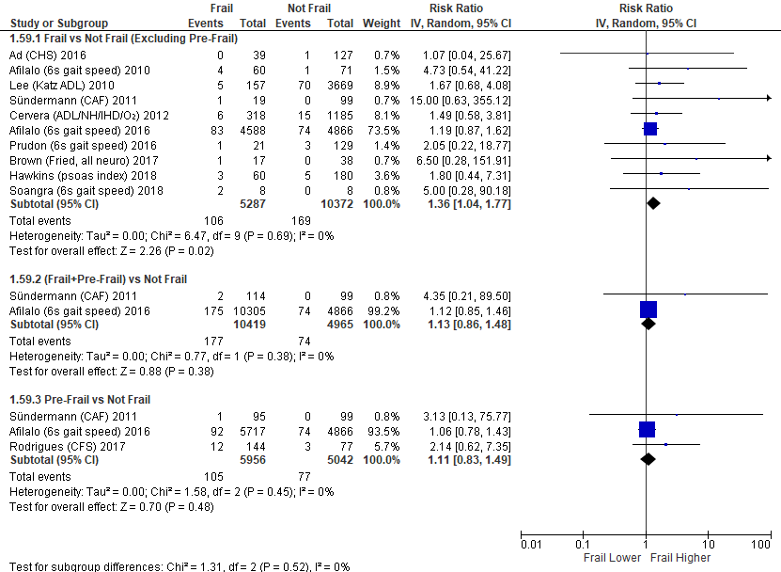
Supplementary Figure 5

Slide 6
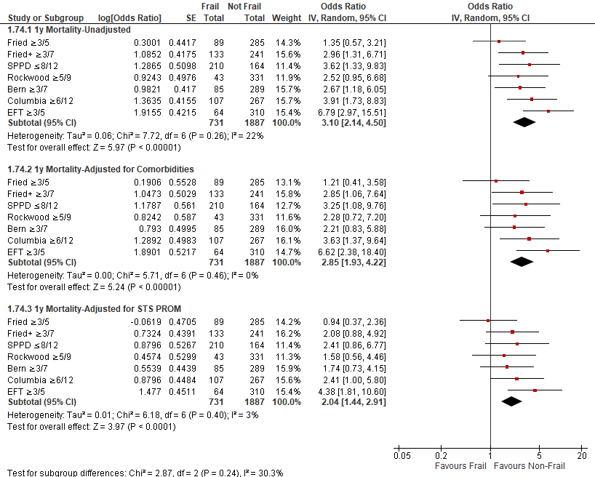
Supplementary Figure 6

