Slide 1
These introductory videos demonstrate the application of low-cost video-assisted thoracic surgery (VATS) techniques in several cases.

Slide 2
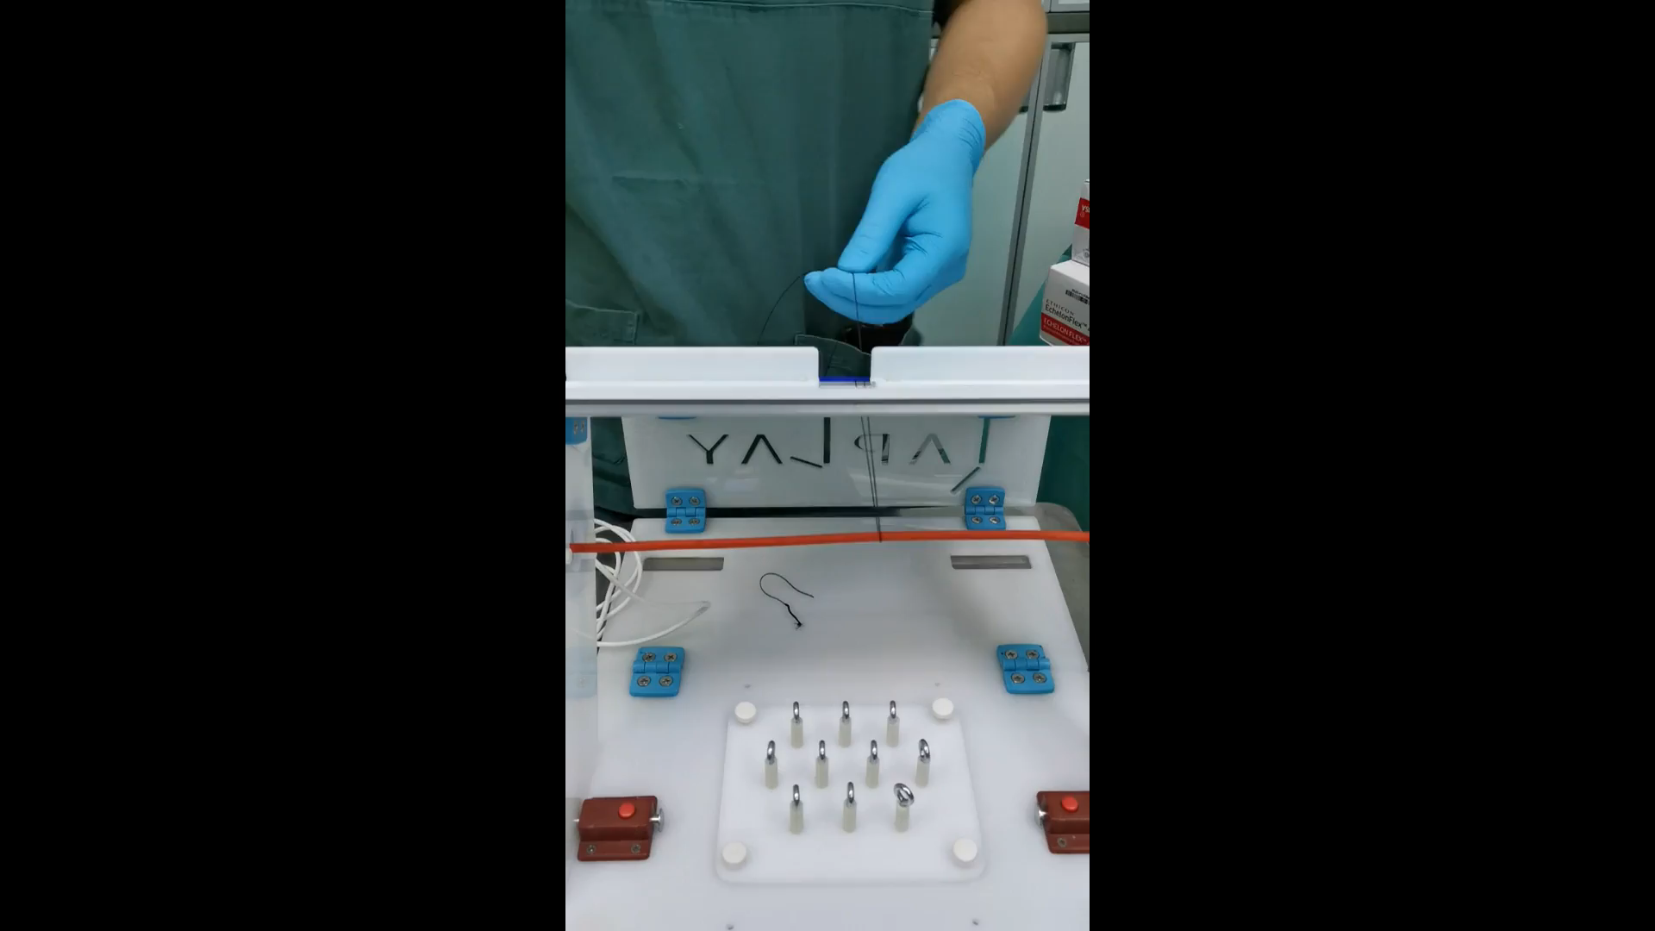
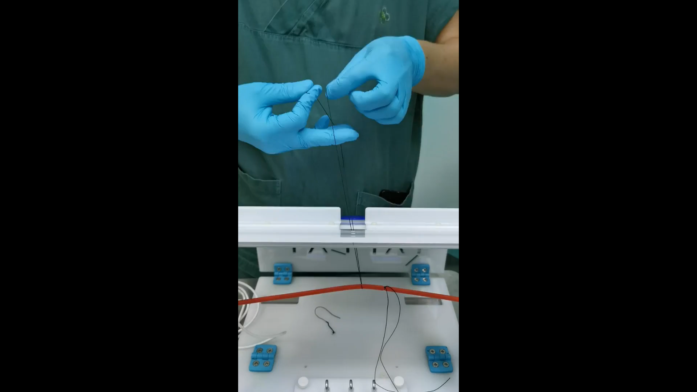
This video demonstrates the braided high-tension knot-tying method used in VATS. The standard and high-tension knot-tying techniques are shown, along with the use of basic instruments to enhance safety and effectiveness in bronchial tube ligation.

