Slide 1
Supplementary Figure legends
SFigure 1: Representative MRM chromatograms of blank gut microbiota solution, GCK, PPD and PPT. a₁,b₁,c₁ were the corresponding chromatograms of blank gut microbiota solution; a₂: GCK; b₂: PPD; c₂: PPT.
SFigure 2: Relative abundance of differentially abundant bacteria in each sample. (a) Bifidobacterium; (b) Blautia; (c) Corynebacterium; (d) Enhydrobacter; (e) Rothia; (f) SMB53; (g) Bacteroides; (h) Collinsella; (i) Coprobacillus; (j) Enterobacteriaceae; significant difference of relative abundance were analyzed using Kruskal-Wallis test; * p<0.05, ** p<0.01 and # p<0.001
SFigure 3: Significant functional pathways between health and CRC group by PICRUSt analysis (p<0.05, LDA scores >2).

Slide 2
a₁
a₂
GCK
b₁
b₂
PPD
c₁
c₂
PPT
Guo et al. 2020 SFig. 1

Slide 3
a
b
c
d
e
f
g
h
i
j
Guo et al. 2020 SFig. 2

Slide 4
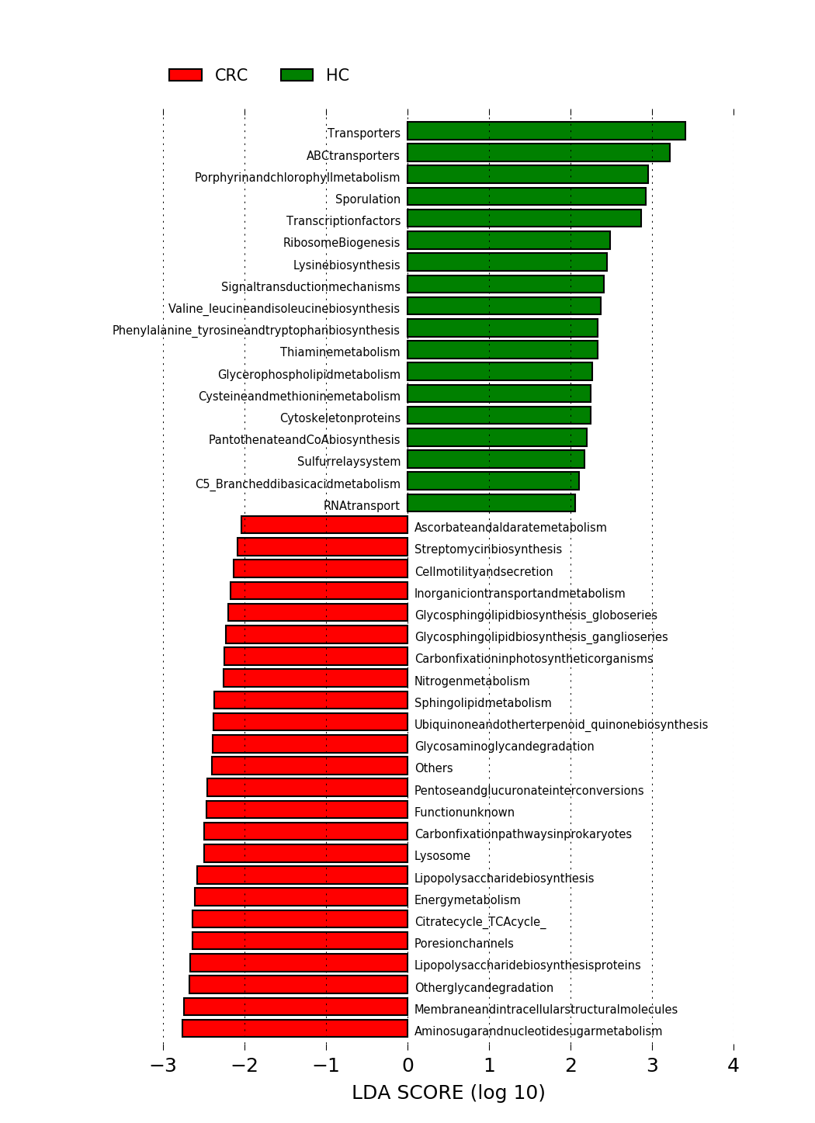
Guo et al. 2020 SFig. 3

