Slide 1
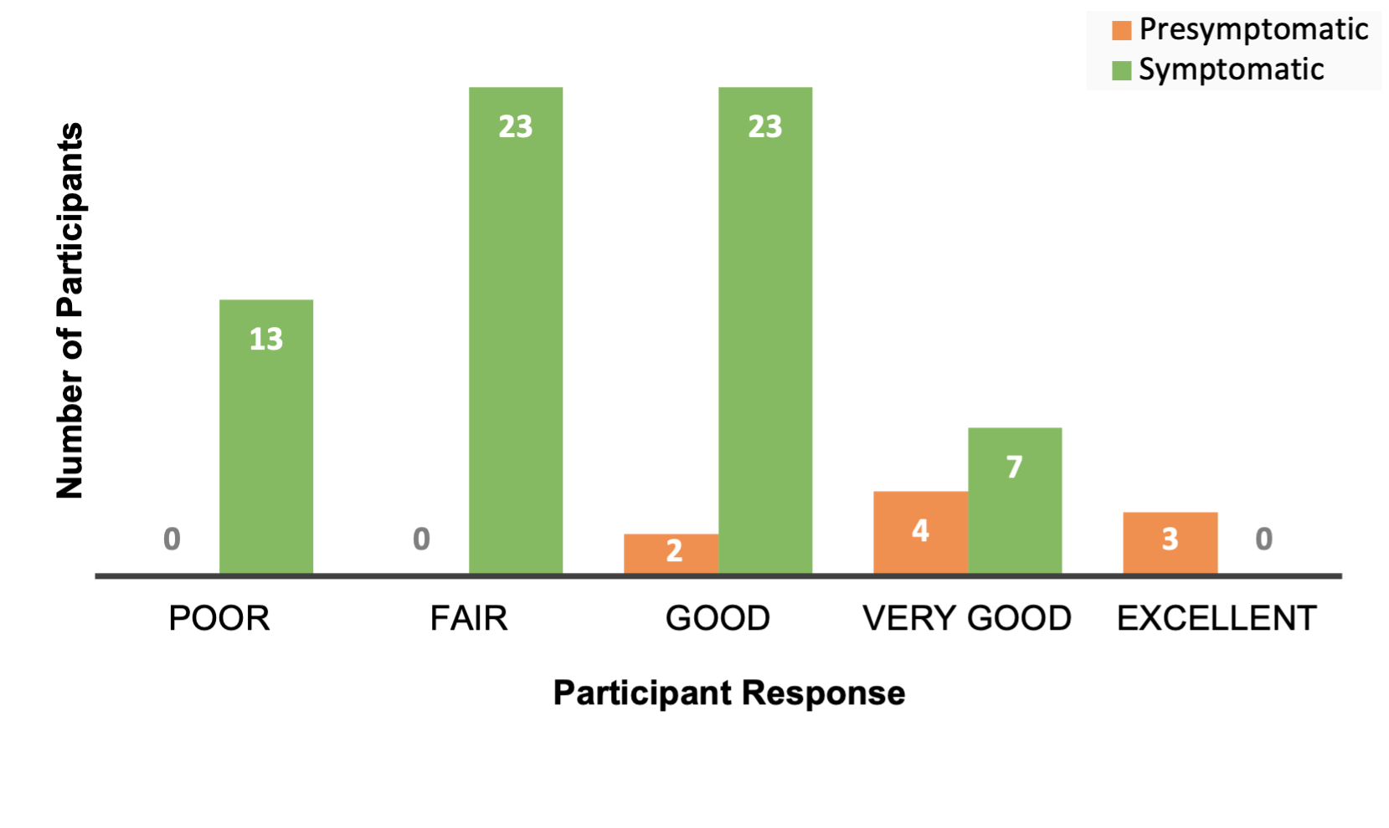
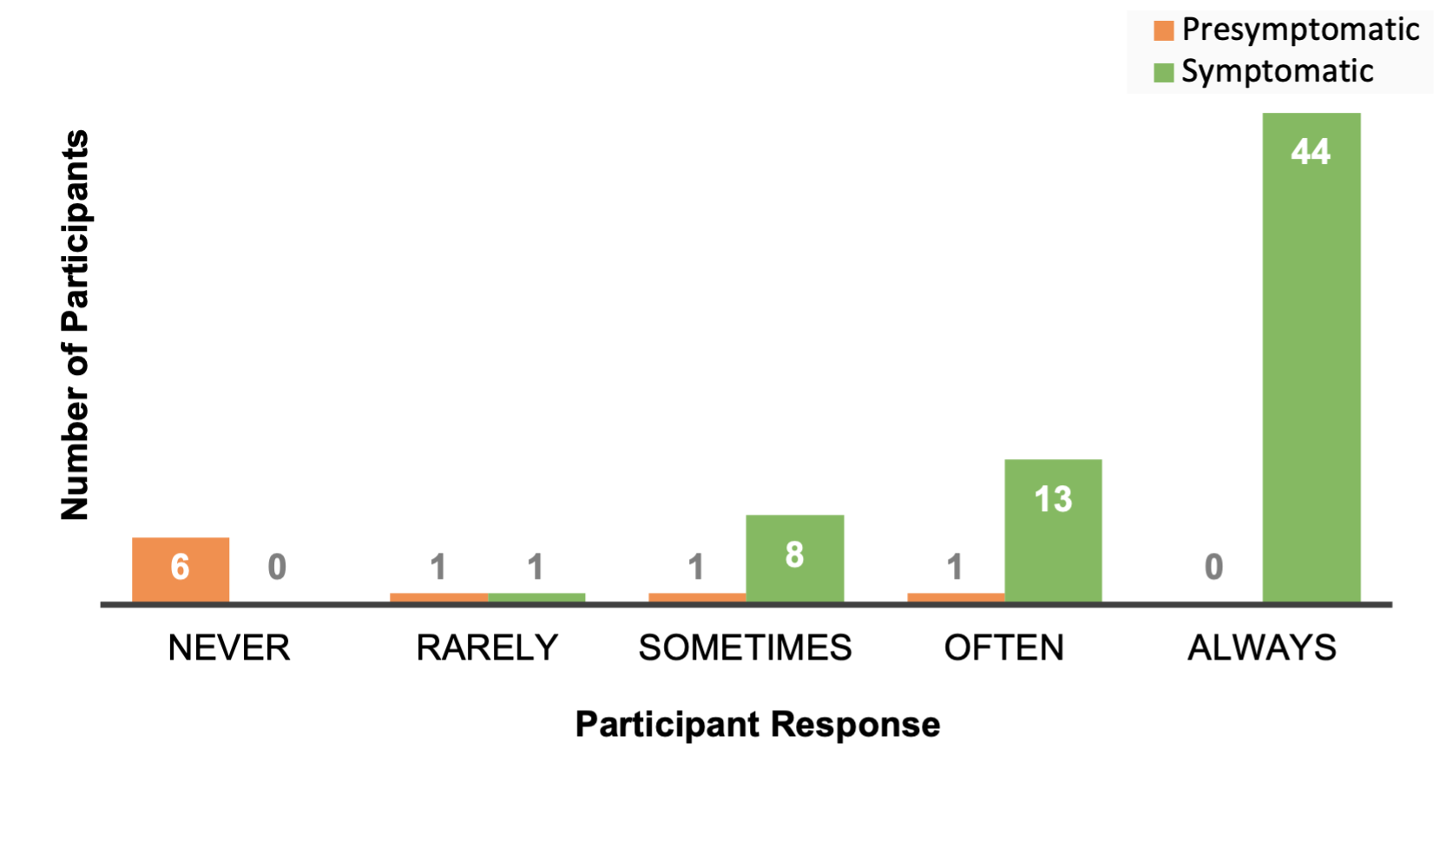
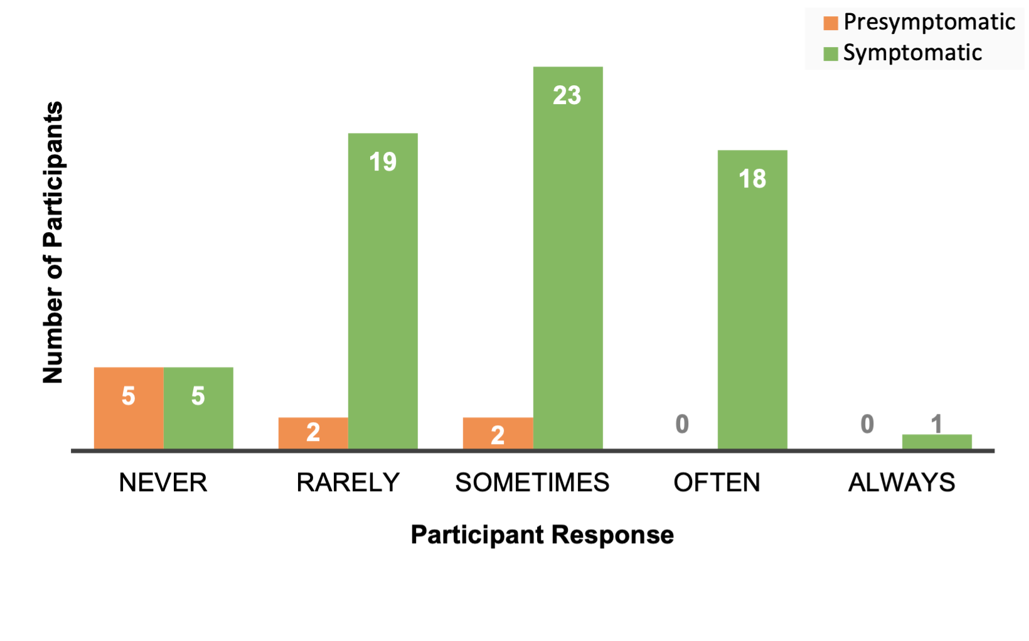
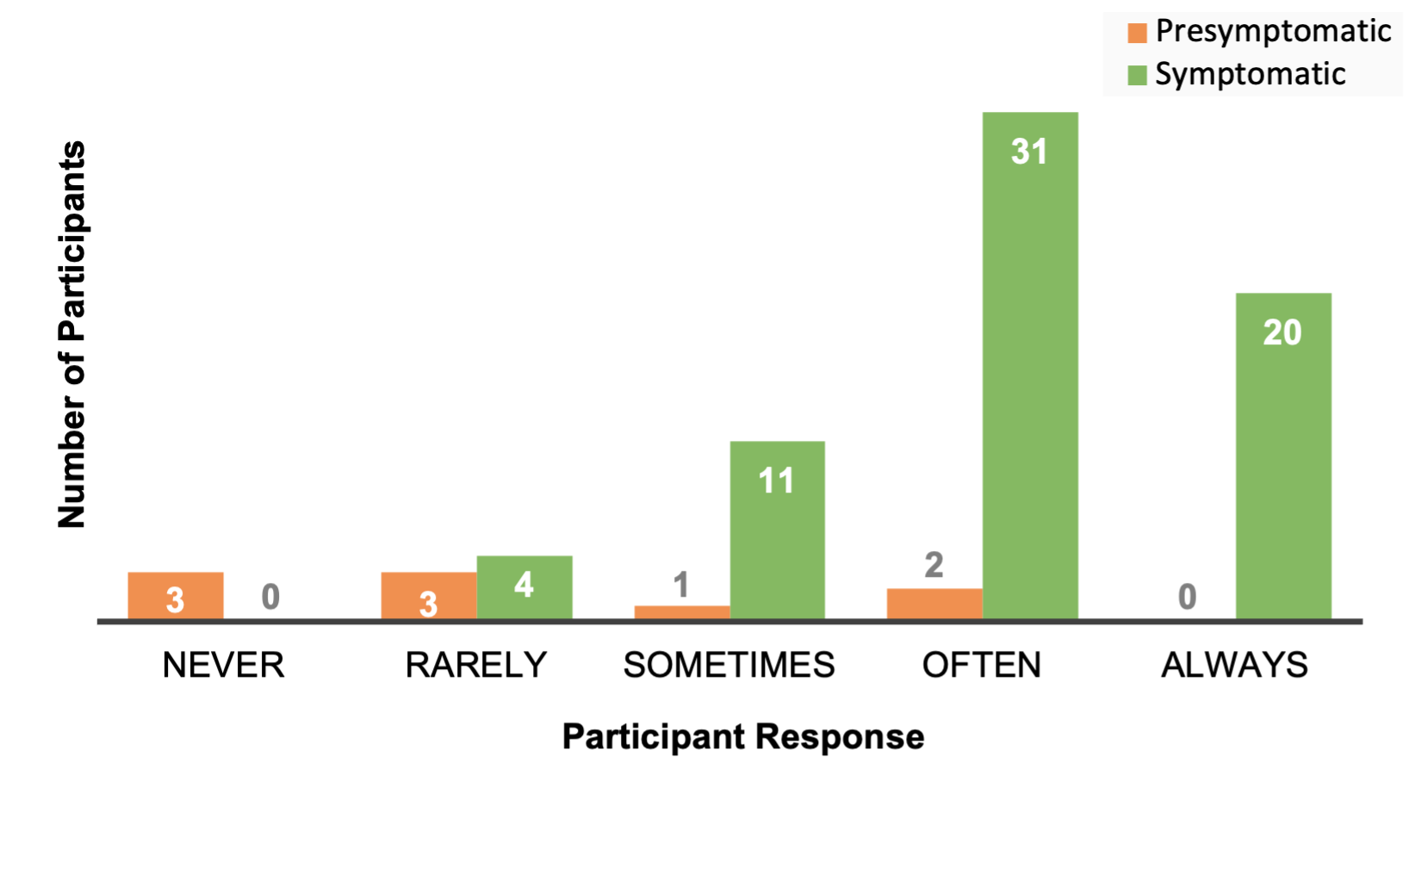
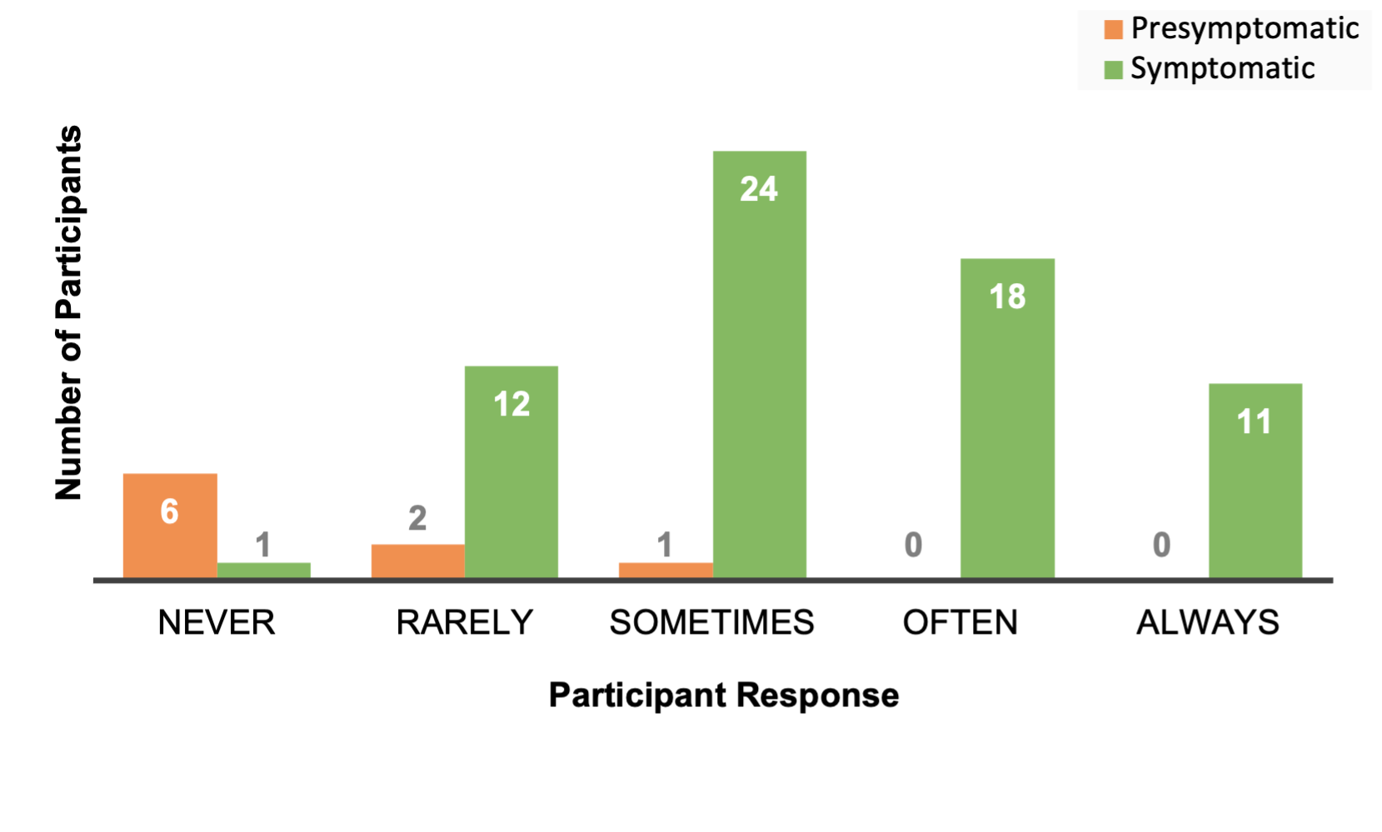
Figure S2
In general, my health is …
Does your health now limit doing
vigorous activities?
(a)
(b)
I feel depressed …
How often do you feel tired?
How much did pain interfere with
your enjoyment of life?
(c)
(d)
(e)

