Slide 1
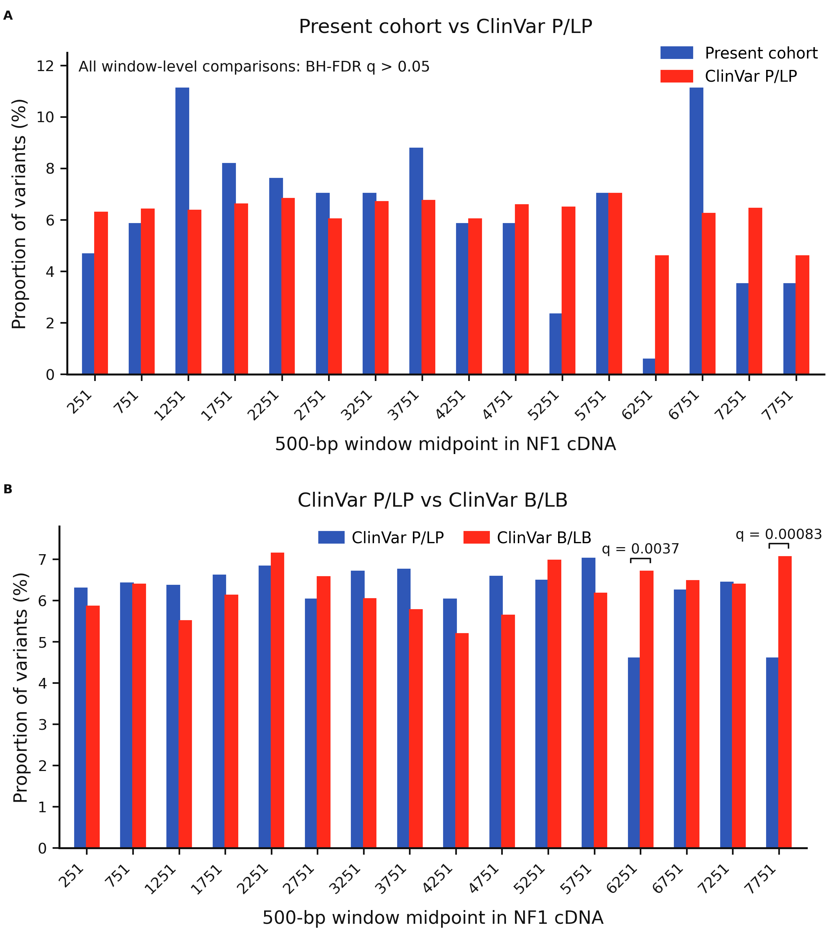
Supplement 6. ClinVar contextualization of NF1 variant distribution.
NF1 variants from the present cohort and ClinVar were summarized across 16 non-overlapping 500-bp windows according to NF1 cDNA coordinates based on NM_000267.4. Variant counts in each window were normalized as proportions within each dataset. A, Comparison of nucleotide-level NF1 variants in the present cohort with ClinVar pathogenic/likely pathogenic (P/LP) NF1 variants. No window-level difference remained significant after Benjamini–Hochberg false-discovery rate (FDR) correction. B, Comparison of ClinVar P/LP variants with ClinVar benign/likely benign (B/LB) variants. Significant differences were observed in the windows centered at cDNA positions 6251 and 7751 after FDR correction. P/LP, pathogenic/likely pathogenic; B/LB, benign/likely benign; FDR, false-discovery rate.

