Slide 1
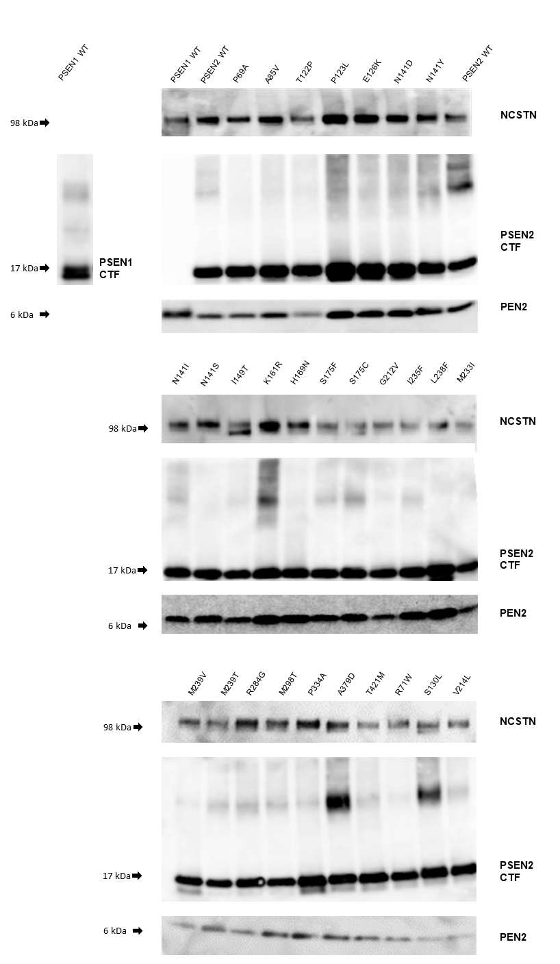
Figure S1

Slide 2
Figure S2
A
B
C

Slide 3
Figure S3
A
B
C
D
E
F

Slide 4
Figure S4
A
B

Slide 5
Figure S5
A
B
C
D
E

