Slide 1
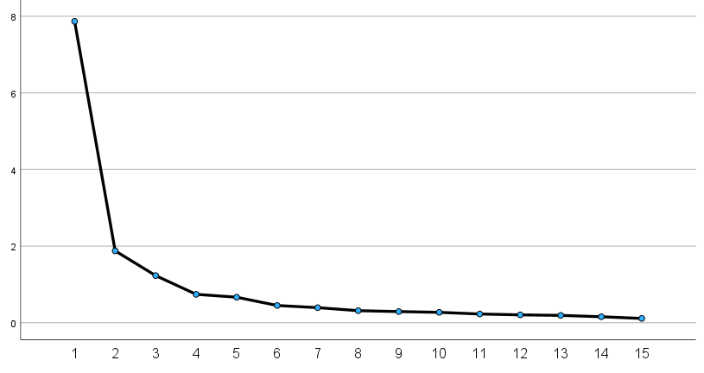
Scree Plot
Eigenvalue
Component Number
Notes:
Additional file 1. Scree plot of exploratory factor analysis on the 15-item DADDS-J
Scree plot from the exploratory factor analysis of the 15-item DADDS-J showing the eigenvalues of each component. DADDS-J: Japanese version of the Death and Dying Distress Scale.

