Slide 1
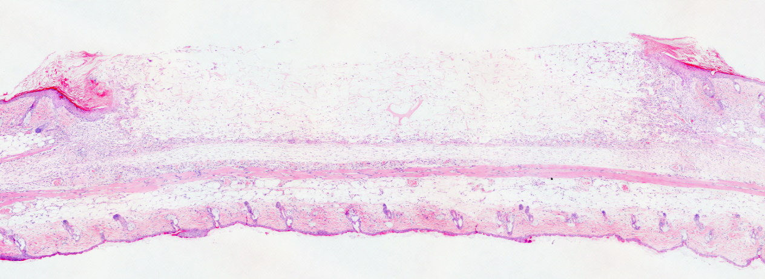
Figure S3
a
b
c
d
e

