Slide 1
Linker | Sequence (ds region in red)
L1-S | CTCGTTACTTACGACACTCCGAGACAGTCAGAGGGTA
L1-P | GGACTAGTTCAATAAATACCCTCTGACTGTCTCGGAG
U1-XS | CTCGTTGAACACCGTCTCAGGTAAGTATCAGTTGTAA
U1-RBS3-P | GGACTATTTCTCCTCTTTTTACAACTGATACTTACCTGA
U1-RBS5-P | GGACTAACCTCCACTAATTTACAACTGATACTTACCTGA
U1-RBSA07-P | GGACtaCCTCCTTAgatTTACAACTGATACTTACCTGA
U2-XS | CTCGTGTTACTATTGGCTGAGATAAGGGTAGCAGAAA
U2-RBS3-P | GGACTATTTCTCCTCTTTTTTCTGCTACCCTTATCTCAG
U3-XS | CTCGGTATCTCGTGGTCTGACGGTAAAATCTATTGTA
U3-RBS3-P | GGACTATTTCTCCTCTTTTACAATAGATTTTACCGTCAG
Notes:
Supplementary Table 1: Partially dsDNA linker sequences used for BASIC DNA assembly. Double stranded regions are highlighted in red

Slide 2
Primer | Truncating | Sequence
JM72_CvFatB1ampR | CvFatB1 | CGATAGGTCTCCCGAGCCTTAACTAACACTGTTCCCATTG
JM73_CvFatB1_1ampF | CvFatB1 | TCTGGTGGGTCTCTGTCCATGGCCAACGGTAGTGCAGTGA
JM74_CvFatB1_2ampF | CvFatB1 | TCTGGTGGGTCTCTGTCCATGTTGCCCGACTGGTCCATGC
JM92_CvFatB1_T3ampF | CvFatB1 | TCTGGTGGGTCTCTGTCCATGCTACTAACCGCTATCACAA
JM93_CvFatB1_T4ampF | CvFatB1 | TCTGGTGGGTCTCTGTCCATGGAAAAACAGTGGACCATGC
JM75_CvFatB1_3ampF | CvFatB1 | TCTGGTGGGTCTCTGTCCATGCTCGACCGGAAATCCAAGC
JM94_CvFatB1_T6ampF | CvFatB1 | TCTGGTGGGTCTCTGTCCATGCGACCTGACATGCTAGTAG
JM95_CvFatB1_T7ampF | CvFatB1 | TCTGGTGGGTCTCTGTCCATGAAATCCATCGTGCGTGATG
JM111_CvFatB1_T8ampf | CvFatB1 | TCTGGTGGGTCTCTGTCCATGCGCCACAGCTTCAGCATTCGAT
JM112_CvFatB1_T9ampf | CvFatB1 | TCTGGTGGGTCTCTGTCCATGATCGGAGCTGACCGGACCG
JM113_CvFatB1_T10ampf | CvFatB1 | TCTGGTGGGTCTCTGTCCATGACACTGATGAACCATTTACAAG
JM114_CvFatB1_T11ampF | CvFatB1 | TCTGGTGGGTCTCTGTCCATGATCAATCACTGTAAGAGCTTGG
JM115_CvFatB1_T12ampF | CvFatB1 | TCTGGTGGGTCTCTGTCCATGAATGACGGATTCGGCCGCACAC
JM116_CvFatB1_T13ampF | CvFatB1 | TCTGGTGGGTCTCTGTCCATGTGTAAGAATGACCTCATCT
JM117_CvFatB1_T14ampF | CvFatB1 | TCTGGTGGGTCTCTGTCCATGAAGATGCAAATTATGGTTAATC
JM118_CvFatB1_T15ampF | CvFatB1 | TCTGGTGGGTCTCTGTCCATGACCTGGGGCGATACTGTAGAGA
JM119_CvFatB1_T16ampF | CvFatB1 | TCTGGTGGGTCTCTGTCCATGTGGTTTAGTCAAAGTGGCAAGA
JM120_CvFatB1_T17ampF | CvFatB1 | TCTGGTGGGTCTCTGTCCATGGCGTCCGACTGGCTAATCTCTG
JM121_CvFatB1_T18ampF | CvFatB1 | TCTGGTGGGTCTCTGTCCATGACCGGGGAAATCCTGATCCGAG
JM122_CvFatB1_T19ampF | CvFatB1 | TCTGGTGGGTCTCTGTCCATGGTGTGGGCCATGATGAACCAGA
JM123_CvFatB1_T20ampF | CvFatB1 | TCTGGTGGGTCTCTGTCCATGCGCTTCTCTCGGCTCCCGTATG
JM124_CvFatB1_T21ampF | CvFatB1 | TCTGGTGGGTCTCTGTCCATGCAAGAACTCACCCCGCACTTCG
Rev_UcFatB1 | UcFatB1 | TCCGGCAGAACCGCGCGTGTAAGGCTCGGGAGACCTATCG
F_UcFatB1_T1 | UcFatB1 | TCTGGTGGGTCTCTGTCCATGCCCCGTTCCTCTGACTTAC
F_UcFatB1_T2 | UcFatB1 | TCTGGTGGGTCTCTGTCCATGCTTCCCGACTGGAGTATGTT
F_UcFatB1_T3 | UcFatB1 | TCTGGTGGGTCTCTGTCCATGATGTTATTTGCTGTGATTAC
F_UcFatB1_T4 | UcFatB1 | TCTGGTGGGTCTCTGTCCATGGAGAAACAGTGGACAAACTT
F_UcFatB1_T7 | UcFatB1 | TCTGGTGGGTCTCTGTCCATGCTTCACGGCCTTGTTTTCCG
Notes:
Supplementary Table 2: Primers used during this work

Slide 3
CvFatB1 Truncation | Truncation Site | Rationale | Origin
CvT1 | A58 | Removal of chloroplast localisation peptide predicted by ChloroP | Prior unpublished work by the Jones lab
CvT2 | L89 | Truncation from the literature | Prior unpublished work by the Jones lab
CvT3 | M94 | Truncation from the literature | This study
CvT4 | E107 | Truncation from the literature | This study
CvT5 | M112 | Truncation from the literature | Prior unpublished work by the Jones lab
CvT6 | R119 | Truncation from the literature | This study
CvT7 | K130 | Truncation from the literature | This study
CvT8 | R140 | Systematic truncation | This study
CvT9 | I150 | Systematic truncation | This study
CvT10 | T160 | Systematic truncation | This study
CvT11 | I170 | Systematic truncation | This study
CvT12 | N180 | Systematic truncation | This study
CvT13 | M189 | Systematic truncation | This study
CvT14 | K200 | Systematic truncation | This study
CvT15 | T210 | Systematic truncation | This study
CvT16 | W220 | Systematic truncation | This study
CvT17 | M229 | Systematic truncation | This study
CvT18 | T240 | Systematic truncation | This study
CvT19 | V250 | Systematic truncation | This study
CvT20 | R260 | Systematic truncation | This study
CvT21 | Q270 | Systematic truncation | This study
Notes:
Supplementary Table 3: CvFatB1 truncations

Slide 4
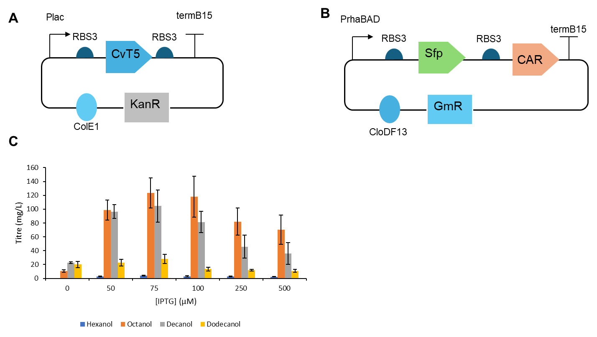
Notes:
Supplementary Figure 1 Inducer optimisation of CvT5 expression E. coli ΔfadD were co‑transformed with two plasmids for alcohol biosynthesis A) A pET plasmid with kanamycin resistance cassette was used to express CvT5. CvT5 was expressed using the Plac promoter and RBS3 B) A pCDF plasmid with gentamycin resistance cassette was used. Sfp and CAR were expressed in a single operon using PrhaBAD and RBS3.
C) Alcohol titres after 48 hrs cultivation in M9 media with 2% glucose and a 10% v/v isopropyl myristate overlay. The overlay was sampled and analysed by GC‑MS. Cells were induced with a variable amount of IPTG and 1% rhamnose. Data is the average of 3 biological replicates and error bars are of 1 standard deviation.

Slide 5
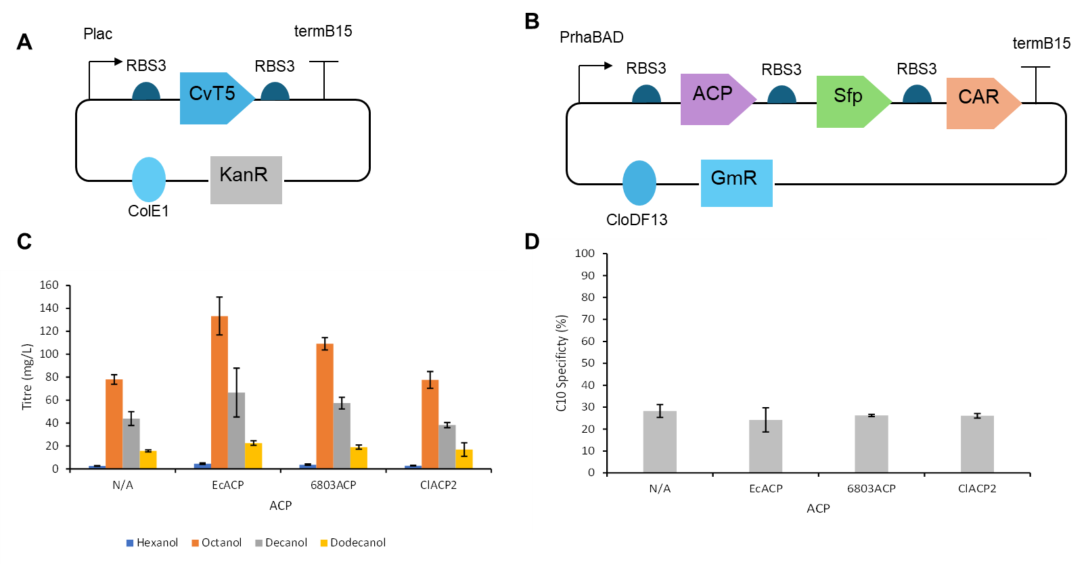
Notes:
Supplementary Figure 2ACP Expression in Combination with CvT5 A) A pET plasmid with kanamycin resistance cassette was used to express CvT5. CvT5 was expressed using the Plac promoter and RBS3 B) A pCDF plasmid with gentamycin resistance cassette was used. ACP, Sfp and CAR were expressed in a single operon using PrhaBAD and RBS3. B) Alcohol titres after 48 hrs cultivation in M9 media with 2% glucose and a 10% v/v isopropyl myristate overlay. The overlay was sampled and analysed by GC‑MS. Cells were induced with 75 μM IPTG and 1% rhamnose. C) C10 specificity, calculated as the percentage of total moles of fatty alcohol that were decanol. Data is the average of 3 biological replicates and error bars are of 1 standard deviation.

Slide 6
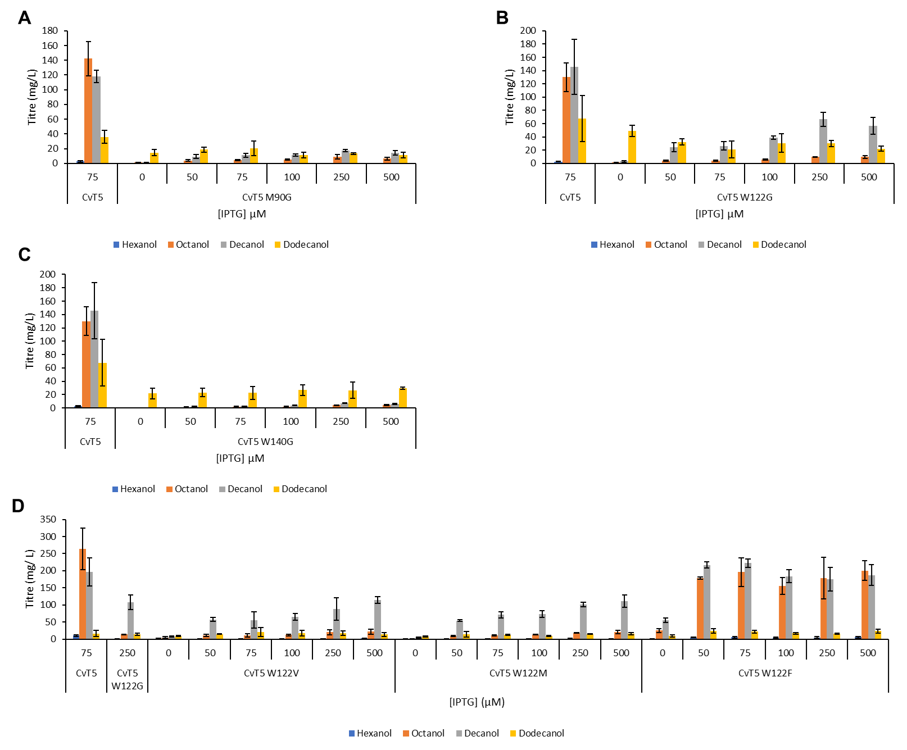
Notes:
Supplementary Figure 3 Inducer optimisation of expression of CvT5 mutants E. coli ΔfadD were co-transformed with two plasmids for alcohol biosynthesis, and expression of CvT5 mutants was optimised by varying the amount of IPTG used for induction. A) Alcohol titres after M90G expression was inducer optimised B) Alcohol titres after W122GG expression was inducer optimised C) Alcohol titres after W140G expression was inducer optimised D) Alcohol titres after expression of W122V, W122M and W122F were inducer optimised in parallel

Slide 7
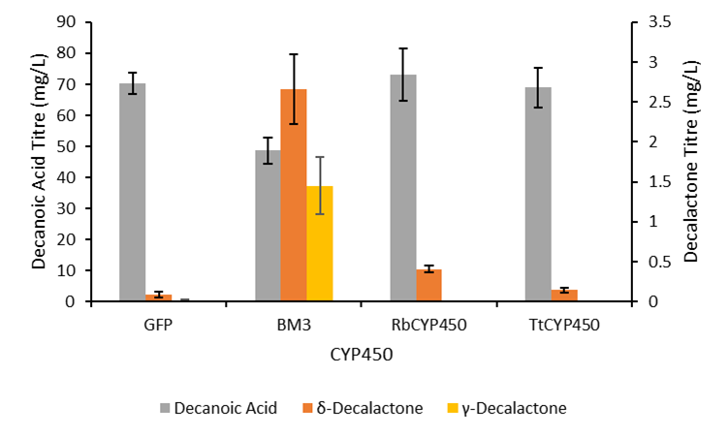
Notes:
Supplementary Figure 4 Screening CYP450s E. coli ΔfadD were transformed with a plasmid expressing either GFP or a CYP450. Decanoic acid, δ‑decalactone and γ‑decalactone titres after cultivation in M9‑Fe media for 48 hrs at 30°C, 150rpm. Cells were induced with 0.5 mM IPTG and fed with 2.5 mM methyl decanoate. Products were extracted from the media using chloroform‑methanol and sulfuric acid and analysed by GC‑MS. Data is the average of 3 biological replicates and error bars are of 1 standard deviation

